Slide 1
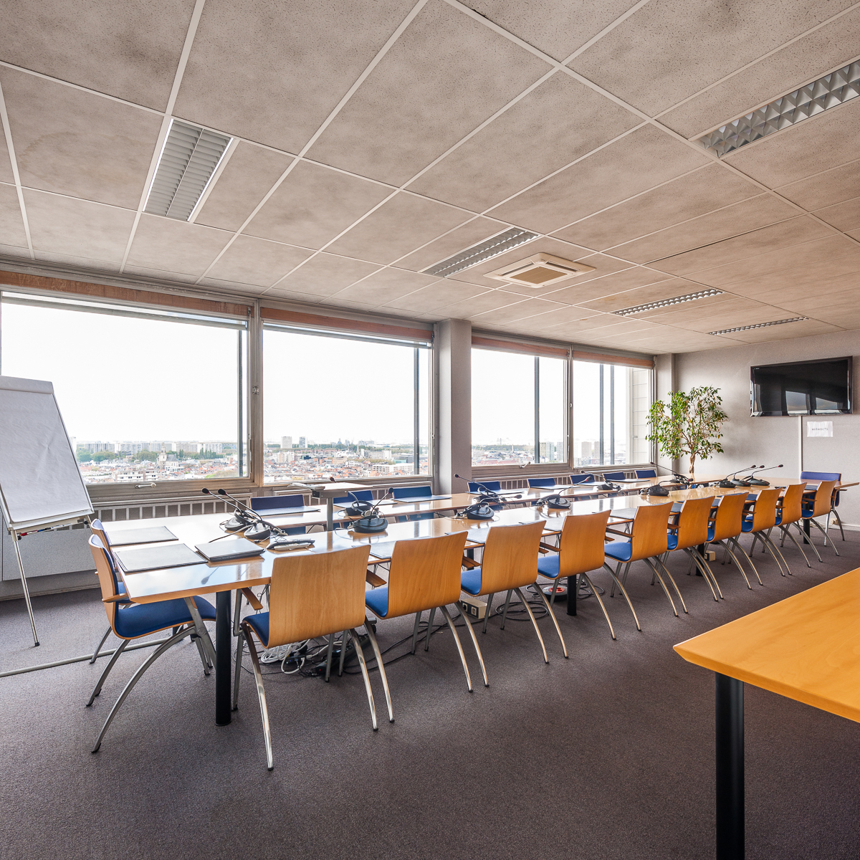
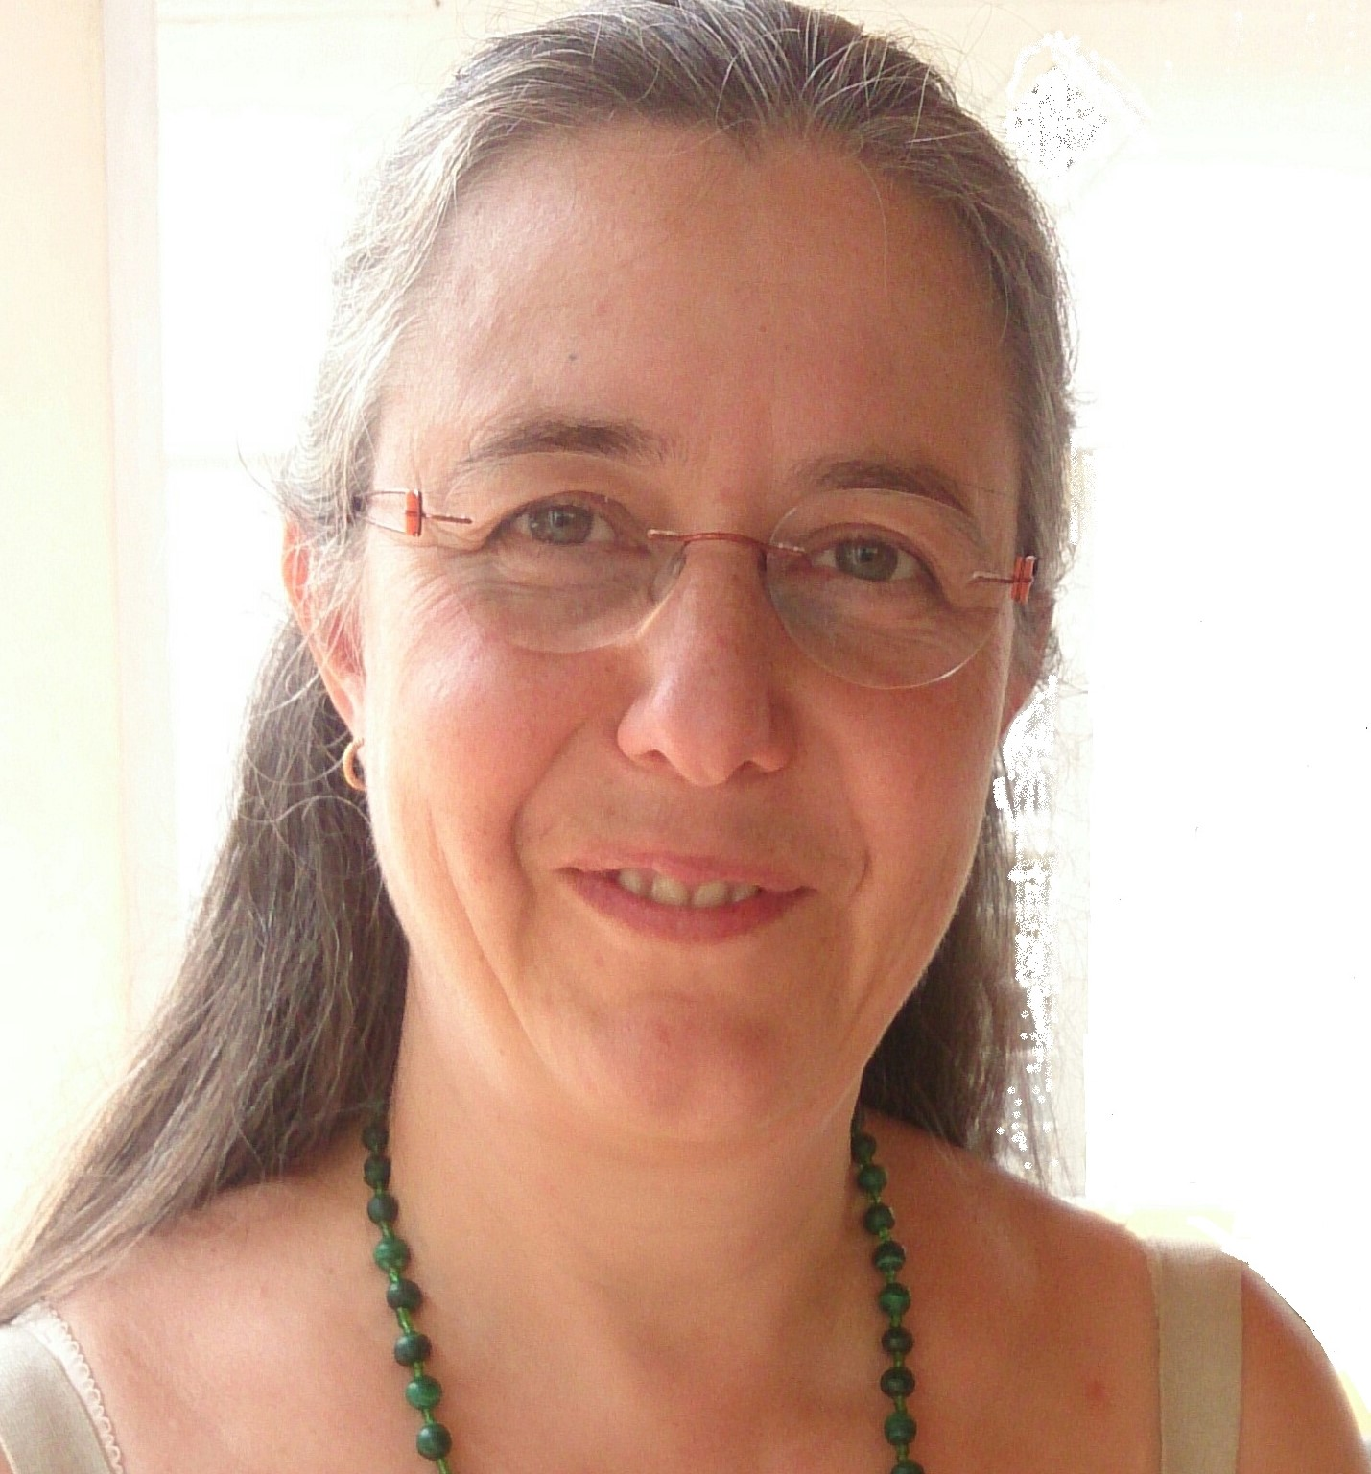
Masterplan Fish & the role of coordination for river restoration: coordination tools developped within the International Scheldt Commission
Véronique Gosselain – Executive Secretary
International Scheldt Commission
Free Flow webinar 2023
23 May 2023

Slide 2
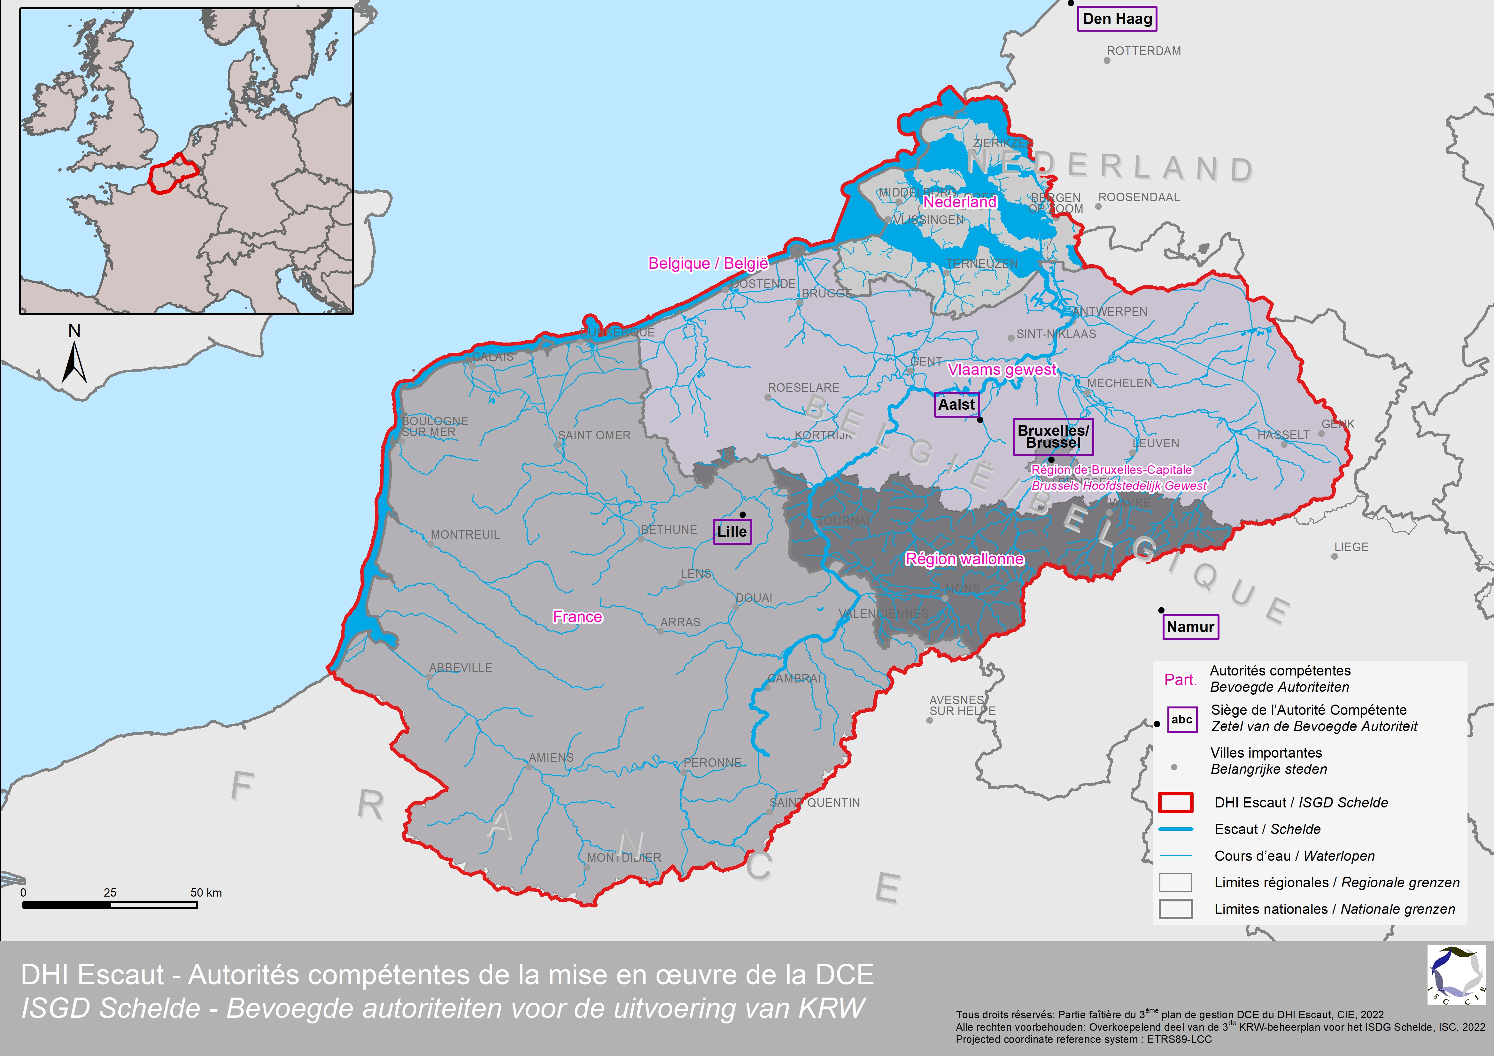
The International Scheldt Commission : mission parties responsibilities
MISSON Intergovernmental organisation for the coordination of joint actions and monitoring of water quality and quantity (surface and groundwater) aiming at a sustainable and harmonised water management, at the international level in the International Scheldt District.
PARTIES
France
Federal Belgium
Wallonia
Flanders
The Brussels-Capital Region
The Netherlands
INTERNATIONAL FORUM FOR COÖRDINATION OF
European water directives in the Scheldt district:
WaterFramework Directive (2000/60/EC),
Floods Directive, on the assessment and management of flood risks (2007/60/EC),
Adaptation to climate change
Transboundary communication about accidental pollution in rivers of the Scheldt Bassin
Notes:
The International Scheldt Commission (ISC) is composed of 6 Contracting Parties, from 3 countries: France, Federal Belgium, Wallonia, Flanders, the Brussels Capital Region and the Netherlands,
and is the coordinating body for the implementation of the EU Water Framework Directive and EU Flood Directive.
It also coordinates measures to prevent and control accidental water pollution and ensures the transmission of the necessary information, within the Scheldt Warning and Alert System (SAAE).

Slide 3
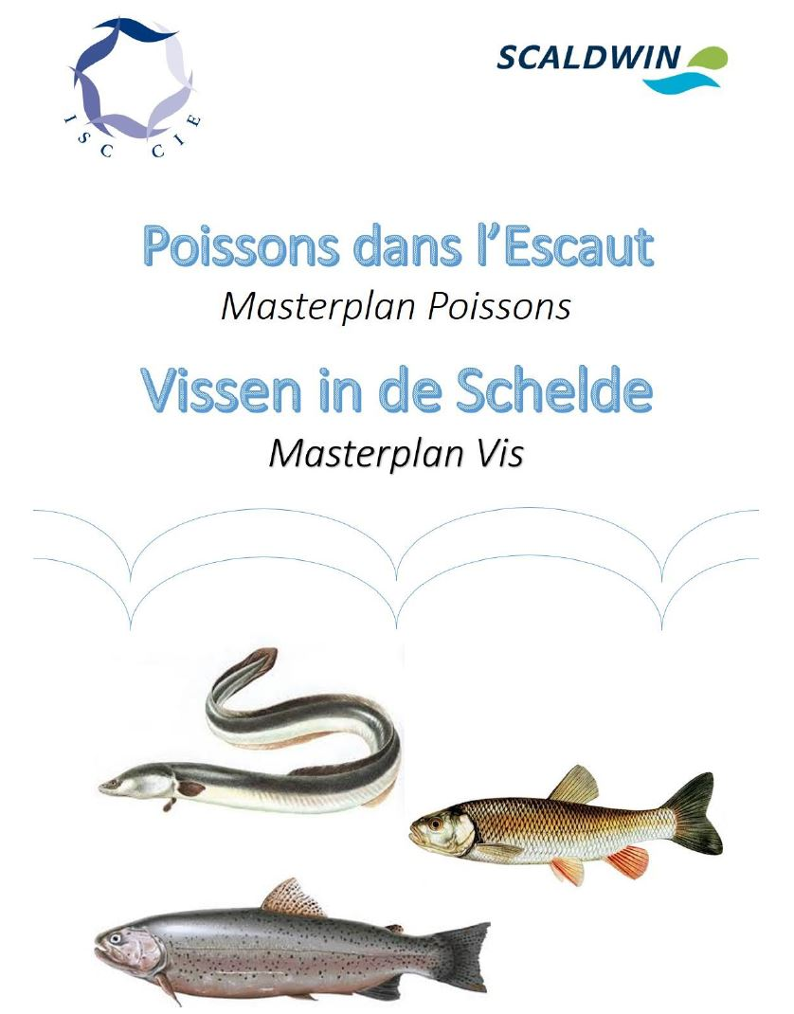
The Masterplan Fish of th ISC
2008 : ScaldWIN project
assessment of fish situation : obstacles to migration and migratory species
2015: Fish Master Plan for the Scheldt district
a response to the Benelux decision M(2009)1 on the free circulation of fish
integrated into the roof part of the second WFD management plan
focuses in particular on ecological continuity
Content:
Context of the Scheldt district
Fish status
Obstacles to fish migration
Measures
Conclusion & recommendations
→ Set up of the project group Masterplan Fish:
reduce obstacles to the free circulation of fish
coordinate to improve transboundary ecological continuity
Notes:
The cooperation work within the ScaldWIN project, which started in 2008, focused on ecological rehabilitation, with a special emphasis on fish migration. It allowed for an in-depth assessment of the fish situation in the Scheldt International River Basin District, in particular with regard to obstacles to migration and the distribution of migratory species. The results of the project were used to draw up, in 2015, the first fish master plan for the Scheldt district.
The ISC Fish Master Plan is a response to the Benelux decision M(2009)1 on the free circulation of fish in the Benelux river systems, and France has joined the Benelux countries in the follow-up to this decision. The Fish Master Plan has been integrated into the roof part of the second WFD management plan on the river ecological quality and focuses in particular on ecological continuity. The adoption of a Master Plan for Fish has made it possible to set up a global consultation on the free circulation of fish within the CIE.
The Master Scheldt Fish Plan addresses the following points:
The specific context of the Scheldt district that may have an influence on fish life (hydrographic, historical, legal and administrative):
The fish status of the district (what existed before the restoration actions, their evolution, the indicators used)
Obstacles to fish migration (barriers, loss of habitats and spawning grounds, pollution, fishing).
the measures already taken and to be taken to achieve the objectives, particularly with regard to eels
the conclusions and recommendations for ensuring the ecological continuity of the district's watercourses and thus achieving good ecological status

Slide 4
The Masterplan Fish of th ISC: Synthesis & Recommendations
Scheldt district
Highly populated and industrialised
Intensive agriculture
River used for transport
Pressure on the water quality and hydromorphology of the river
Recommendations
Ensure upstream-downstream coherence
Ensure cross-border coordination
Pursue efforts towards free circulation of fish
Encourage regular exchanges of information and knowledge between the Parties
Ensure bilateral coordination of ecological continuity

Slide 5
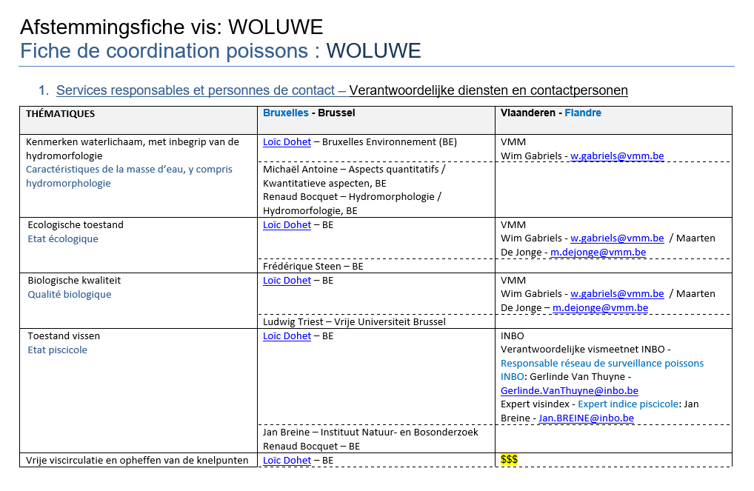
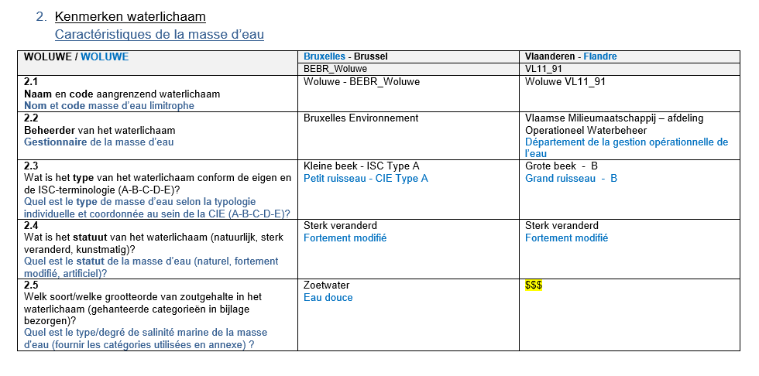
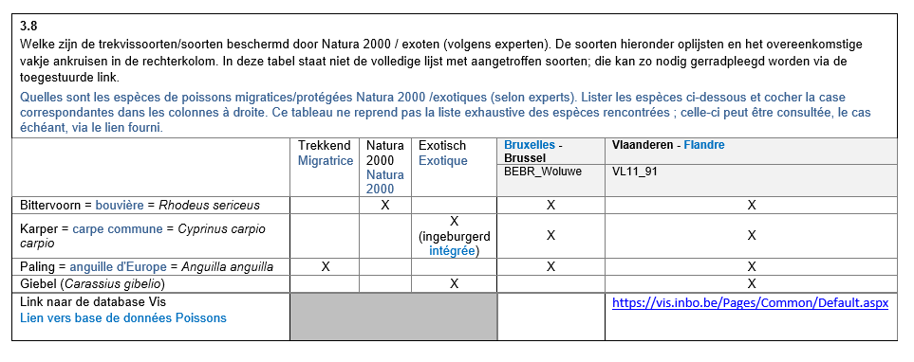
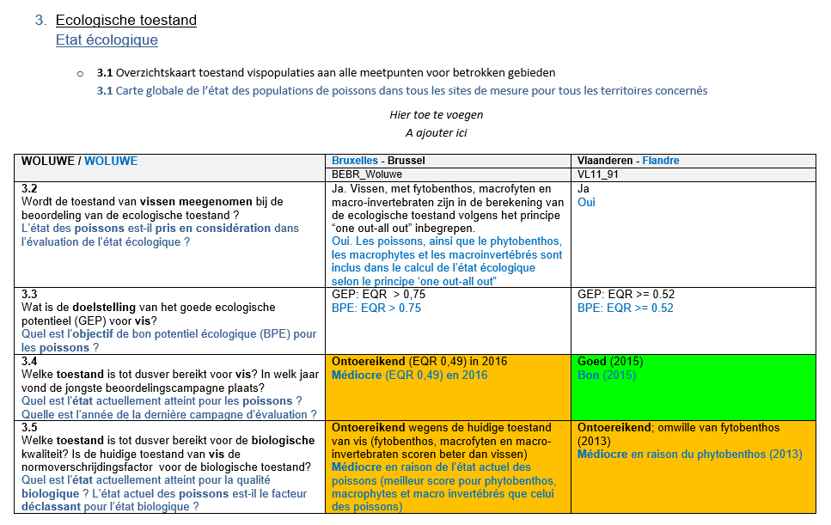
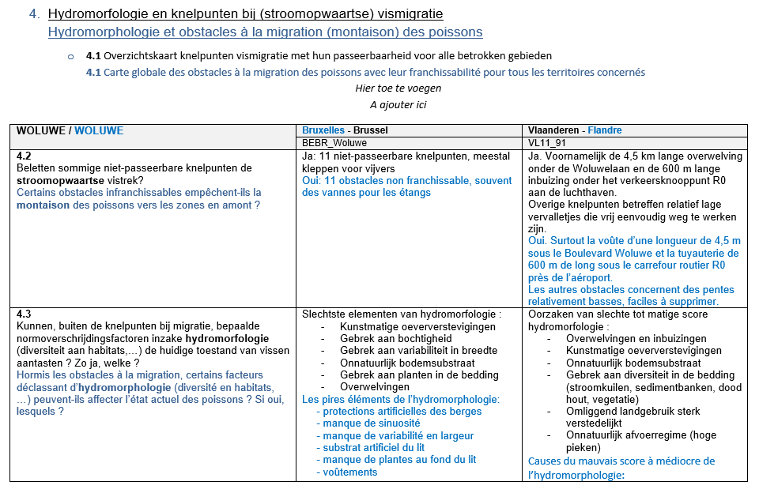
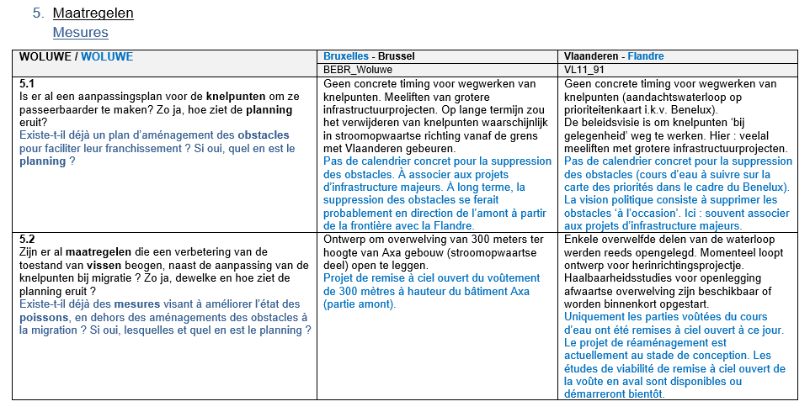
Working tools of the project group Fish: CARDS
Coordination cards
Contiguous water bodies
Characteristics of the environment
Fish species present
Results of environmental quality assessments
Obstacles to the rise of fish
Measures taken or to be taken
Towards a greater coherence between the regions
Assessing obstacles
Fish population and status
Measures to be implemented
Towards a better knowledge of each other
Improve transboundary ecological continuity
Notes:
The coordination cards concern contiguous water bodies, on either side of the borders between Parties. The characteristics of the environment and the results of environmental quality assessments are included. The quality elements taken into consideration either influence or depend on the quality of the fish population; in the end, they make it possible to characterise the ecological status of the water bodies. The cards are designed to diagnose and work towards greater coherence between the regions, in terms of assessing obstacles, fish populations, fish status, and measures to be implemented to improve transboundary ecological continuity.
Considering the complexity of the departments involved in fish and ecological continuity, cards also gather information about department and people in charge of various topics of interest for fish and ecological continuity in rivers.

Slide 6
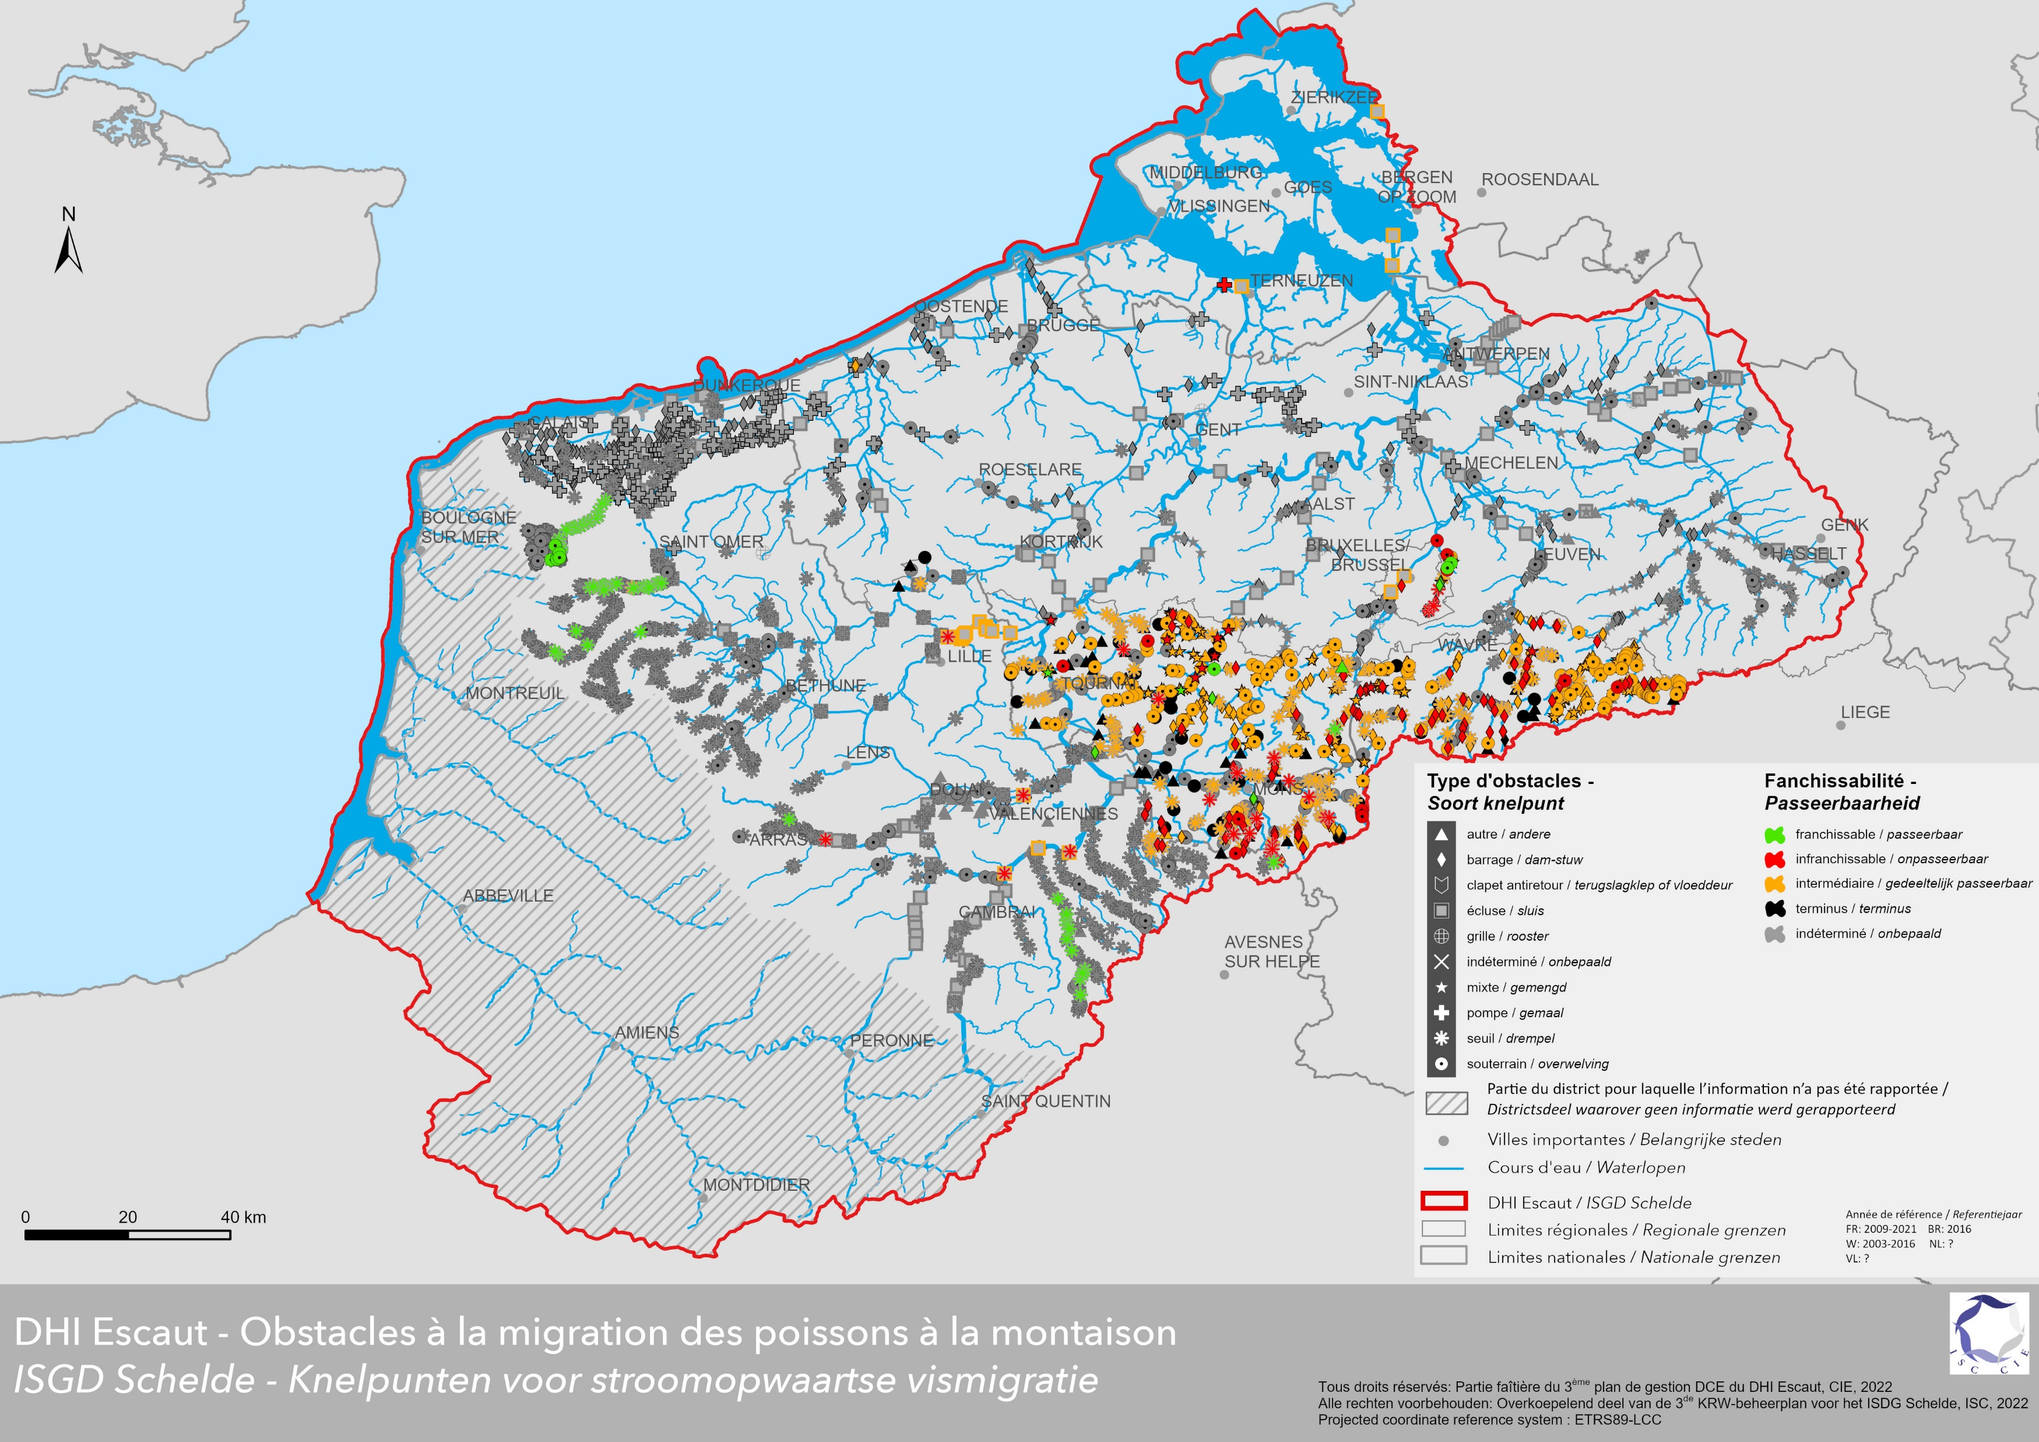
Working tools of the project group Fish: MAPS
Obstacles to fish migration (upstream)
Notes:
A district-level mapping is an important tool for cross-border analysis and coordination. It provides a global view of a given problem at the district level.
The mapping for the ISC is carried out by the GIS Unit of the SPW Agriculture, Natural Resources and Environment (DEMNA-DCoD).
The methodology followed for the implementation of the new map of obstacles to fish migration was as follows:
- Sharing, discussion and harmonisation of updated cartographic data on barriers to migration from each of the Parties: types of barriers, degrees of crossability of barriers, resolution or not of barriers and mode of resolution (removal, development, management, ...) ;
- Creation of a bilingual and documented database of all the information, as provided by the Parties and harmonised, with photographic presentation of the obstacles when available, and implementation of the database within the Scheldt WebGIS;
- Creation of a private version of the WebGIS, reserved for the ISC working groups, which allows to work, in particular the map of obstacles to fish migration, from working hypotheses, beyond the official data to be shared with the general public.
Obstacles to upstream fish migration, presenting the types of obstacle and the degrees of crossability in a harmonised way at the Scheldt IRBD level,

Slide 7
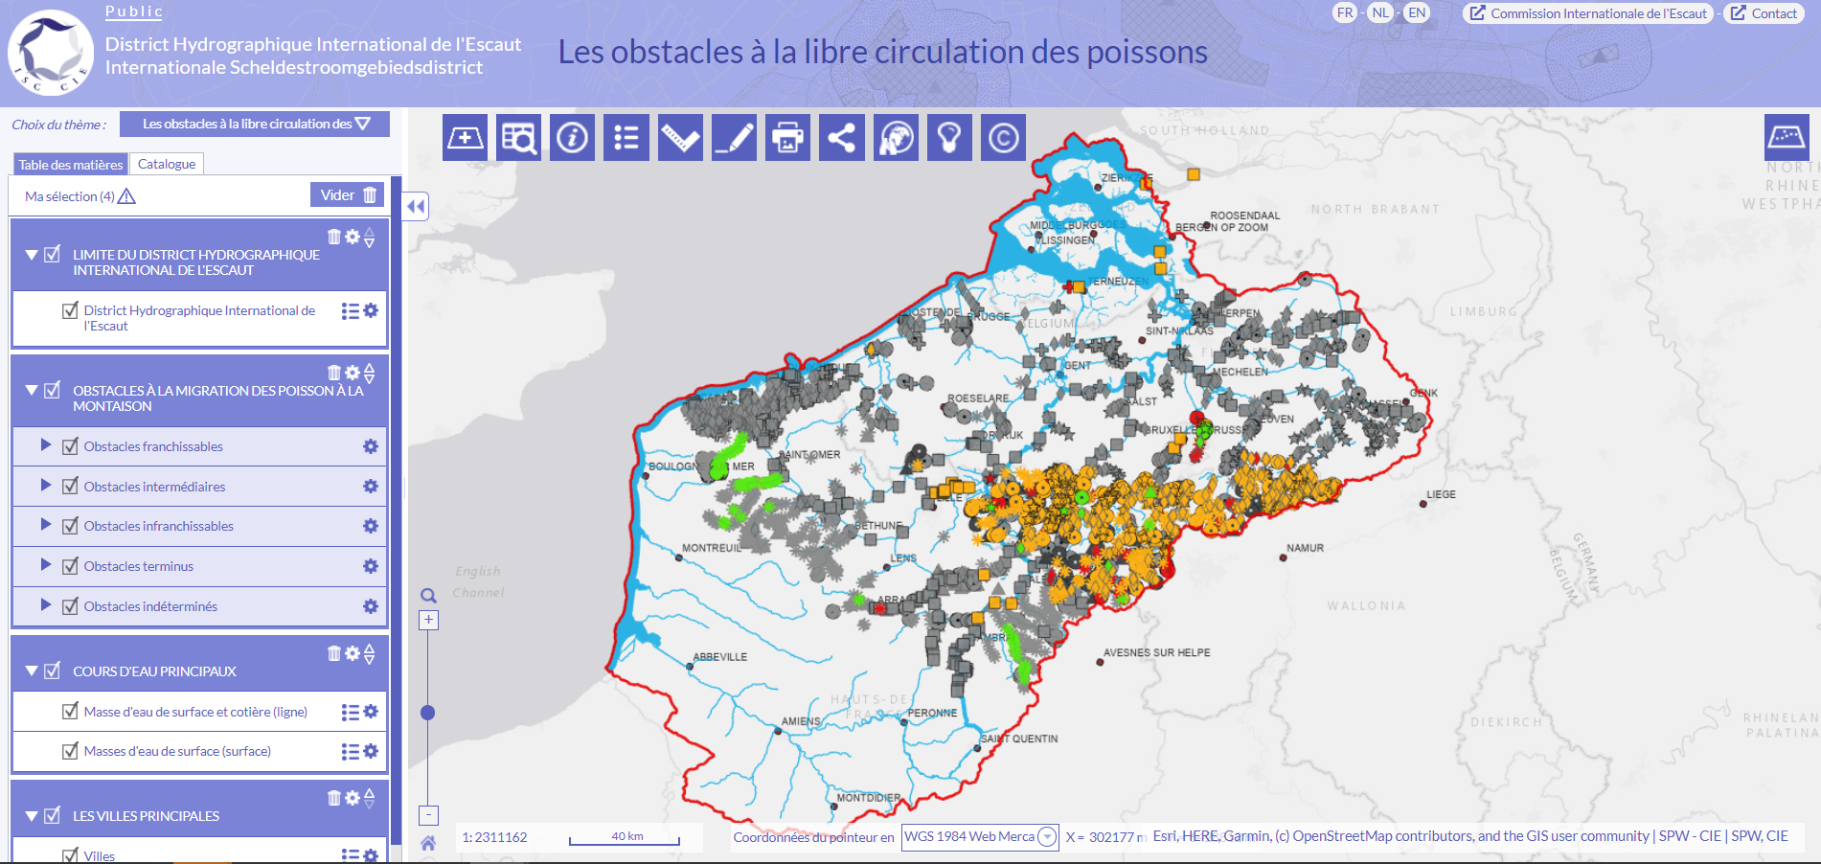
Working tools of the project group Fish: WebGIS
Obstacles to fish migration (upstream)
Notes:
- implementation of the database within the Scheldt WebGIS;
- Creation of a private version of the WebGIS, reserved for the ISC working groups, which allows to work, in particular the map of obstacles to fish migration, from working hypotheses, beyond the official data to be shared with the general public.
An important part of the coordination work on the general issue of ecological continuity consisted in working on a common and harmonised map of obstacles to fish migration, on the scale of the Scheldt IRBD (with the exception of the Somme, Authie, Canche and Boulonnais basins). The objective was to provide a common reading of the obstacles to migration (upstream) both on the global scale of the district and in the details of the obstacles. This common reading of obstacles to migration constitutes a central tool for "fish" coordination which will be useful for the continuation of coordination via the bi- or tri-lateral coordination cards. These will serve as a basic document for the organisation of a workshop which should lead to the formulation of recommendations on ecological continuity.

Slide 8
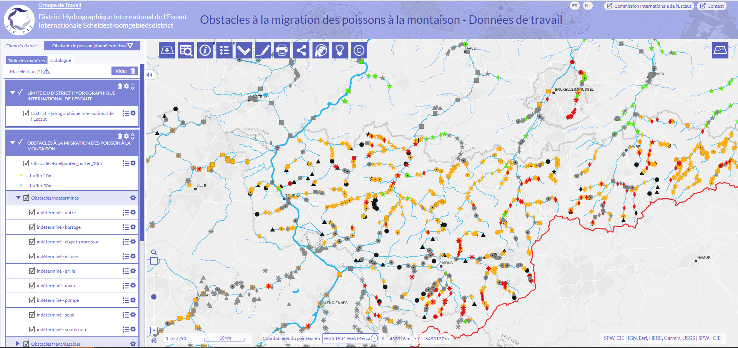
Working tools of the project group Fish: WebGIS
Obstacles to fish migration (upstream)
Notes:
This dual approach, broad and detailed at the same time, was made possible by the implementation of this mapping in the new ISC WebGIS Scheldt.
The mapping for the ISC is carried out by the GIS Unit of the SPW Agriculture, Natural Resources and Environment (DEMNA-DCoD).

Slide 9
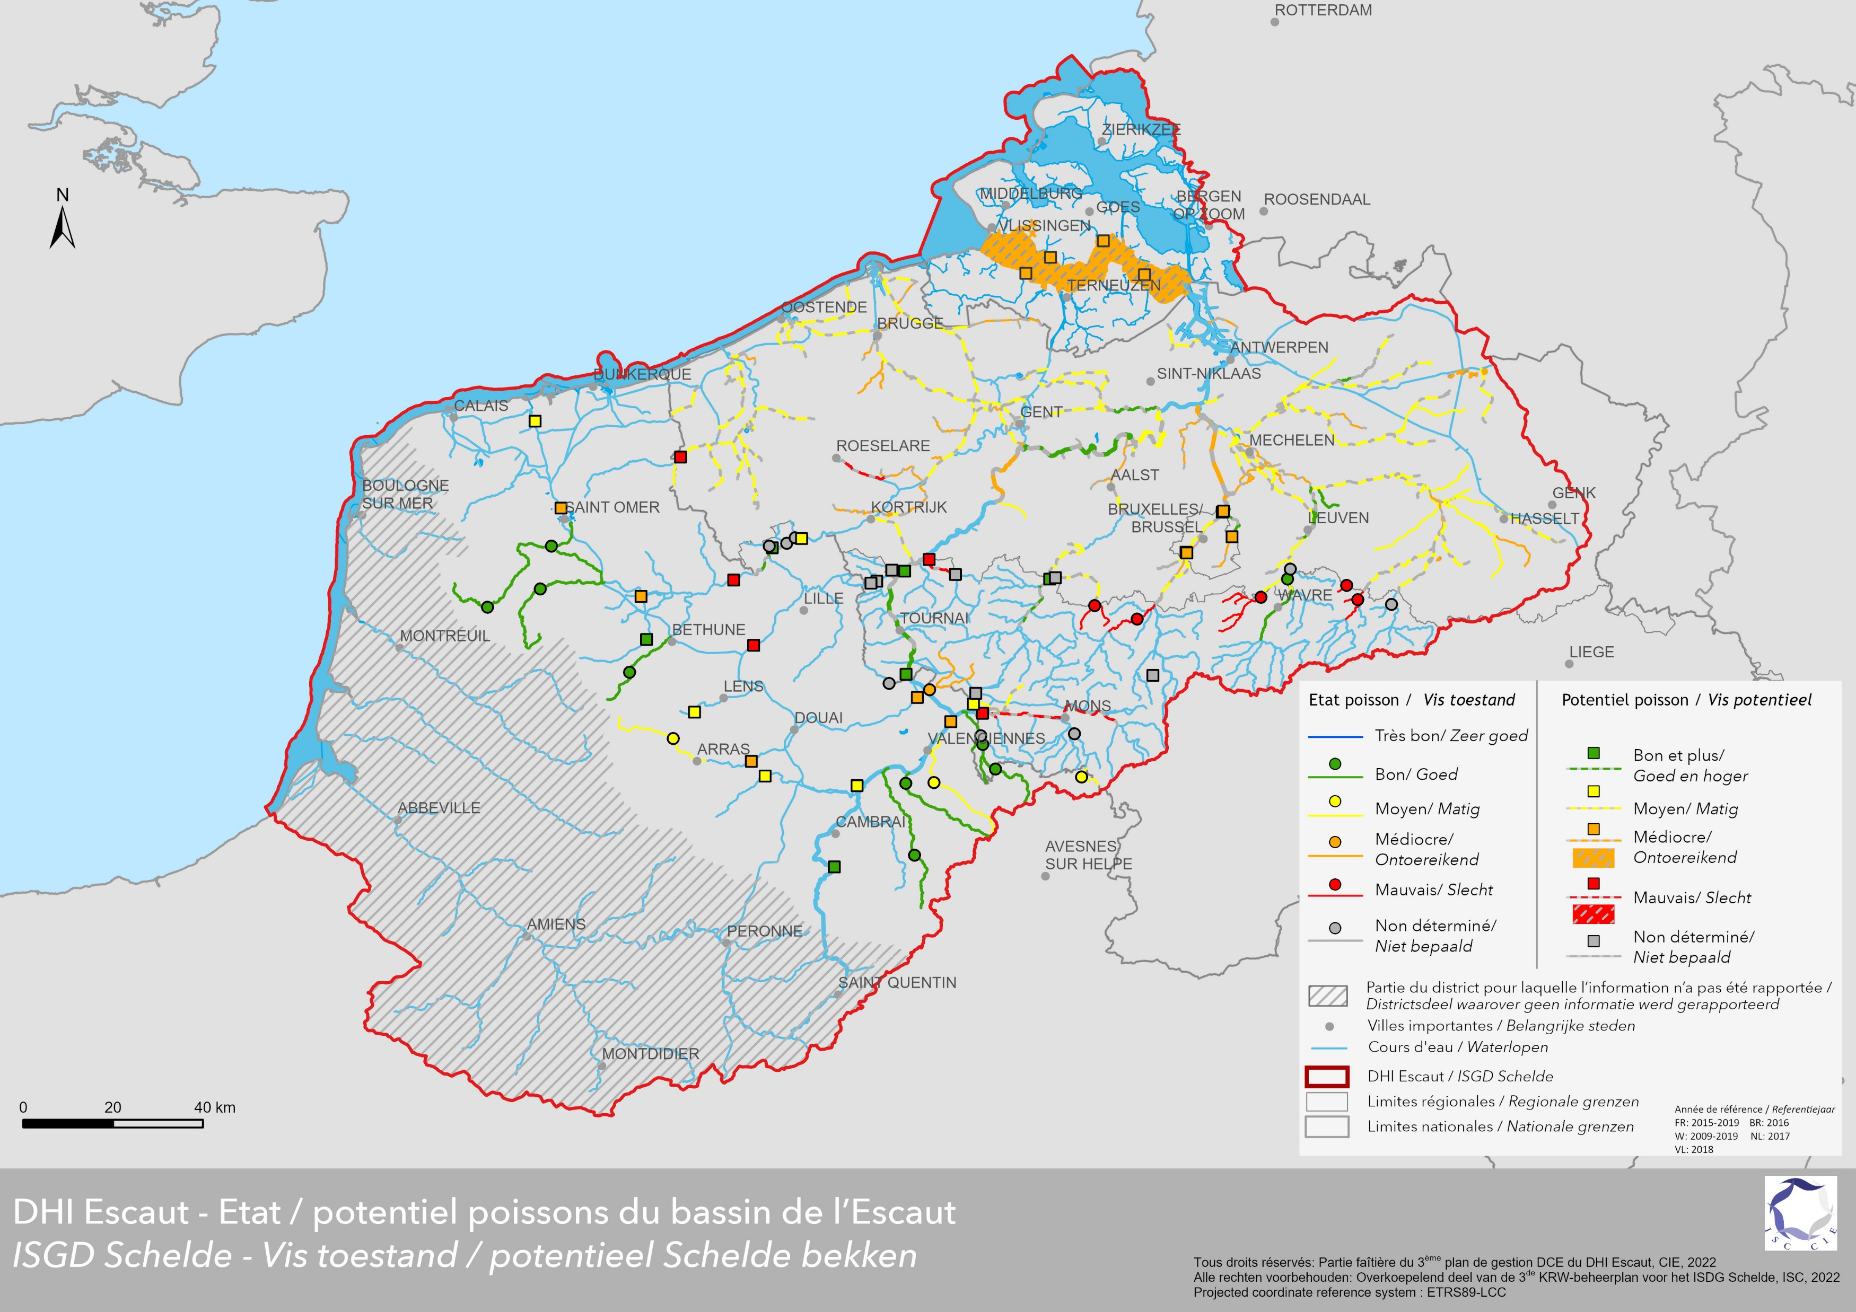
Working tools of the project group Fish: MAPS
Fish state of potential
Notes:
Fish status or potential, as measured or estimated by the Parties, at the Scheldt IRBD scale. Depending on the methodologies used by the Parties, different ways of estimating and using the fish data can be distinguished: the fish status or potential estimated from fisheries is represented by a coloured dot at the measuring station (FR, W, BR) or at the median point of assessment, based on samples taken at several points (NL); when these data have been used to estimate the fish status of the water body, this is represented by colouring the linear length of the water body (FR, W, BR, NL) in FR, fish data are not used to estimate the ecological potential, hence for artificial and heavily modified water bodies, only the measuring station is shown; in VL, the fish status or potential is not determined on the basis of fisheries alone, but on the basis of expert opinion, hence the fish status or potential is shown only at the water body level.

Slide 10
Conclusion: ISC transboundary coordination for fish migration
Opportunities
Master plan Fish of the Scheldt
WebGIS Scheldt (SPW)
Combination of scales
Information for each data represented on the map
Coordination tools set up:
Coordination cards
Harmonised DB of obstacles
Multi-scale maps
Constraints
Complexity of resolution of fish migration obstacles
What means “crossability”?
How to get a harmonized map of “crossability” of obstacles still providing information ?
Slow process of removal/remediation of obstacles,
under the responsibility of the Parties
Availability of experts and president for the project group Master plan Fish ISC
Notes:
The coordination work on the fish master plan will continue over the next few years and will be based on the following axes/themes
- Setting up new fish coordination cards, integrating the map of obstacles on the border water body, in close relation with the coordination cards of the border surface water bodies; this work should make it possible to establish a fish diagnosis per border water body, evaluating the ecological continuity and other potential obstacles to the restoration of fish populations, and discussing the measures to be favoured on both sides of the borders to improve the state of fish populations in each of these water bodies (in particular by restoring ecological continuity);
- Organise a workshop on the topic of ecological continuity of watercourses, with the general objectives of promoting coordination and collaboration between services, institutions and regions on the scale of the Scheldt IRBD, and of producing an overall vision and recommendations for action on the state of fish populations and ecological continuity at the scale of the IRBD;
- Maintain and complete the current coordination tools;
- Update the Fish Master Plan and, if necessary, draw up new recommendations for the implementation of new measures and actions;
- Implement a joint assessment exercise of the fish status, based on the needs identified from the work on the fact sheets and the fish workshop;
- Continue and strengthen the coordination around the resolution of obstacles to migration at the Scheldt IRBD level;
- Update the data on obstacles to fish migration, and if necessary other data that would be coordinated around the general issue of ecological continuity, at least once every 6 years (in preparation for the next management plan).

