Slide 1
The Emscher Conversion: Europe’s Largest River Restoration Project and Contribution to Free-flowing Rivers and Streams
Dr. Mario Sommerhäuser, EGLV
May 23rd, 2023

Slide 2
Emschergenossenschaft and Lippeverband (EGLV)
Public water associations for over a 100 years
Cooperative area LV
Cooperative area EG
Europe
Germany
North Rhine-Westphalia
Notes:
The Emschergenossenschaft was founded in 1899 as the first German water management association.
It served as a model for a whole series of other water management associations, including the Lippeverband, founded in 1926.

Slide 3
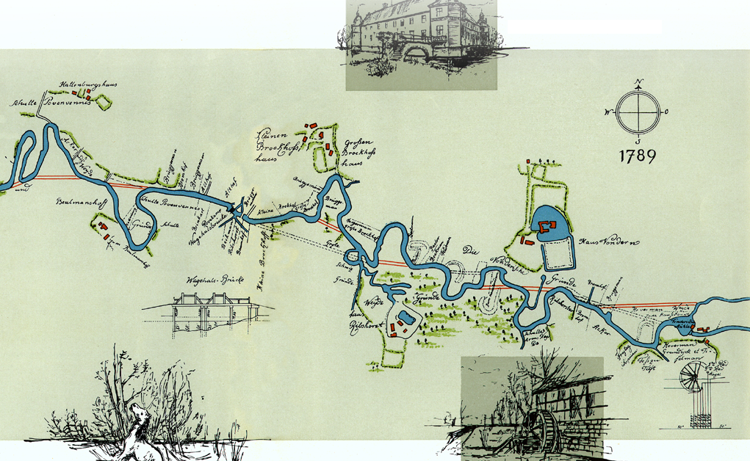
Historical Emscher around 1800
Villages, mills, fish and crayfish
Notes:
And now we have to look back - into the past! Here you can see a map of the historic Emscher, which was still a meandering river back then. Before industrialization came along, the Emscher was used for fishing and for running mills. But the numerous mills slowed down the flow. Therefore, around 1800, people thought about straightening the river to increase the flow velocity. These thoughts are shown in this plan from 1789 (red line).

Slide 4
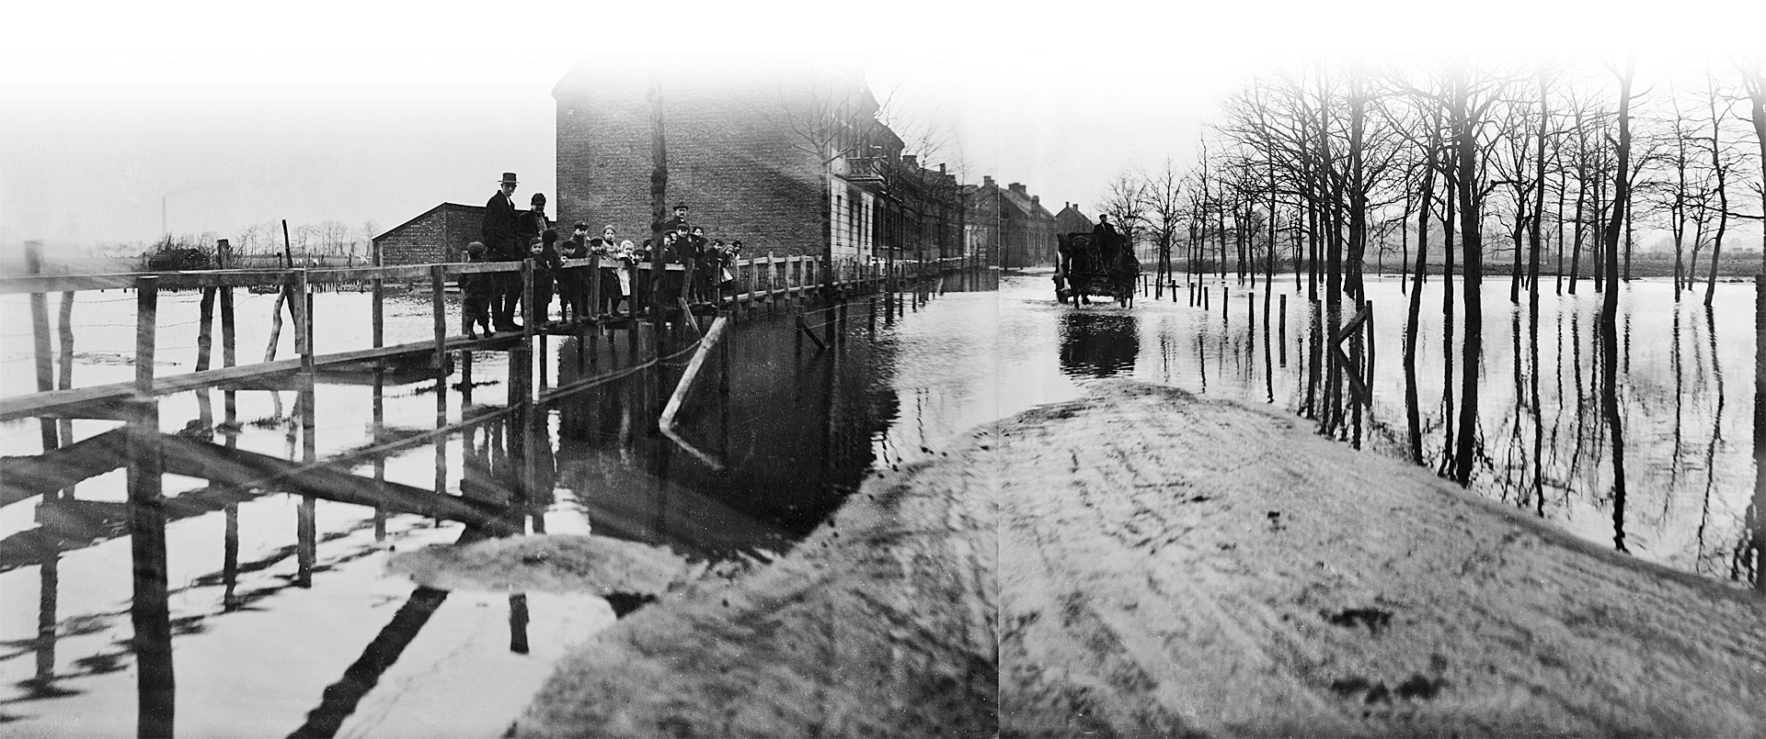
The Emscher valley around 1900
Flooding caused epidemics and diseases
Notes:
The formerly rural Emscher region developed into a densely populated industrial area in the 1800s. This led to an enormous increase in the volume of wastewater. In addition, the mining industry caused considerable disruptions in wastewater discharge. The topography changed, and water could no longer be safely discharged. Floods caused epidemics and diseases. Measures had to be taken!

Slide 5
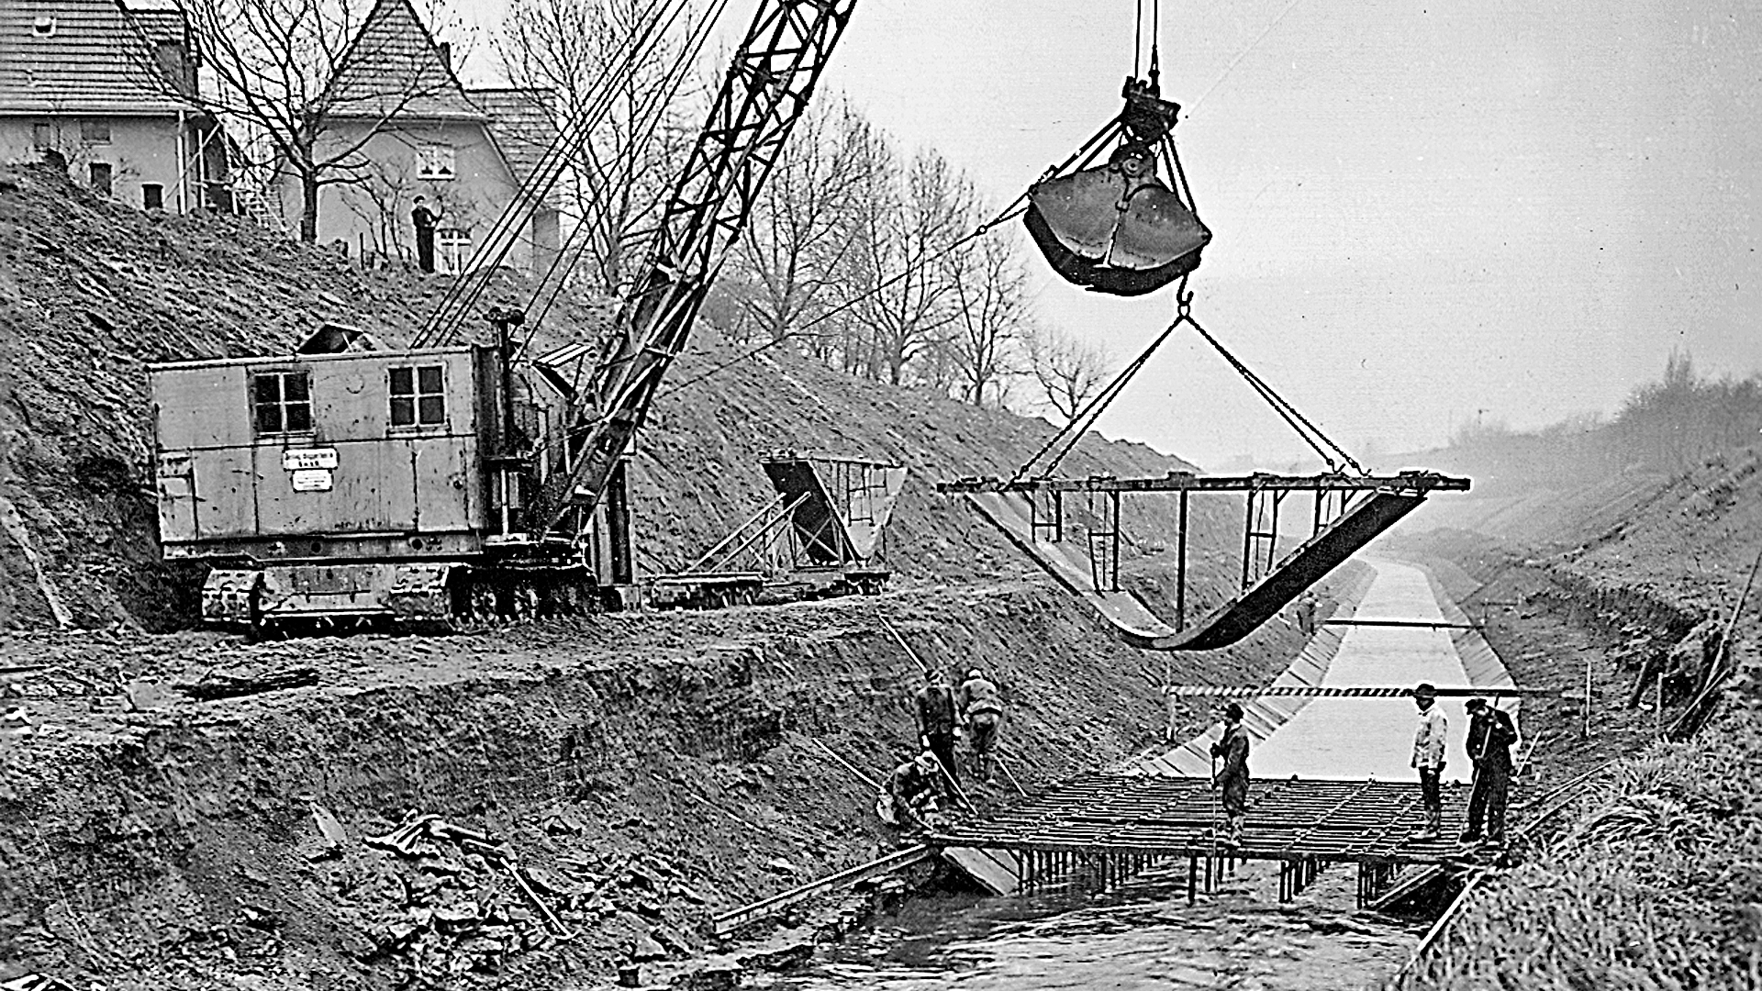
The construction of the technical Emscher system
1900 – 1940
Notes:
In response to the difficult situation, the Emschergenossenschaft was founded in 1899. The major project was the straightening and embankment of the Emscher. The Emscher and also the associated streams were regulated and concreted. The construction of an underground sewer was not possible due to coal mining and mining subsidence. At that time, the regulation of the river was the best solution.

Slide 6
From grey
to blue-green

Slide 7
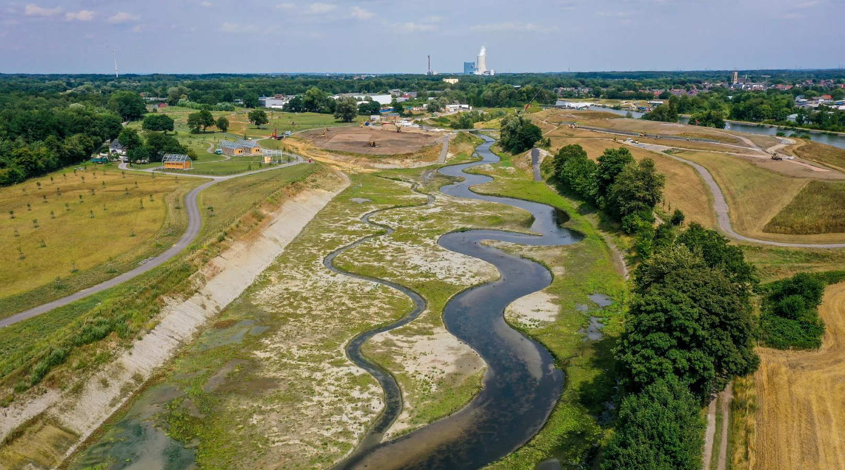
Reconstruction of the former meandering stream on suitable sections
330 km new blue-green infrastructure for nature and man
New Emscher at Castrop-Rauxel / Herne ©Fritsche, 2022
7
Notes:
Die riesigen Pumpwerke sind allein aufgrund ihrer Größe bauliche Meisterleistungen.
Das historische Verwaltungsgebäude der Emschergenossenschaft passt in die Pumpwerksgrube am Standort Bottrop.
40 m Tiefe und 48 m Durchmesser, Baukosten von 60 Mio. Euro sagen alles.
Rechts ein Blick auf die spätere Technik, das zukünftige Innenleben der Baugrube.

Slide 8
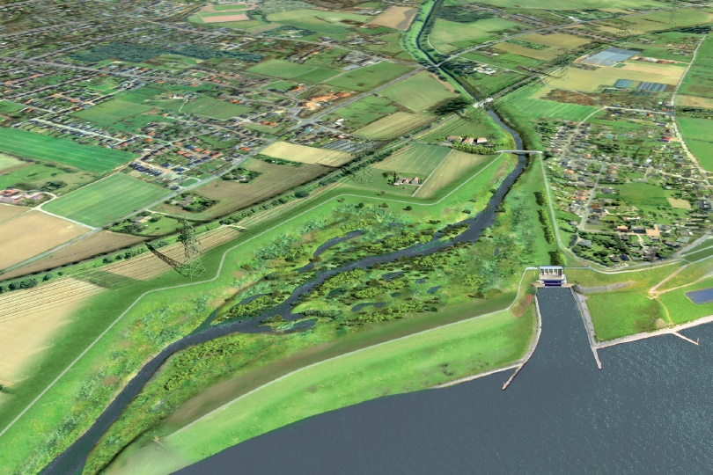
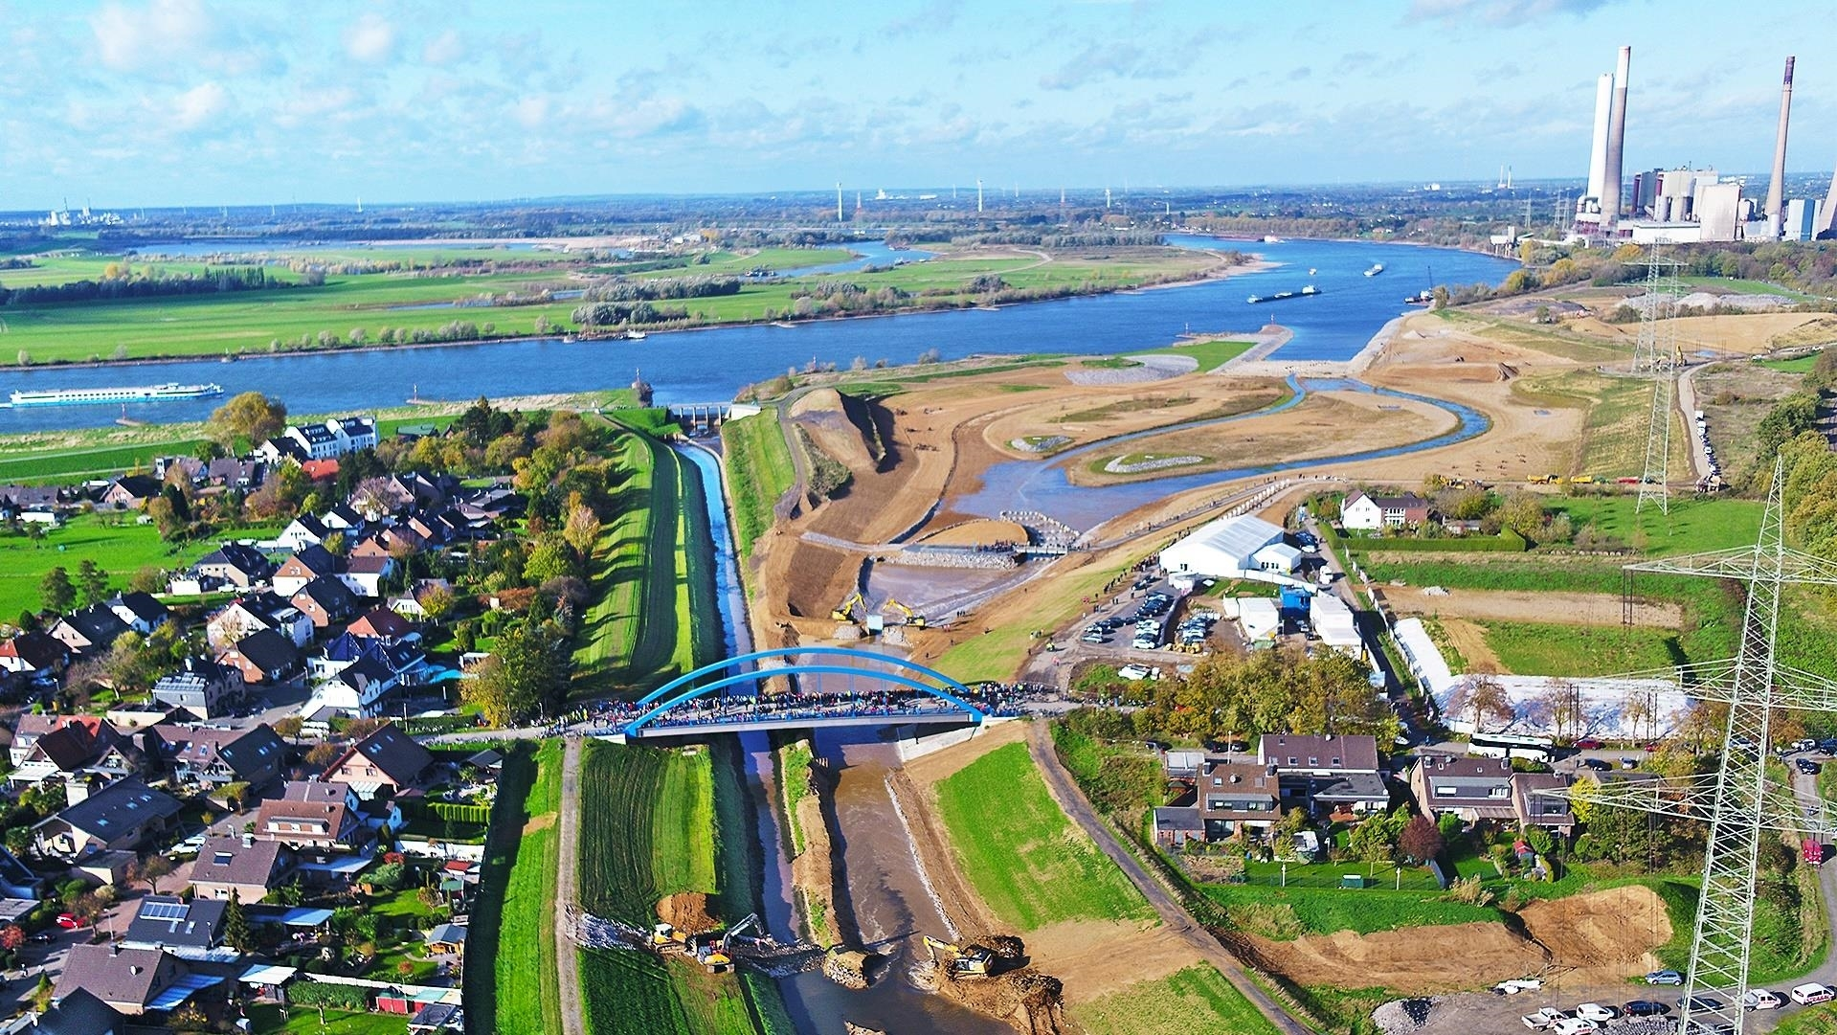
New Emscher mouth (2023)
Restored connectivity Emscher – Rhine and future hot spot of biodiversity
The Plan
Realisation 11/2022

Slide 9
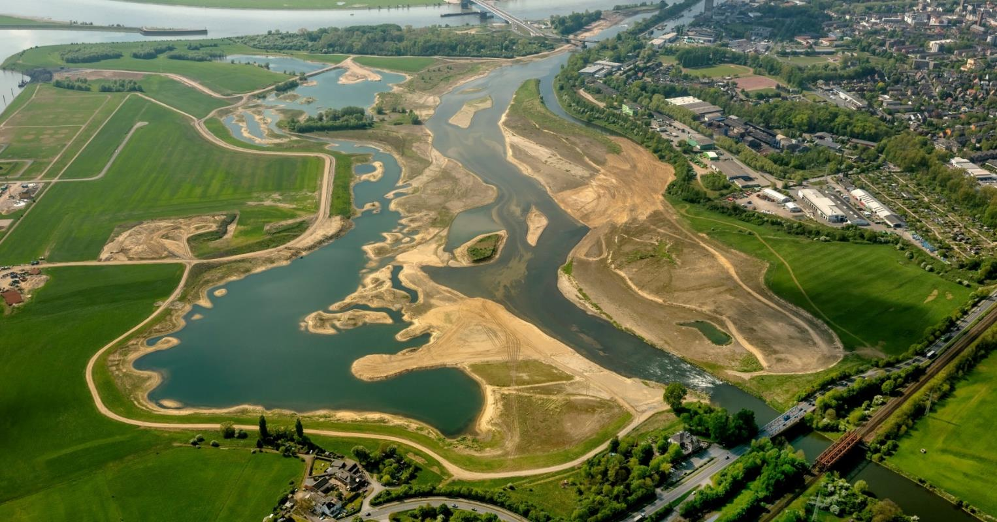
New mouth of neighbor river Lippe
Restoration of 25 ha floodplain and connectivity with the Rhine
© Lippeverband 2014 – Luftbild Blossey

Slide 10
© Lippeverband – Aerial view Blossey 23.8.2022

Slide 11
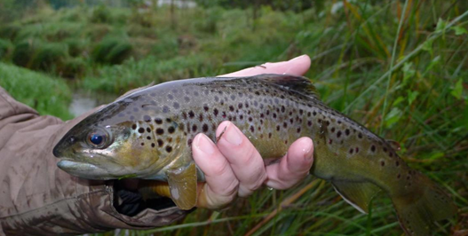
23 fish species, 450 invertebrates u. a.

Slide 12
Thank you for your attention!

