Slide 1
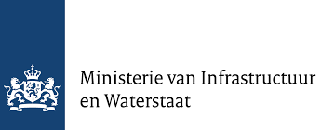
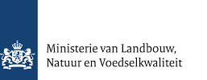

PROJECT FREE FLOW
Working together for Free-Flowing Rivers by removing barriers
Wilco de Bruijne & Herman Wanningen
World Fish Migration Foundation
May 17, 2023
Notes:
I have to excuse Christa Groshart, client.
Herman Wanningen
On behalf of 2 ministries and the Dutch national water authority

Slide 2
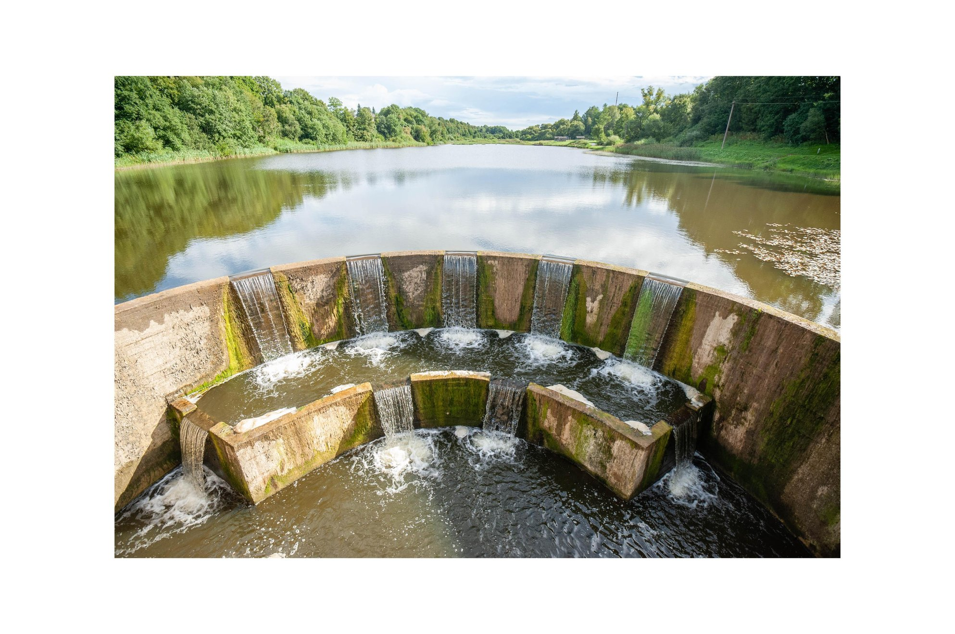
BARRIERS IN RIVERS
DAMS
WEIRS
CULVERTS
SLUICES
RAMPS
© Administration of Zemaitija
Notes:
Riversystems in Europe are highly fragmented due to dams, weirs, sluices and other barriers.
Watermanagement: barriers needed, water safety, drinking water, industrial intakes and navigation.
Impact on riverine ecosystems and biodiversity associated with flowing water.
Some barriers have lost their function.

Slide 3
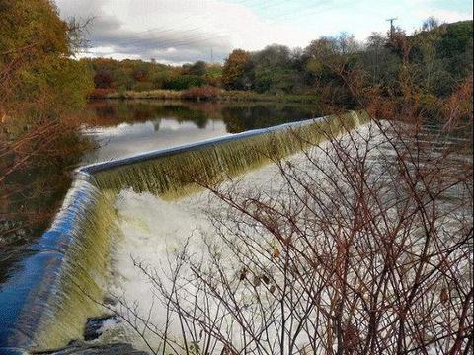
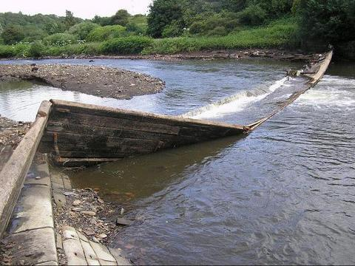
OBSOLETE BARRIERS
European Commission’s Guidance on Barrier Removal as:
‘barriers that no longer fulfil their original purpose or that are no longer needed’.
Notes:
What are we talking about, old obsolete structures which lost their function.
Often decades or even centuries old, without a clear function anymore.
In England on average 8 dams per year collapse in hydraulic peak events, just due to lack of maintenance and ownership.

Slide 4
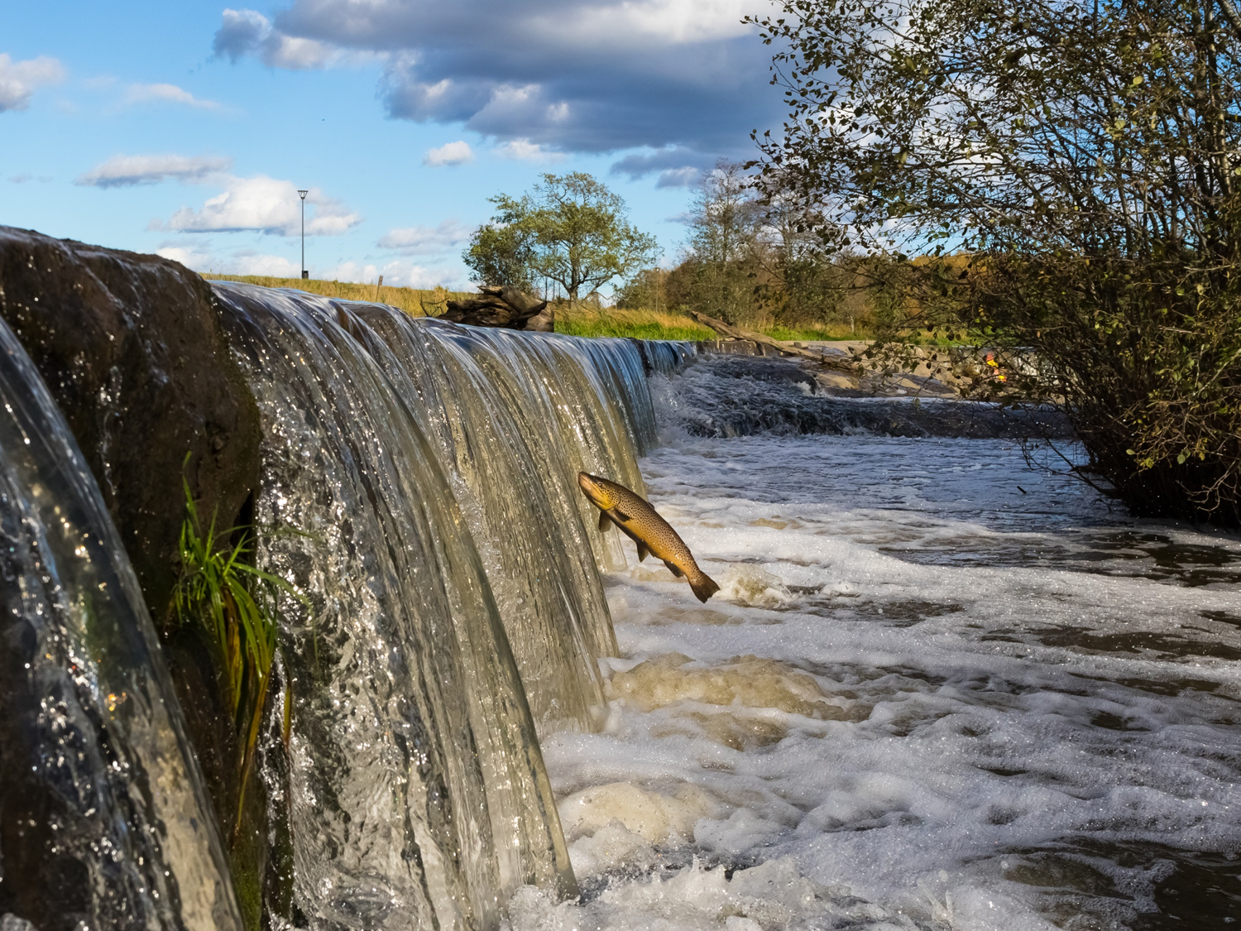
93%
DECREASE IN EUROPEAN MIGRATORY FISH STOCKS
THE PROBLEMS
1.100
FRESHWATER MIGRATORY FISH SPECIES GLOBALLY ARE BLOCKED BY BARRIERS
>1,2 MILLION*
BARRIERS FRAGMENT EUROPE AN RIVERS
>150.000*
BARRIERS IN EUROPE LISTED AS OBSOLETE
*(HORIZON 2020 AMBER
EU COMMISSION FUNDED RESEARCH)
© Petteri Hautamaa
Notes:
And this is the effect, over 1.2 mljn barriers in Eu, more than 150.000 listed as obsolete.
The latest Living Planet index indicated that ther is a decrease of 93% of migratory fish stocks in european rivers.
Other problems like lack of sediment transport with erosion as a consequence and WQ issues

Slide 5
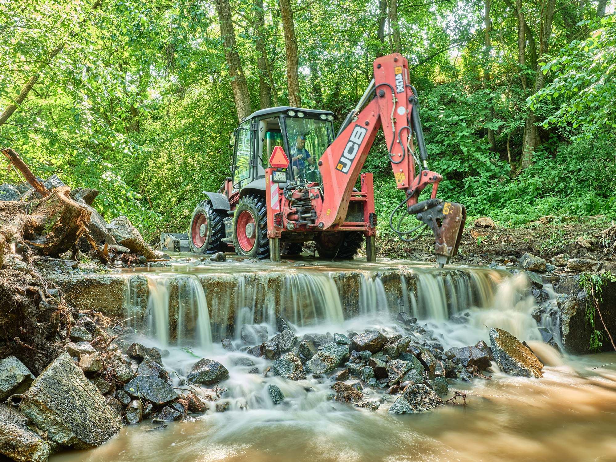
THE SOLUTION
DAM REMOVAL
STARTING WITH >150.000 OBSOLETE & OLD BARRIERES
IN EUROPE
IN LINE WITH WFD &
EU BIODIVERSITY STRATEGY
(c) Rob Kleinjans / WFMF
Notes:
One solution to retore FF conditions: dam removal.
Not only fish migration, but also reduced safety and flood protection issues, improved WQ, natural sedimentation and erosion processes and biodiversity associated with rivers.
This is also completely in line with the EU biodiversity goals in which is stated that in 2030 25.000km of Free Flowing rivers should be restored.

Slide 6
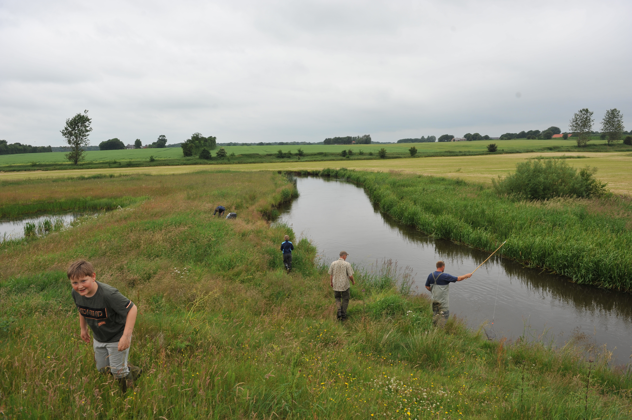
DAM REMOVAL
CONTRIBUTES TO
RECREATIONAL ECONOMIES
CREATING JOBS
MARINE/INLAND FISHERIES
PREVENTING MAINTENANCE COST
Notes:
Besides the ecological benefits there are also economic benefits.

Slide 7
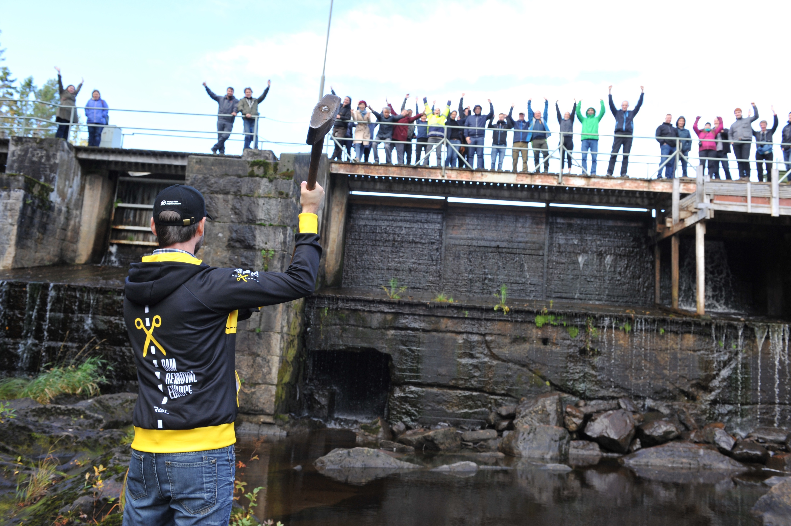








DAM REMOVAL EUROPE
A MOVEMENT OF ORGANISATIONS AND CITIZENS MAINSTREAMING DAM REMOVAL
AS RIVER RESTORATION TOOL.
FINANCIALLY SUPPORTED BY THE DUTCH POSTCODE LOTTERY AND MANY MORE
INIATED AND HOSTED BY WFMF
Notes:
To make dam removal a more mainstream measure we started dam removal Europe. Some of our colleagues were afraid to talk about this topic. Loose job, etc. We want to change that!

Slide 8
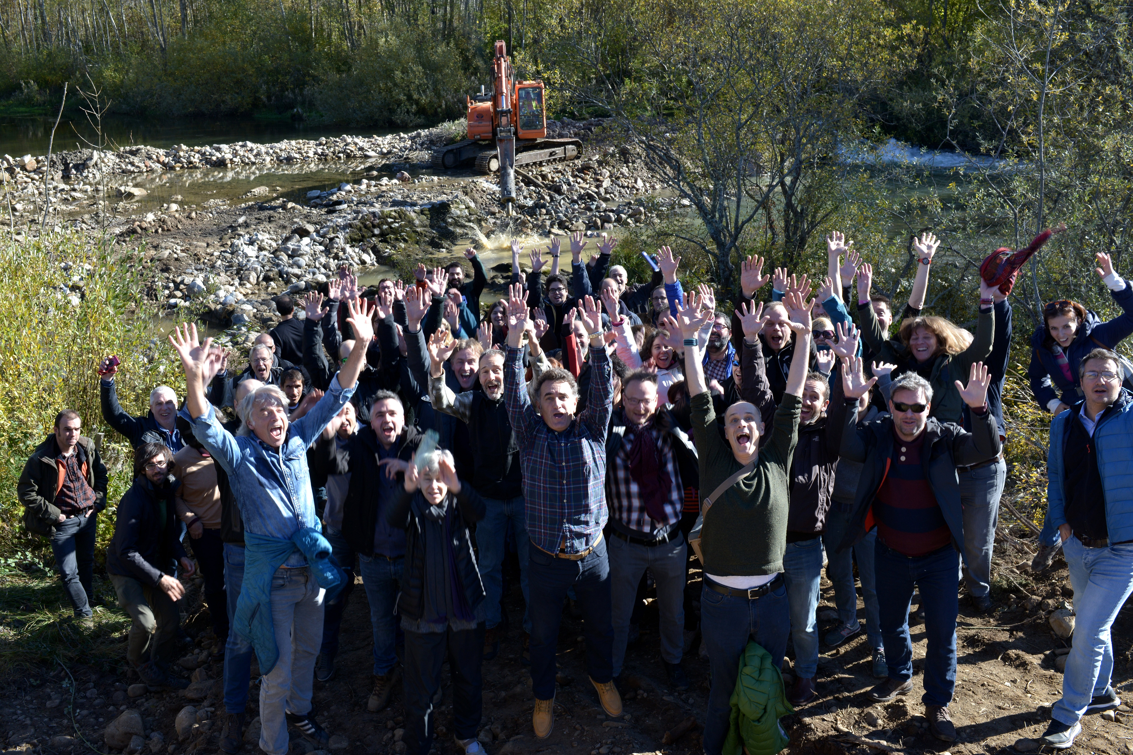
OUR STRATEGY
ENABLE RIVER PRACTITIONERS TO REMOVE DAMS AND CELEBRATE SUCCESS STORIES
“I really value your amazing events and work, and the fantastic community you have established for knowledge sharing and support”.
Tania White, Environment Agency (UK)
Notes:
Enable practioners
Celebrate succeses
Knowledge sharing
Build a network
We are not going to remove barriers ourselves, that is the job of water managers and contractors, but want to make this possible by promoting, funding, provide the needed knowledge and showcasing.

Slide 9
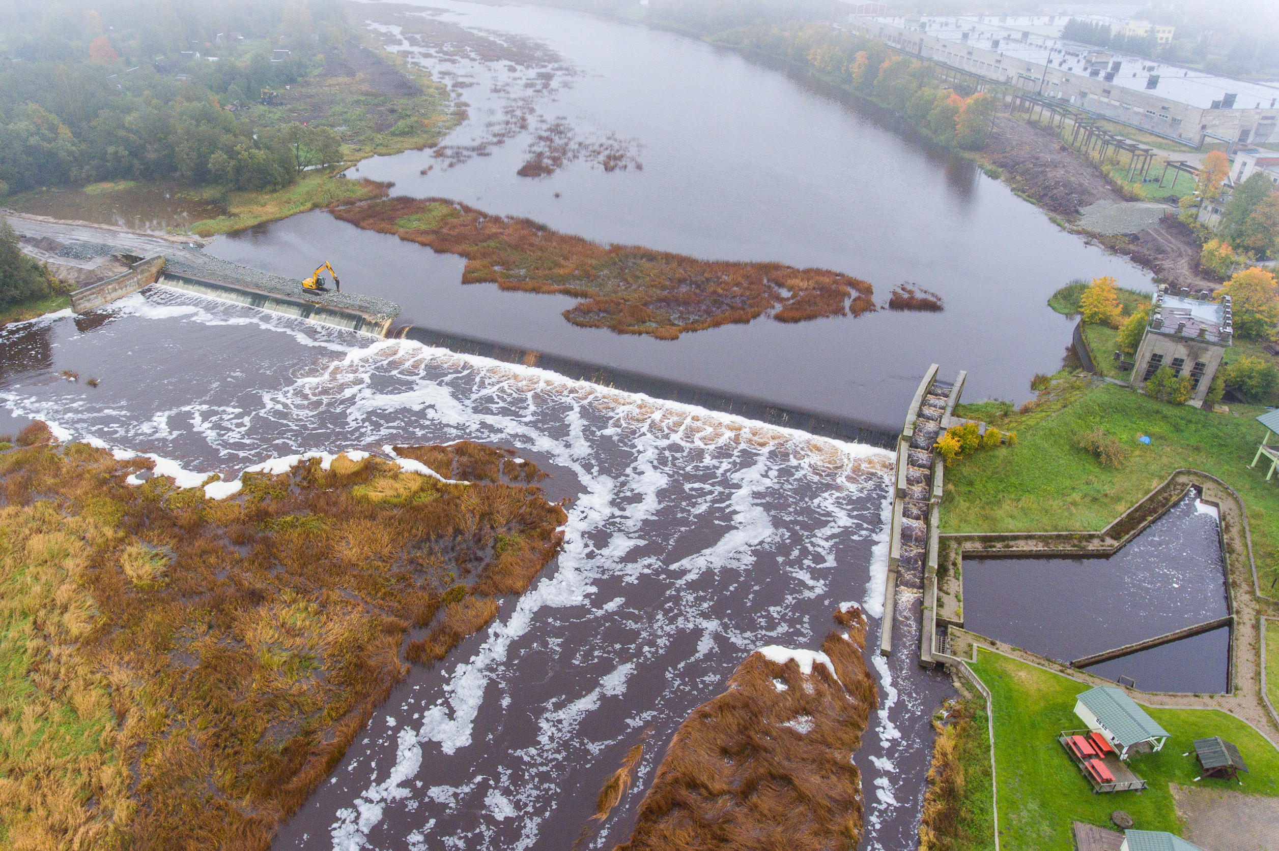
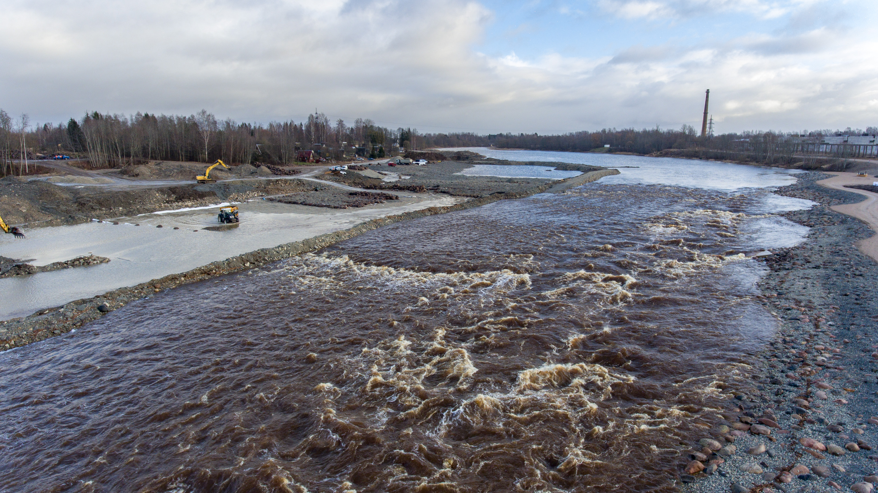
SHARING EUROPEAN SHOWCASES
After
Before
ESTONIA PARNU RIVER: 3000KM RESTORED BY EU DEVELOPMENT FUNDING
Notes:
8 dams removed under the radar (old industrial dams), 3000KM restored river. Important to highlight these kind of examples.

Slide 10
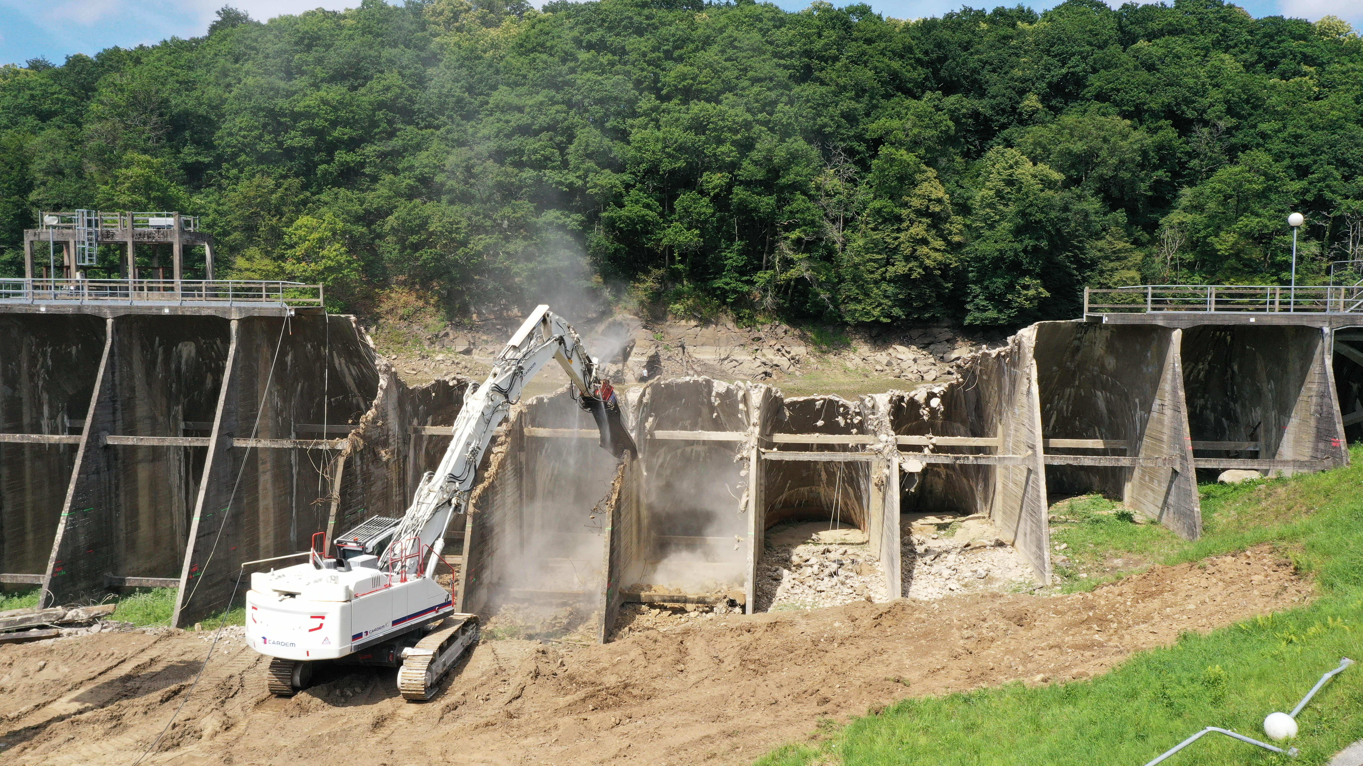
LA ROCHE QUI BOIT SELUNE RIVER FRANCE
© Robert Epple, ERN
Notes:
Another showcase: Selune: old hydropower dam. To expensive to refurbish.

Slide 11
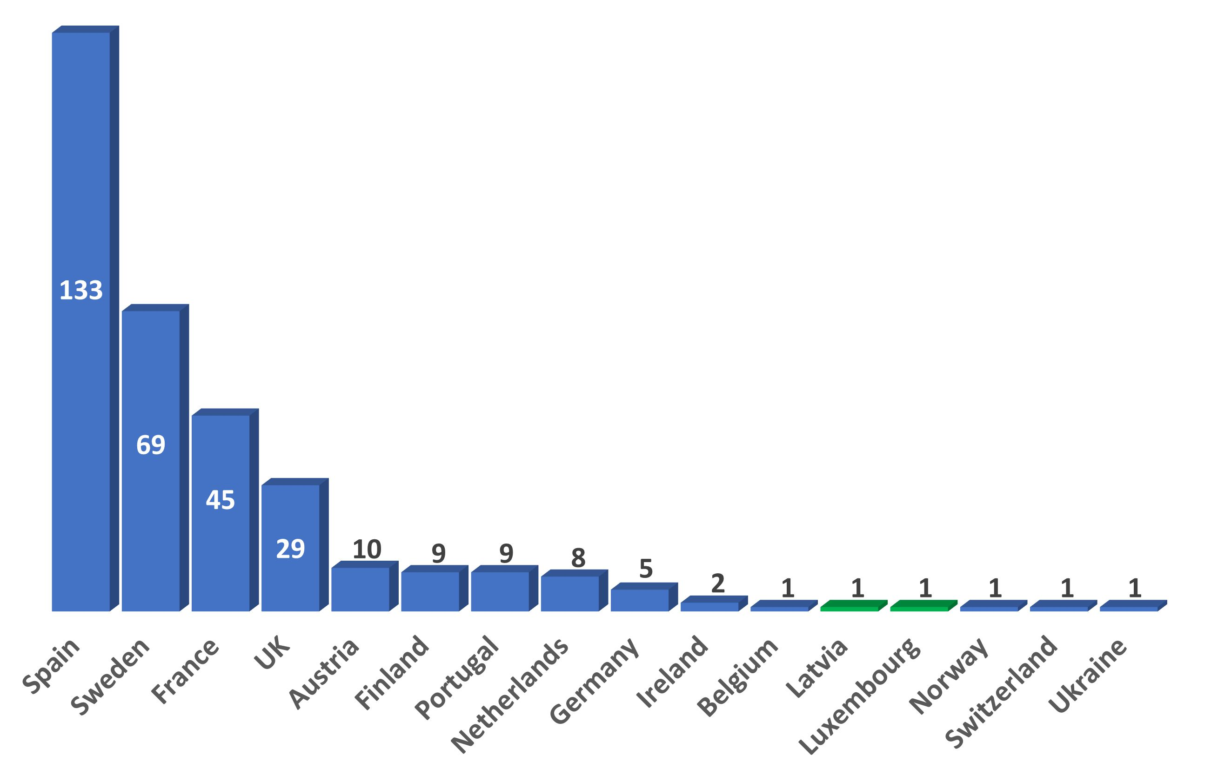
RECORD YEAR OF DAM REMOVALS IN 2022
AT LEAST 325 BARRIERS REMOVED
>150.000 OBSOLETE BARRIERS TO GO
12
BILLION EURO
Notes:
In 2022 a record number of dams was removed,
Average costs per dam: EURO 80.000, enormous possibility for contractors, engineers etc. Interesting business case.
If you simply count that 150K barriers have to go, then 12 billion EURO is needed for that. So dam removal becomes an industry itself.

Slide 12
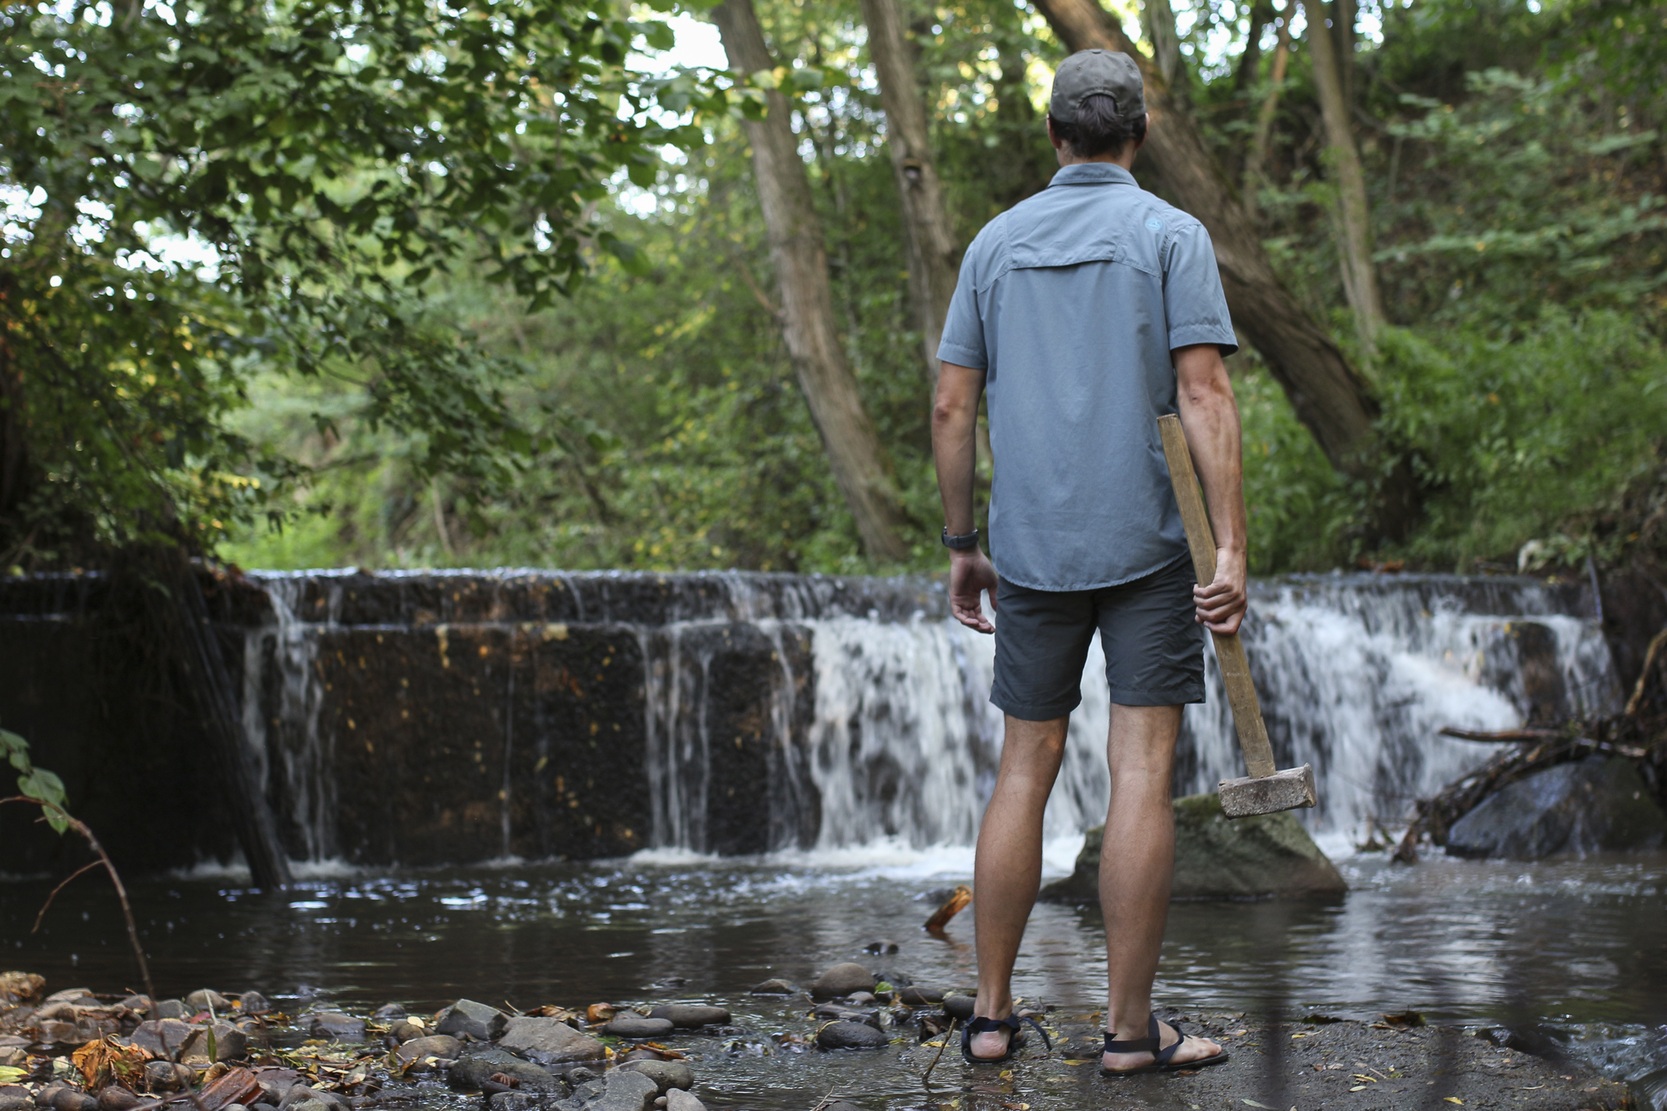

Dam fine work. record number of barrier removals helps restore rivers across Europe
More than 300 barriers were taken down last year, boosting the health of waterways and the wildlife they support, say experts.
(c) Zuzana Matusova
Notes:
Not only the specialist and water managers, also media, policymakers, politicians are picking up the message/story and helping to make this a success.

Slide 13
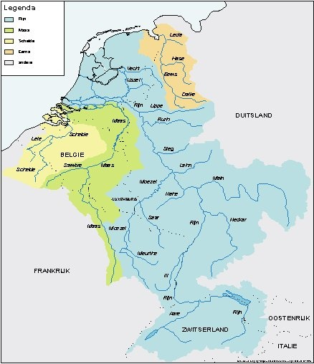
FREE FLOW PROJECT
TARGET
MAPPING THE POSIBILITIES FOR FREE FLOWING RIVER RESTORATION
DAM REMOVAL
SEARCHING FOR SHOWCASES
NETWORK
BUILD A NETWORK OF EXPERT IN THE RIVERS RHINE, MEUSE, SCHELDT AND EEMS BASINS, IN CLOSE COOPERATION WITH DAM REMOVAL EUROPE
CELEBRATE SUCCESSES
CELEBRATE SUCCESFULL PROJECTS WITH EXCURSIONS AND LIVE STREAMS OF RESTORATION MEASURES
Notes:
Introduction to the Free Flow project

Slide 14
IN FACT THIS
ALREADY STARTED
NL Part of 4 international river basins
River and brook restoration since the 90’s.
Connectivity (fish ways) and habitat (bank restoration) measures since the EU WFD.
Still a lot of river stretches lack riverine habitats with free flowing water.
First concept Free Flow map, searching for free flowing stretches.
Notes:
Eerst vismigratieroutekaart laten zien: kan vis er komen? Nu is de vraag: is gebied geschikt voor migrerende soorten.
Uitsnede Dommel invoegen. Message: we searched for the biodiversity hotspots. According to the water managers.
Less than 10% is free flowing according to the definition.

Slide 15
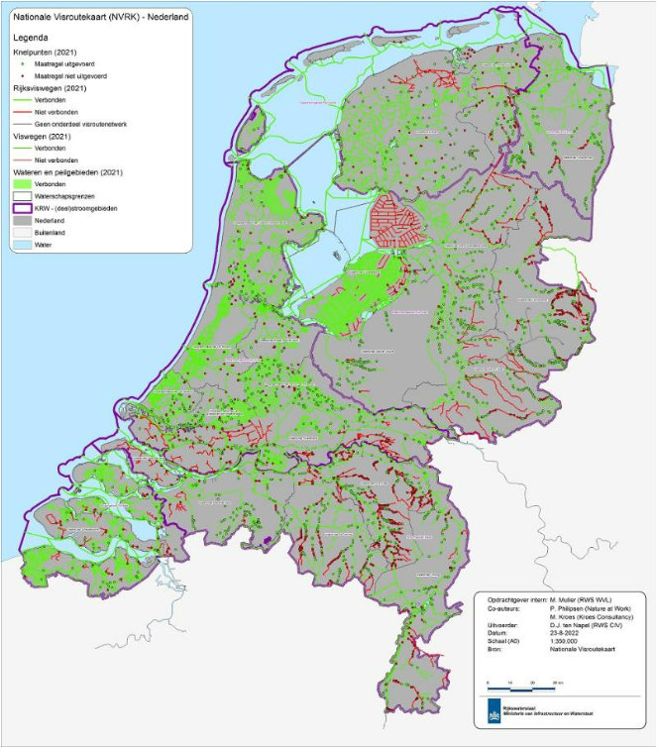
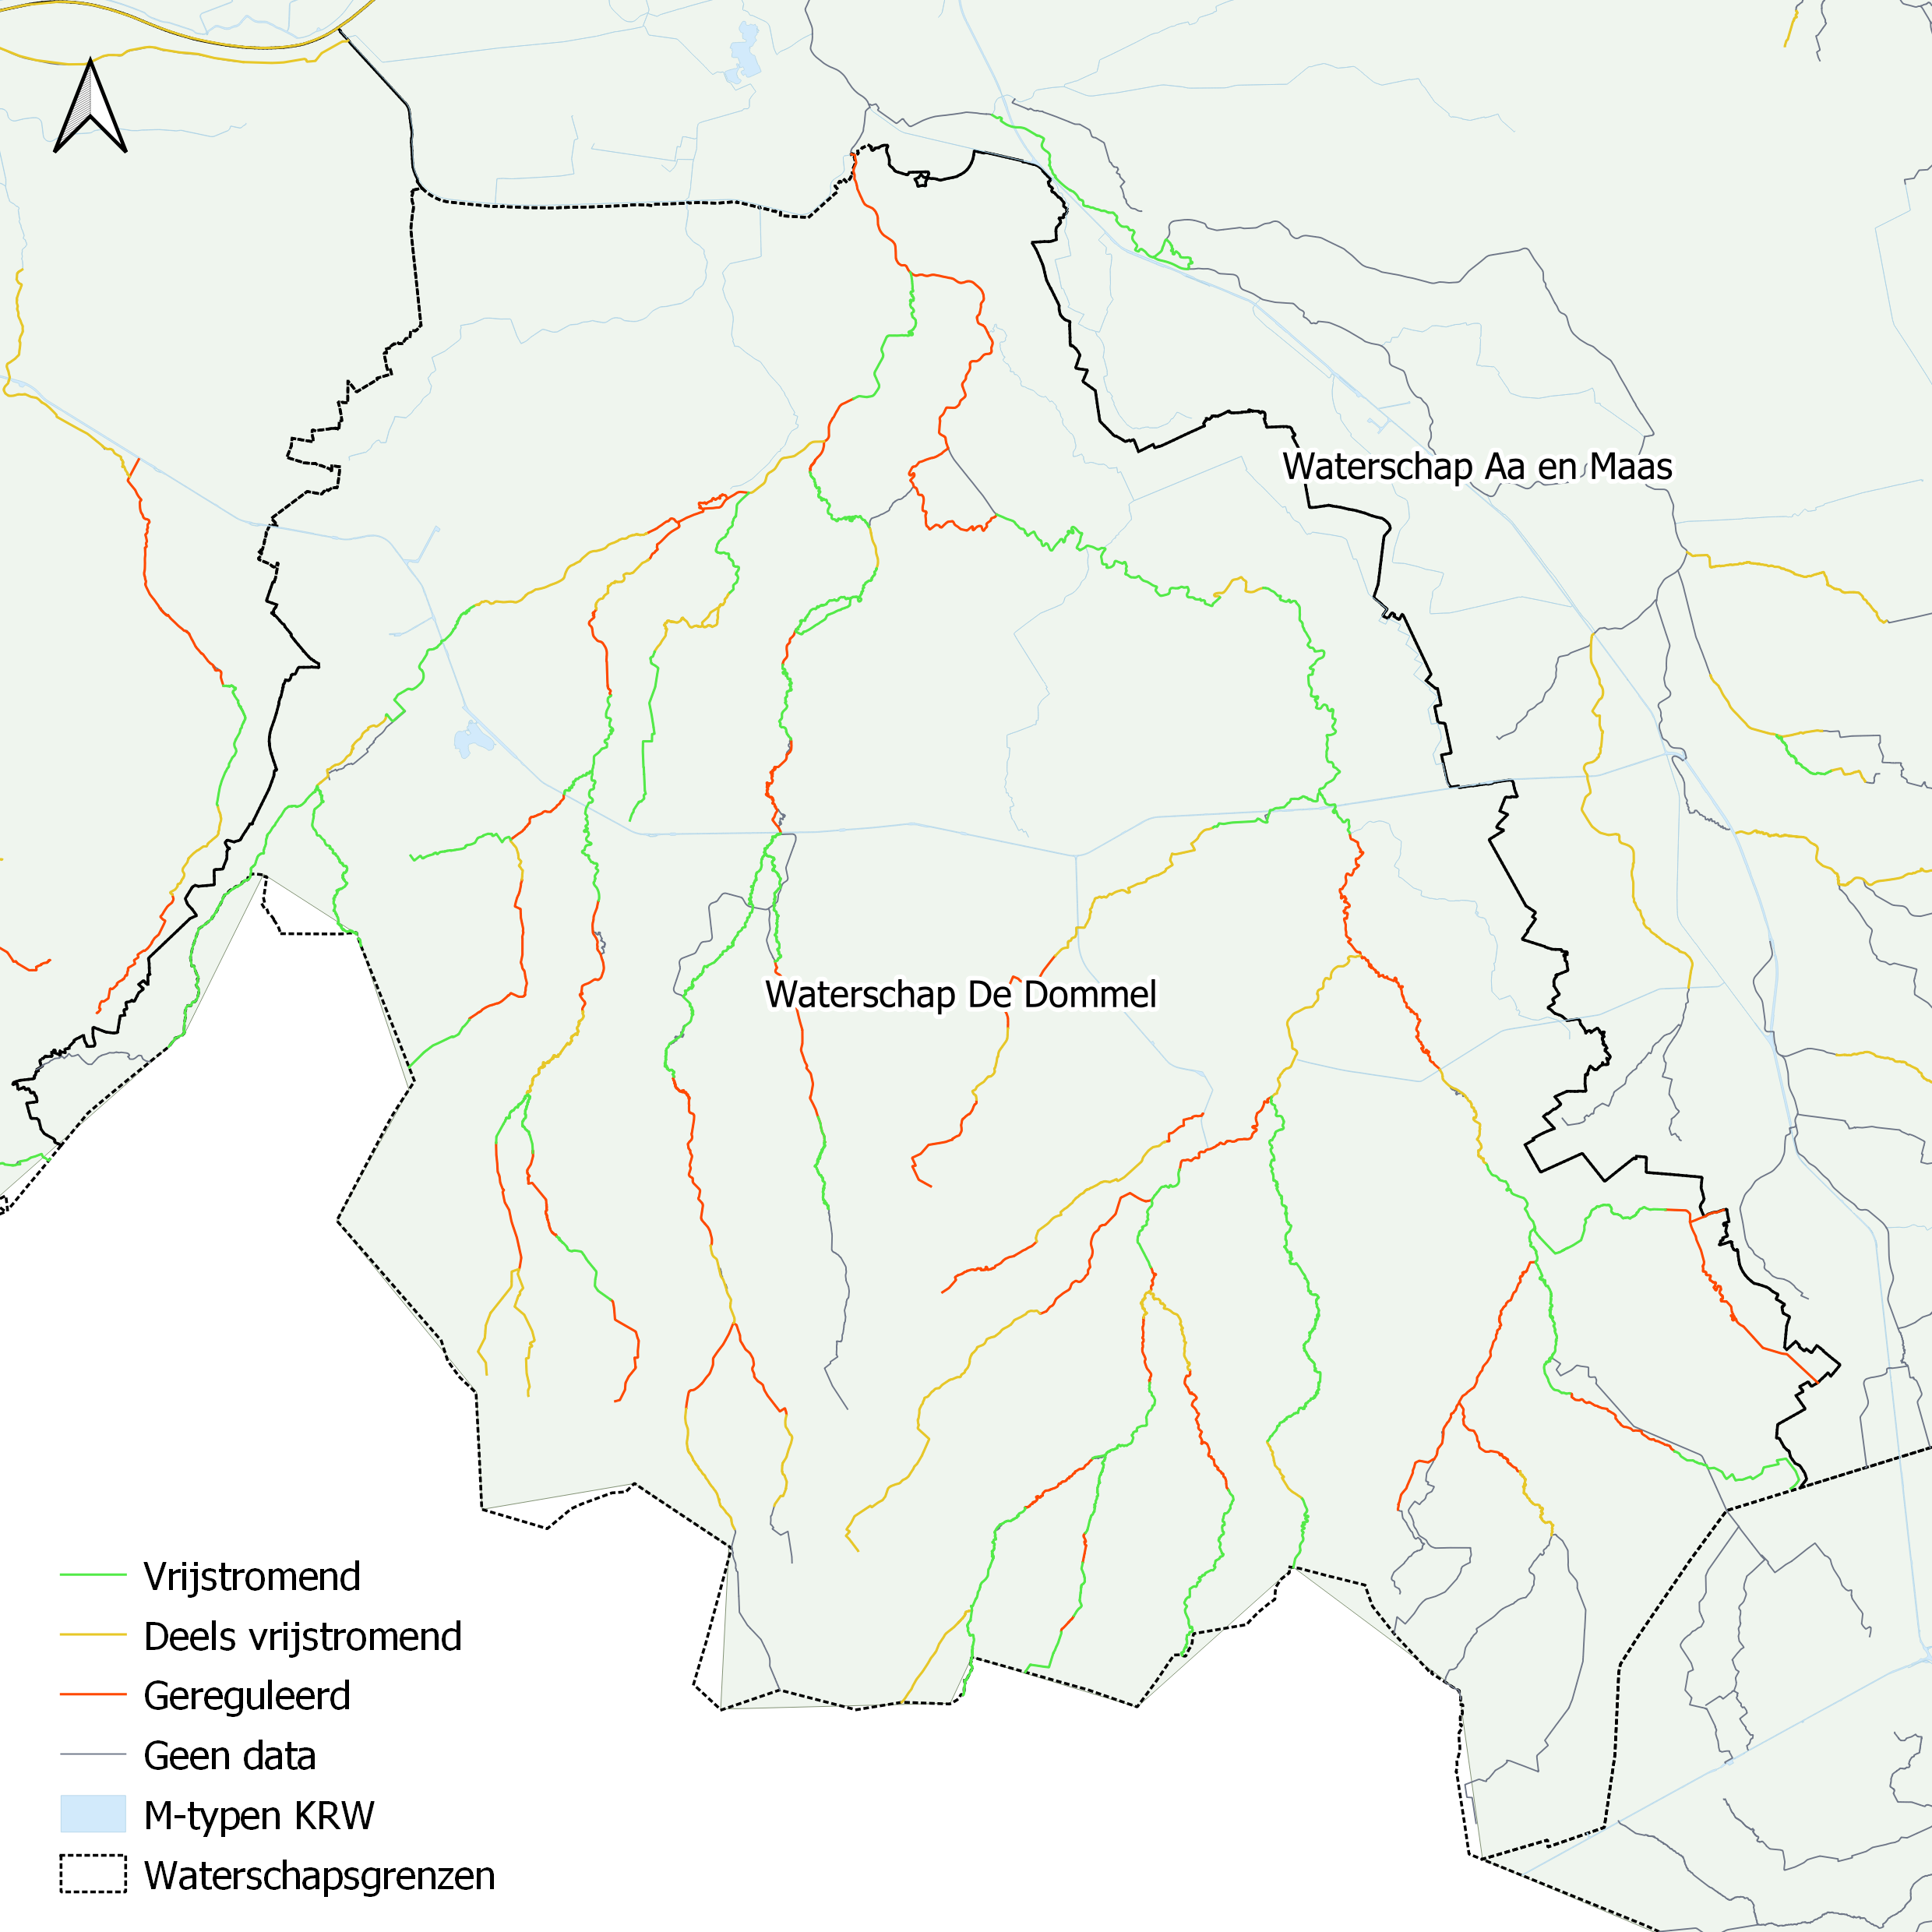
Source: Nationale visroutekaart
Notes:
Eerst vismigratieroutekaart laten zien: kan vis er komen? Nu is de vraag: is gebied geschikt voor migrerende soorten.
Uitsnede Dommel invoegen. Message: we searched for the biodiversity hotspots. According to the water managers.
Less than 10% is free flowing according to the definition.

Slide 16
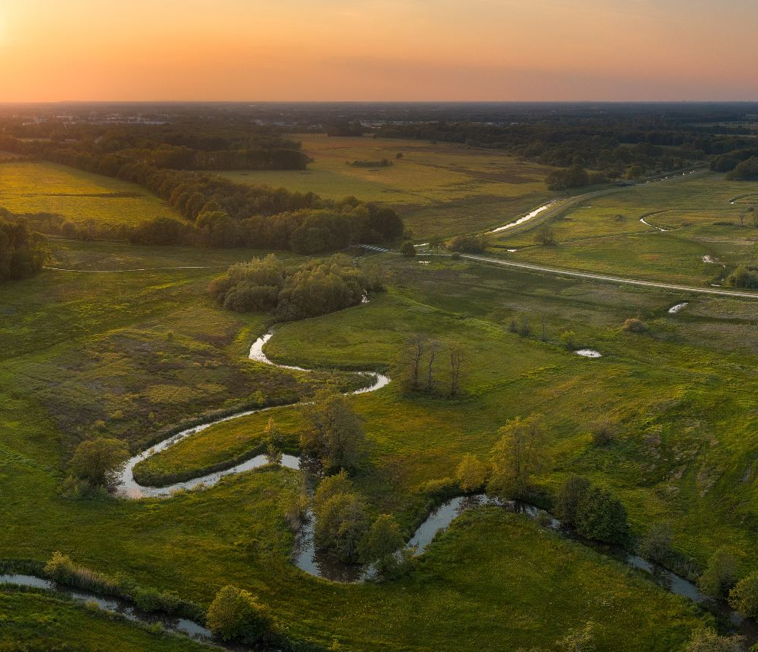
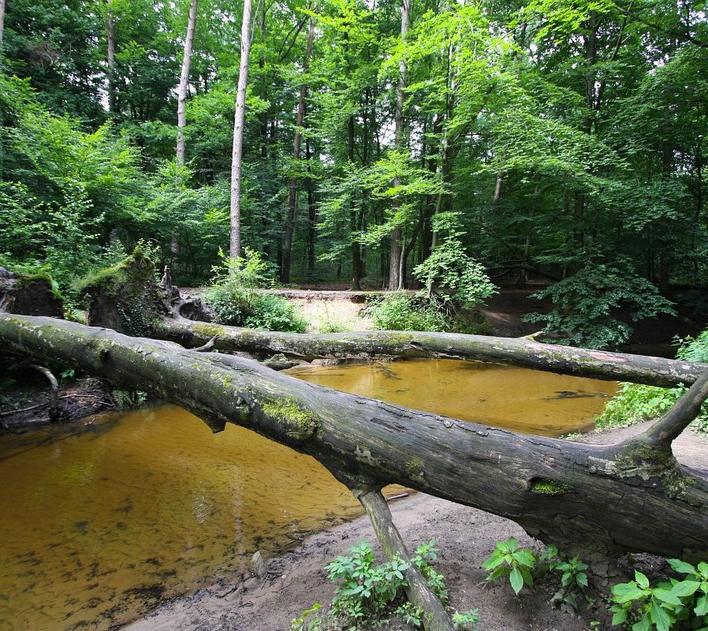
FREE FLOWING BIODIVERSITY HOPTSPOTS
Photo left: Drentse Aa (source: ANWB), Photo right: Boven Slinge (Source: Saxifraga - Bart Vastenhouw)
Notes:
Een paar waterschappen hebben al meegedacht, vraag: waar ligt er nog echt vrij stromend water zonder stuwen/vispassages/barrieres. Volledig natuurlijk. Op zoek naar de biodiversiteits hotspots in NL en uiteindelijk daarbuiten!
Klopt het dat dit de biodiversiteits hotspots zijn? Plaatjes van de mooie beken. Drentse Aa, WRIJ Dommel

Slide 17
How to proceed?
Currently only 10% of all river stretches are seen as Free Flowing.
There is already a fish route map about barriers, the additional FreeFlow map is about habitat.
FreeFlow Map work session with involved regional Water Authorities.
Where can we improve the status to free flowing to contribute to the EU biodiversity goals?
Expand the FreeFlow approach to other countries and exchange knowlegde
Notes:
Werksessie is het belangrijkste, waar liggen kansen voor uitbreiding van Free Flowing stretches.

Slide 18
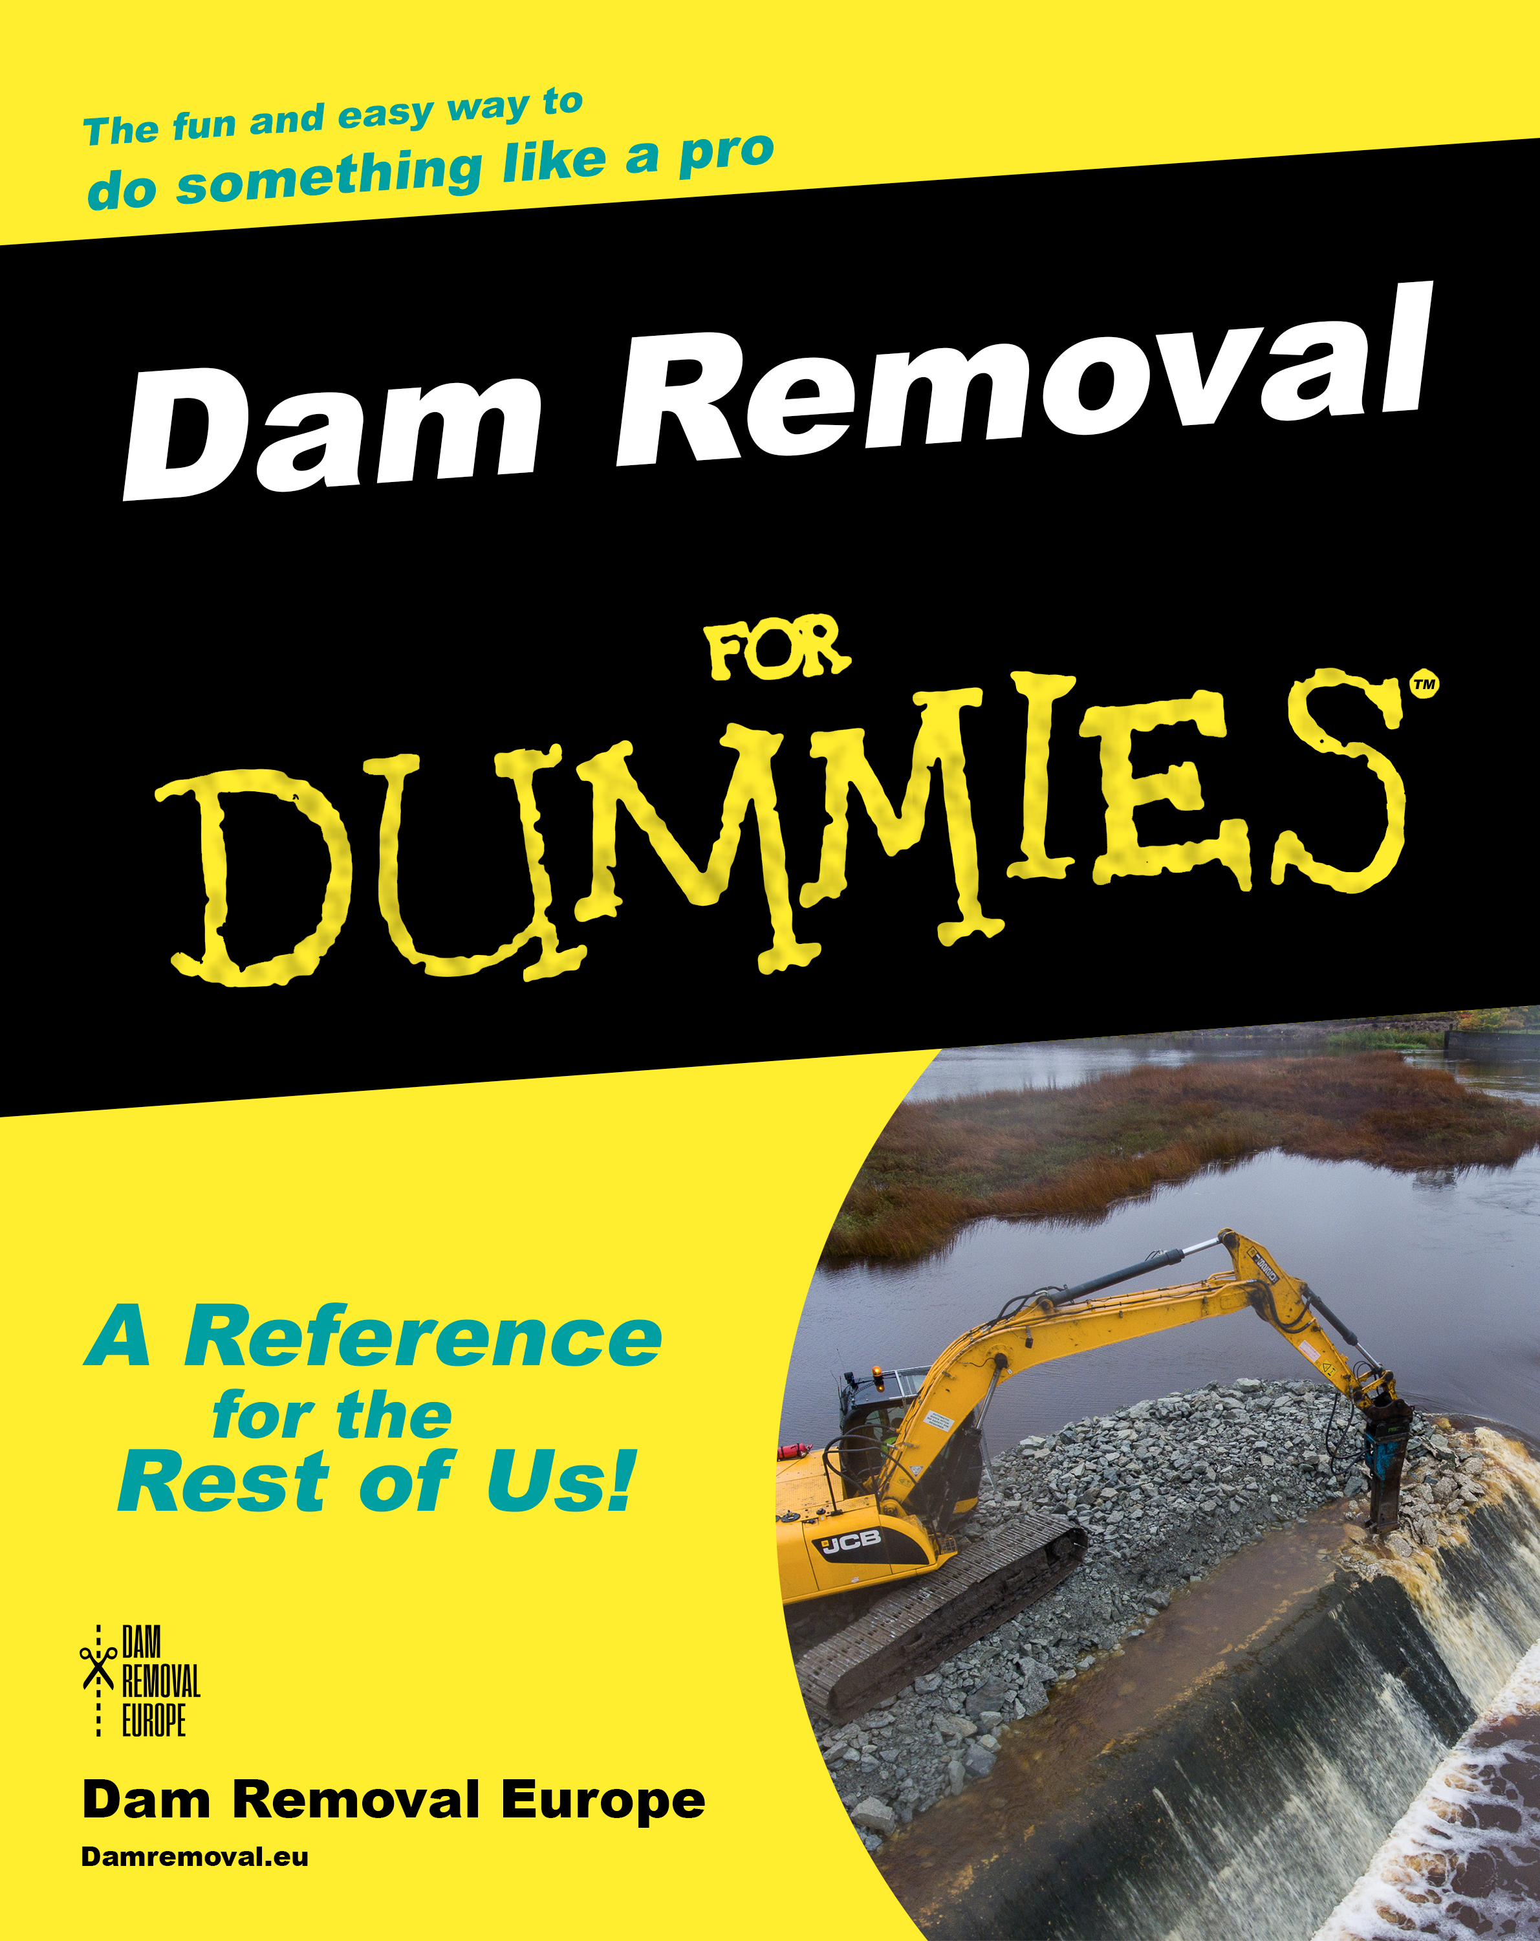
FREE FLOW MILESTONES
UPCOMING INTERNATIONAL ACTIONS
CONFERENCE (April 15-17, 2024)
GUIDANCE (April 15-17, 2024)

Slide 19
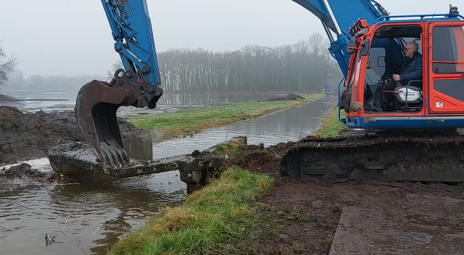
FREE FLOW – DAM REMOVALS
ANY IDEAS, DAM REMOVAL PLANS OR SUGGESTIONS? GET IN CONTACT! (HERMAN@FISHMIGRATION.ORG)
Notes:
Voorbeeld van een “impressive” dam removal representative for the Netherlands.

Slide 20
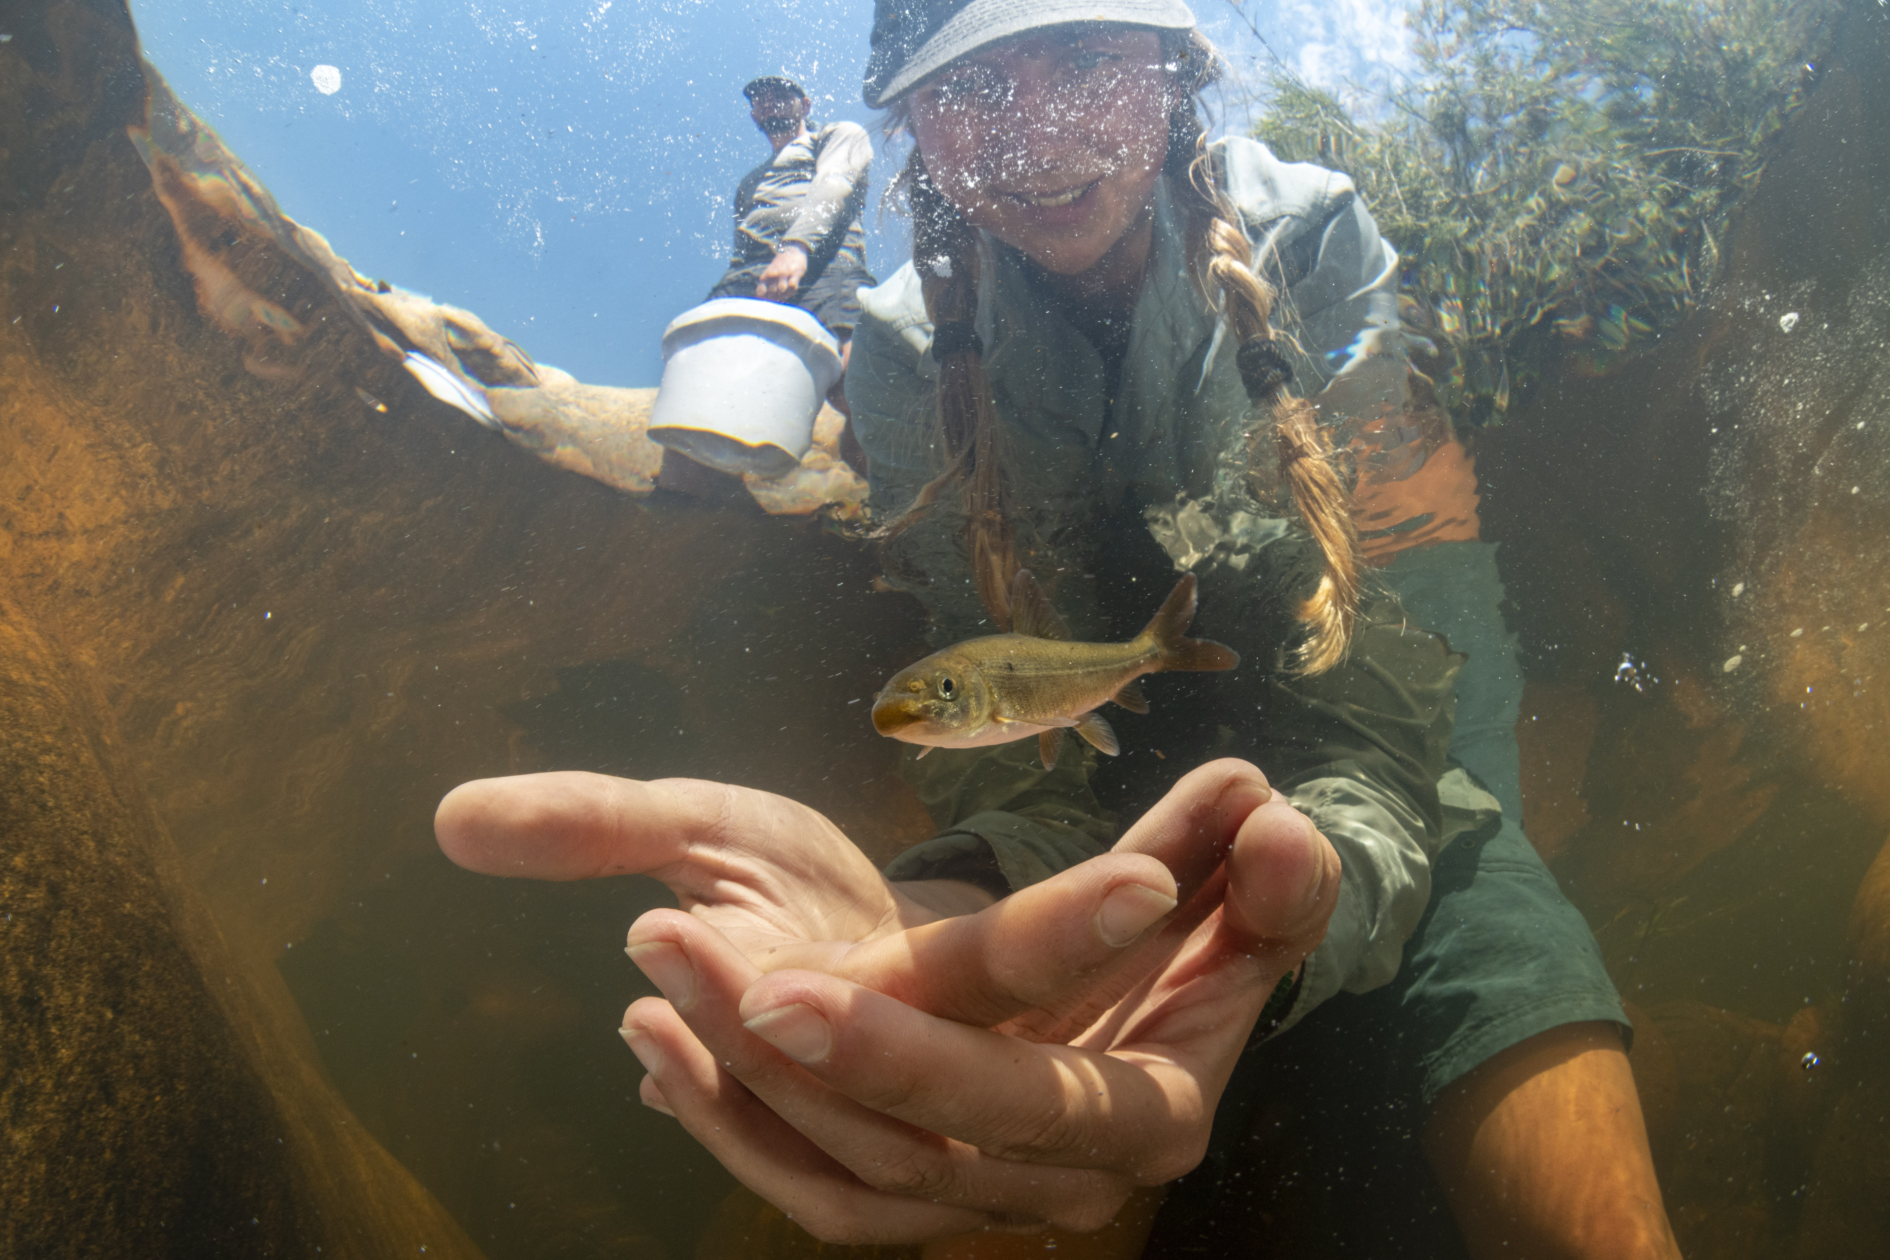
THANK YOU!

