Slide 1
Implementation of the « Free Flowing River » target of the biodiversity strategy in Luxembourg
Free Flow Webinar vol.2 – Barrier removal for river restoration in the river basins of the Rhine, Scheldt, Meuse and Ems (23.05.2023)
Carole Molitor, AGE (LU)

Slide 2
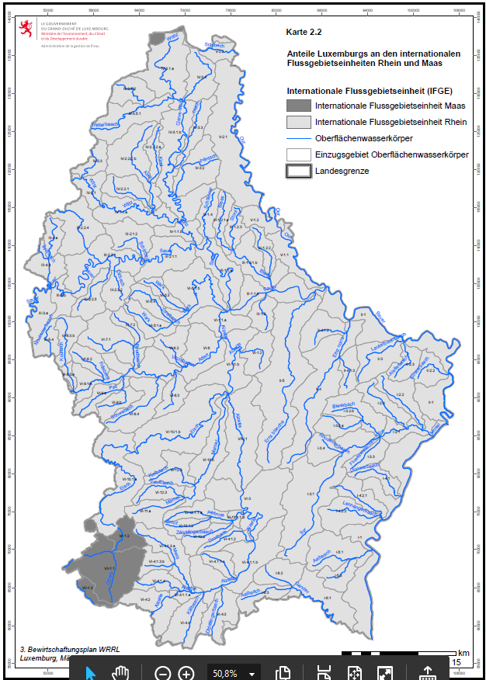
Geographical situation
On the watershed between Meuse (3 WB) and Rhine (103 WB) catchment areas
Main river type: (small) rivers of the submontanous/colline level
Dominant Fish region: Brown trout region (grayling region for middle sized rivers)
Via Rhine => Sea

Slide 3
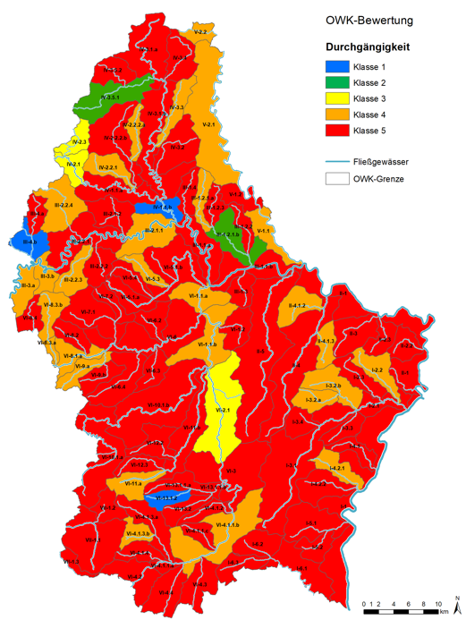
Ecological continuity - Current state
Evaluation of the ecological continuity in the 3rd RBMP (HyMo Quality Element)
Classification based on up- and downstream migration potential and sediment passability
Only 3 NWB are classified in a very good status regarding ecological continuity
2 NWB are classified in a good status => no significant barriers for fish migration (upstream and downstream)

Slide 4
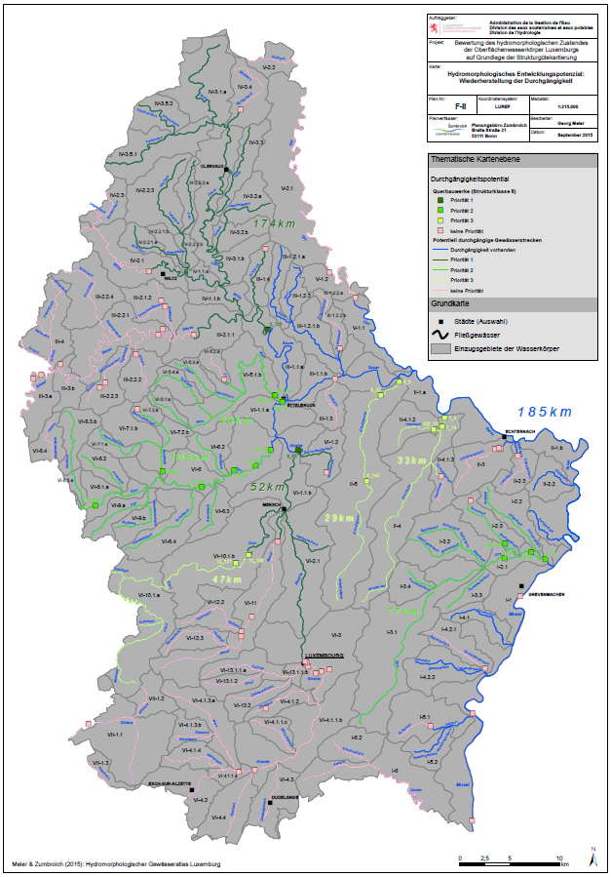
What we did so far…
2nd RBMP: priorization scenario focussed on estuary areas to reconnect the rivers.
Only dams/weirs with a height of >1m were considered
Criteria based on the length of continuous river stretches and hydromorphological quality of the potential additional habitat
Dam removal where possible (Obsolete, agreement of the owner, no static issues,..)

Slide 5
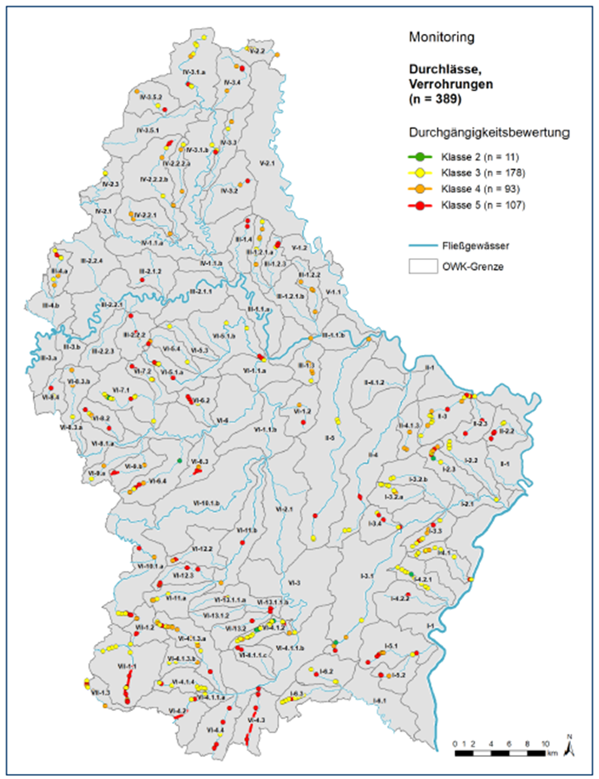
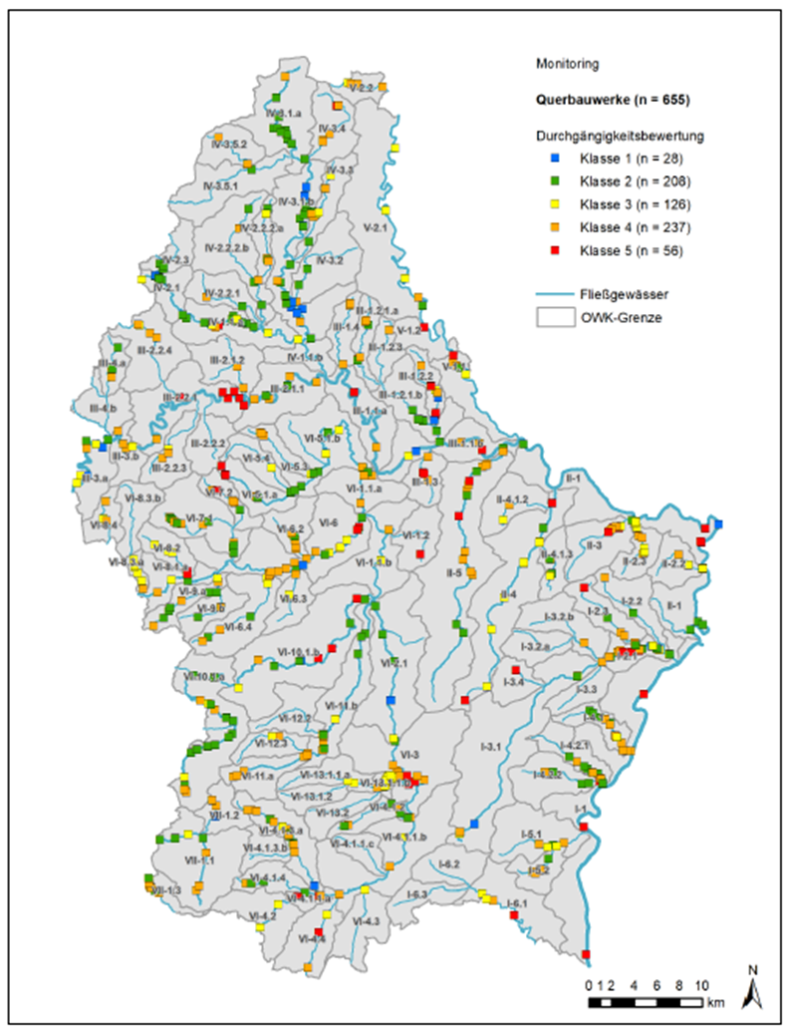
What we did so far…
3 rd RBMP: Inventory of all existing instream barriers > 0,1 m including dams, weirs, culverts, pipings, crossings
Culverts & pipings
Dams & weirs

Slide 6
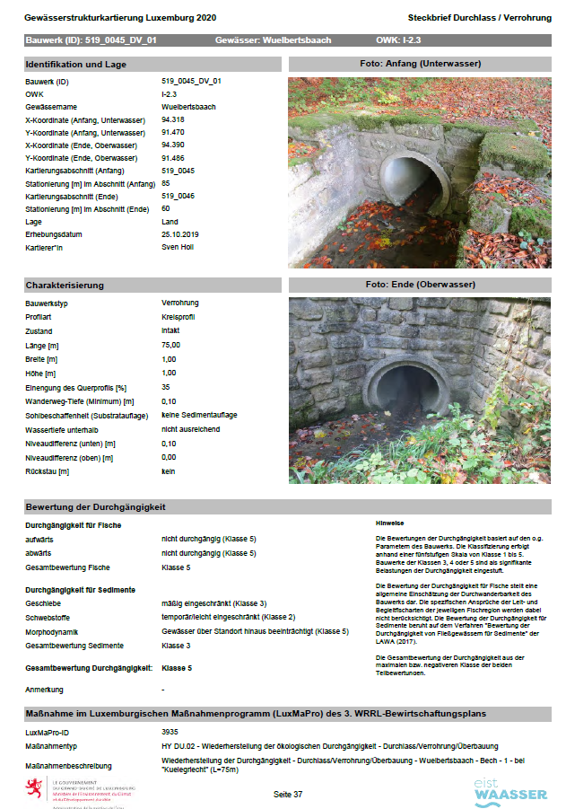
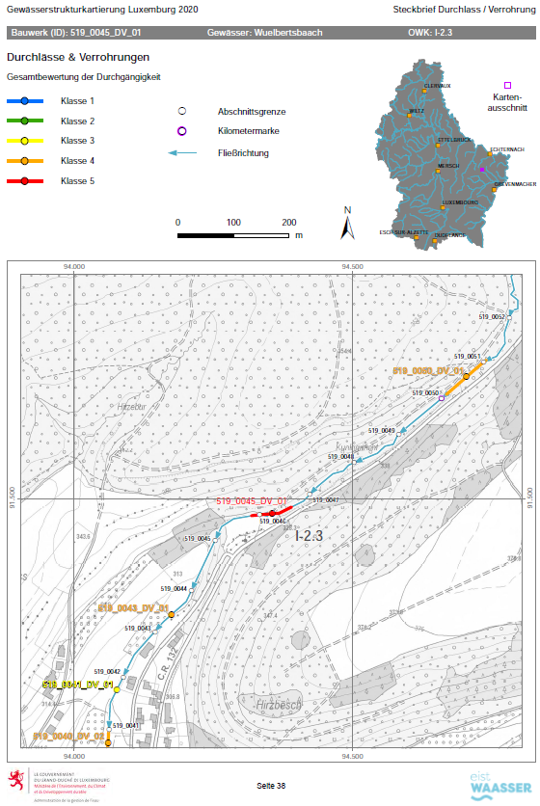
What we did so far…
Map with 1.016 identified instream barriers
1 Fact sheet per barrier:
Pictures
Location
Dimensions
Construction type
Evaluation of up-and downstream migration and sediment passability
…

Slide 7
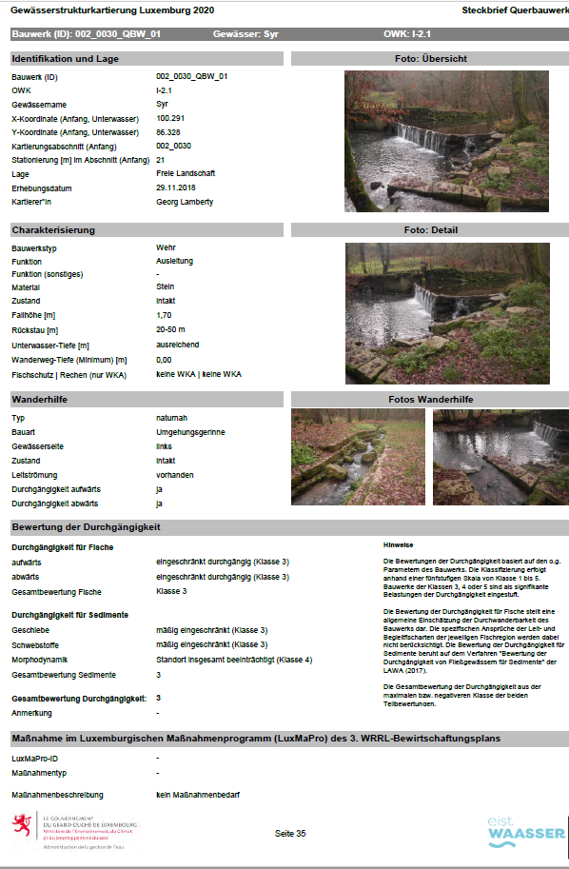
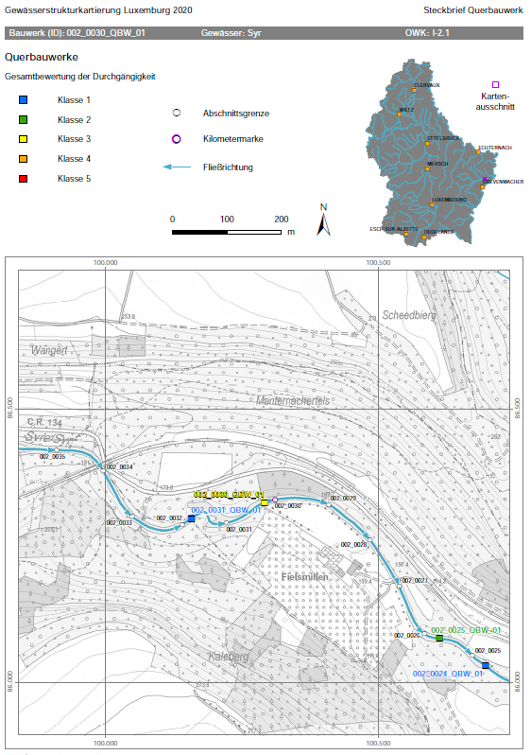
What we did so far …
Fact sheet for each dam/weir including the ones with existing fish passages

Slide 8
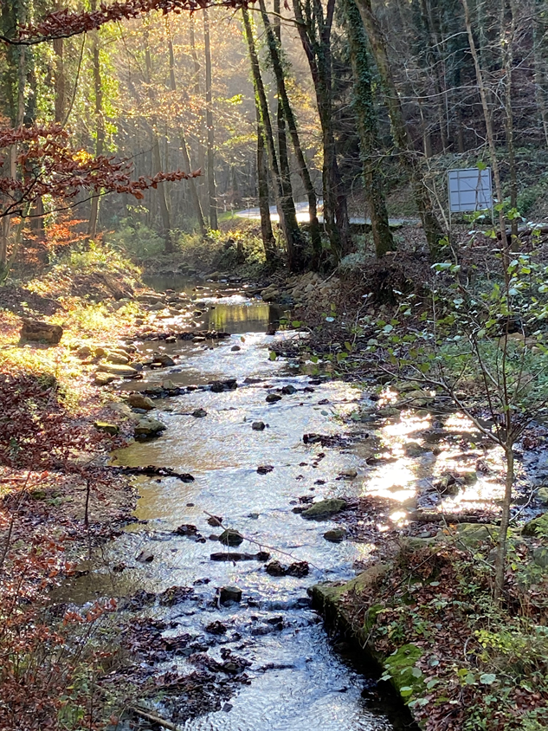
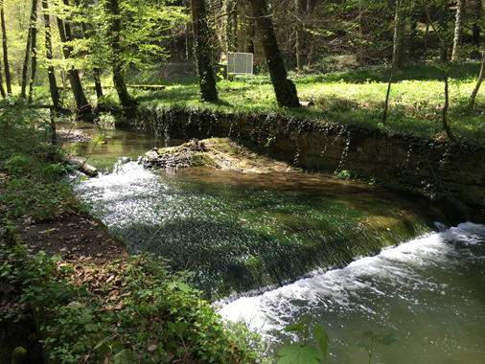
What we did so far …in parallel
After:
Barrier removal in the river “Ernz noire” in 2020
Before:

Slide 9
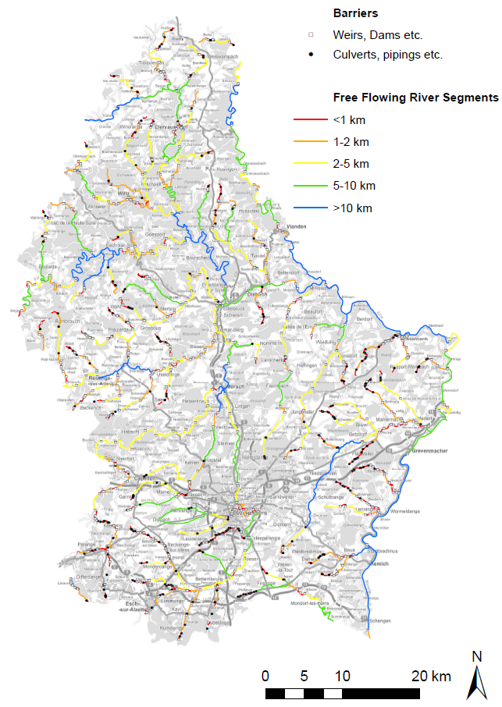
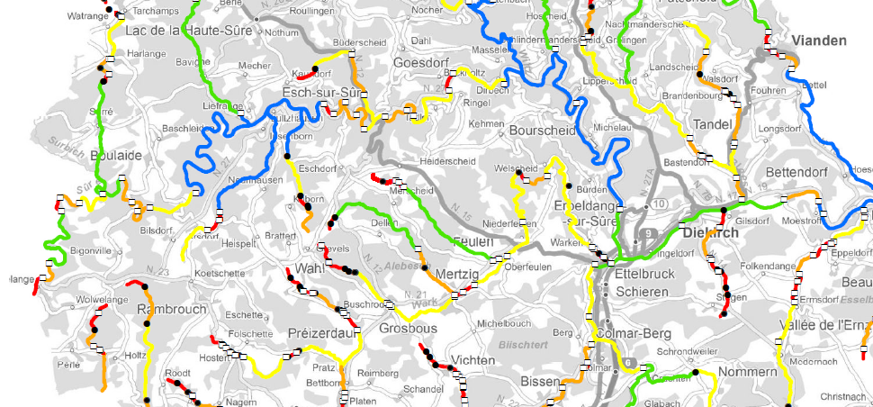
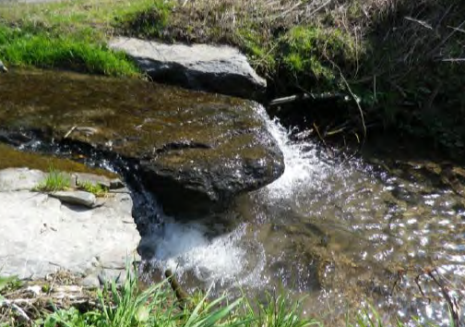
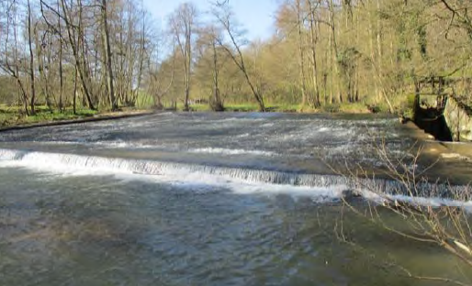
Map with free flowing segments…to develop

Slide 10
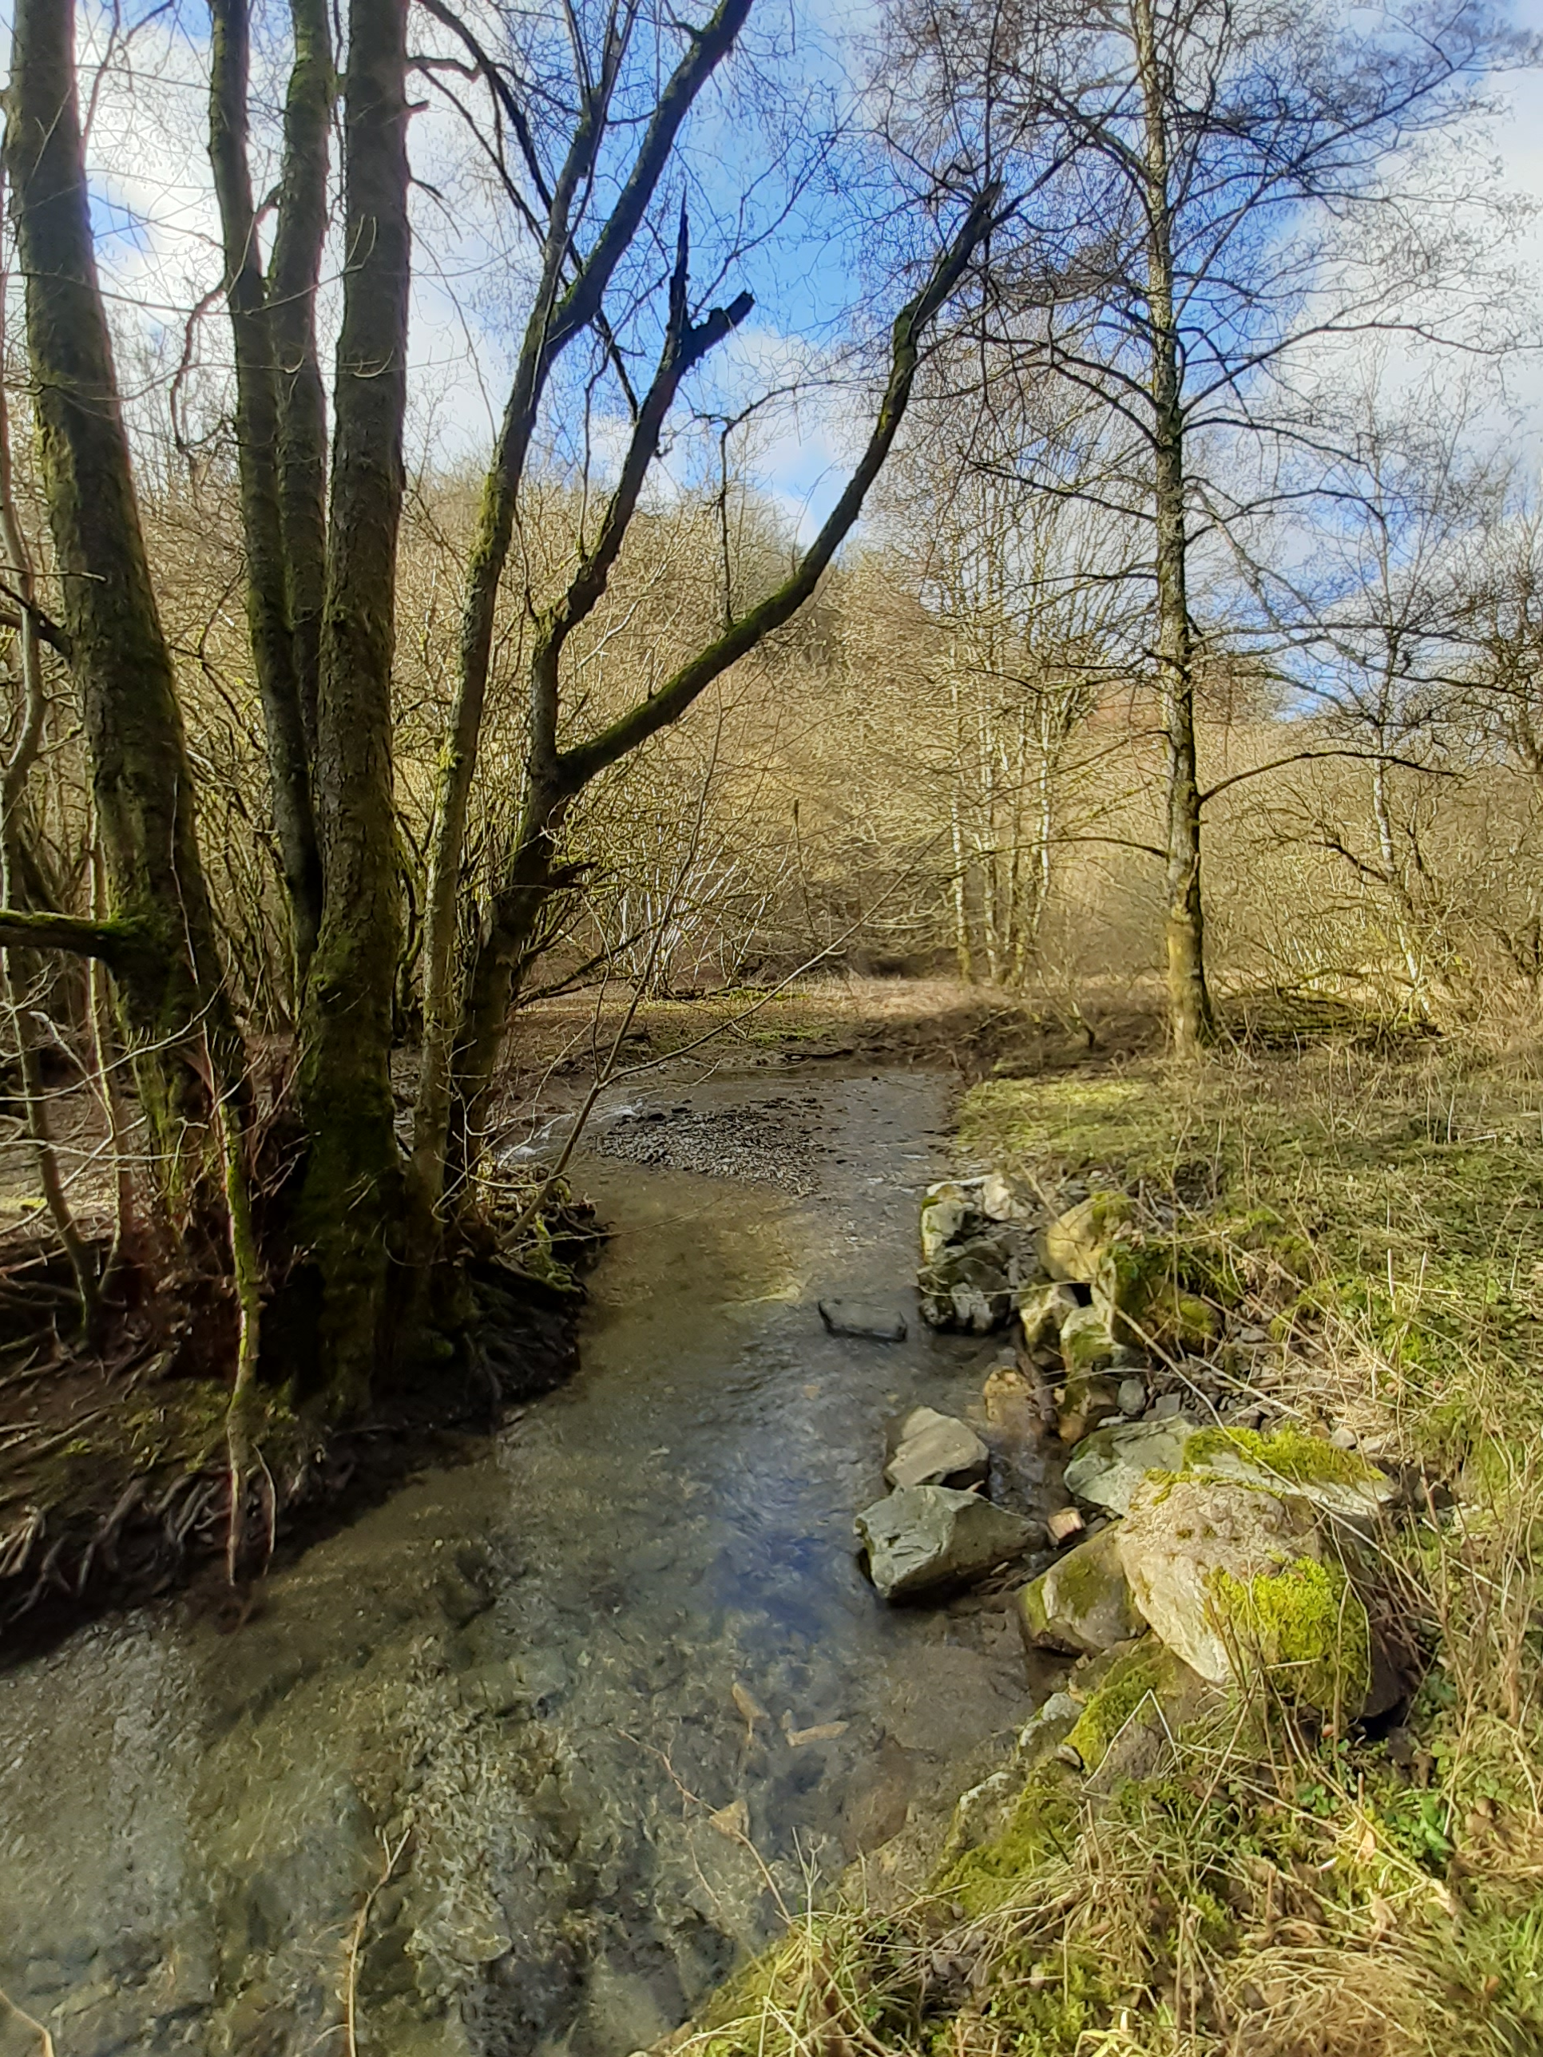
Next steps…
Map of free flowing river segments:
Analyse available data sets (biological data, HyMo mapping data,…)
Define criteria to define a priorization method (e.g. ecologically valuable areas, nature reserves,…)
Identification of river stretches to prioritize
Communication and Sensibilisation campaign on dam removal in 2024 for the WFMD

Slide 11
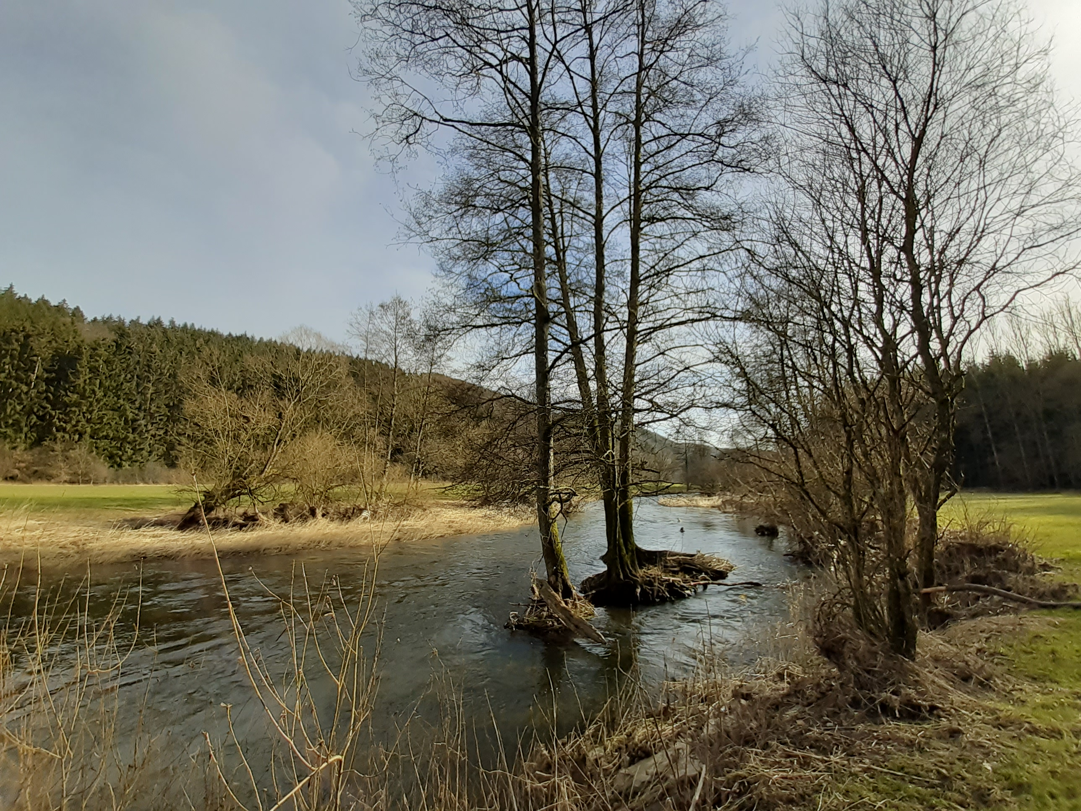
Thank you for you attention! Questions?

