Slide 1
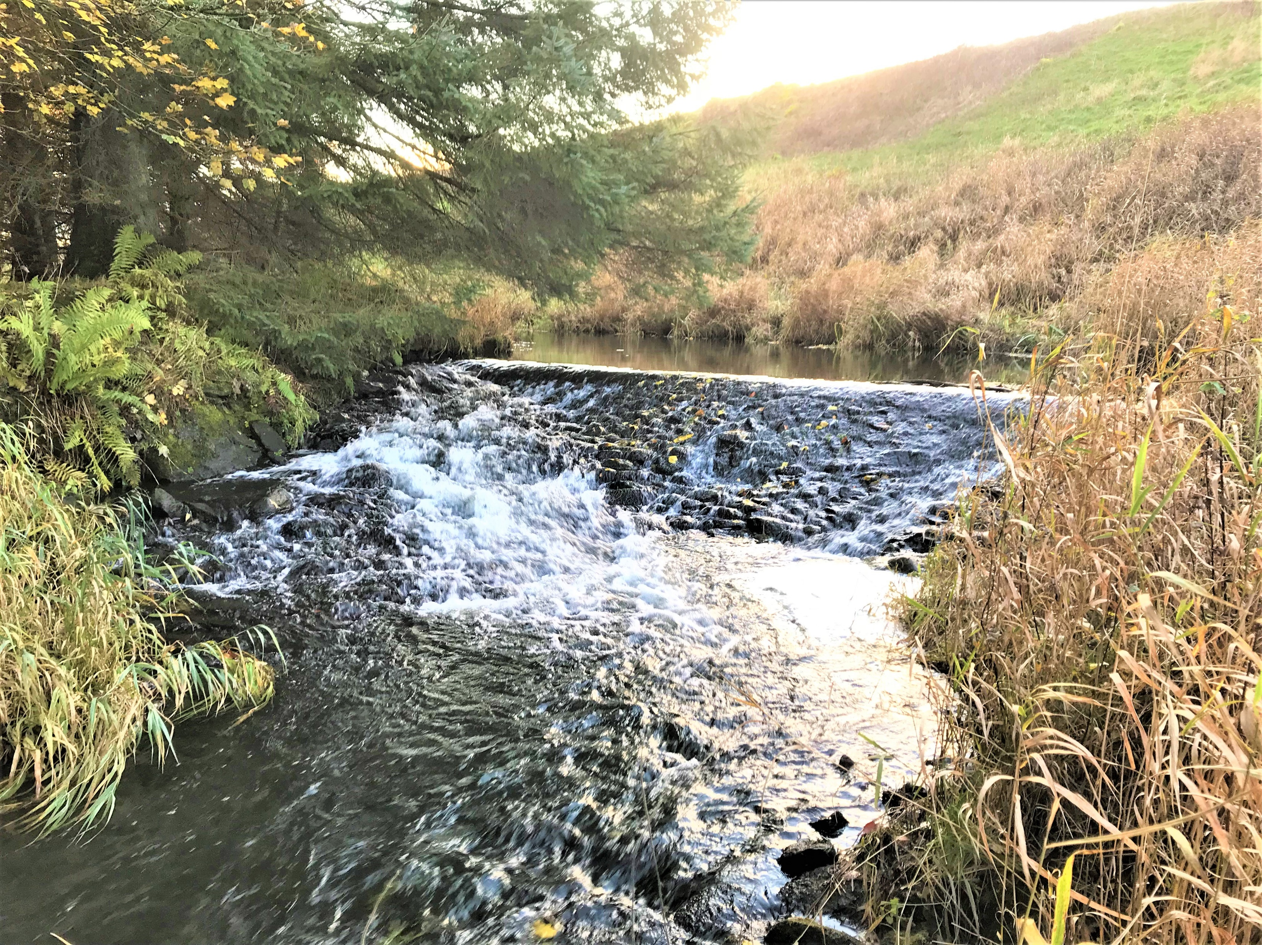
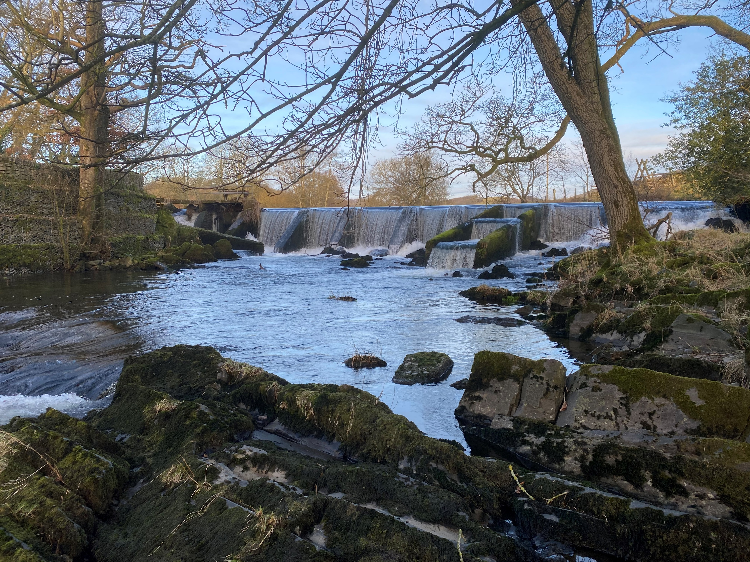
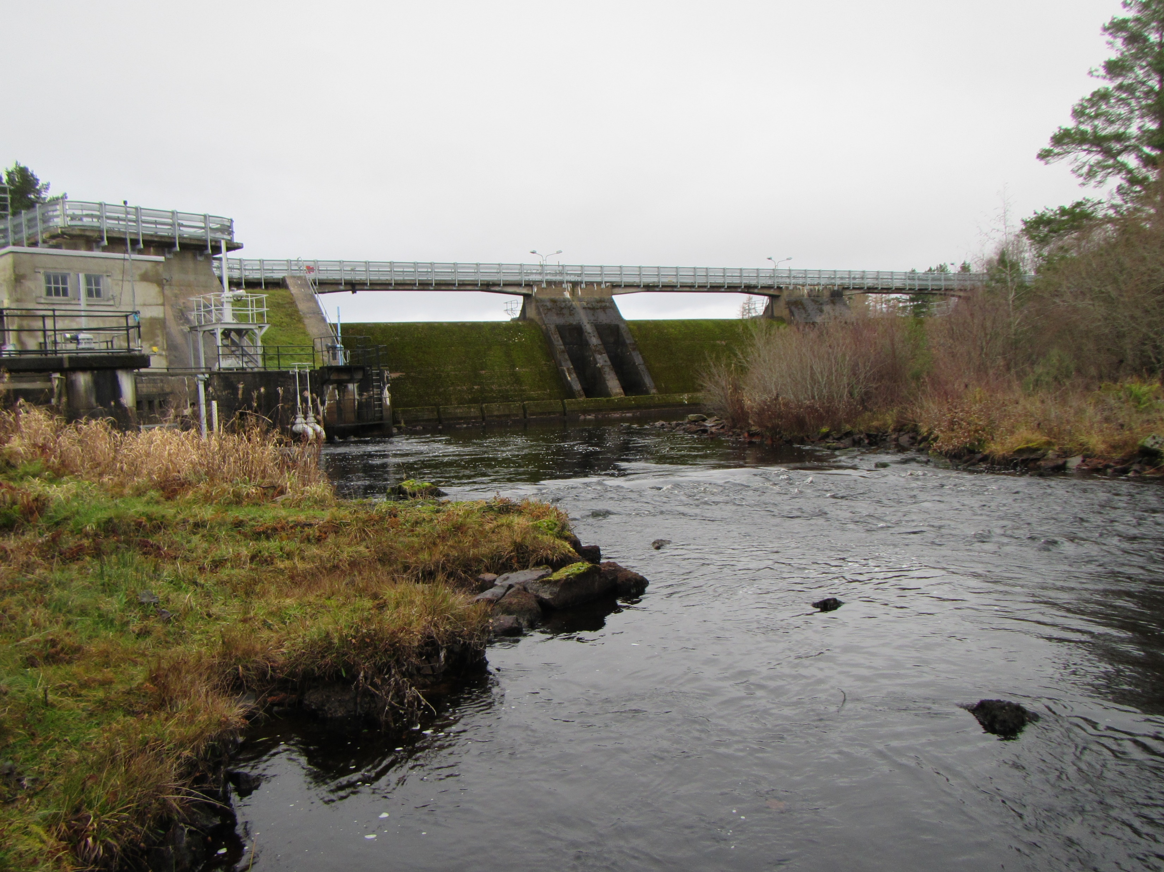
The sustainable ‘nature-based’ management of sediment at dam structures: design and implementation case studies from Scotland, England and Iceland.
‘designing with nature’
Dr. Hamish Moir and Dr. Eric Gillies
cbec eco-engineering UK Ltd
UK Dam Removal Conference| Manchester, England | 18-19 May 2023

Slide 2
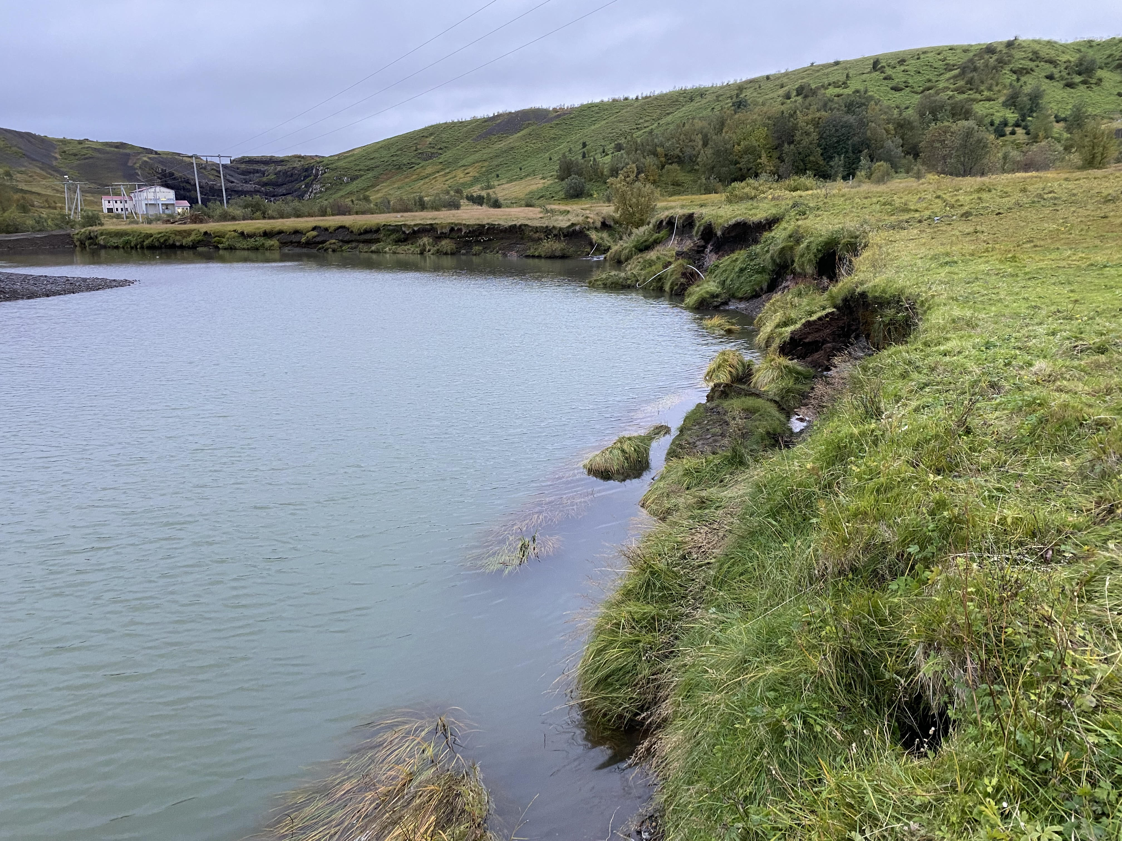
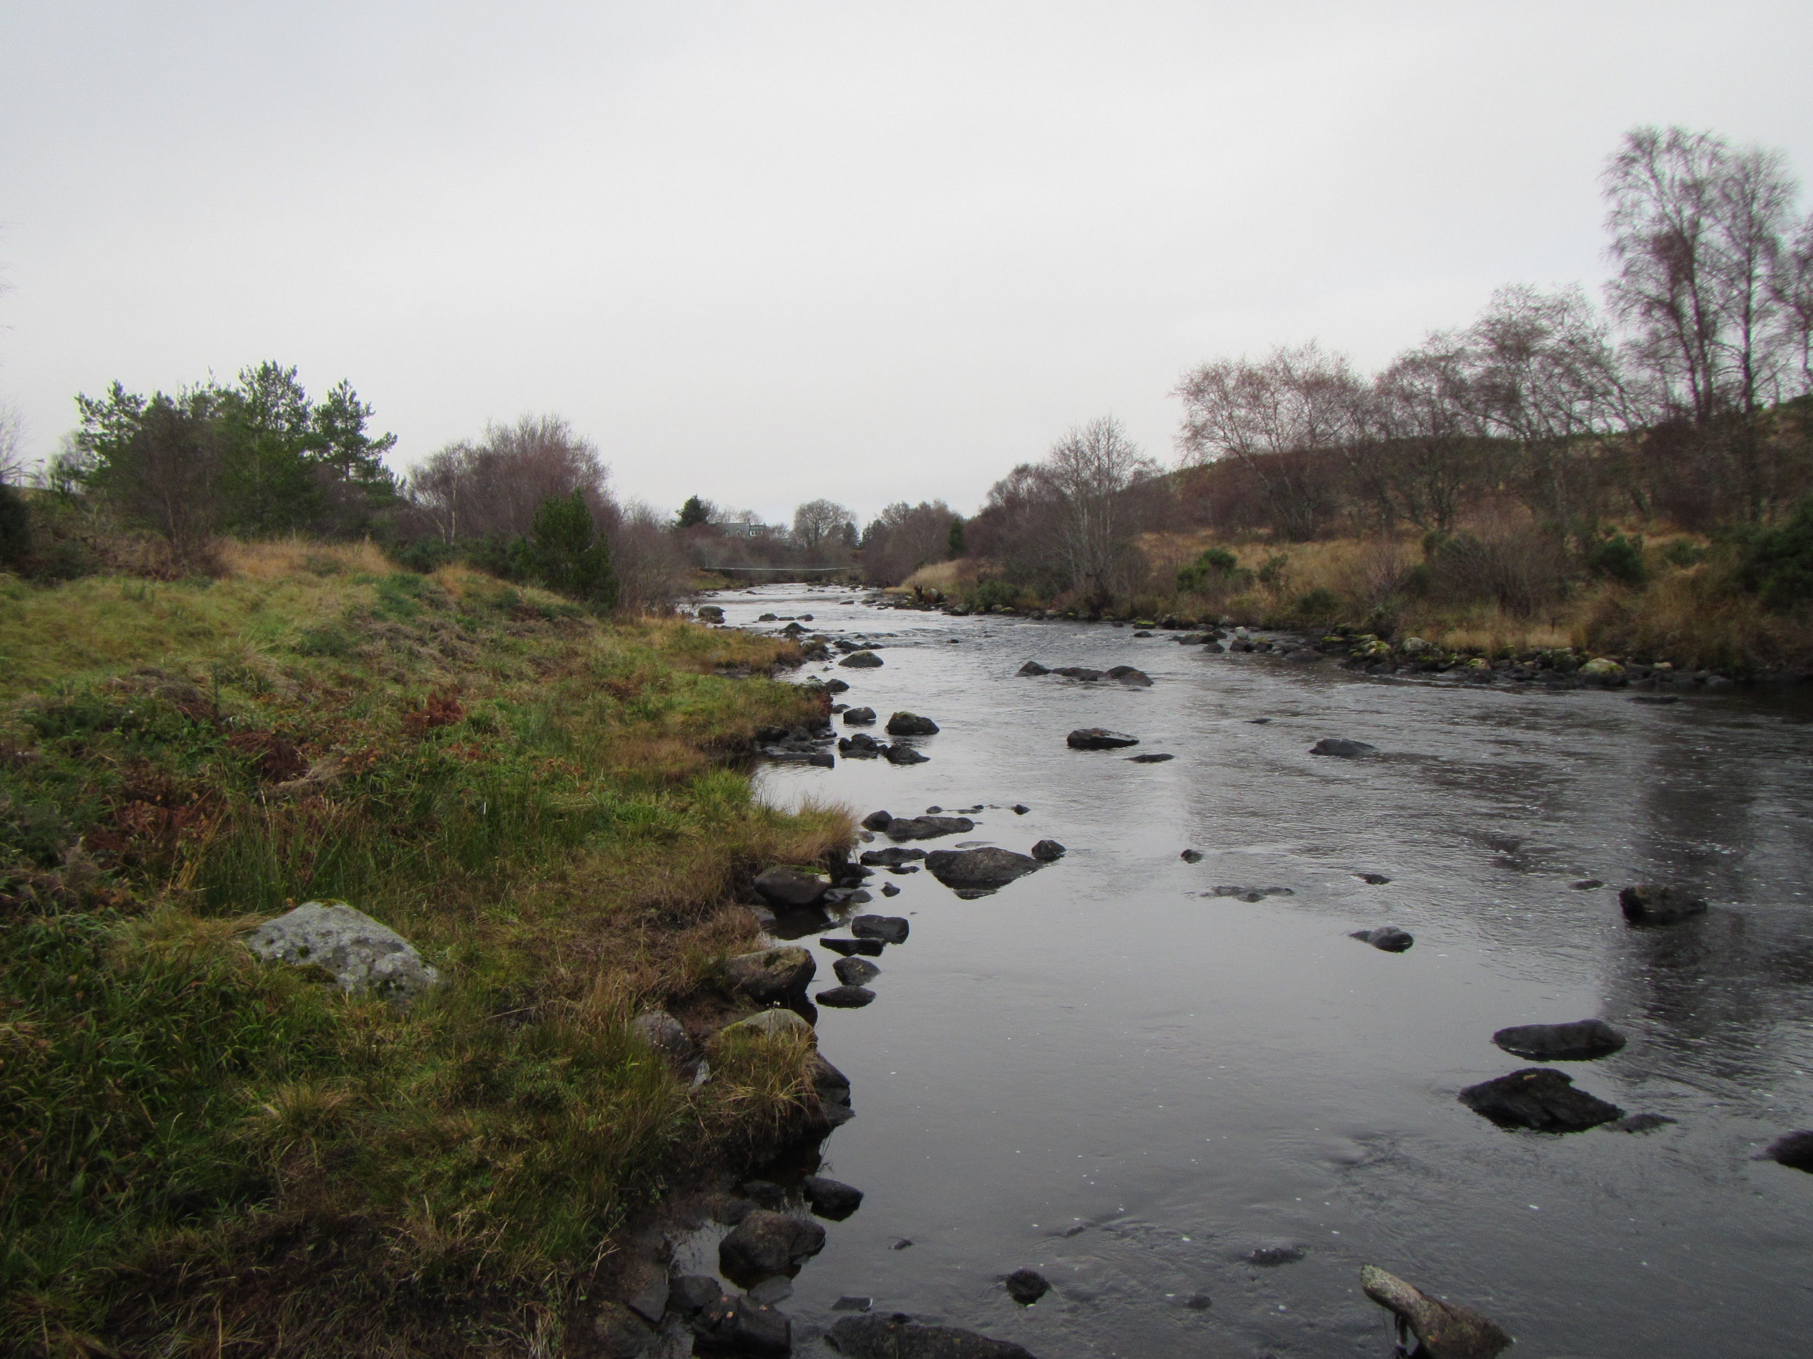
Sediment continuity in rivers
Geomorphic processes
channel stability
channel morphology
Biodiversity/ ecological condition
Flood risk
Infrastructure, services etc
DAM

Slide 3
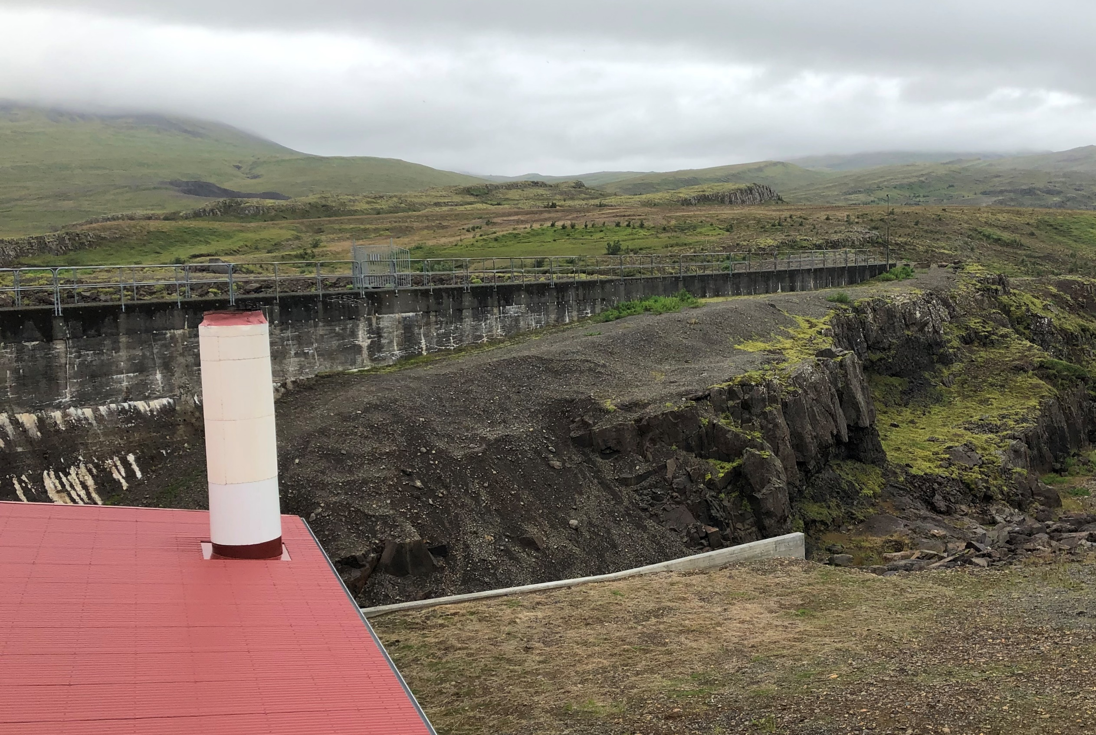
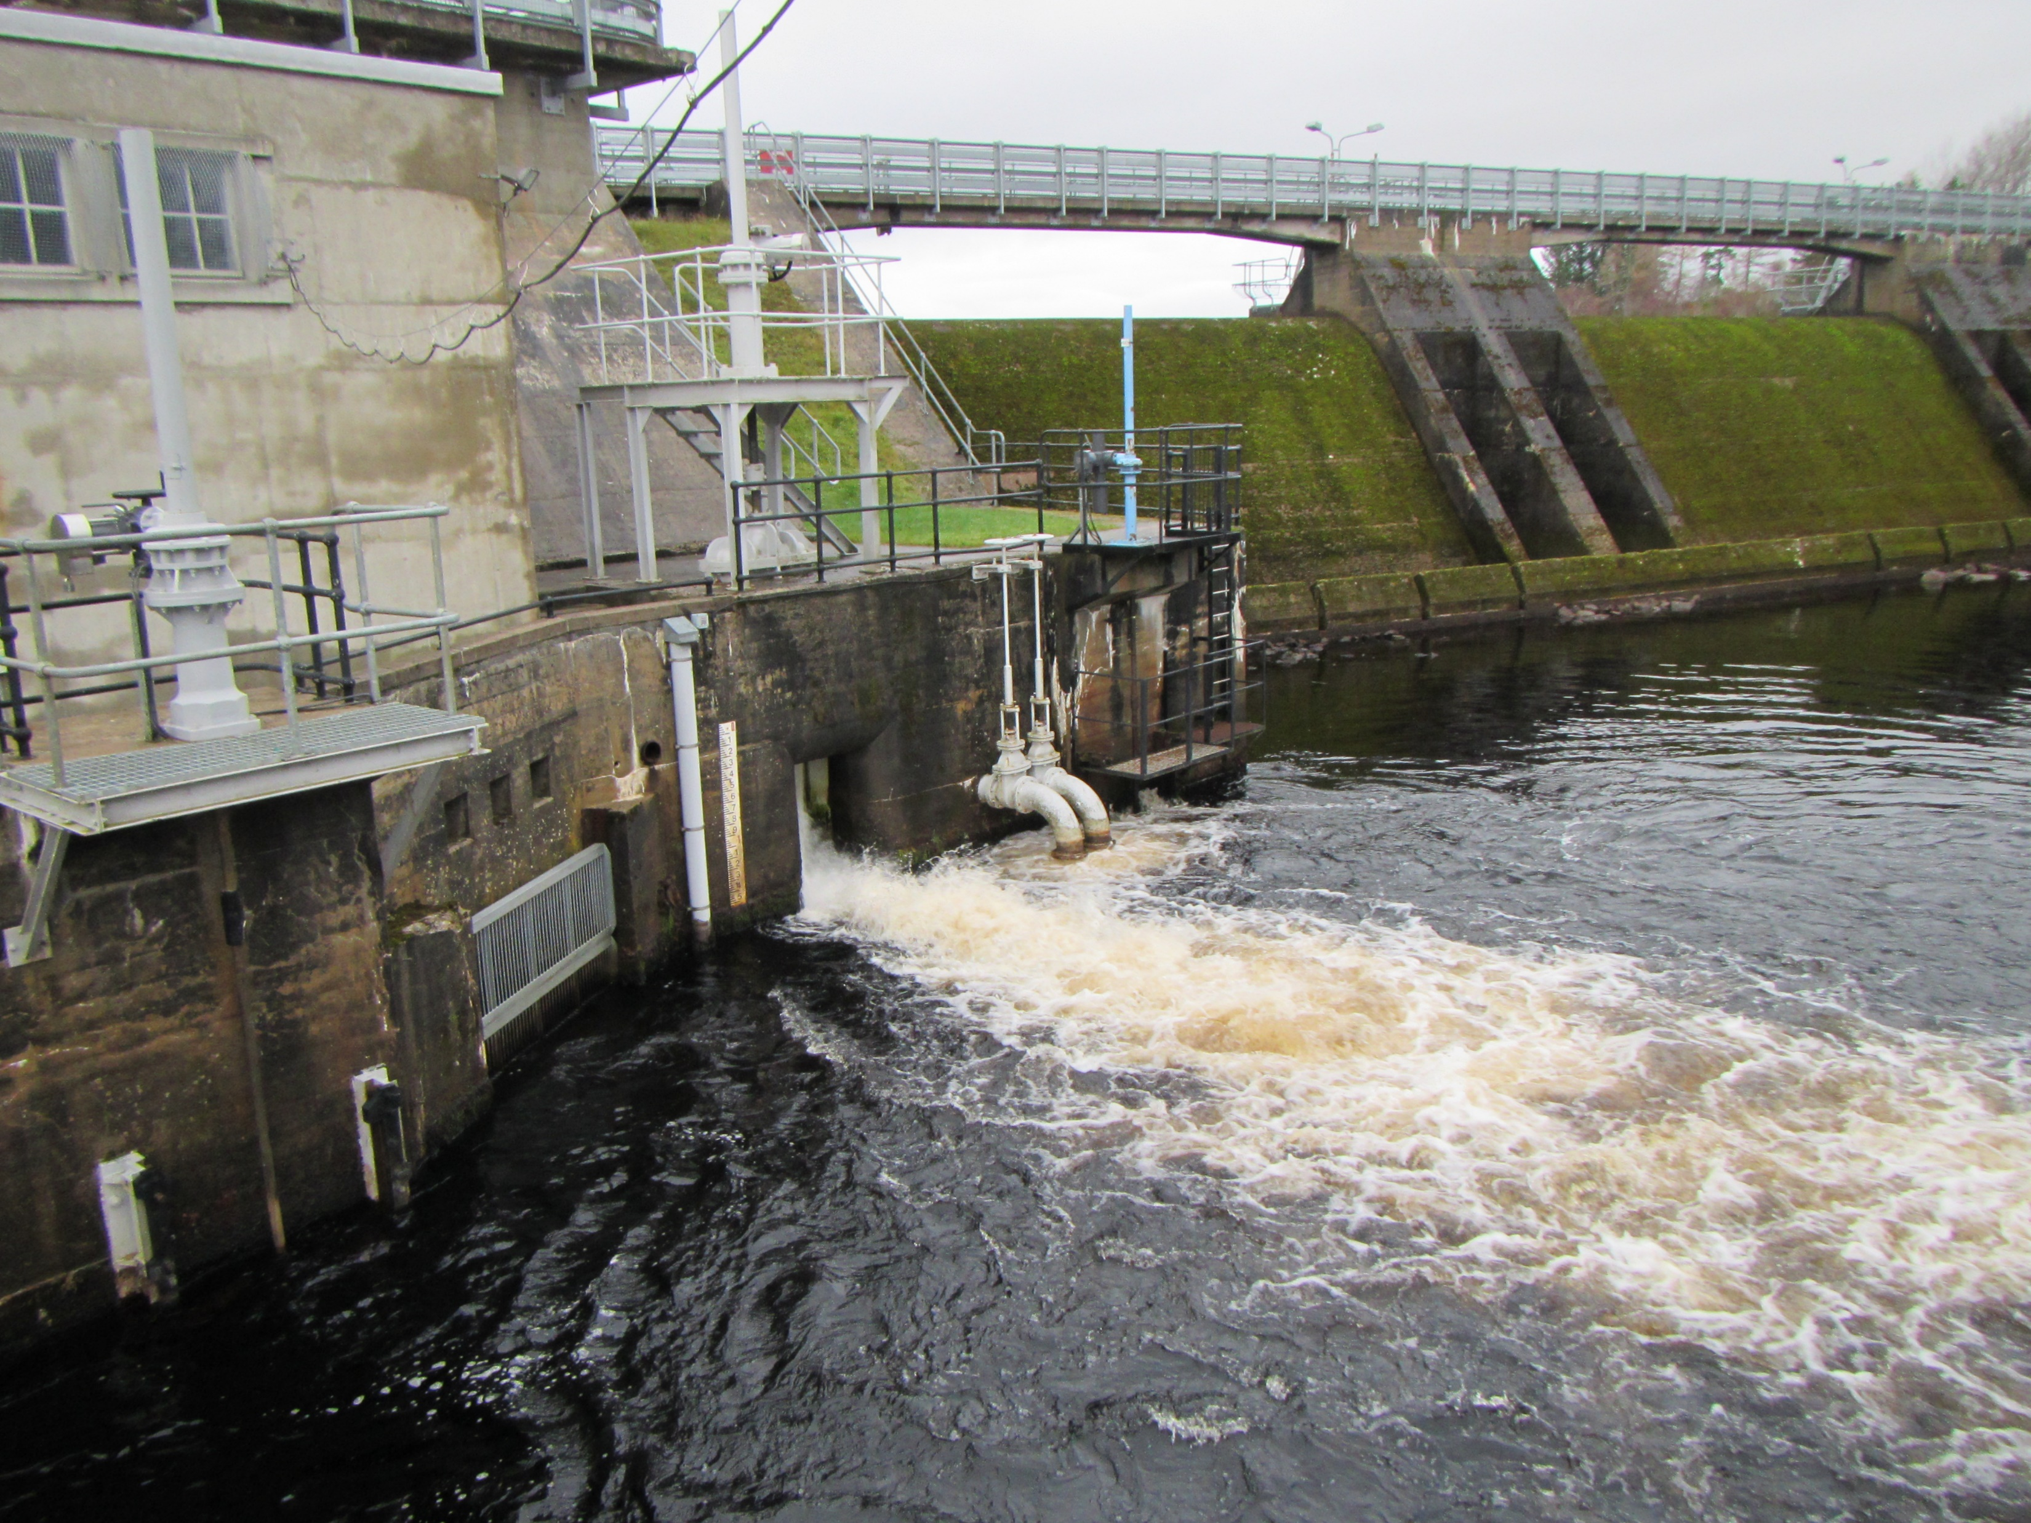
Different size structures, different approaches? (not just removal!)
CASE STUDIES:
Bronie Burn – full removal
Bowston Weir – partial removal (full removal but rock ramp replacement)
Andakílsá (Iceland) – retrofit of dam structure (sediment management)
River Shin – downstream habitat mitigation (sediment management)
Increasing size of structure/ decreasing degree of removal

Slide 4
Significant risk in dam/ weir management!
Bronie Burn – full removal
Bowston Weir – partial removal (full removal but rock ramp replacement)
Andakílsá (Iceland) – retrofit of dam structure (sediment management)
River Shin – downstream habitat mitigation (sediment management)
COMMON THEME – RISK!
Managed through application of morphodynamic modelling

Slide 5
Bronie Burn – full removal
weir
morphodynamic modelling identified channel instability resulting from simple weir removal
channel reprofiling upstream and downstream necessary → significant additional biodiversity benefit

Slide 6
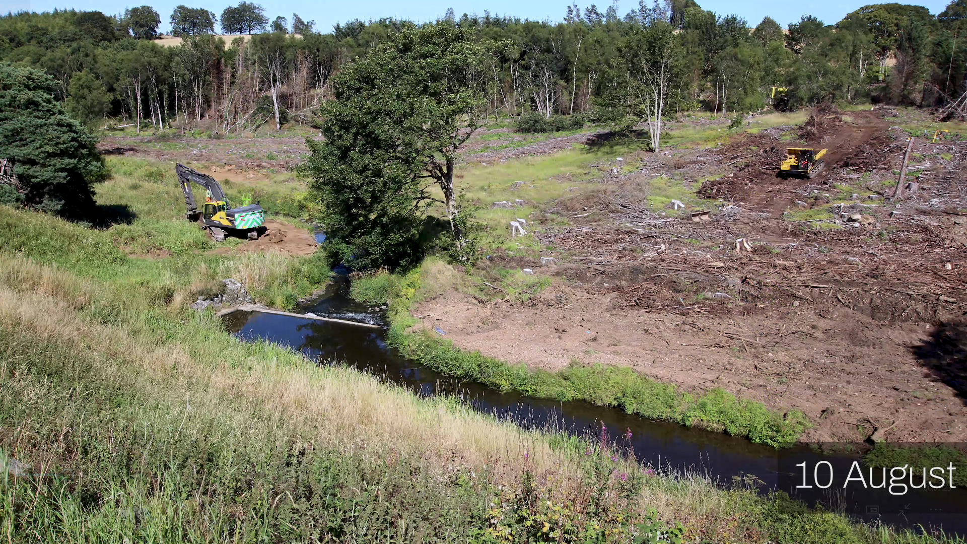
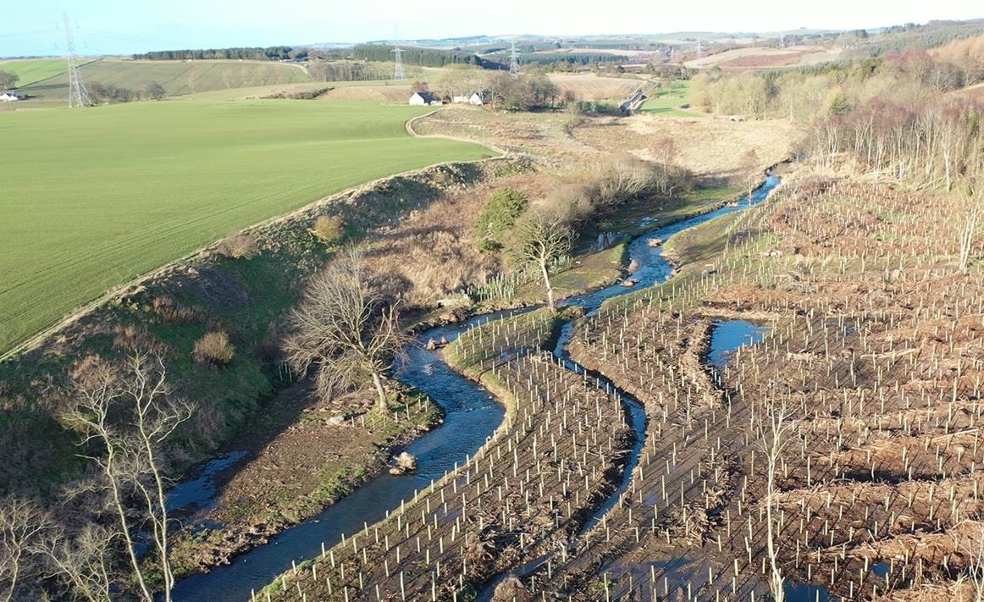
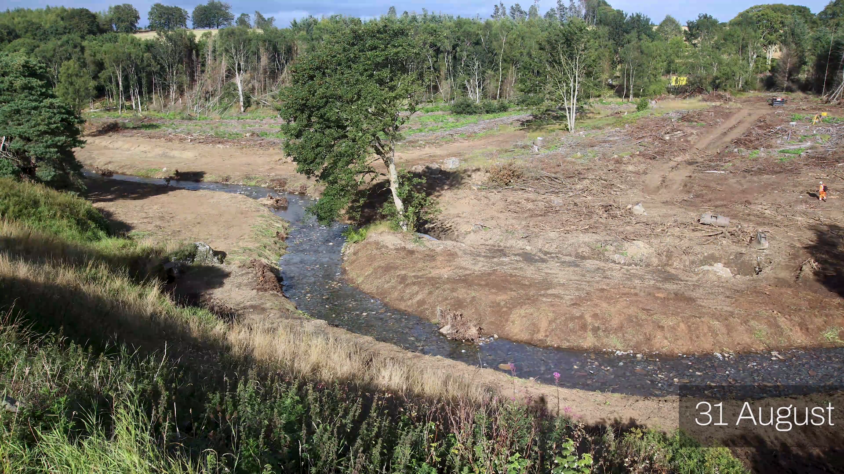
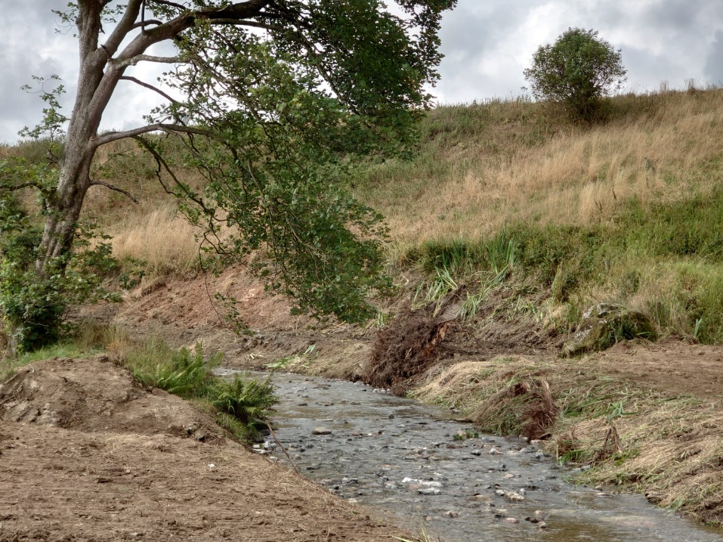
Bronie Burn – full removal

Slide 7
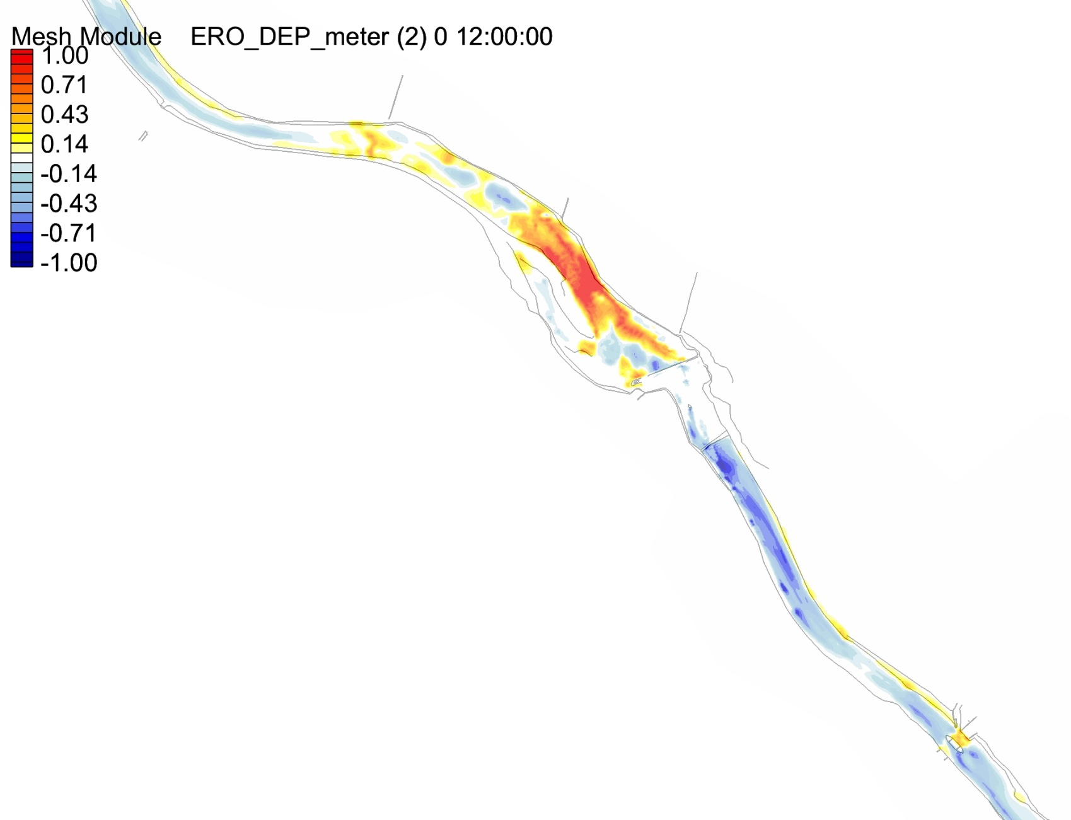
Bowston Weir – partial removal/ rock ramp
Application of ‘morphodynamic’ modelling of channel bed evolution as a result of the removal of large weir structure and rock ramp replacement.
POWERFUL DESIGN/ RISK MANAGEMENT TOOL - IDENTIFIES ‘FATE’ OF STORED SEDIMENT.

Slide 8
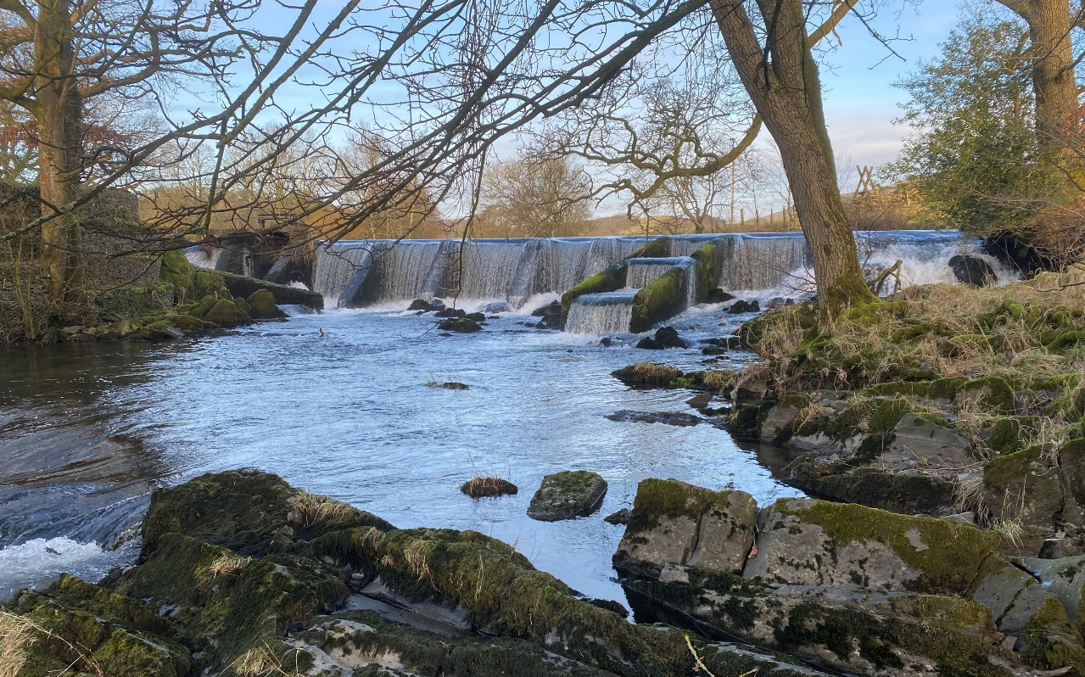
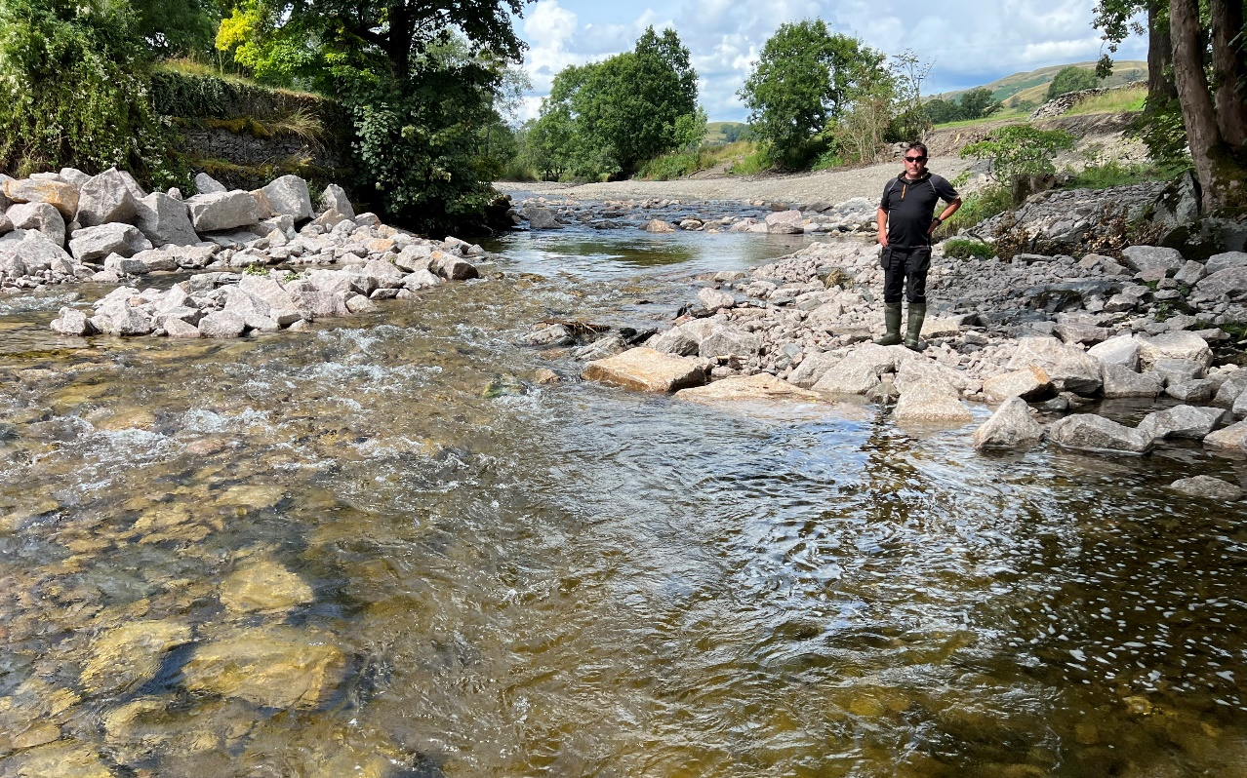
Bowston Weir – partial removal/ rock ramp

Slide 9
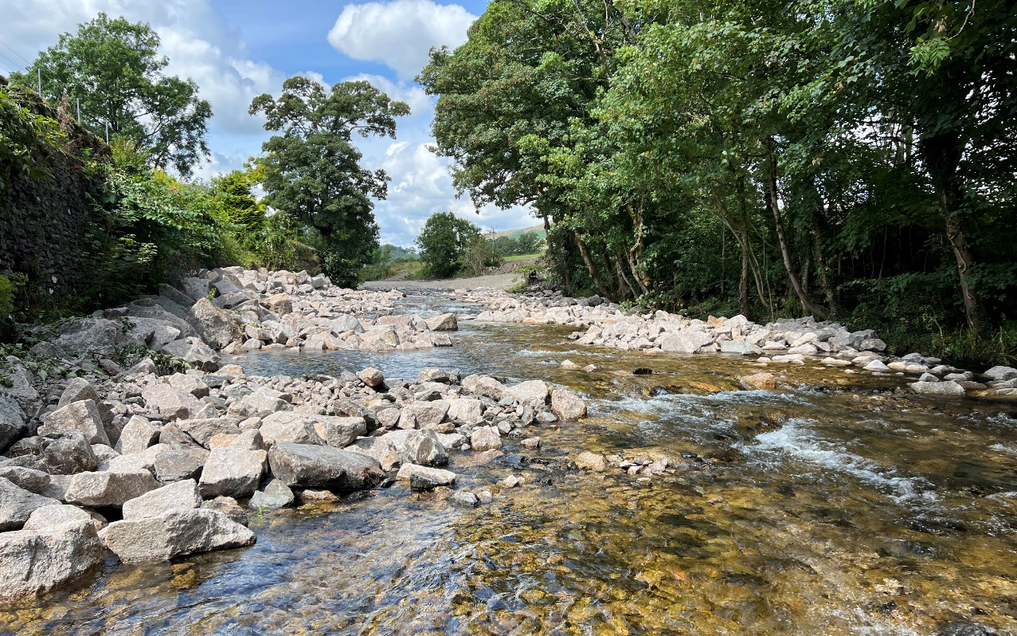
Bowston Weir – partial removal/ rock ramp

Slide 10
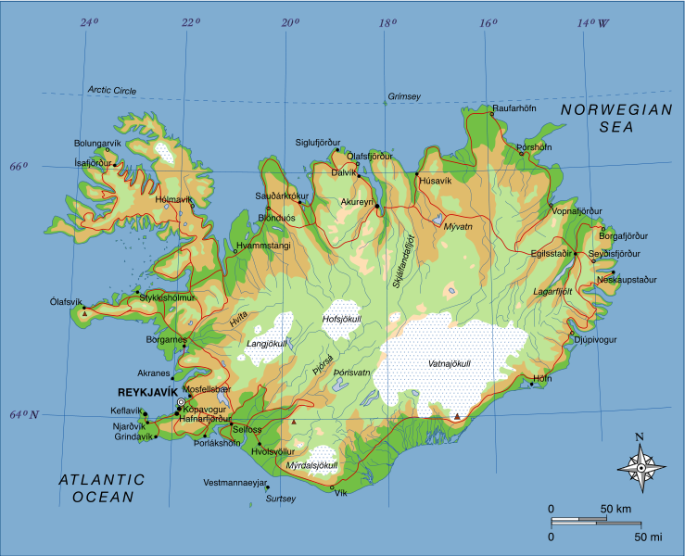
Andakílsá – sediment management/ ‘dam retrofit’
FLOW
HP RESERVOIR
HP INTAKE
HP INTAKE
Álfsteinsá
Hornsíki
Hornsá
Kaldá
SKORRADALSVATN

Slide 11
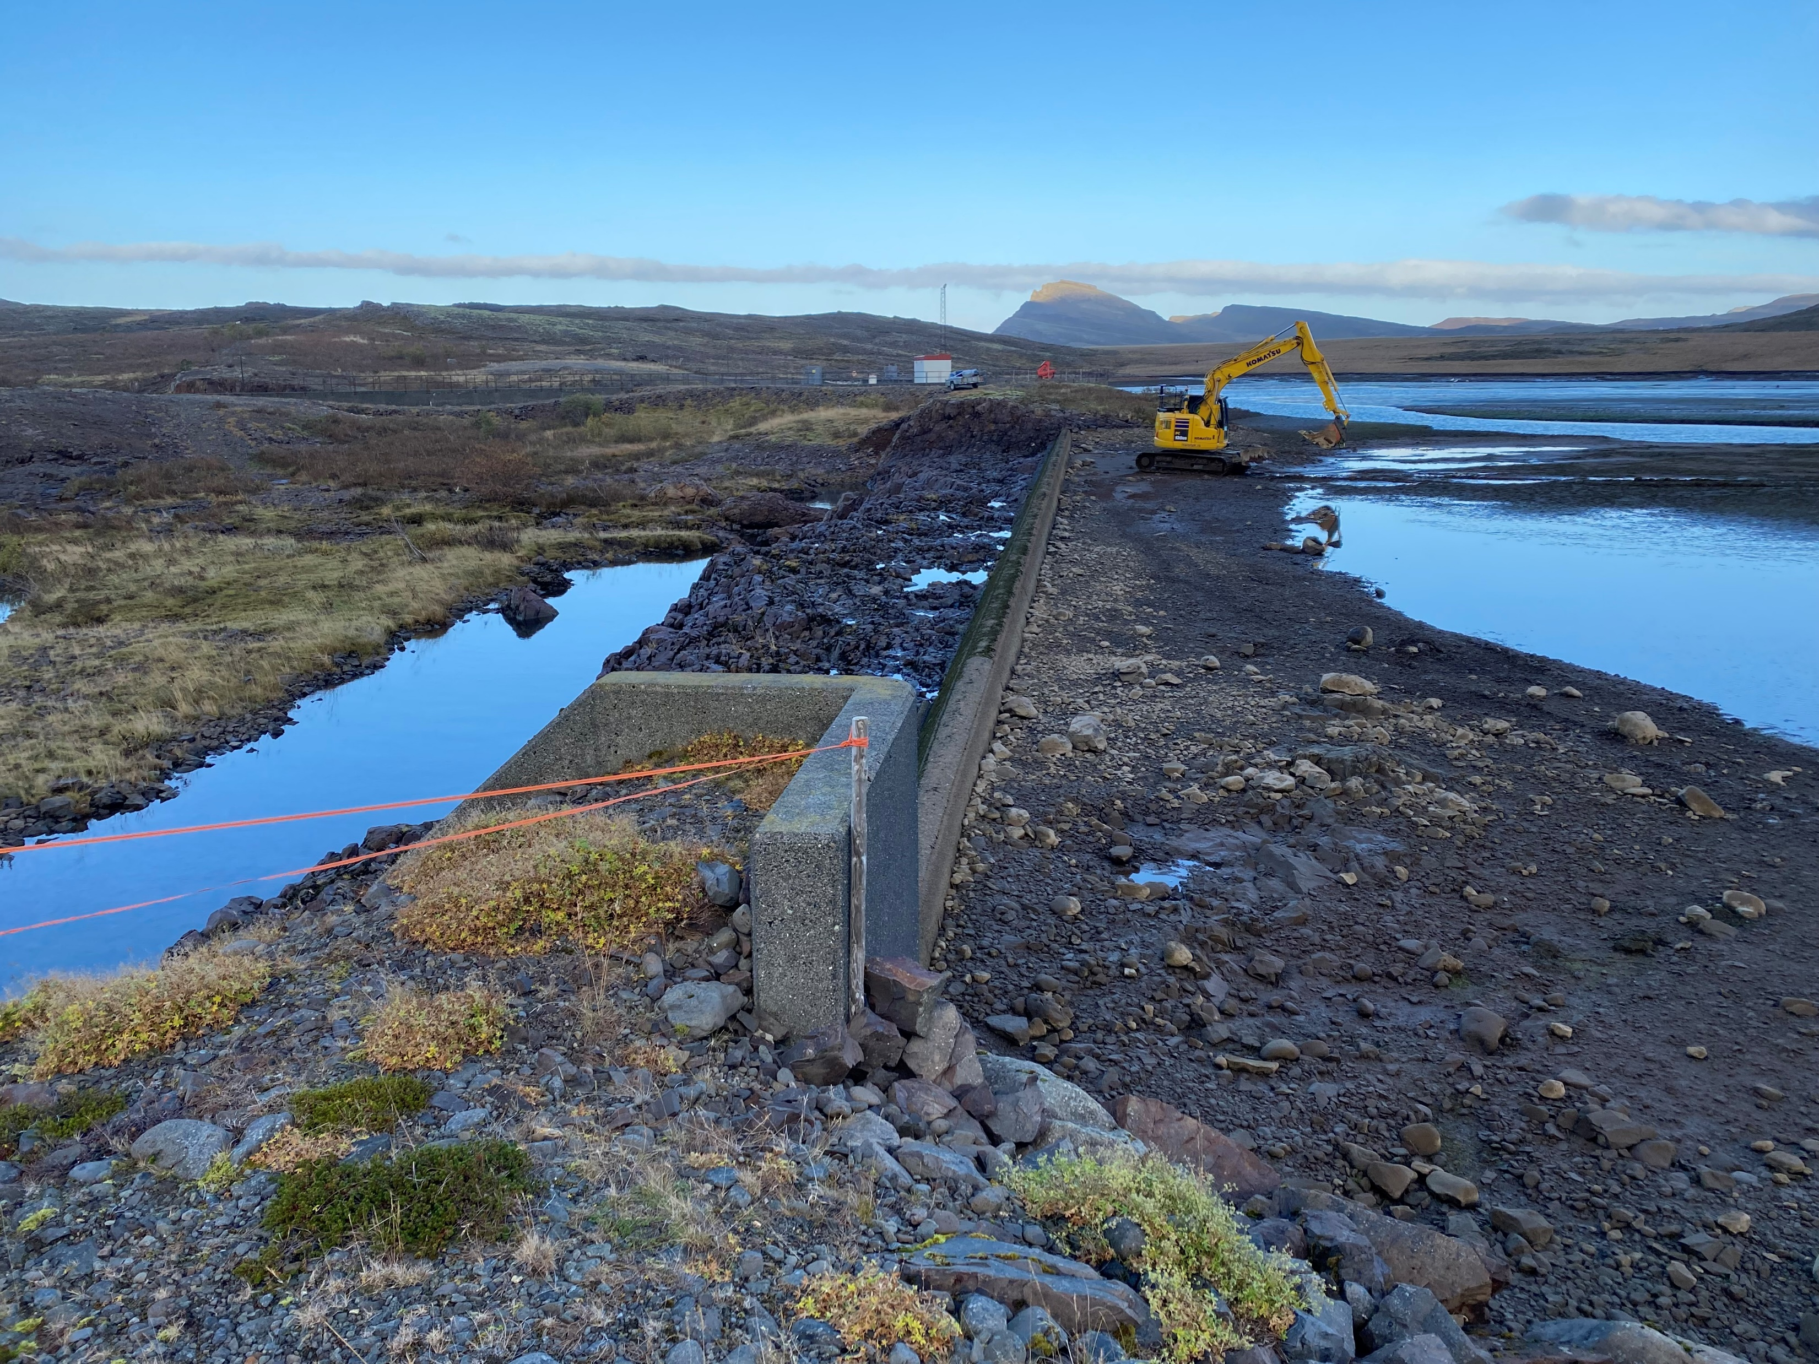
Andakílsá – sediment management/ ‘dam retrofit’
Retrofit spillway structure to permit natural transport of coarse sediment downstream.
Retrofit variable elevation invert at spillway crest
Main zone of sediment accumulation

Slide 12
Andakílsá – sediment management/ ‘dam retrofit’
Retrofit spillway structure to permit natural transport of coarse sediment downstream.
Lower spillway crest elevation during sufficiently high flow events
→ increased water surface slope/ energy gradient
→ transport of coarse sediment over spillway crest and downstream
Retrofit variable elevation invert at spillway crest
Main zone of sediment accumulation

Slide 13
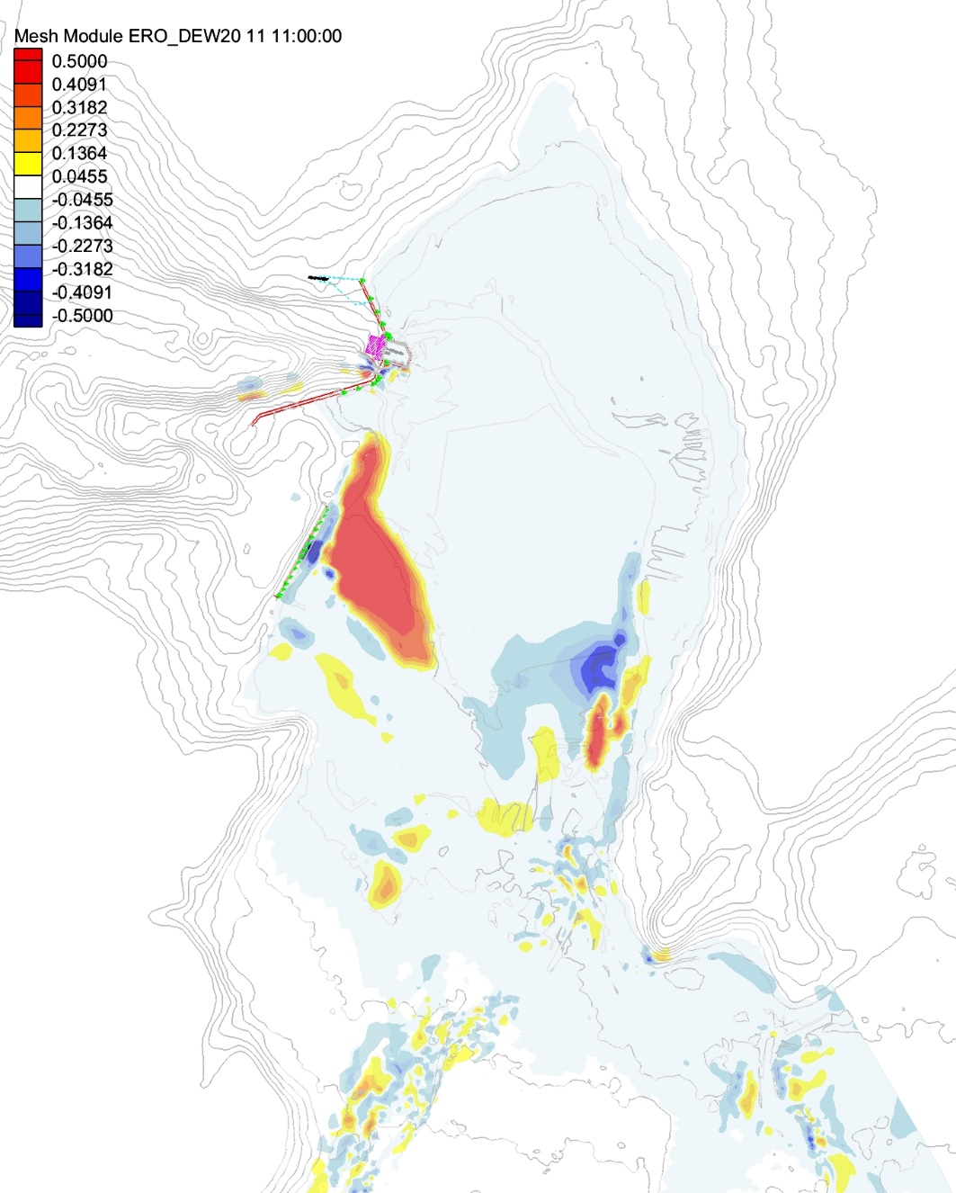
Andakilsa reservoir sediment transport modelling
Hypothetical design case (2 m variable head spillway crest):
Greatly increased transport of sediment over spillway, much reduced deposition in reservoir.
Stresses capable of transport of bedload over spillway → supply to downstream reach → channel equilibrium?
turbine offtake
spillway
Need to match this to requirements of downstream channel for equilibrium conditions

Slide 14
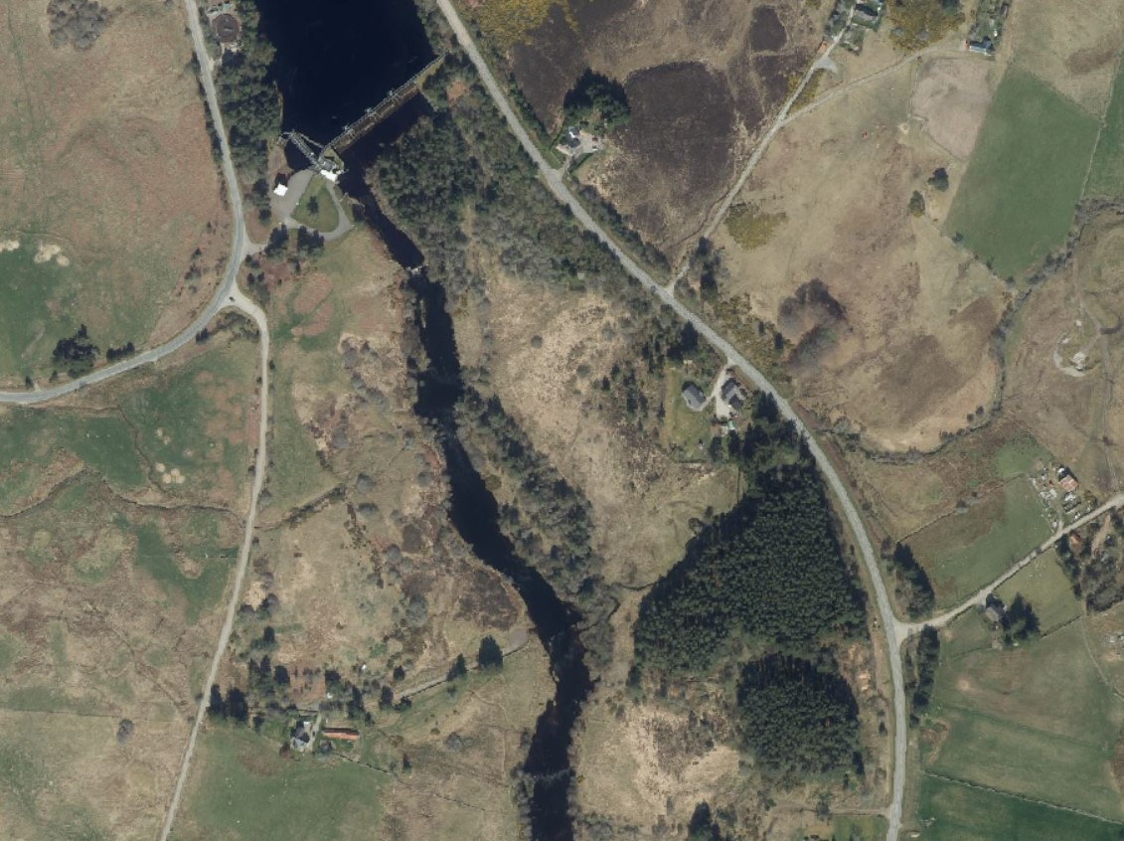
River Shin – habitat mitigation/ sediment management
Dam interrupting sediment transport
Project aimed to design for the reintroduction of this lost sediment, for benefit to instream ecology while considering practical constraints.
Morphodynamic model used to predict transport and depositional reaches, determine best locations for sediment augmentation.

Slide 15
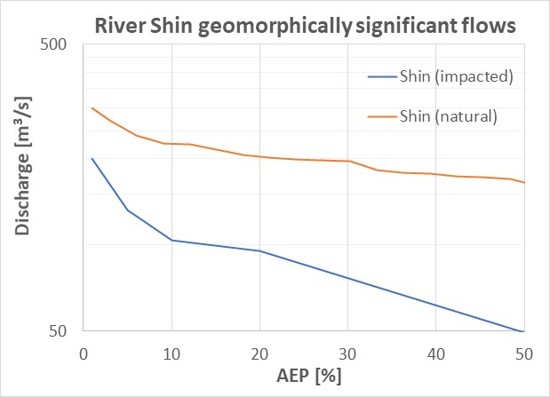
River Shin – habitat mitigation/ sediment management
50% AEP or 2-year event – natural ‘geomorphic flows’ start here…
Very little geomorphic work in modified river!
‘DIG AND DUMP’ APPROACH NOT APPROPRIATE – NEED TO PLACE SEDIMENTS IN ECOLOGICALLY APPROPRIATE LOCATIONS
~3% AEP (or 35-year) event for geomorphic flows due to modified hydrology

Slide 16
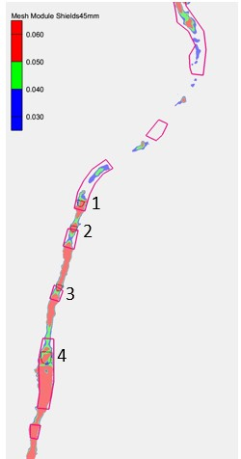
River Shin – habitat mitigation/ sediment management
Where should sediment be placed downstream of dam to improve habitat conditions?
2D morphodynamic modelling identifies areas appropriate for sediment augmentation
Regions identified by landowner suitable for sediment addition
2

Slide 17
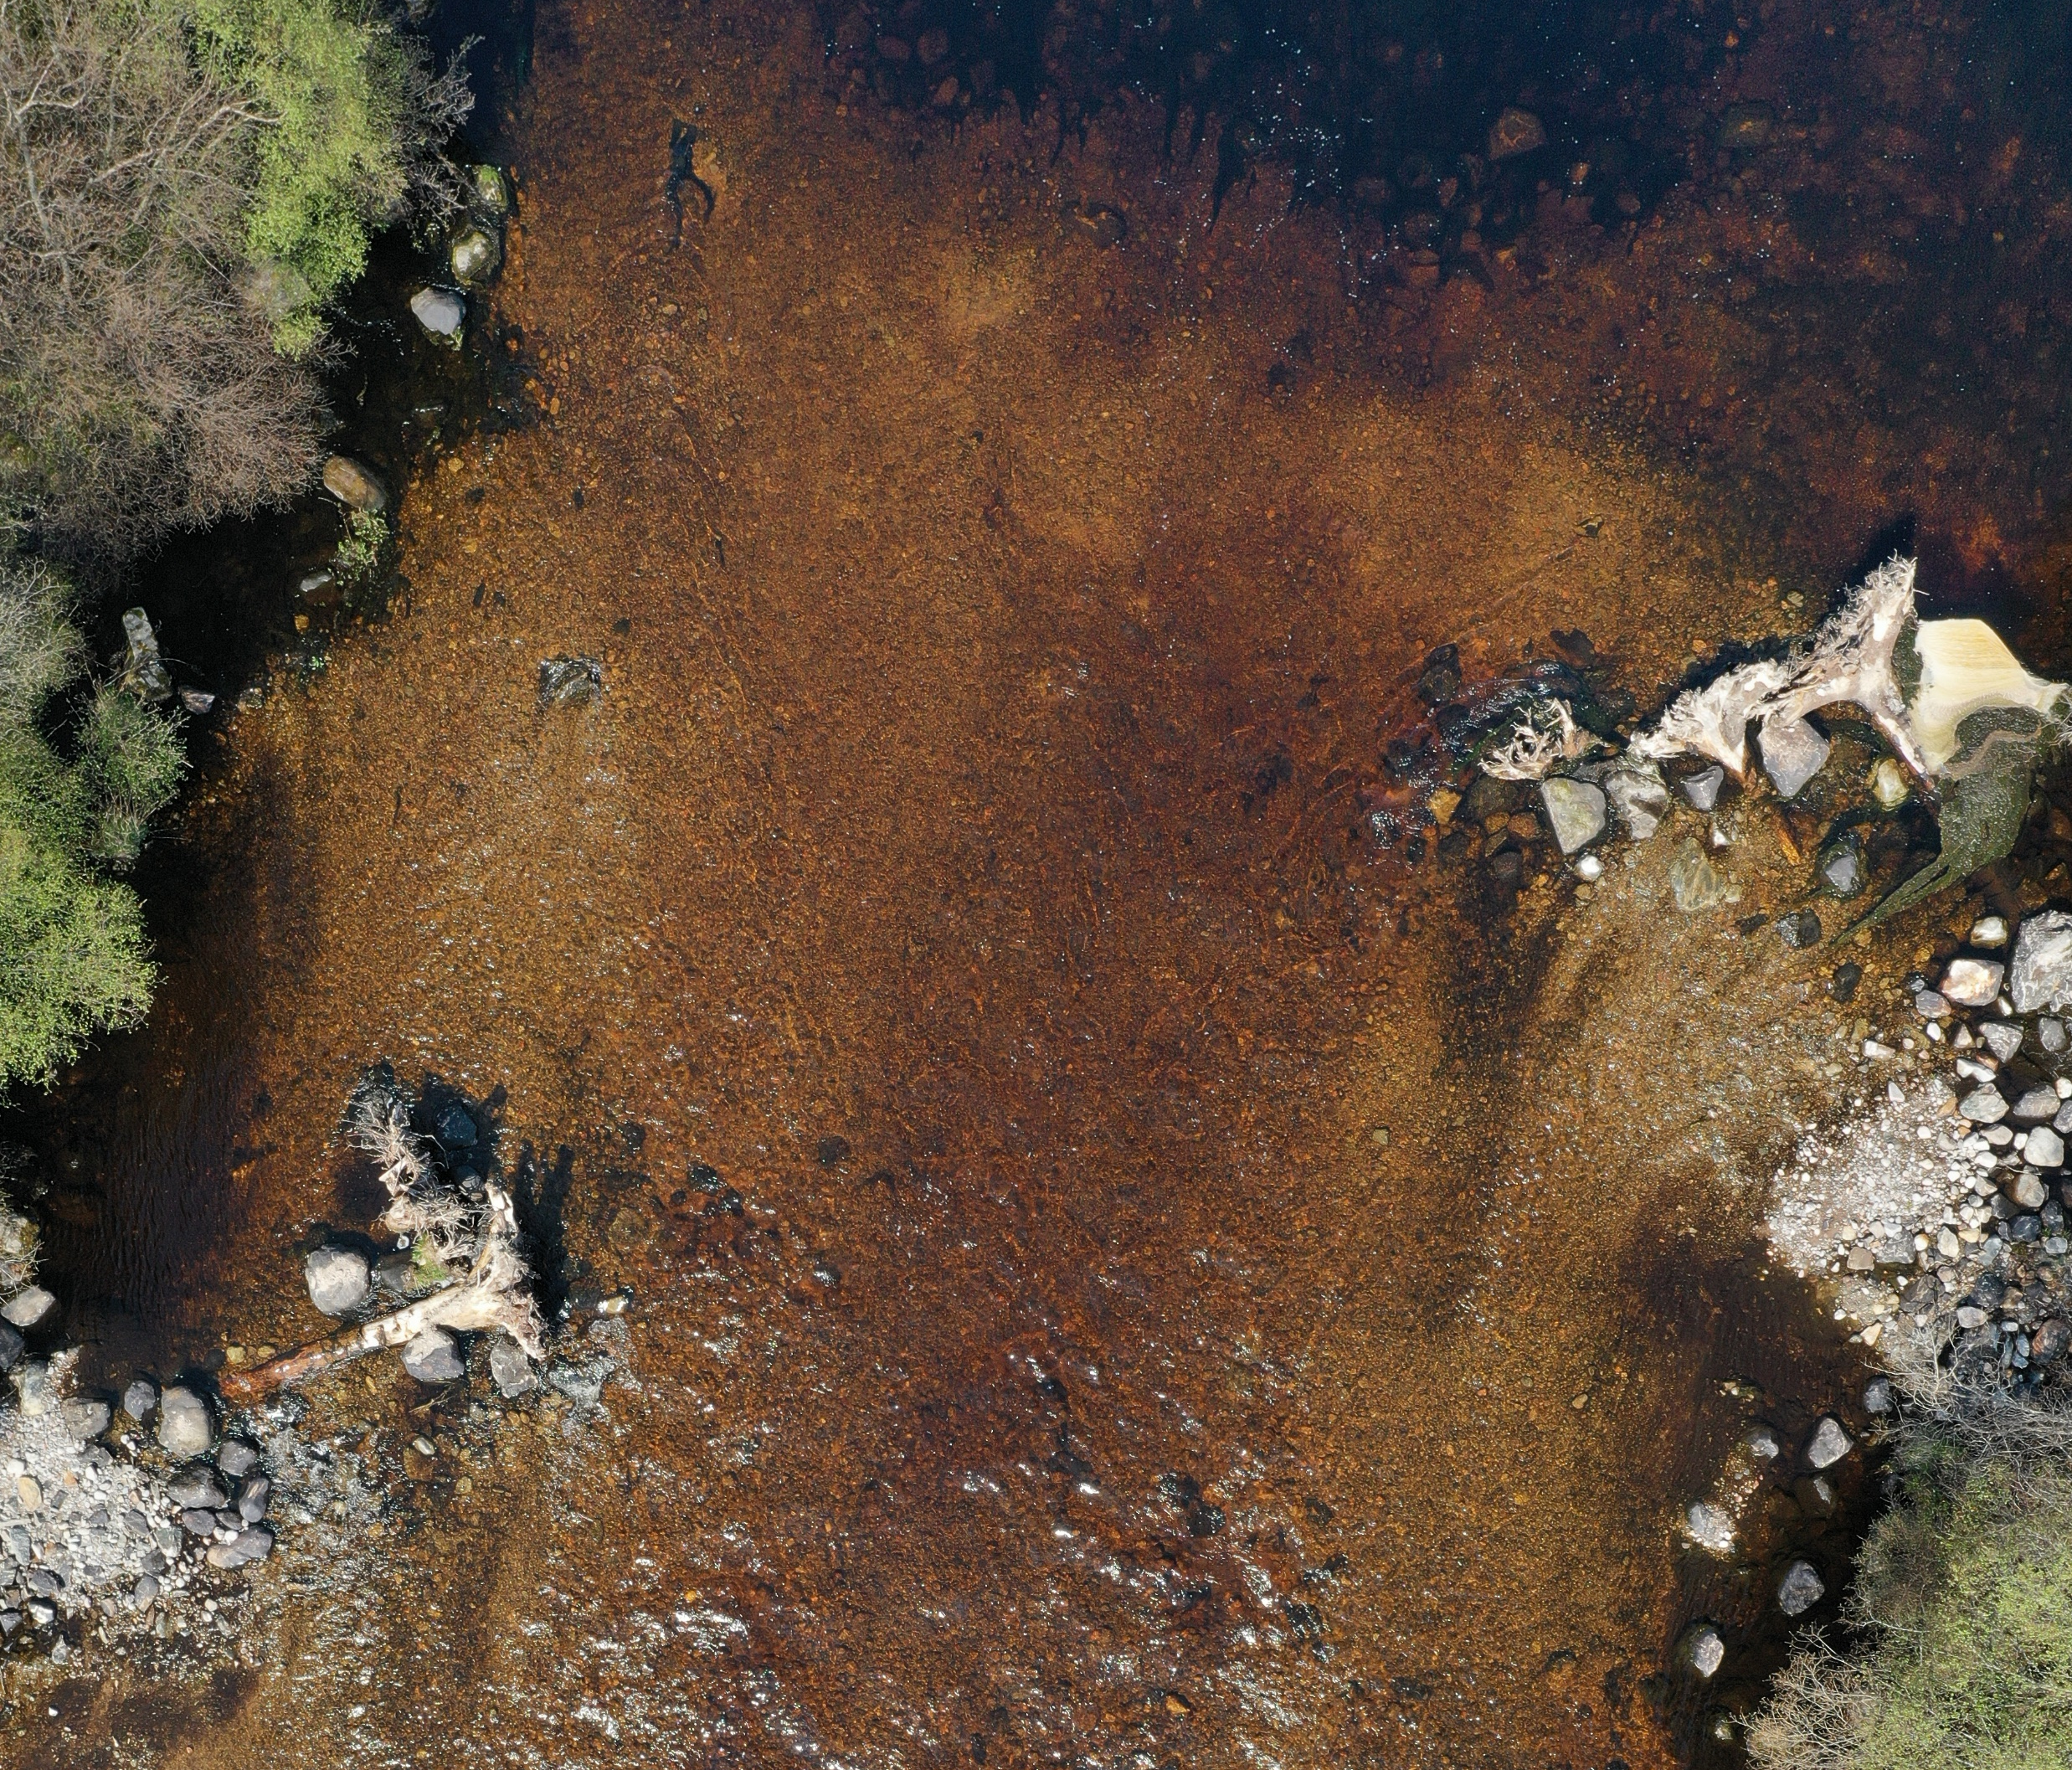
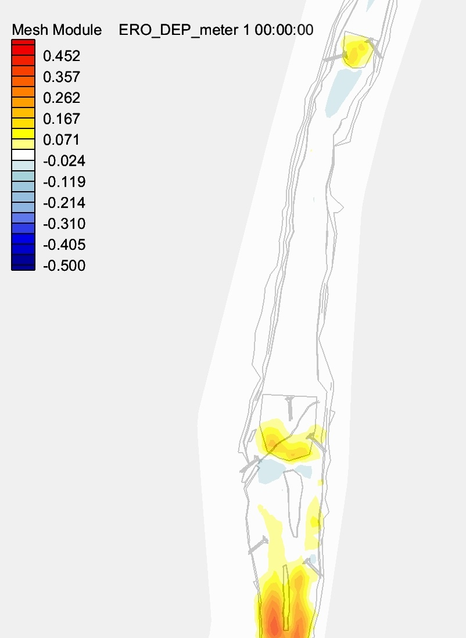
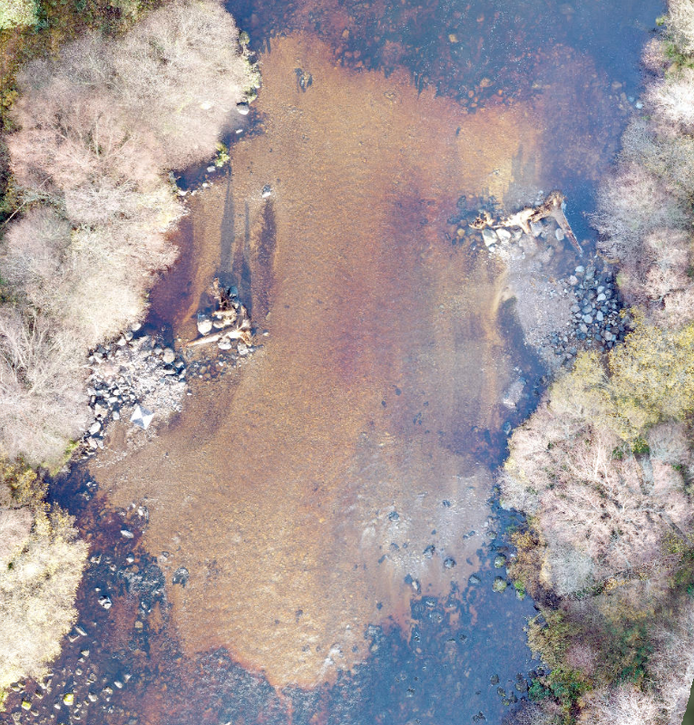
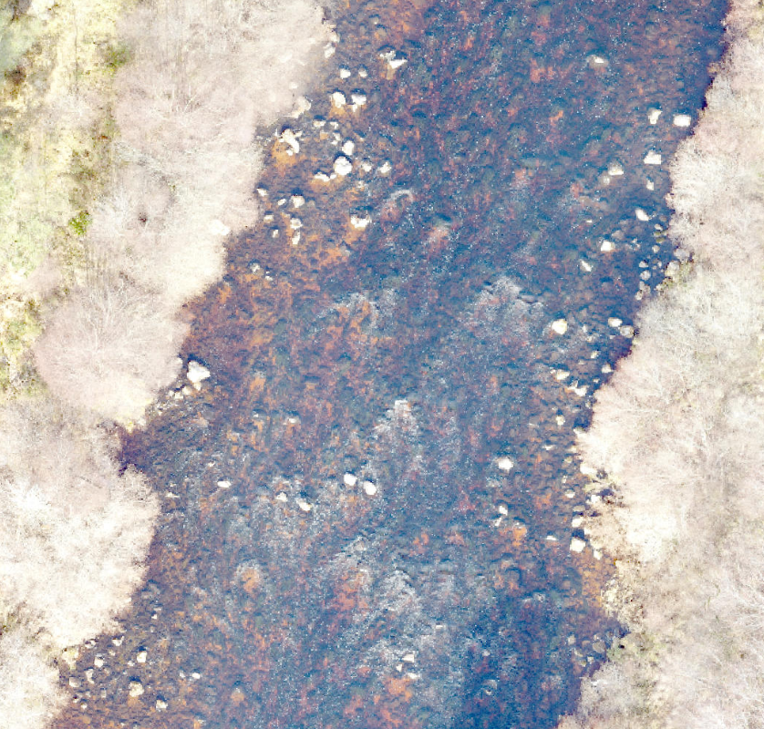
River Shin – habitat mitigation/ sediment management
3
SALMON REDDS
4

Slide 18
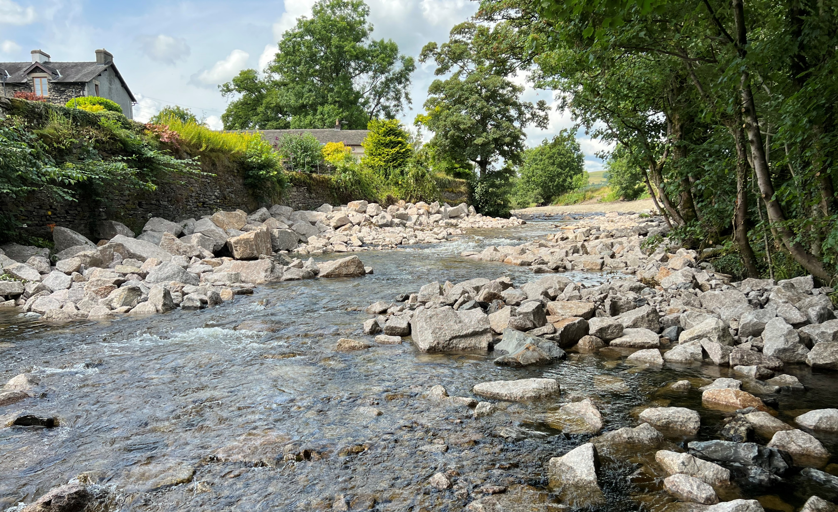
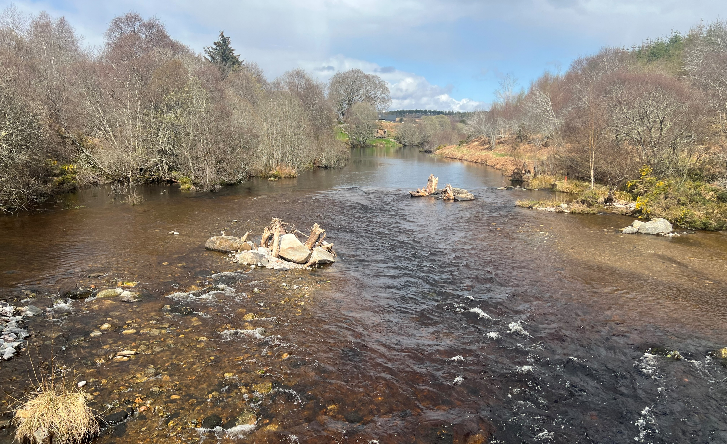
Different size structures, different approaches? (not just removal!)
Bronie Burn
Bowston Weir
Andakílsá, Iceland
River Shin
Increasing size of structure/ decreasing degree of removal
Greater benefit from full removal – long-term aspiration?

Slide 19
Thank-you for your attention!
cbec are hiring!
h.moir@cbecoeng.co.uk

