Slide 1
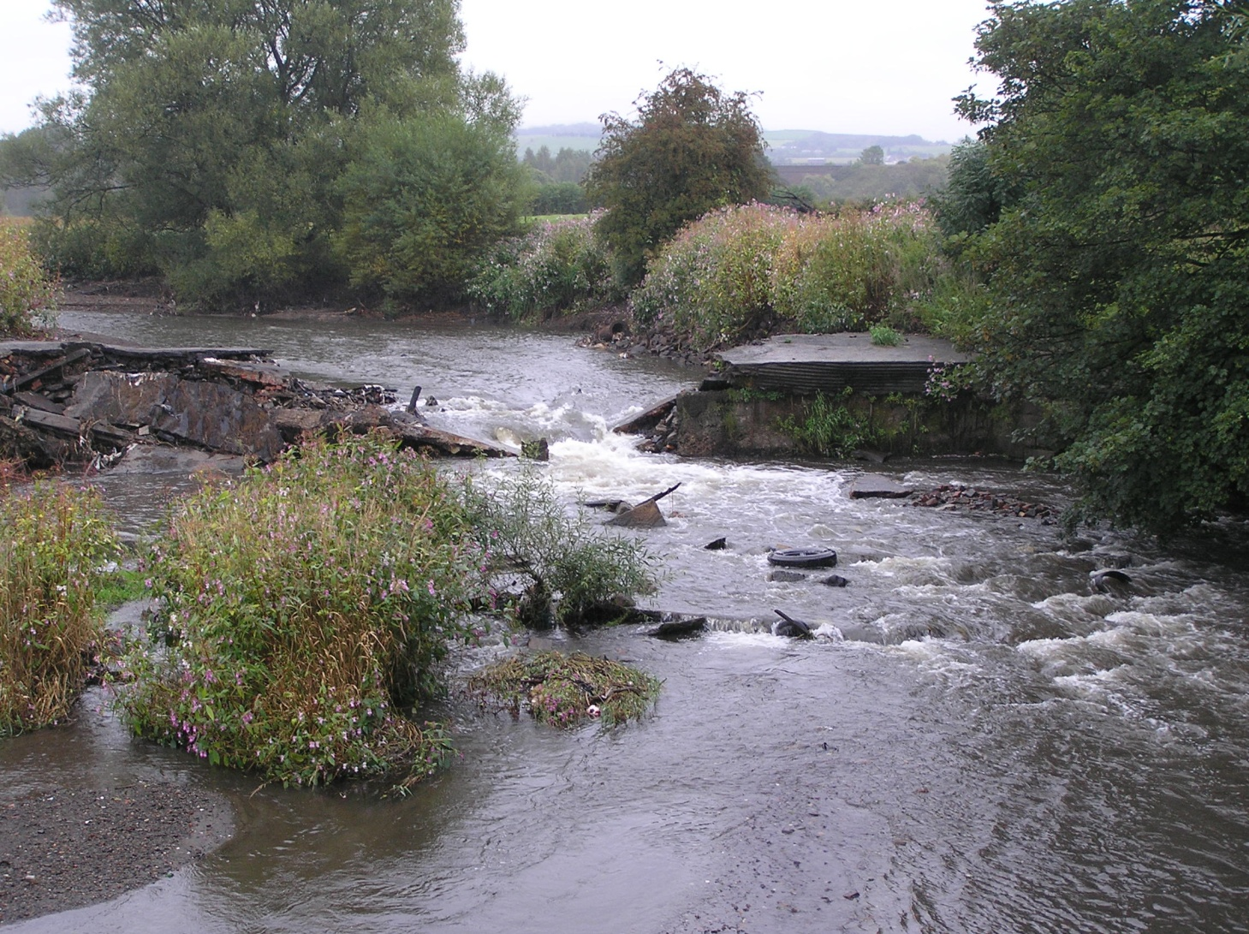
How does a weir removal compare to a weir collapse
Kevin Nash
Fisheries Biodiversity Geomorphology
GMMC
Notes:
I’ll be looking at two case studies:
Goshin Weir, removed and to be visited tomorrow
2. Rawtenstall weir, collapsed and not being visited.
This cuts to the question of risk, roles and responsibilities and Liability

Slide 2
Contents
Goshen, a managed removal
Rawtenstall, a collapsed weir
Risks
Outcomes

Slide 3
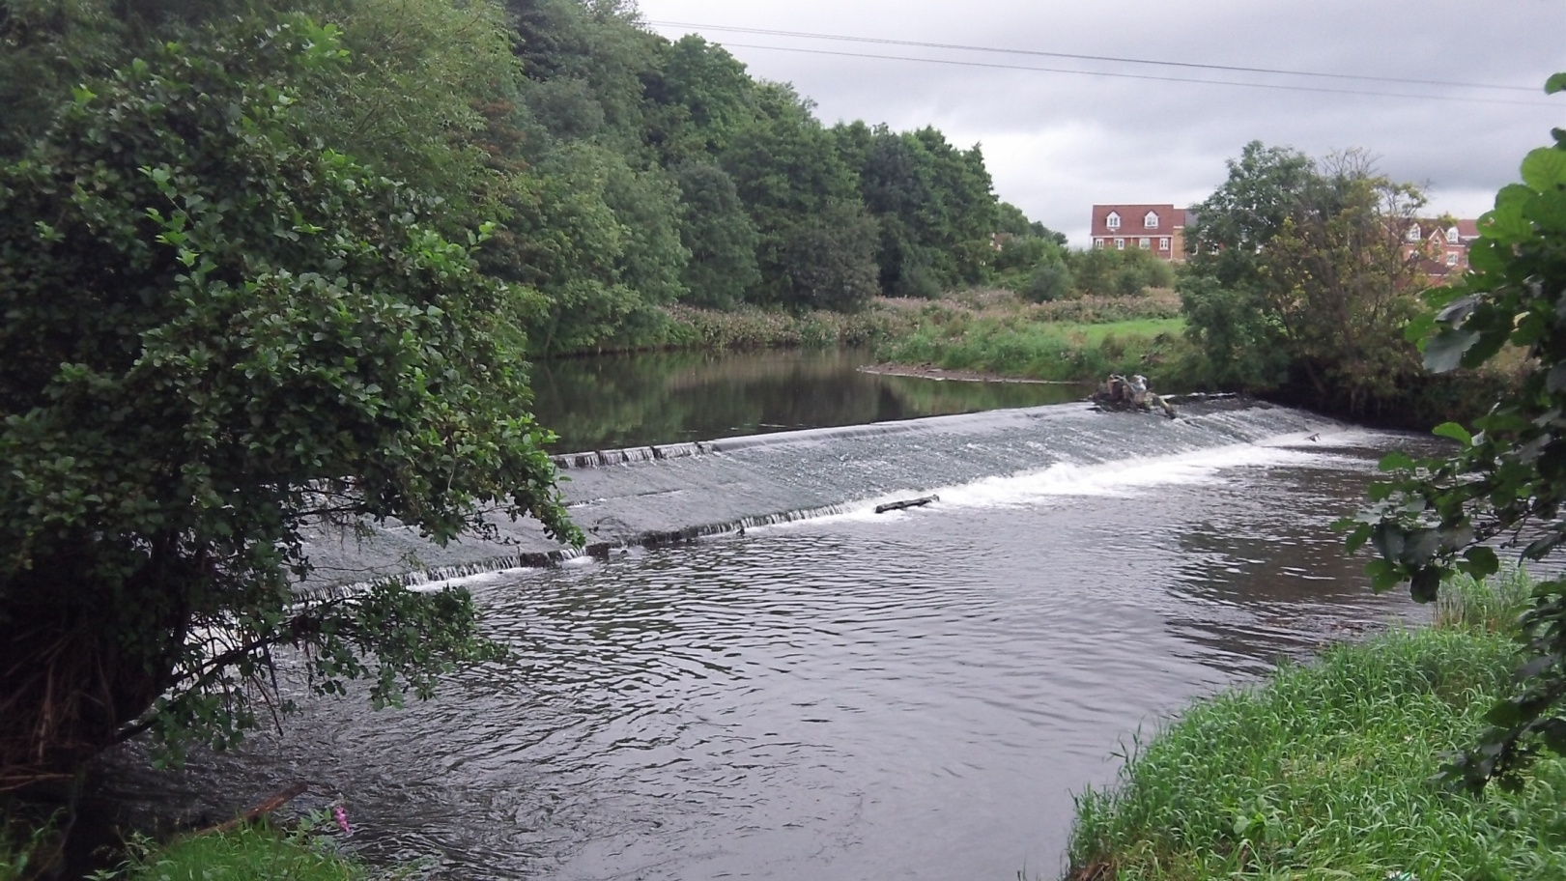
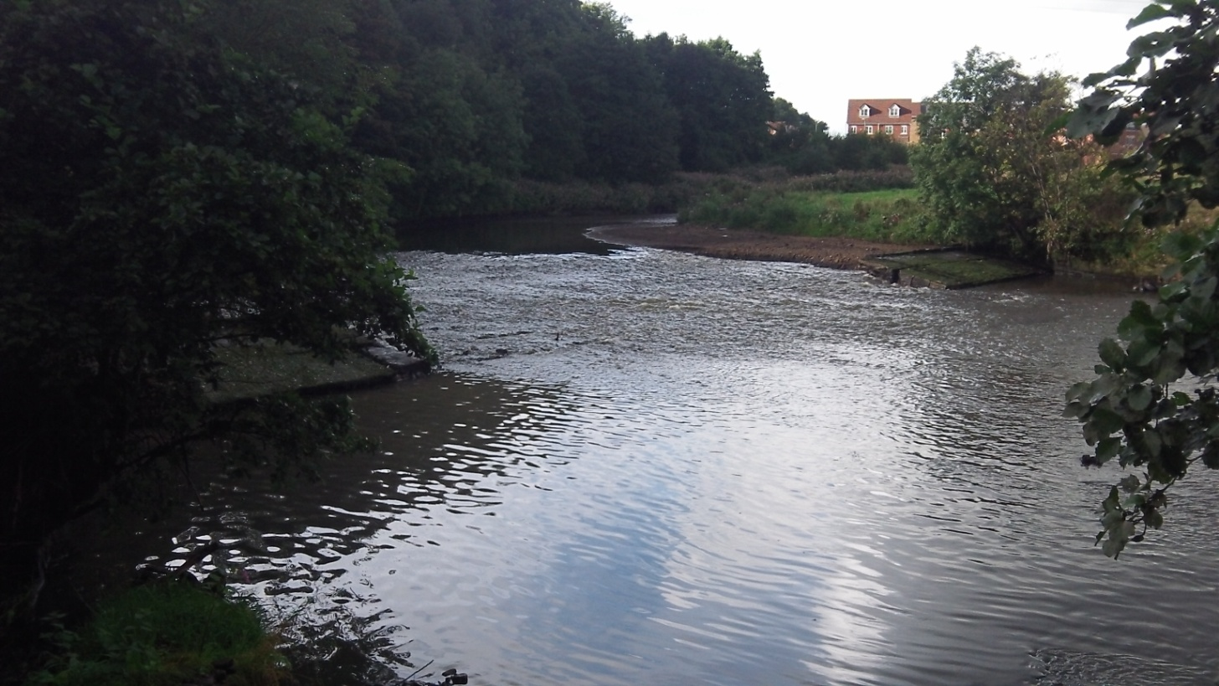
Goshen Weir
River Roch
Notes:
Case study Goshen weir
Large weir on River Roch, on the outskirts of Bury.
This removal was the largest that we had attempted at the time, and was approx 1 km downstream of Gigg lane weir that had previously collapsed. Cumulative benefits.
Removal delivered internally by Ops, some consultancy pre-app work by APEM that included the removal strategy to take out middle 60% and leave in the bankside lengths of the weir. This was to try and centralise the flow and take pressure of the river banks, especially the outer RHB.

Slide 4
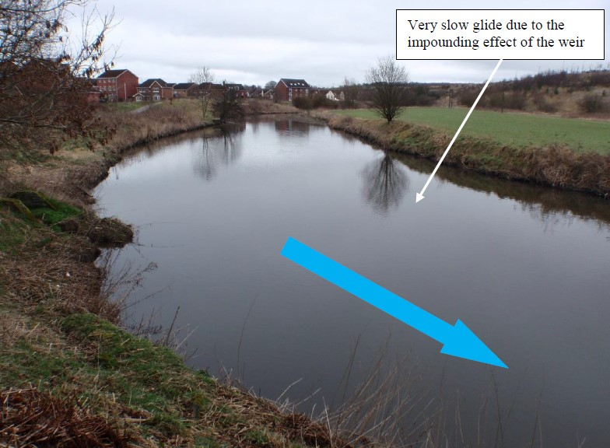
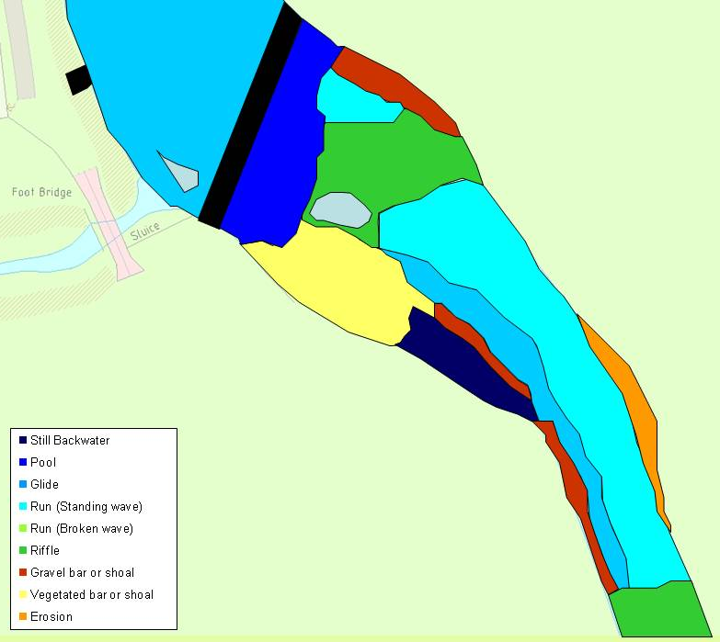
Before
2012

Slide 5
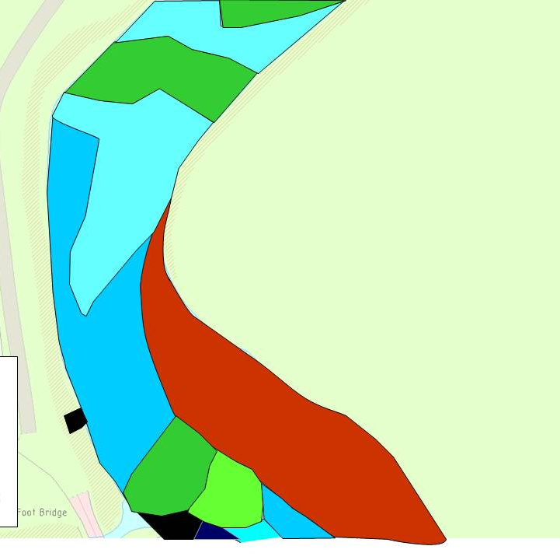
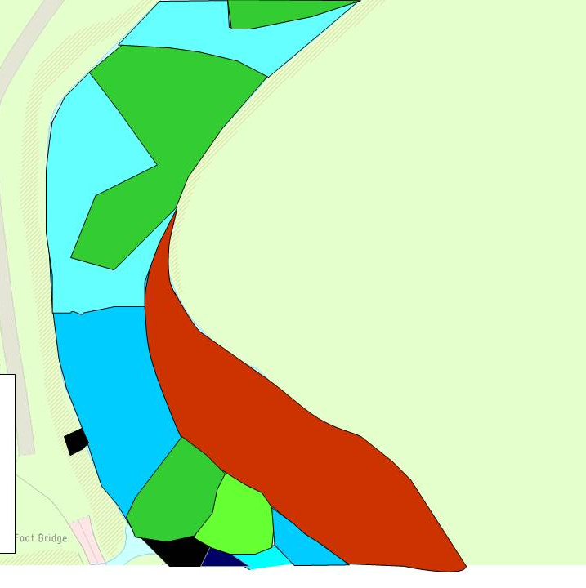
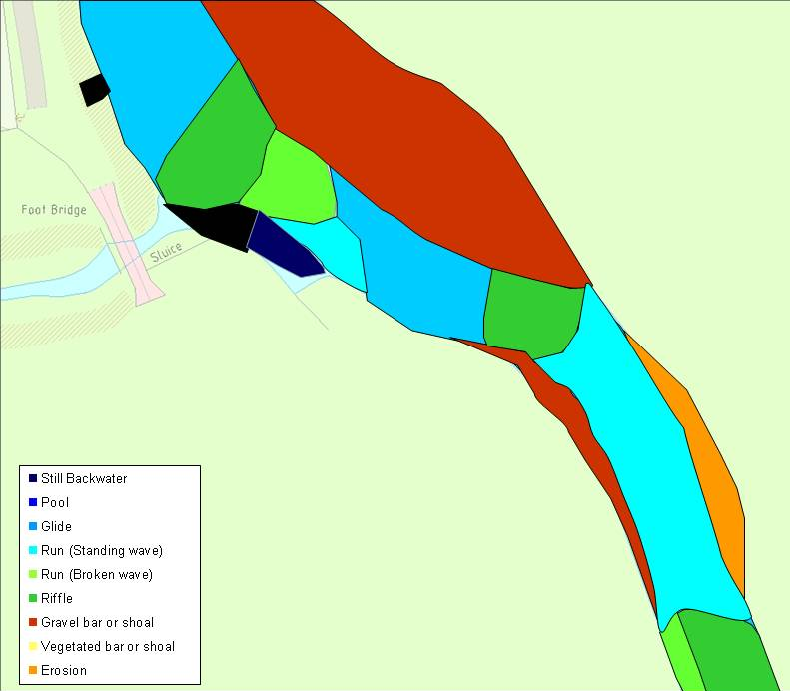
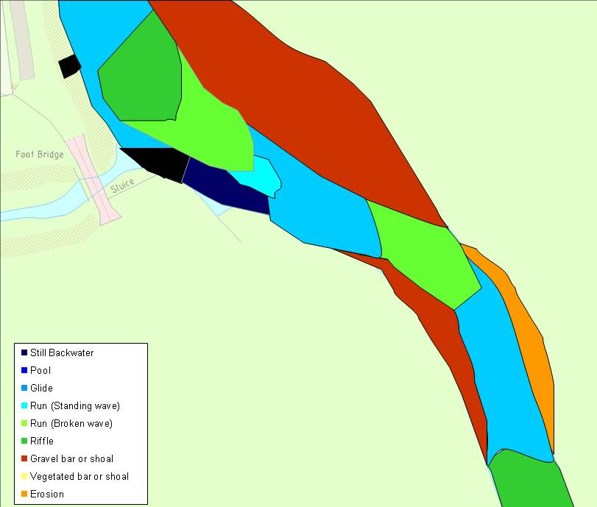
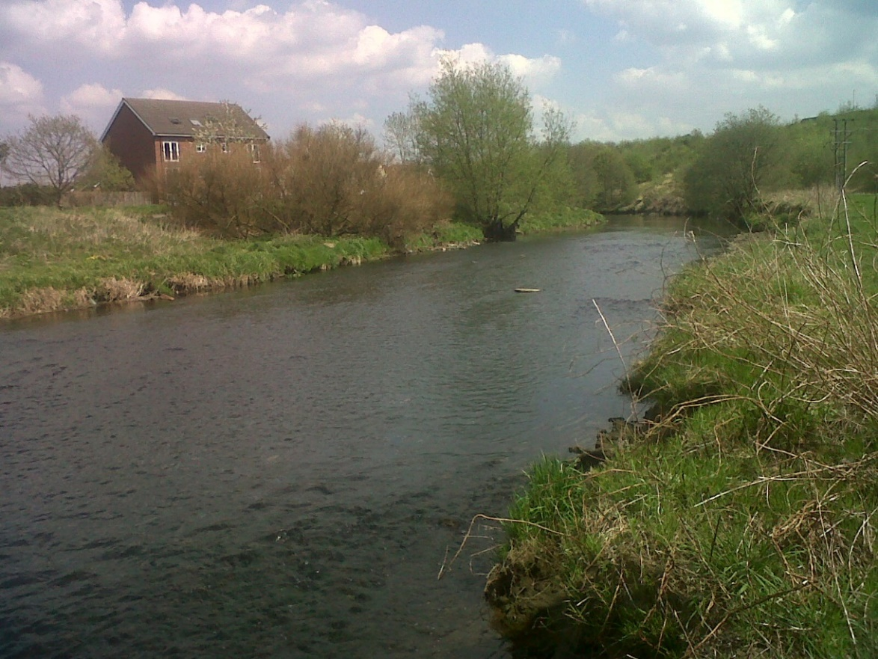
After
2013
After
2014

Slide 6
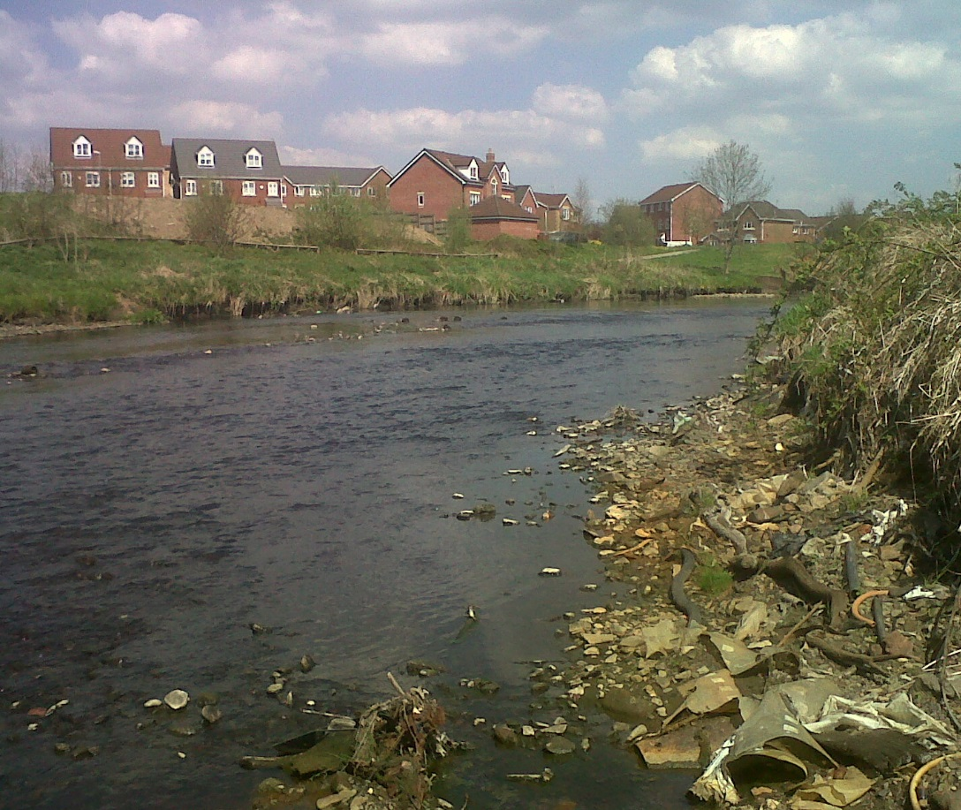

Slide 7
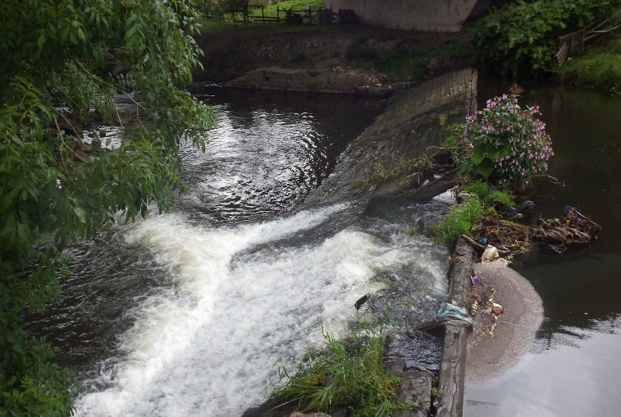
Rawtenstall Weir
River Irwell

Slide 8
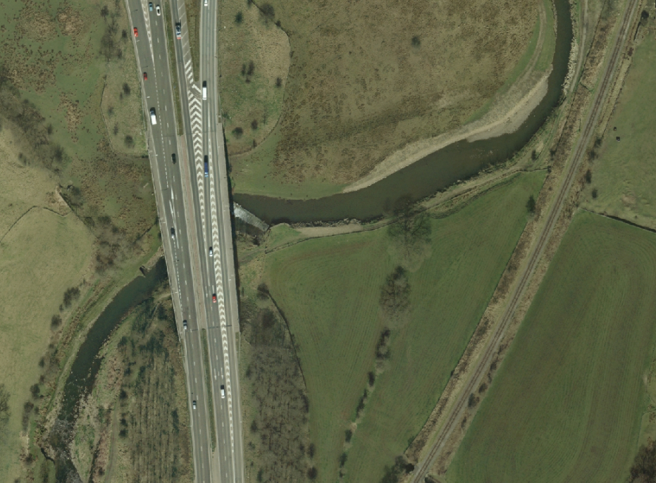
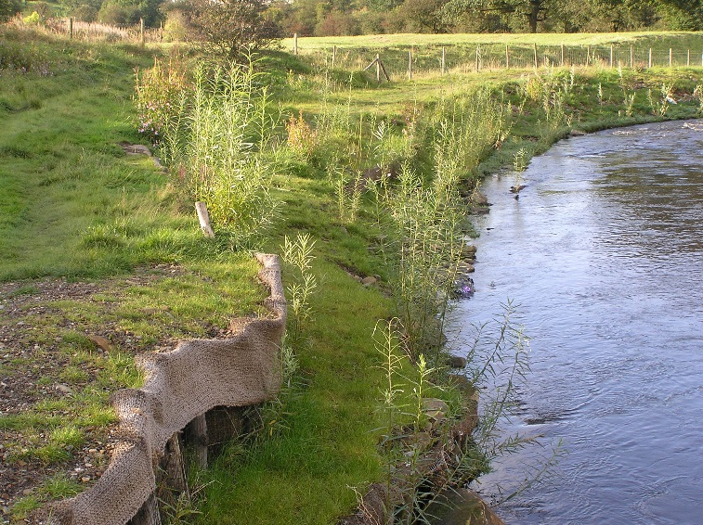
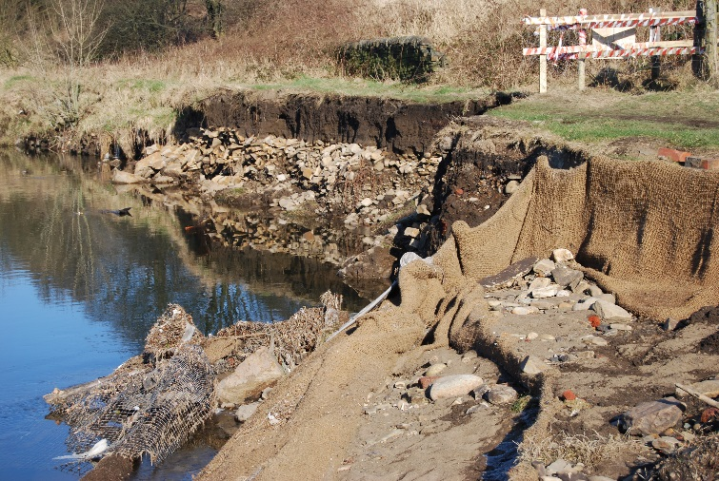

Slide 9
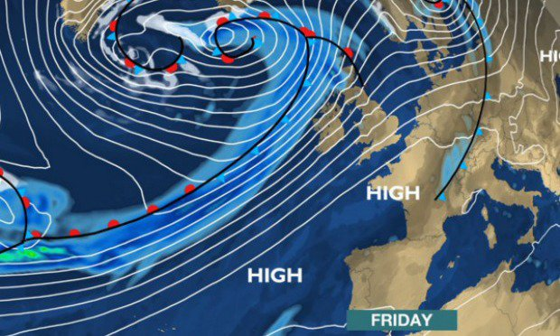
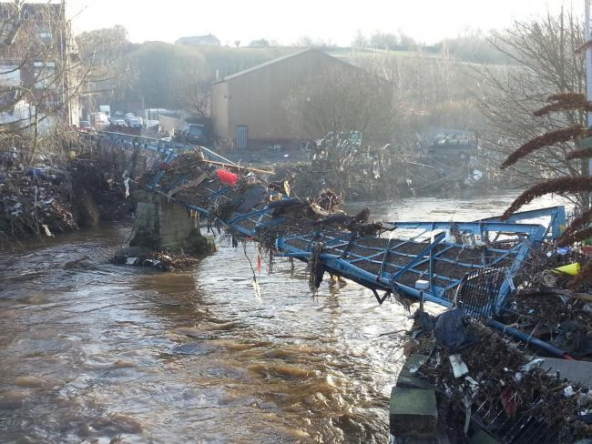
Storm Desmond 2015

Slide 10
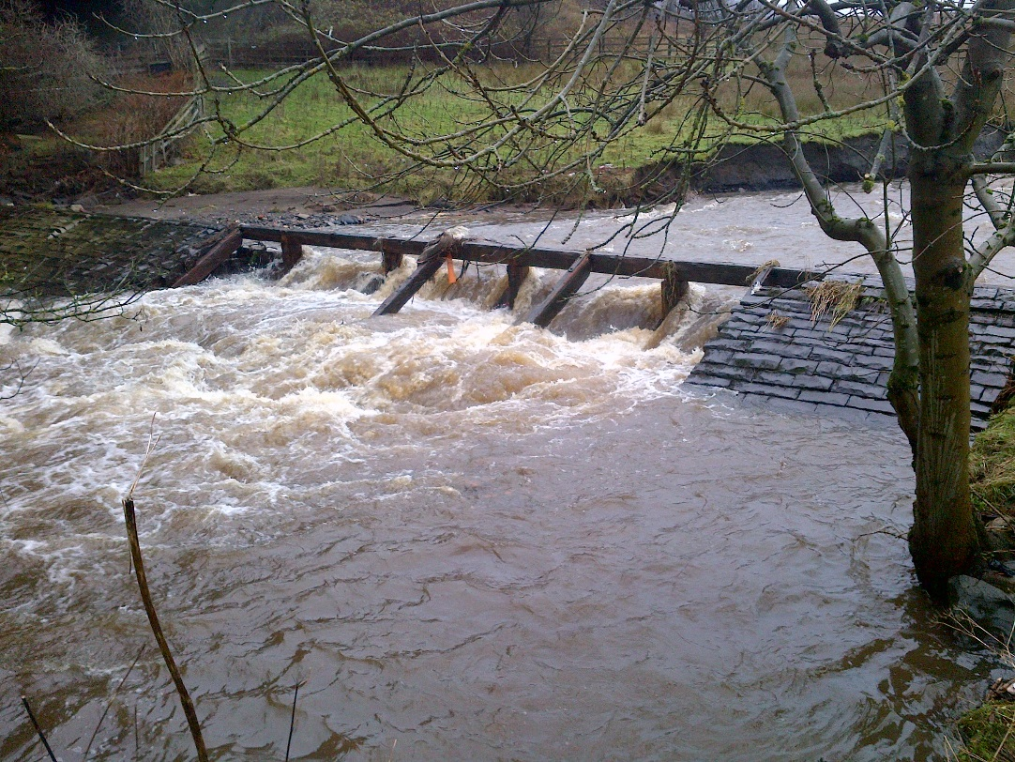
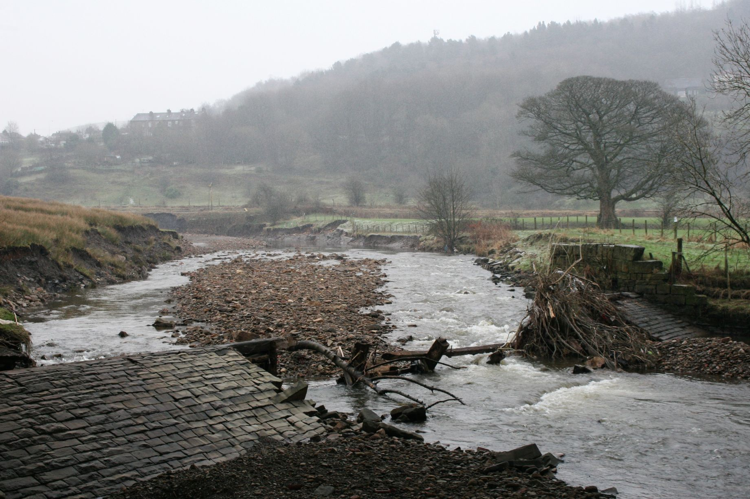
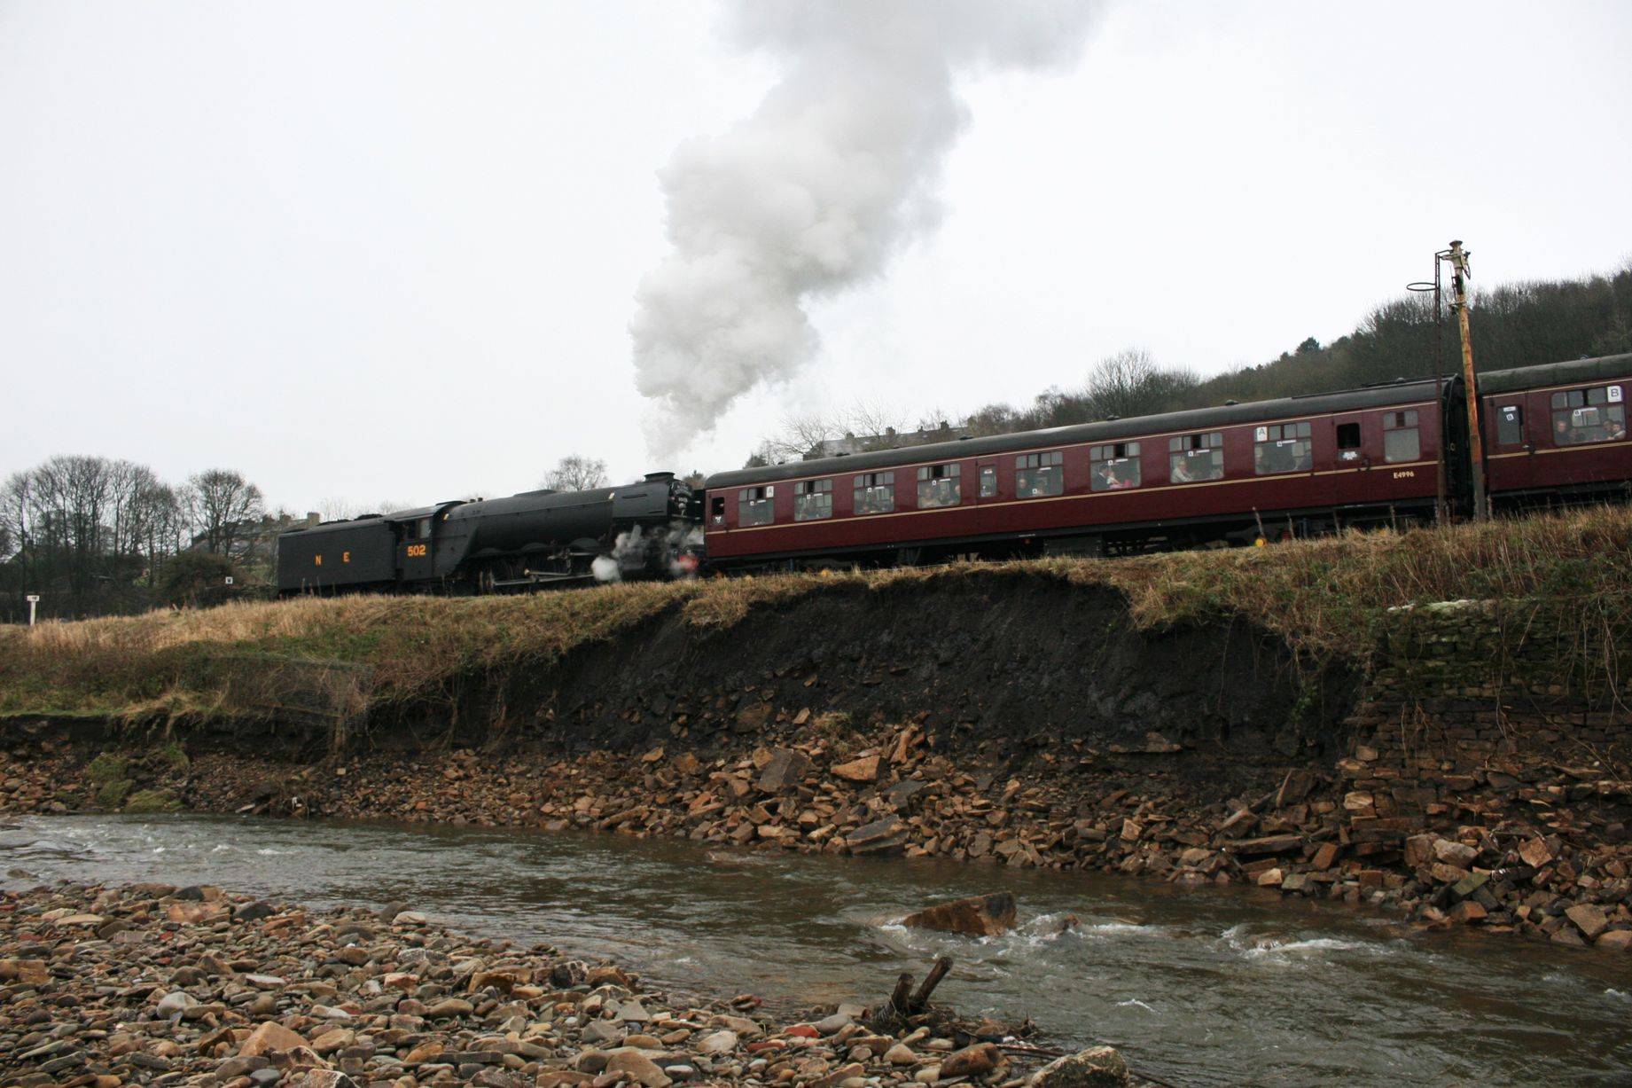

Slide 11
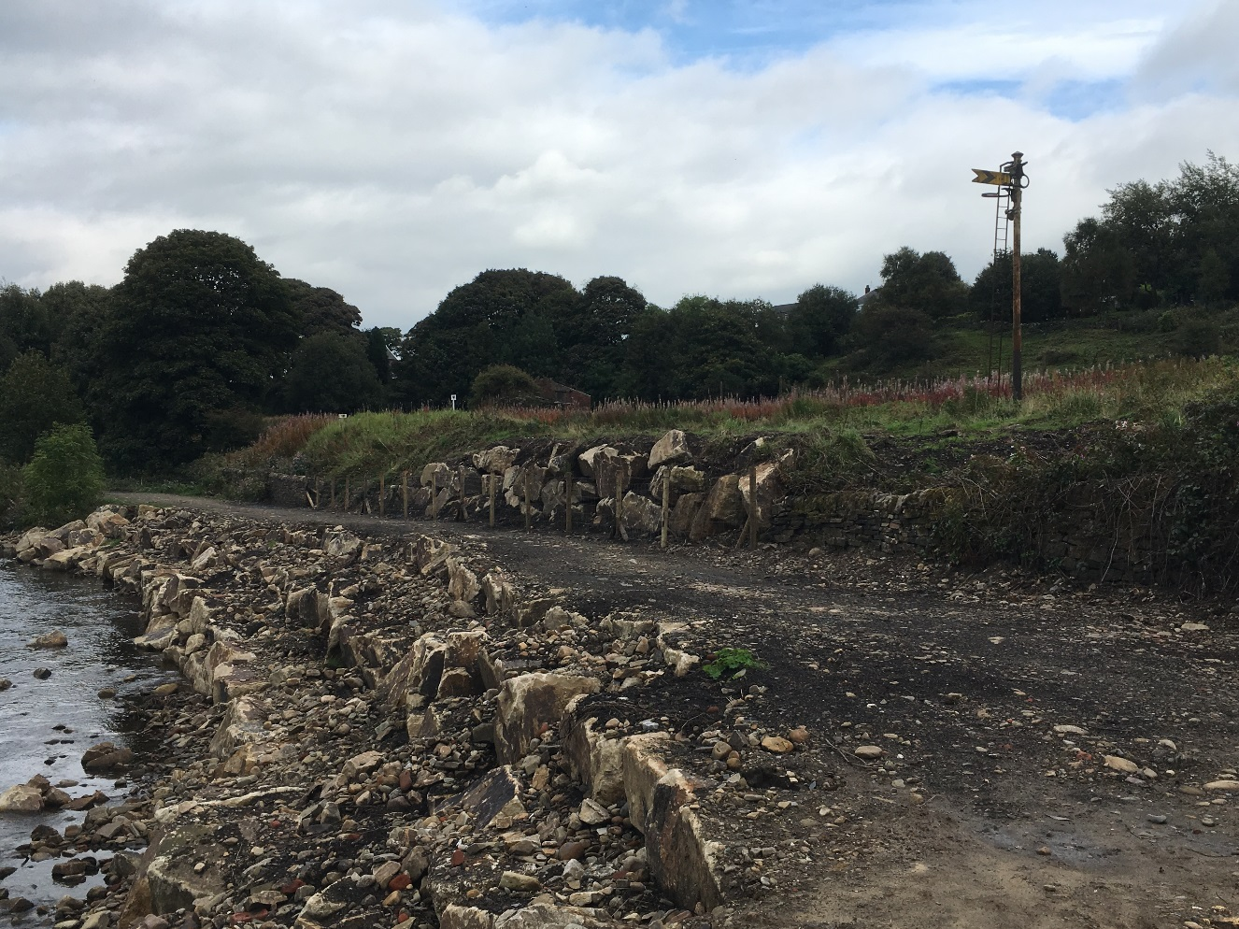

Slide 12
2017 Summer
Goshen

Slide 13
2014
2017

Slide 14
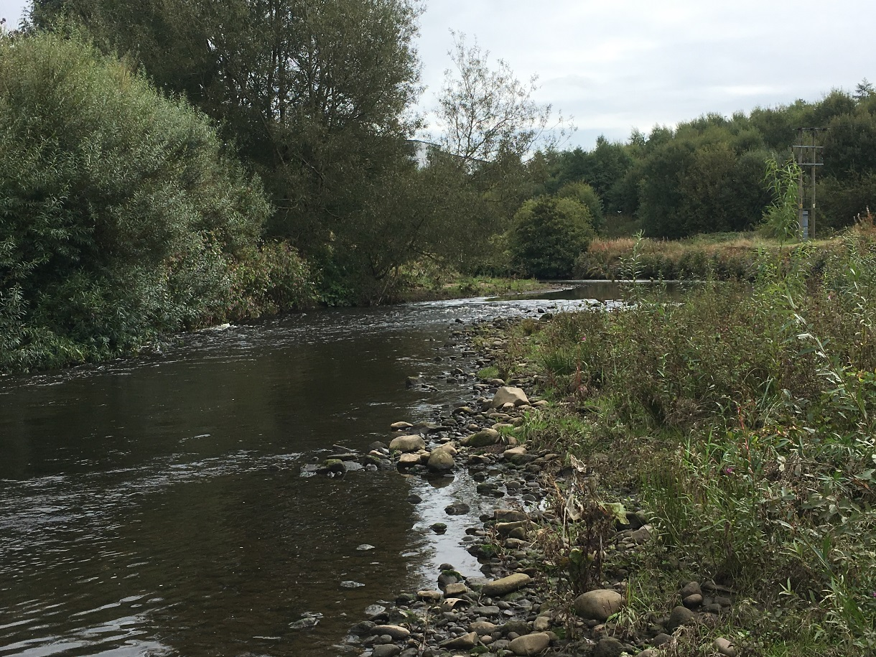
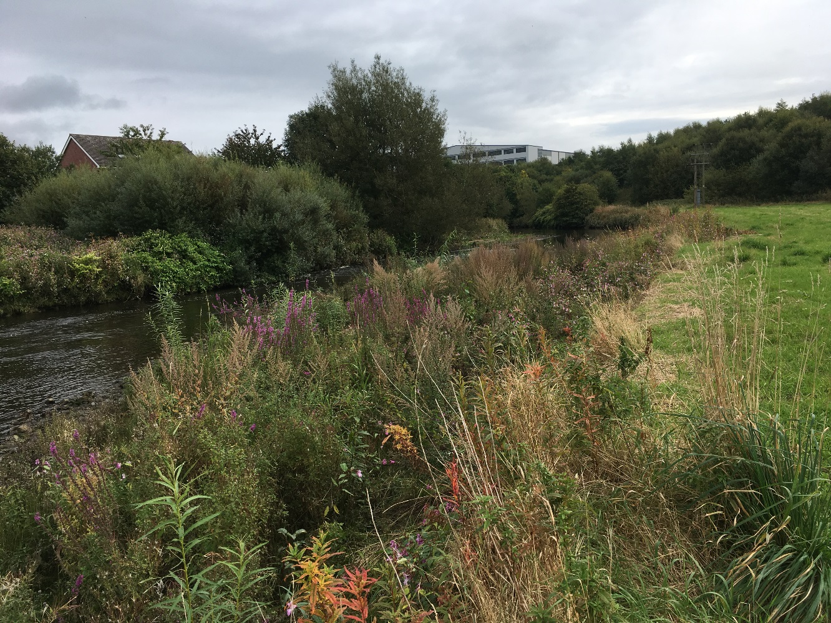
Upstream
diversity
2017

Slide 15
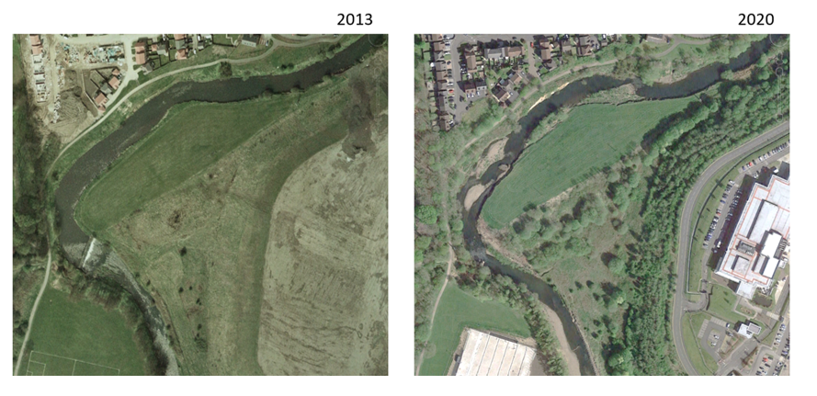

Slide 16
2020

Slide 17
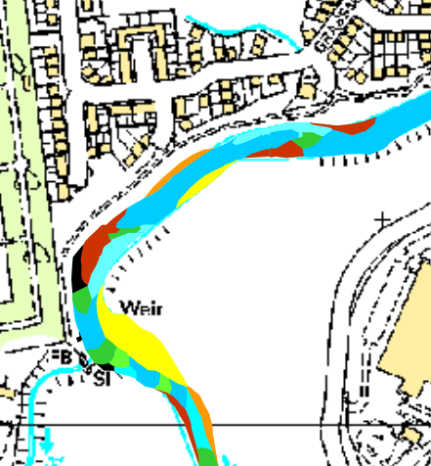
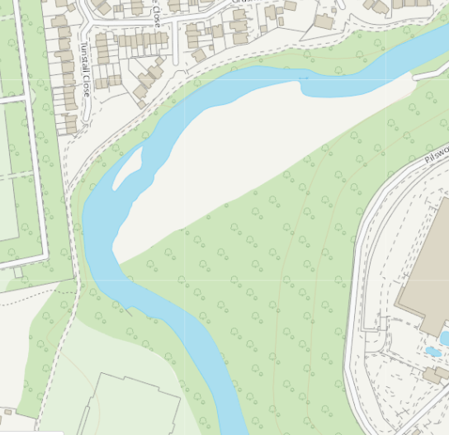
2017
2023

Slide 18
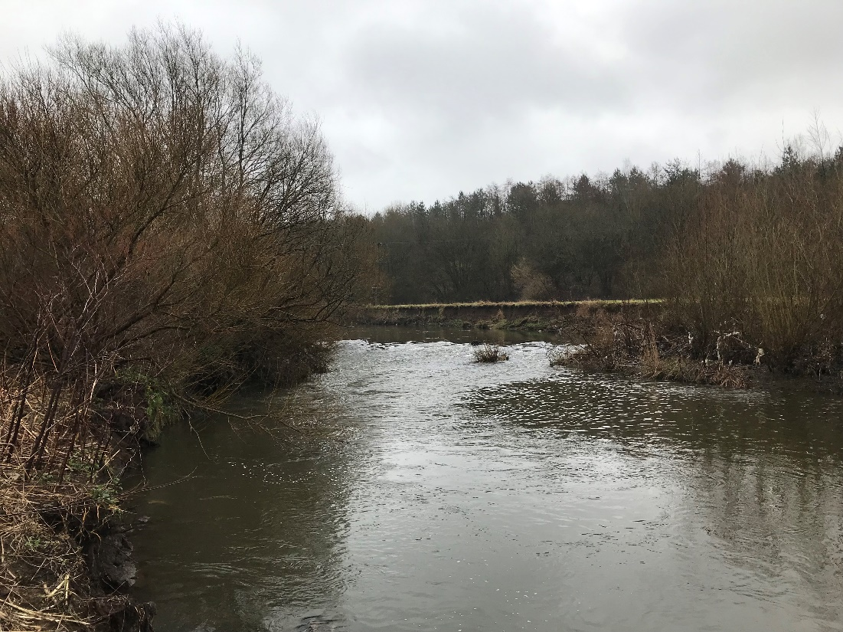
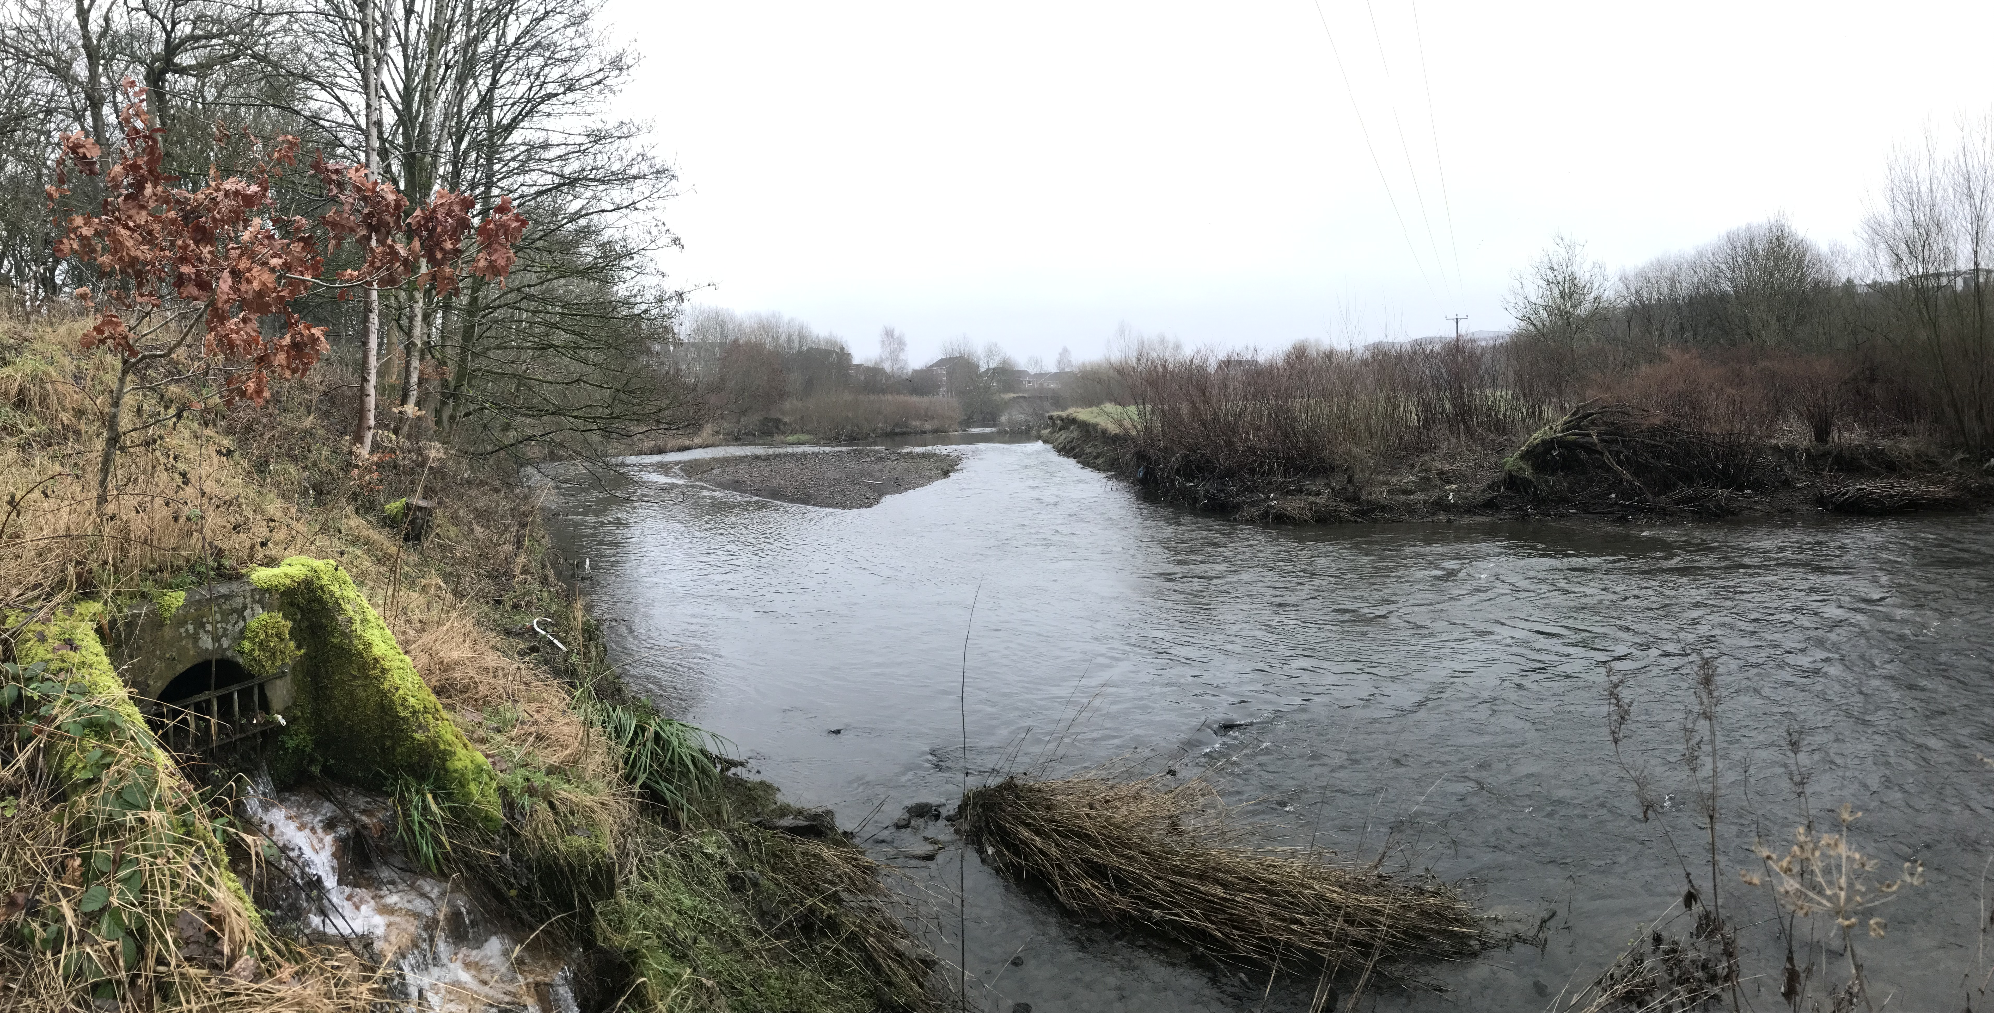
River Roch 2023

Slide 19
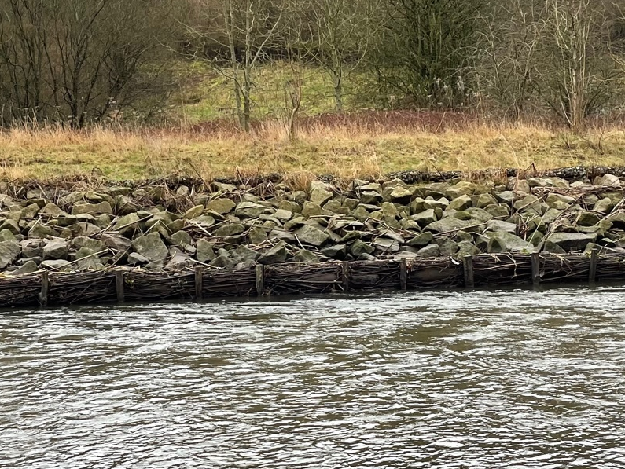

Slide 20
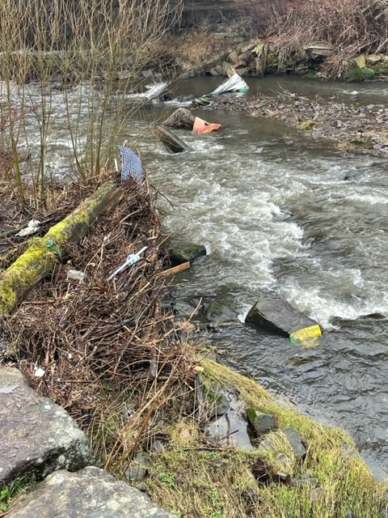

Slide 21
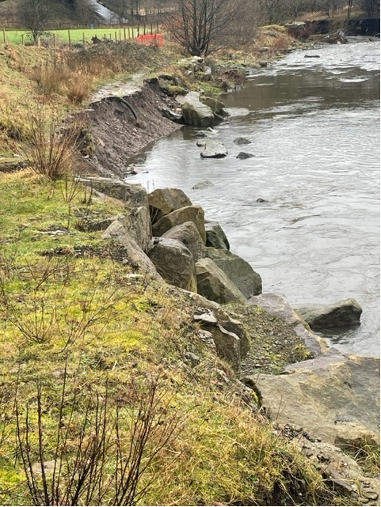
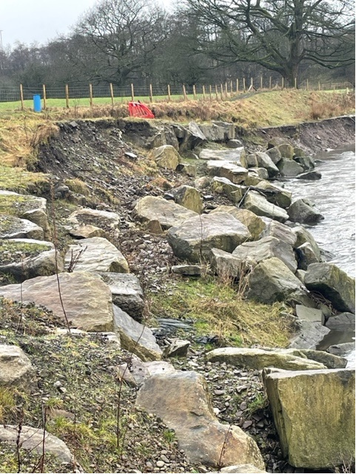

Slide 22
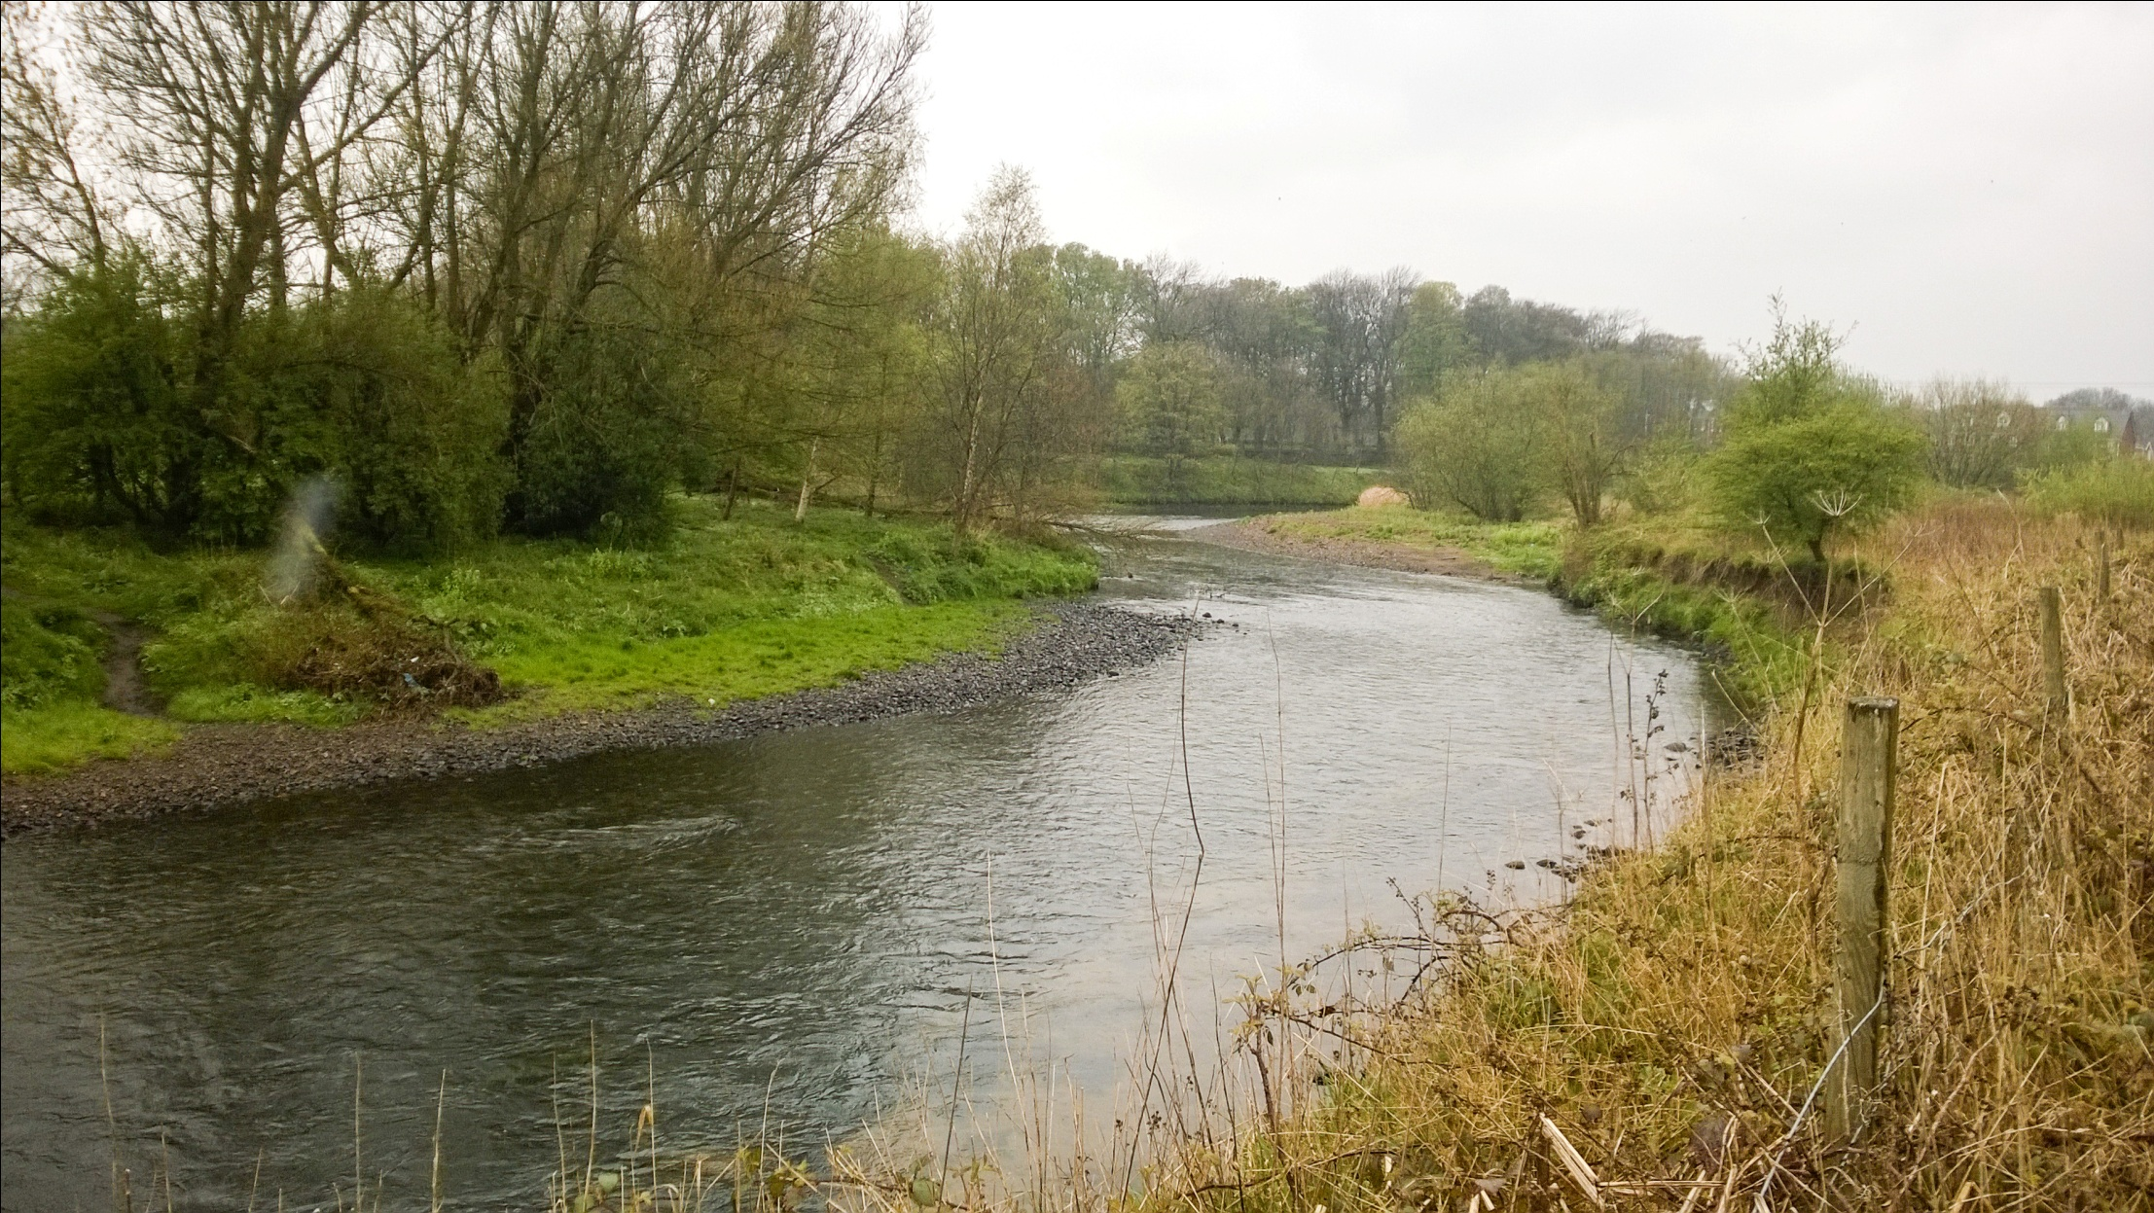
In conclusion

