Slide 1
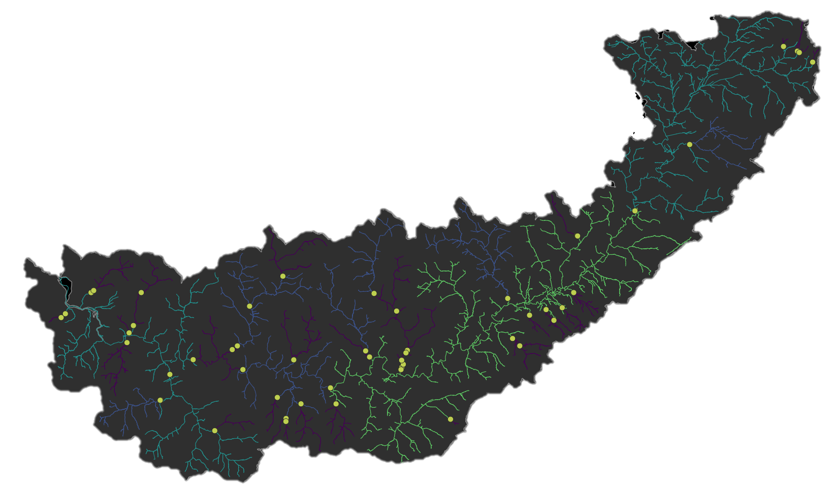
Fragmented rivers: the desk-based bit
Josh Jones
18/05/2023

Slide 2
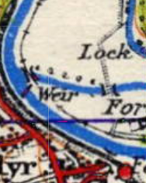
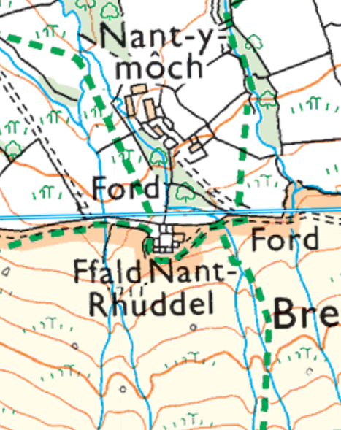
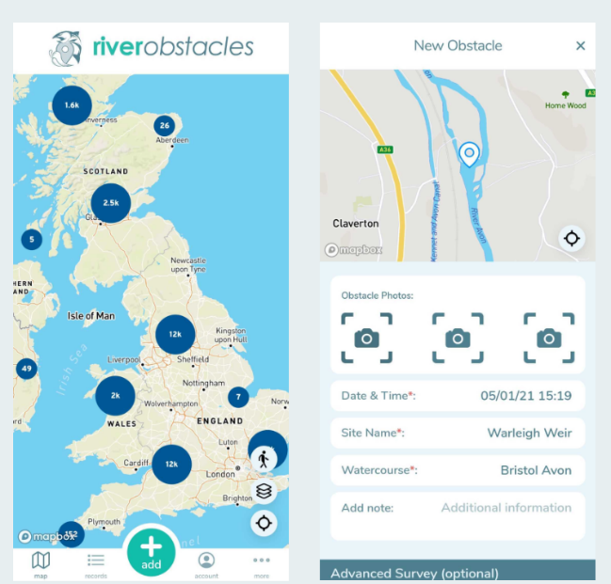
Origins
Notes:
Origins – EA OS maps, LiDAR
Also Highways England
36685 artificial and natural barriers

Slide 3
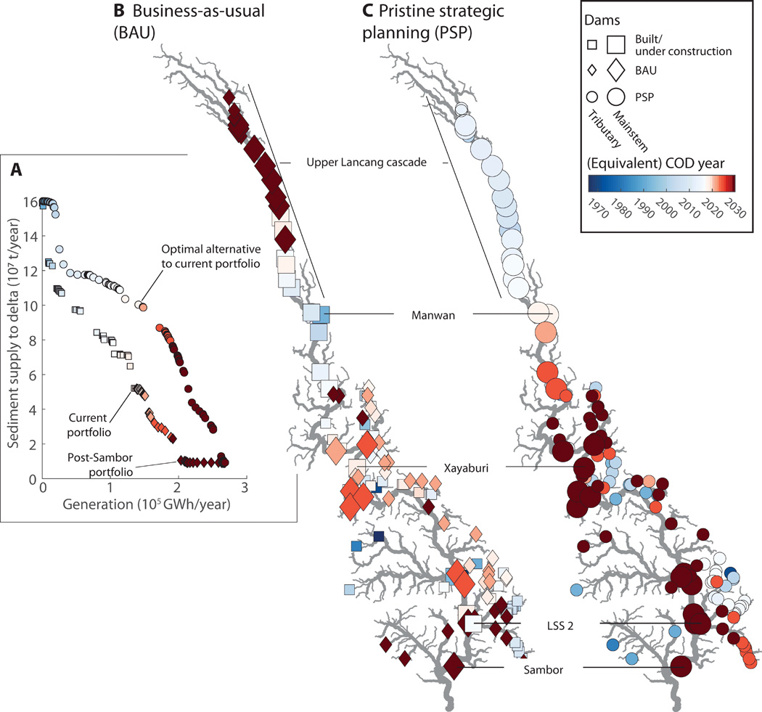
Is prioritisation the right thing to do?
Notes:
Then fragmentation stats. Non party political – I don’t prescribe to any desk based prioritisation. Even European Open Rivers has a panel of people making the final decision.
A computer can tell only tell you as much info as you put in
If it doesn’t known about land owners and other factors then anything it produces will be top down and only useful for thinking about the problem
I sat in on the EC progress update on their prioritisation strategy and basically there’s no enough data.
Useless if you don’t have all the barrier data
Local prioritisation maybe. Less likely we’ll have complete data at a national scale.
Discuss.

Slide 4
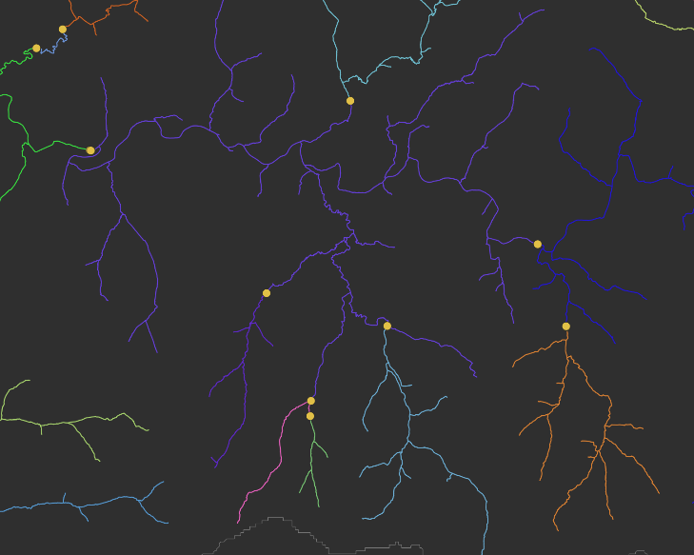
However, prioritisation requires some measure of fragmentation
Attribute field | Description
SYSlength | Total catchment "SYSID" length to MHW (m)
LNEXT | Length upstream to next barrier(s) (or source if no barriers) - excludes locks (m).
LSOURCE | Length upstream (along primary flow path) to source (m).
SLENGTH | Length downstream (along primary path) to MHW (m) (-1 indicates below MHW)
STOTAL | Total number of barriers downstream to MHW
PrimaryPathTotal | Sum of LSOURCE and SLENGTH
%toNext | LNEXT as a percentage of PrimaryPathTotal
%DS | SLENGTH as a percentage of PrimaryPathTotal
%PPT_SystemLength | PrimaryPathTotal as a percentage of SYSlength
Notes:
Task: generate these metrics the RO dataset

Slide 5
However, prioritisation requires some measure of fragmentation
Attribute field | Description
LNEXT | Length upstream to next barrier(s) (or source if no barriers) - excludes locks (m).
LSOURCE | Length upstream (along primary flow path) to source (m).
SLENGTH | Length downstream (along primary path) to MHW (m) (-1 indicates below MHW)
STOTAL | Total number of barriers downstream to MHW

Slide 6
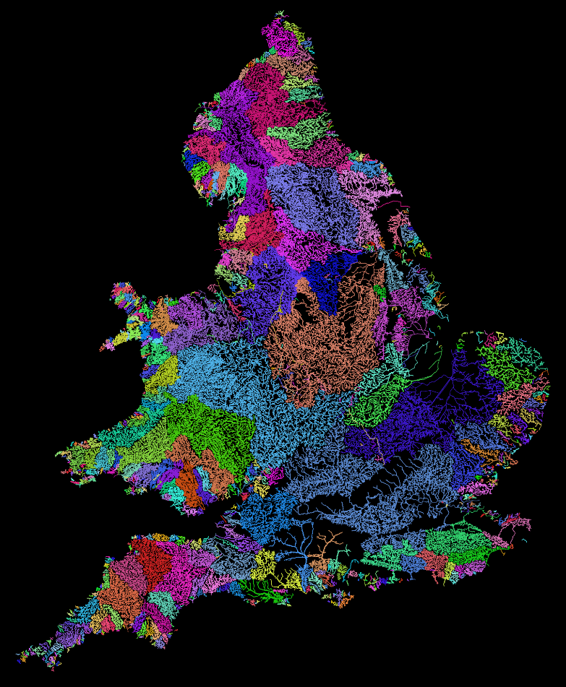
Method
OS Water Network
Artificial barriers
Notes:
No braided channels
No local channels
No basins with total length <5 km

Slide 7
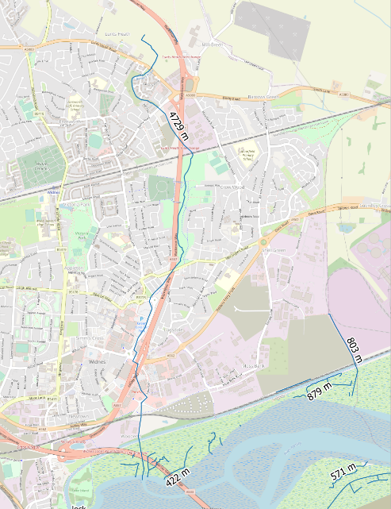
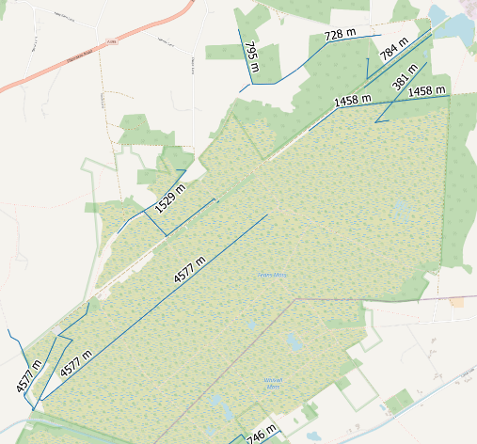
Method
OS Water Network
Artificial barriers
Notes:
No braided channels
No local channels
No basins with total length <5 km

Slide 8
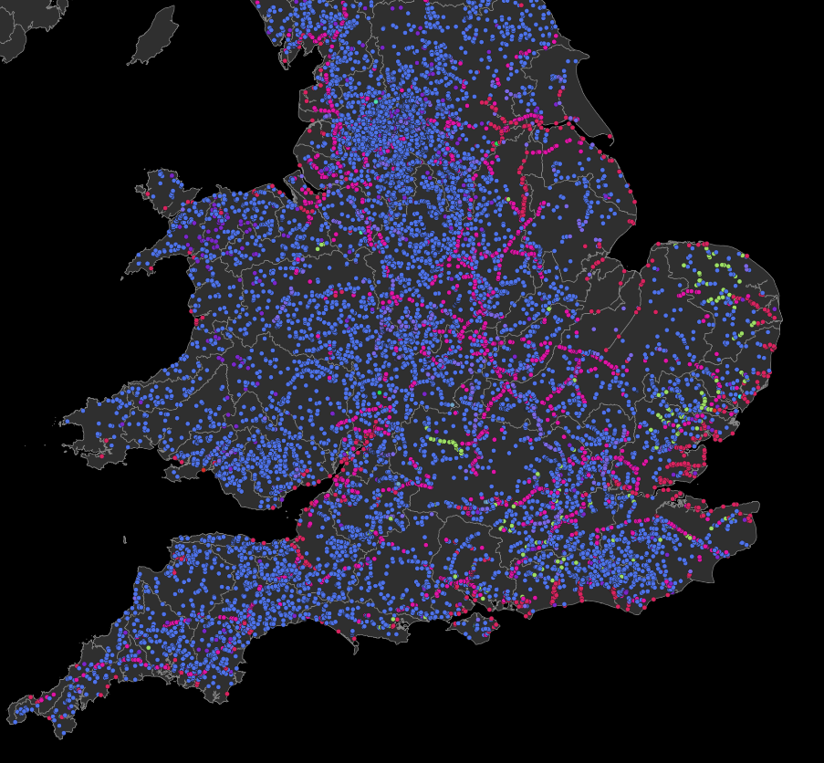
Method
OS Water Network
Artificial barriers
Notes:
19922
Weirs
Culverts
Locks
Sluices

Slide 9
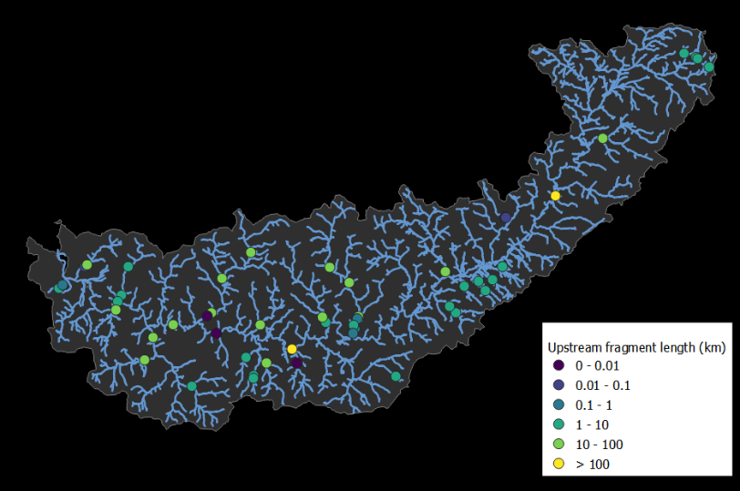
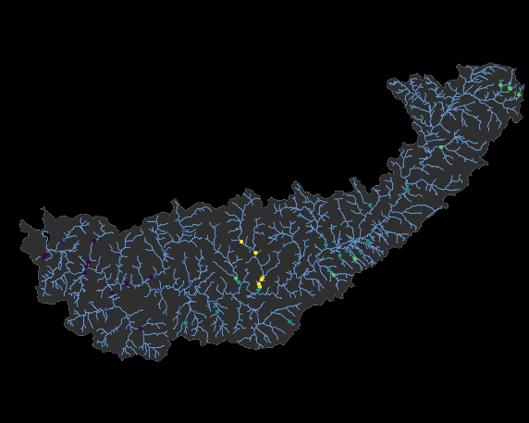
Results
1 km between barriers on average (SD = 24 km)
6 km from source (SD = 20 km)
Number of barriers downstream

Slide 10
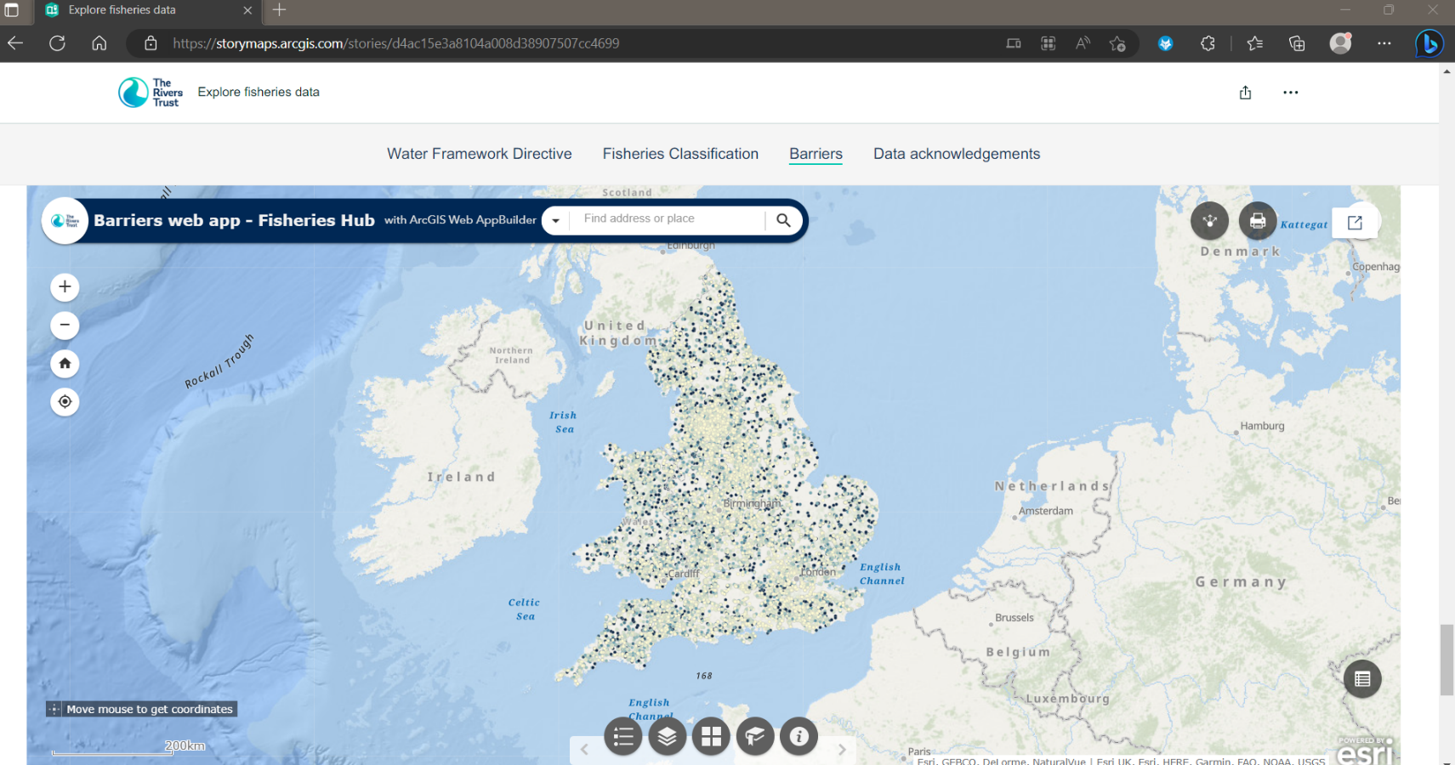
Results
Number of barriers downstream
Explore fisheries data (arcgis.com)
Notes:
It’s in the CaBA data package too

Slide 11
But… this ignore most barriers
23,618 66,381
Jones et al., 2019
Notes:
AMBER – field validation and how it shows what we missed!

Slide 12
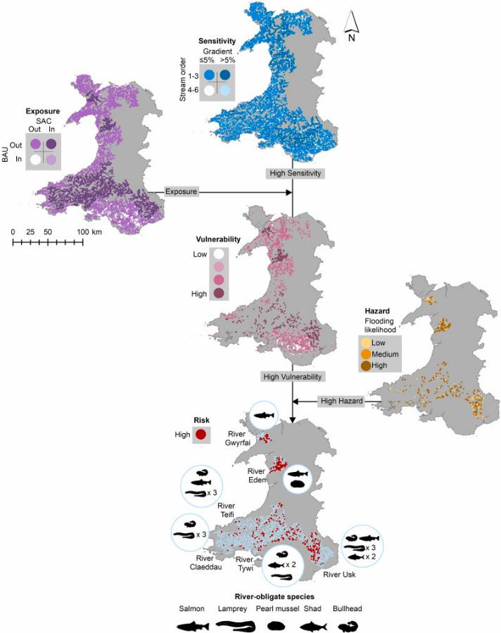
But… not for long!
11,680 road-river structures
River Obstacles app updates
Januchowski-Hartley et al., 2022
Notes:
River Obstacles app updates
Road crossings and dams

Slide 13
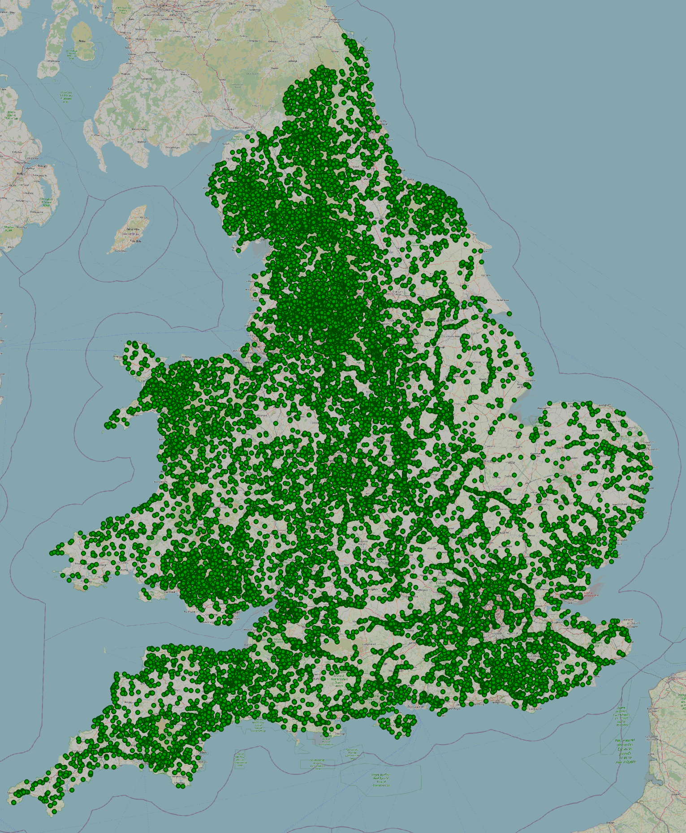
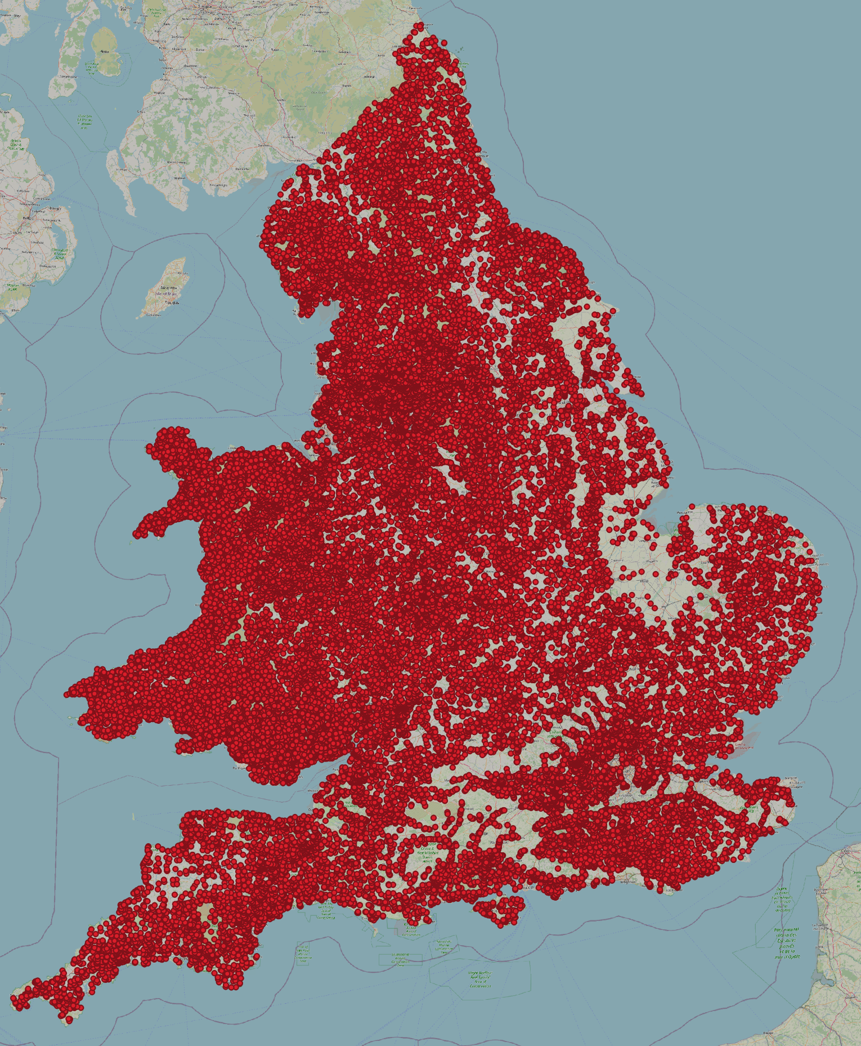
But… not for long!
Currently
Coming soon..?
31,761
69,489
Notes:
River Obstacles app updates
Road crossings and dams

Slide 14
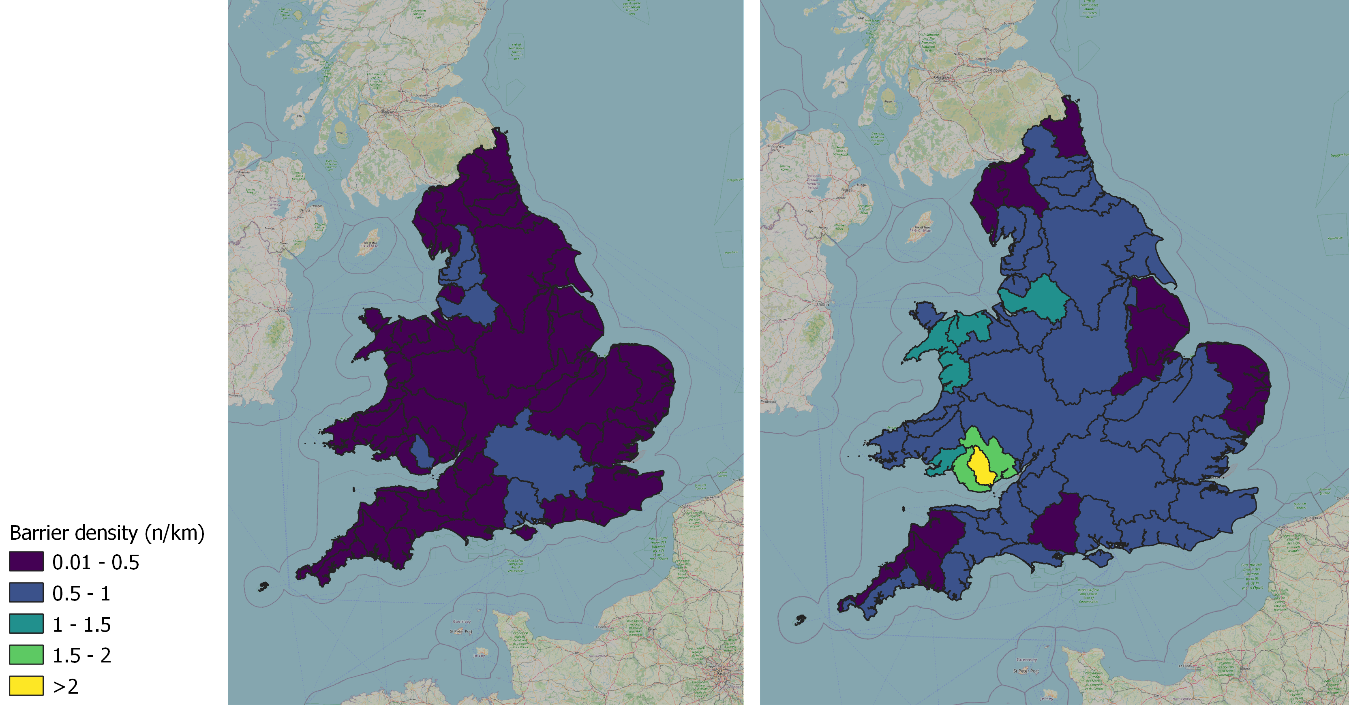
But… not for long!
Currently
Coming soon..?
0.29 barriers/km
0.72 barriers/km
(Includes natural barriers)
Notes:
River Obstacles app updates
Road crossings and dams

Slide 15
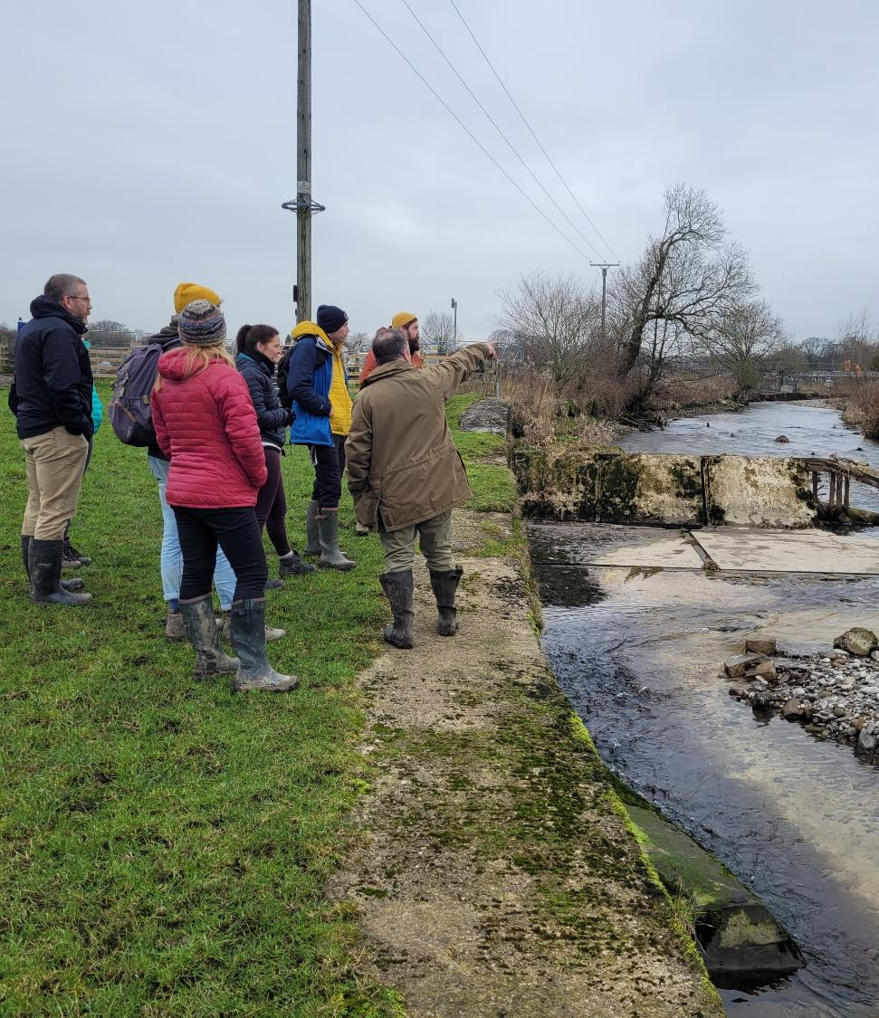
In the mean time
Removed a barrier?
Walkover data!
Fancy a workshop?
Notes:
That’s why we’re doing stuff like workshops in Gargrave PHOTO
And Coquet to get people skilled up to make use of this data

Slide 16
“We are strategically optimistic”
- Andy Bray
josh.jones@theriverstrust.org

