Slide 1
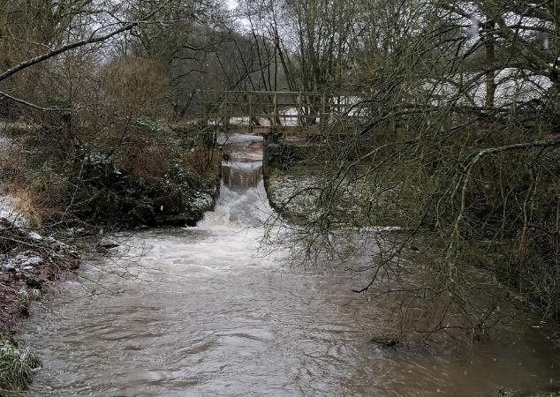
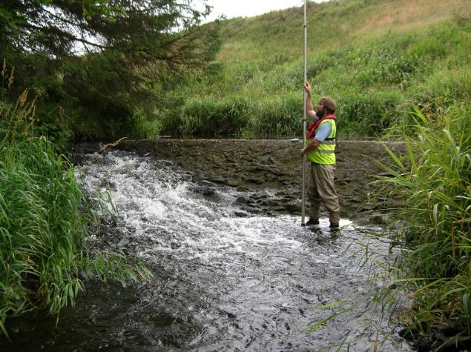
Water Environment Fund
Gateside Mills and Bronie Burn Fish Barrier Removals
Lawrence Belleni

Slide 2
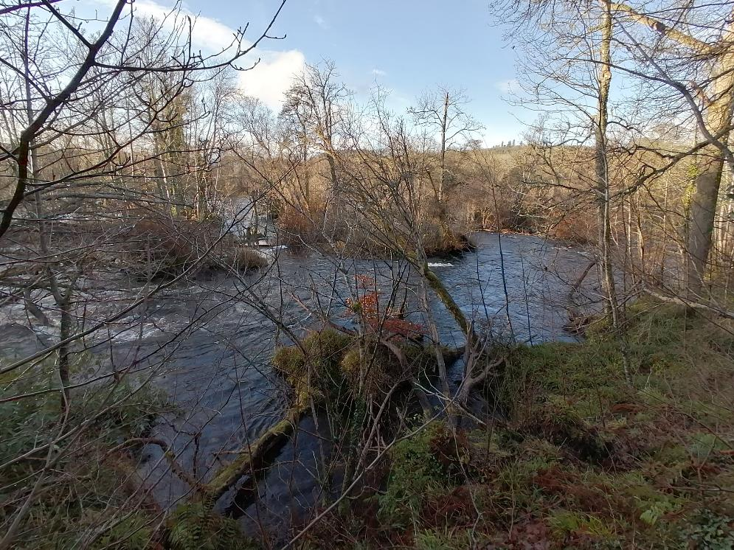
Challenges
Introduction
Fish barriers, it’s complicated!
Notes:
Just like our most natural rivers, fish barrier removal has some unexpected twists and turns along the way.
Most of us in this room have experience of being involved in removing or easing fish barriers or hope to be soon.
I want to share SEPA’s experience of removing Gateside and Bronie barriers and some key challenges, successes and lessons from the experience.

Slide 3
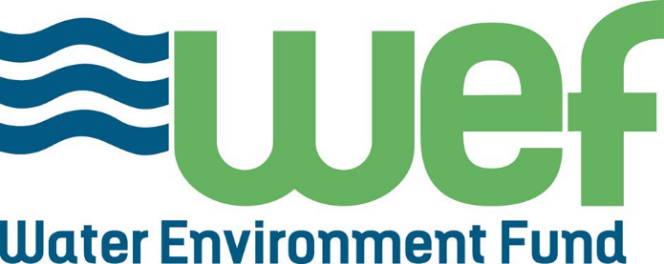
Driver: River Basin Management Plan
Redundant barriers
Notes:
WEF unit in SEPA
Administer funds on behalf of Scot Gov
Deliver RBMP actions on removing fish barriers and improving river morphology
WEF focus on historic structures no longer used

Slide 4
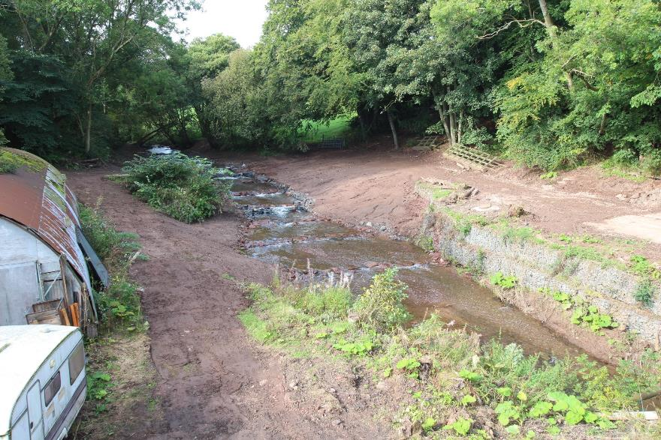
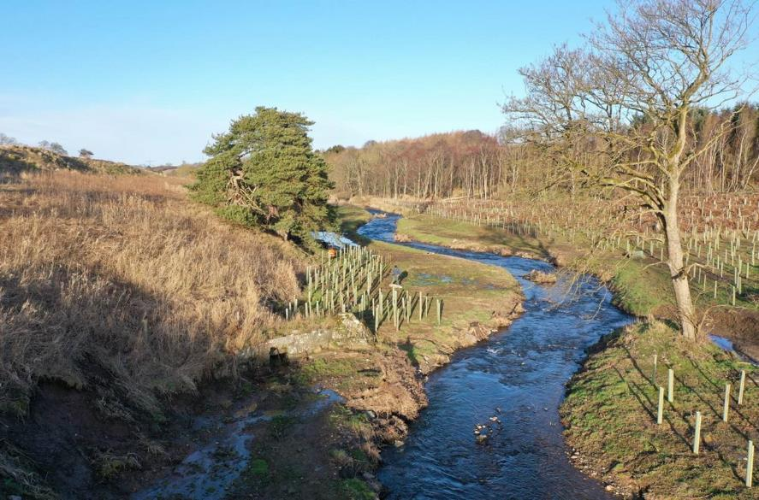
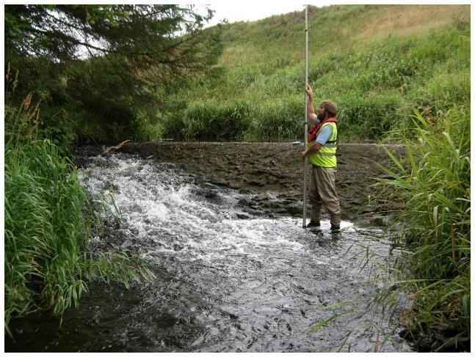
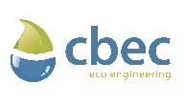
Gateside Mills & Bronie Burn- Quick overview
Notes:
Both projects directly commissioned by SEPA and barriers removed in 2022.
Gateside Mills: 3m high weir on River Eden near Strathmiglo, Fife.
Bronie Burn: 1.5m high weir on trib of River Ythan near Ellon, Aberdeenshire.
Gateside: Weir removed and replaced with 80m of close to nature step-pool channel
Designer: RHDHV ; Contractor: Ebsford Environmental
Bronie: Weir removed and large wood structures used to stabilise channel
Designer: CBEC; Contractor: McGowans Environmental Engineering

Slide 5
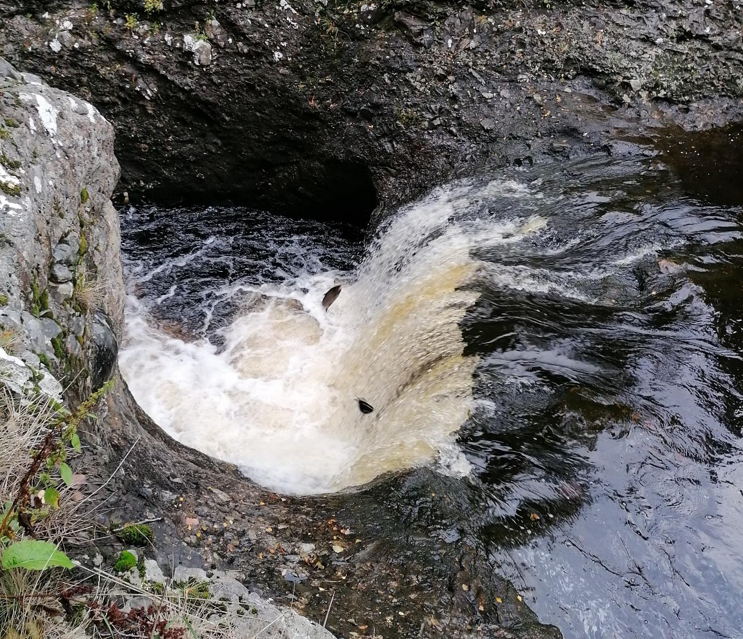
Challenges!
Challenges!
Notes:
Just like our migratory fish, fish barrier removal projects face difficult and unexpected challenges
Focus of my experience will be Gateside

Slide 6
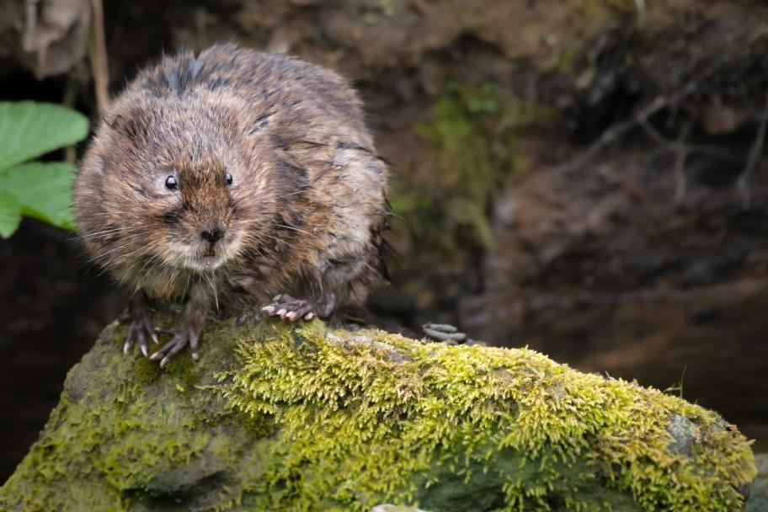
Challenges
Pre-works: Water vole presence
Beware the Water vole!
Specialists provide solutions
Notes:
Challenge: Risk presence of water voles pre-works could delay groundworks by a year if found.
I lost sleep over this…
If unfamiliar with Water Voles, they are a protected species in Scotland and UK.
We missed carrying out water vole survey the Summer before works and timings for pre-works survey, licencing and mitigation did not work in the Spring. Translocation requires a lot of preparation!
We discussed issue with specialists in SEPA Ecology and NatureScot (remit for protected species) and formed an approach that involved surveying outside good practice period to allow us to assess risk as early as possible. Thankfully presence of Mink meant highly unlikely water voles present and which gave us confidence to procure groundworks contract.
Lesson: Communication with technical specialists key to resolving issue. External specialists are willing to help.
Other obvious one: Water voles, plan well ahead!

Slide 7
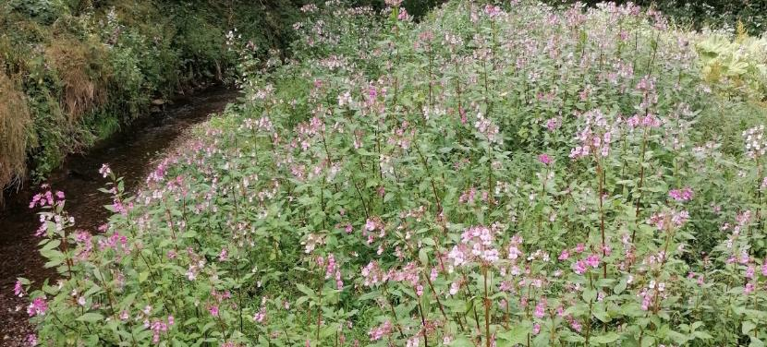
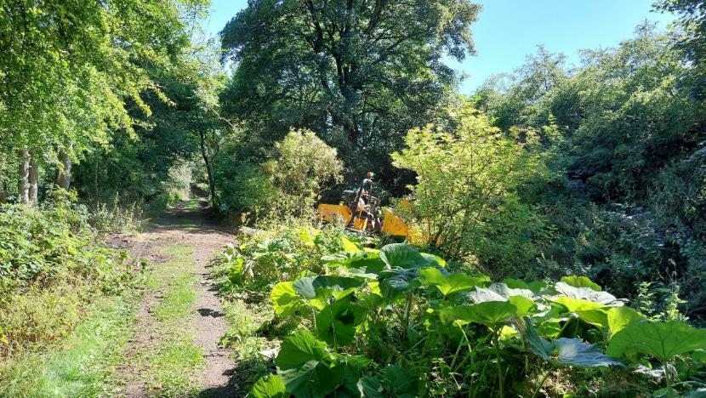
Challenges
Works- INNS on-site storage
Opportunity to store INNS on-site
Relied on contractor experience
Communication with Council to close path
Notes:
Challenge: An opportunity to store 92m3 of INNS contaminated sediment on-site arose before works. We were keen to include due to benefits for sustainability.
What we did: We relied on consultant’s expertise to decide whether to store INNS material on-site or off-site in their tender bids. Some bidders did not like this! Successful contractor happy to bury on site. However, required works site boundary change and approval from local authority to close path for a week.
Council application response time normally a month but early communication meant they were able to do a fast turnaround for us <1 week.
Lessons: Contractor experience and innovation relied upon.
Good relationship building and close communication with approval bodies key in these scenarios.
Obvious: Identifying INNS burial opportunity at Design would have made this task a lot easier!

Slide 8
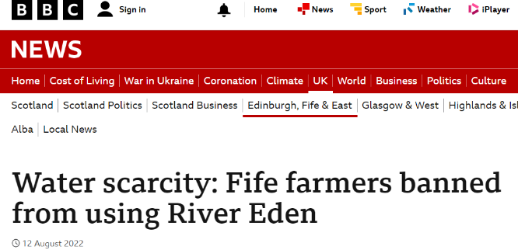
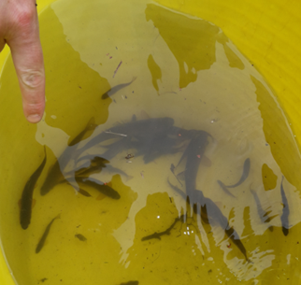
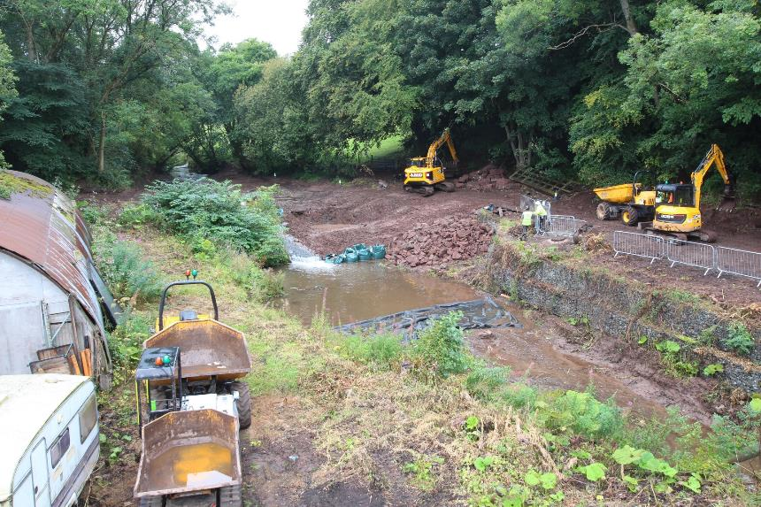
Challenges
Works- Environmental mitigations
Highest Water scarcity in Scotland Aug ‘22
Protect fish and silt management high importance
Notes:
Challenge: River Eden had highest water scarcity in Scotland during the first few weeks of works, this meant aquatic ecology was extra vulnerable to additional stress.
Risk: We cause harm to fish and breach CAR licence requiring SEPA regulatory action. Reputational risk.
Therefore, it was extra important that precautions were taken to protect fish and manage silt during works.
Twist: Fish rescue contractor tested positive for Covid and was fish rescue delayed.
What we did: Worked closely with contractor and Design supervision to ensure no harm came to fish until fish rescue could happen. Water scarcity added to daily weather checks. Trial pits planned for in-channel were done in the dry and ensured silt monitoring and mitigations were in place.
Lesson: Close communication with contractor and Design supervision required to ensure water scarcity and environmental risks managed.
As Clients, we are required to be vigilant and aware.

Slide 9
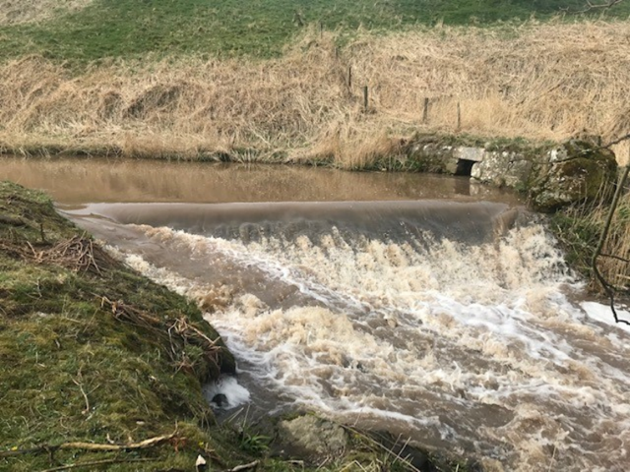
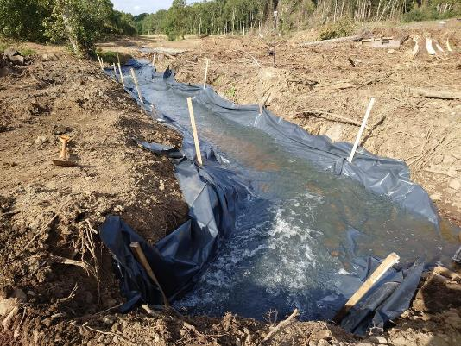
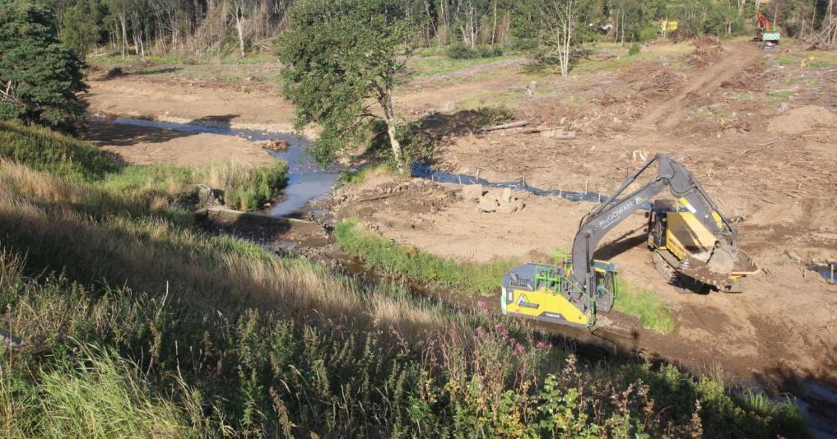
Challenges
Bronie Burn Challenges
Landowner agreement
Heritage attachment
Flytipped Asbestos
Notes:
Challenge:
LO agreement took 1 year and required local regulatory officer support
LO attached to heritage of weir, had to compromise and design around keeping stone lade entrance
Flytipped asbestos on site access, had to be dealt with by specialist contractor.
Great success: Forestry ditch with lining used to dewater works channel and keep silt impact low. Clever use of site.

Slide 10
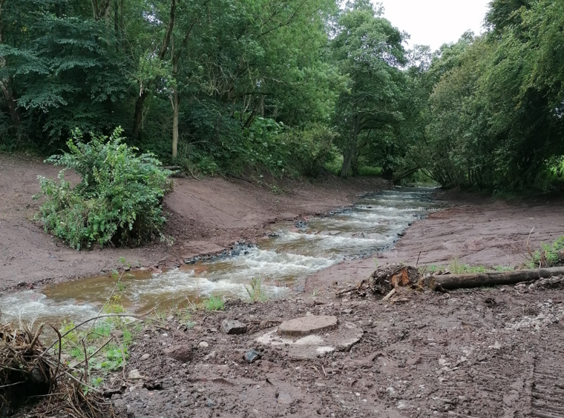
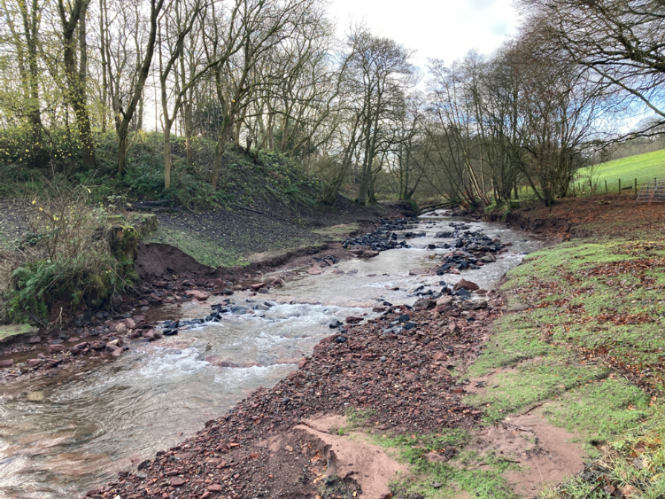
Challenges
Post-works
“the best laid plans of mice and men often go astray.” – Robbie Burns
Notes:
To quote our national Bard, Rabbie Burns: “the best laid plans of mice and men often go astray”
November 2022, 1 in 2 flood adjusted the constructed channel and leading to potential risk to a storage building and waste-water infrastructure.
An Emergency Response Plan was required for Christmas Holidays incase of worst case scenario!

Slide 11
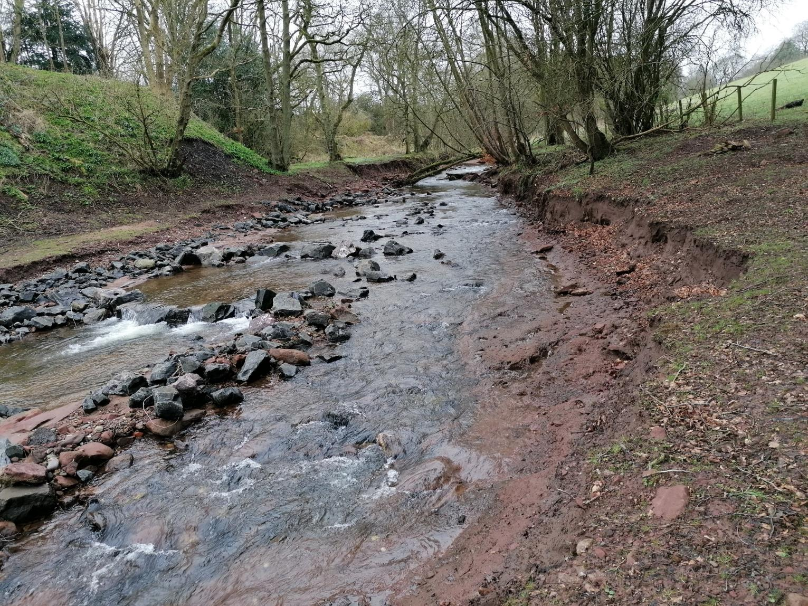
Notes:
Landowner expectation management
As you can imagine, land owner wasn’t best pleased.
No-one expected this level of adjustment.
In addition, Contract and attributing defect to a party wasn’t useable in this case due to Scope which specified restoration of a natural channel.
Lesson-
Keeping up communication with landowner that the river/site could still adjust. Barrier has been there for over 100 years so removing it is a massive change!
With restoring natural rivers maybe we need to accept this risk and plan for remedial work if required. Natural rivers are messy.

Slide 12
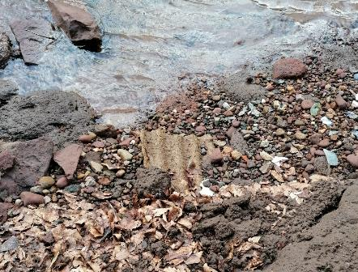
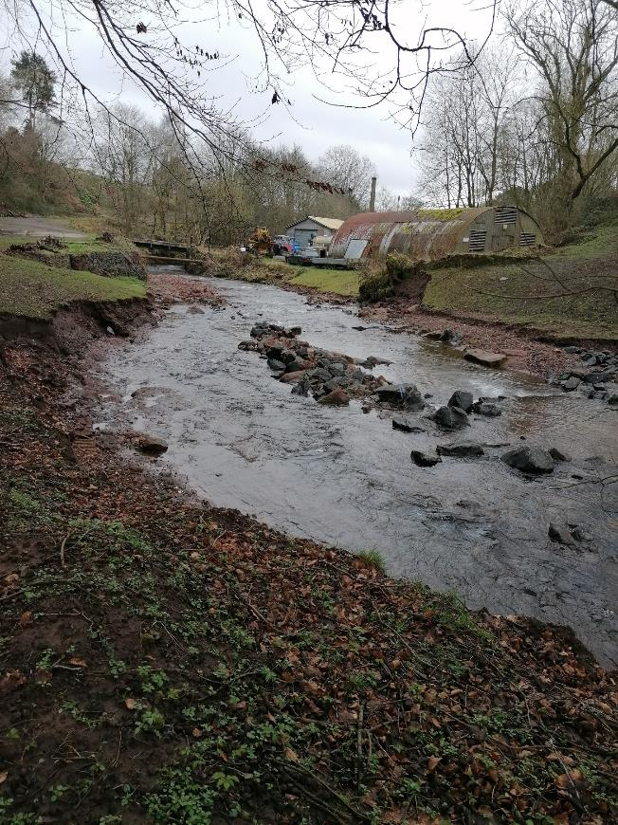
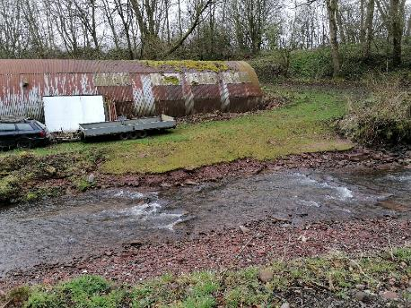
Challenges
Remedial works
Appropriate level of remedial work
Landowner boundary setting
Notes:
Agreed, an appropriate level of remedial work is right thing to do here
To make matters worse, the river also eroded into an old rubbish dump which uncovered asbestos
Remedial work
Right bank below Nissen Hut: Some bank toe protection and willow planting;
Left bank by-pass channel: Remove mid-channel bar (former bank toe) and formalise natural steps that have formed in by-pass with the constructed steps so that there isn’t a weak point.
At this point, landowner quickly forgot about their regulatory obligation as the fish barrier is no longer there. As a result, landowner applied some pressure for more remedial work where risk isn’t present or outwith the restoration site.
Important to set boundaries of what work we will do and re-communicate their position in terms of fish passage obligations which SEPA fulfilled. We will do remedial work where we see risk that needs to be reduced. However, erosion due to winter floods is a land management responsibility.

Slide 13
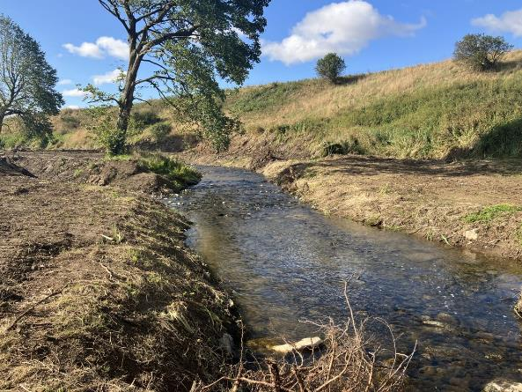
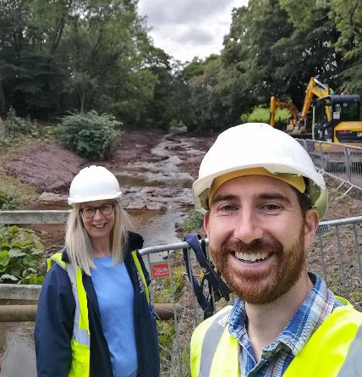
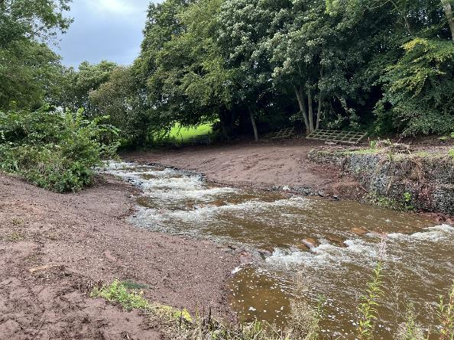
Successes
Successes!
Natural fish passage
37.6km habitat
RBMP actions achieved
Restored natural rivers
Notes:
Despite challenges, removing a fish barrier is incredibly rewarding experience everyone involved. As you can see in the photo! Surreal to look at your site after 4 years and the the weir is gone.
Natural fish passage restored
37.6km habitat opened up for first time in over 100 years
RBMP actions achieved: Two waterbodies raised to Good for fish migration
Natural river form and function including sediment transport restored.
Low maintenance for landowners

Slide 14
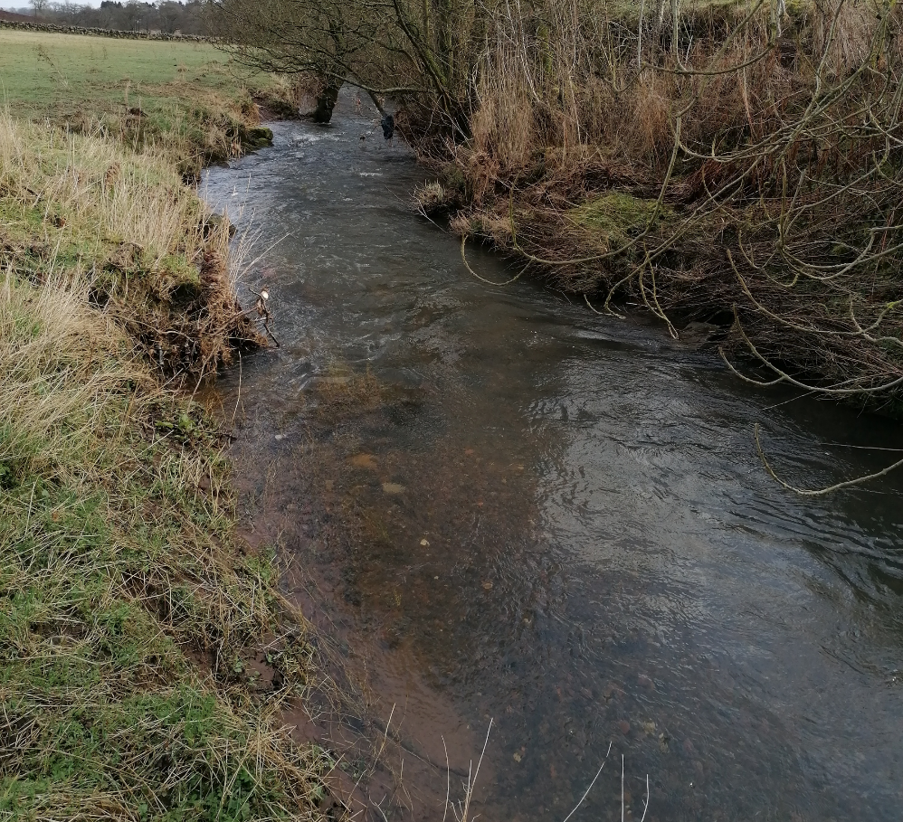
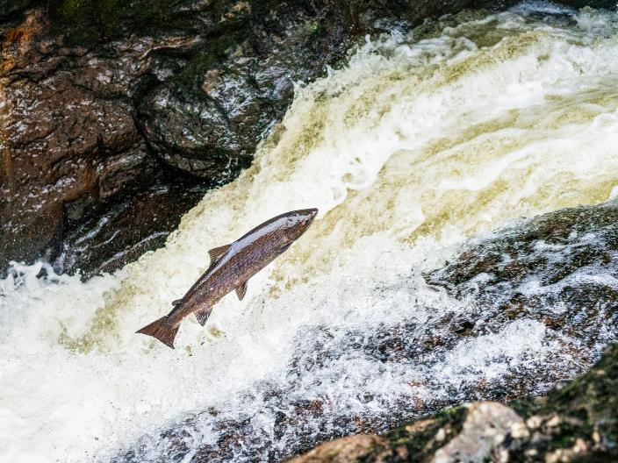
Successes
Return of migratory Fish!
Success!
Notes:
Sea trout redds spotted upstream of Bronie and Gateside Mills.
Hoping to get SEPA ecology to e-fish this Summer to confirm Salmon
Gateside is stabilising while forming messy dynamic natural channel. Otters, Kingfisher, heron to name a few have all been seen.
Bronie weathered first winter well and has stable channel.

Slide 15
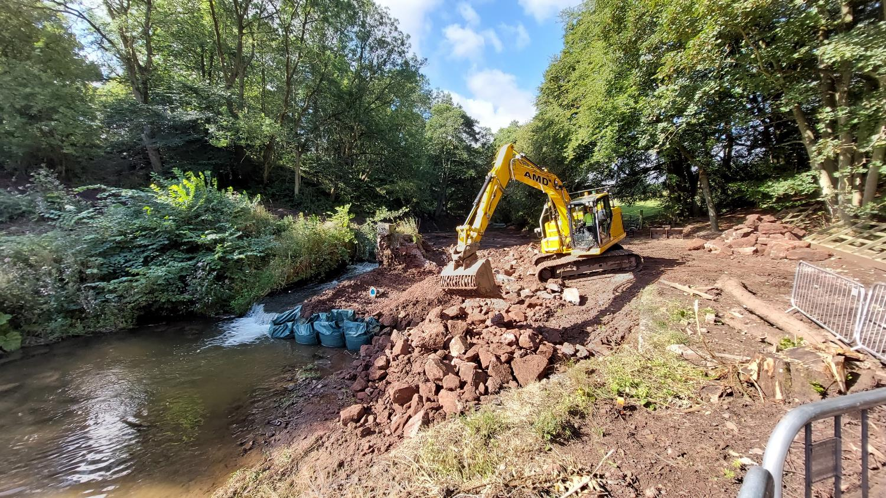
Successes
Added Benefits- Gateside
Low carbon, low waste
Notes:
Added benefit: As-Built Carbon emissions almost 40% less than estimate at end of design and very low waste
Project had a Sustainability focus. Opportunity was identified with Designer to use a carbon calculator to estimate and monitor emissions. 4.3 tonnes were reduced and majority of waste re-used by landowner.

Slide 16
Successes
Added Benefits- Bronie
4400 Native riparian trees
Notes:
Added benefit: 4400 native trees were planted in the riparian zone post works completion
Close communication required with landowner’s forestry manager during works to ensure the works were timed around the harvesting and re-planting of adjacent forest. Forestry manager, contributed 4000 native trees when re-planting site and works contractor McGowans contributed a further 400 to the site.

Slide 17
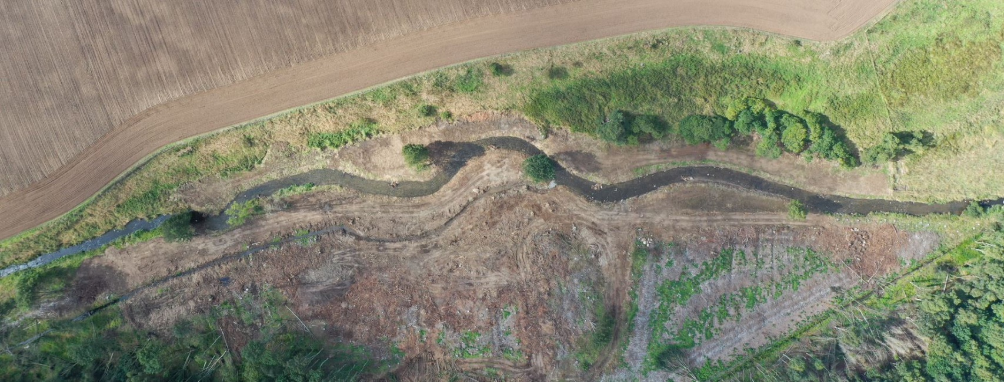
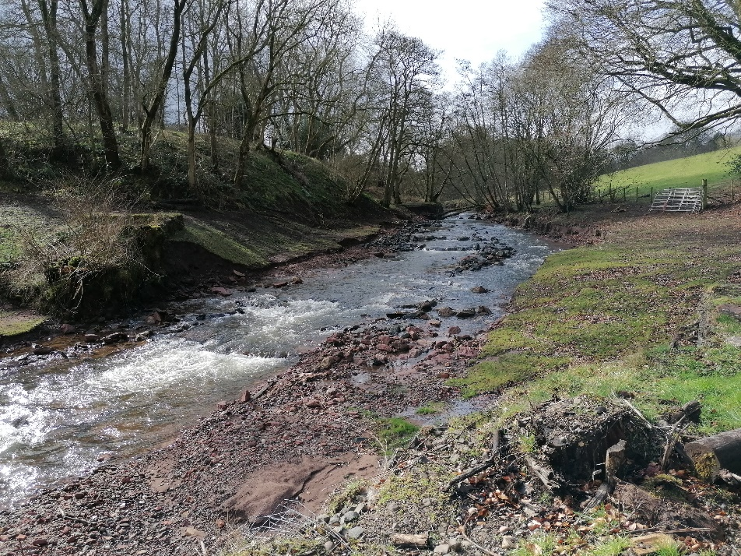
Bronie Burn
Key points
Contact details
Lawrence Belleni
Restoration Specialist
Email: lawrence.belleni@sepa.org.uk
sepa.org.uk
Gateside Mills
Notes:
Hopefully this presentation has been valuable, thought provoking and if I’m lucky, motivational.
Key points
Works- Expect unexpected challenges
Technical support, close communication and relationship building very important
Trust Designers and Contractors
Success extremely rewarding!
Restoring natural rivers may not work well with contracts. May have to accept risk.
Landowner engagement, expectation management and boundary setting
And Added Benefits come from good relationships and simply asking.
Thank you

