Slide 1
Dam Removal Europe Conference
Manchester, 18th May 2023
Tim Jacklin, Wild Trout Trust
Ryan Taylor, Environment Agency

Slide 2
Snake Lane Weir Removal
River Ecclesbourne, Duffield, Derbyshire

Slide 3
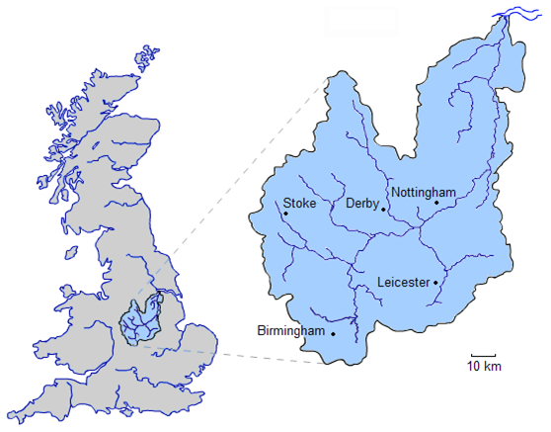
River Trent
3rd longest UK river 298km; tideway 80km
Enters North Sea via Humber Estuary
Two upland (salmonid) tributaries – Dove and Derwent flowing off the south Pennines (Peak District)
Notes:
Context

Slide 4
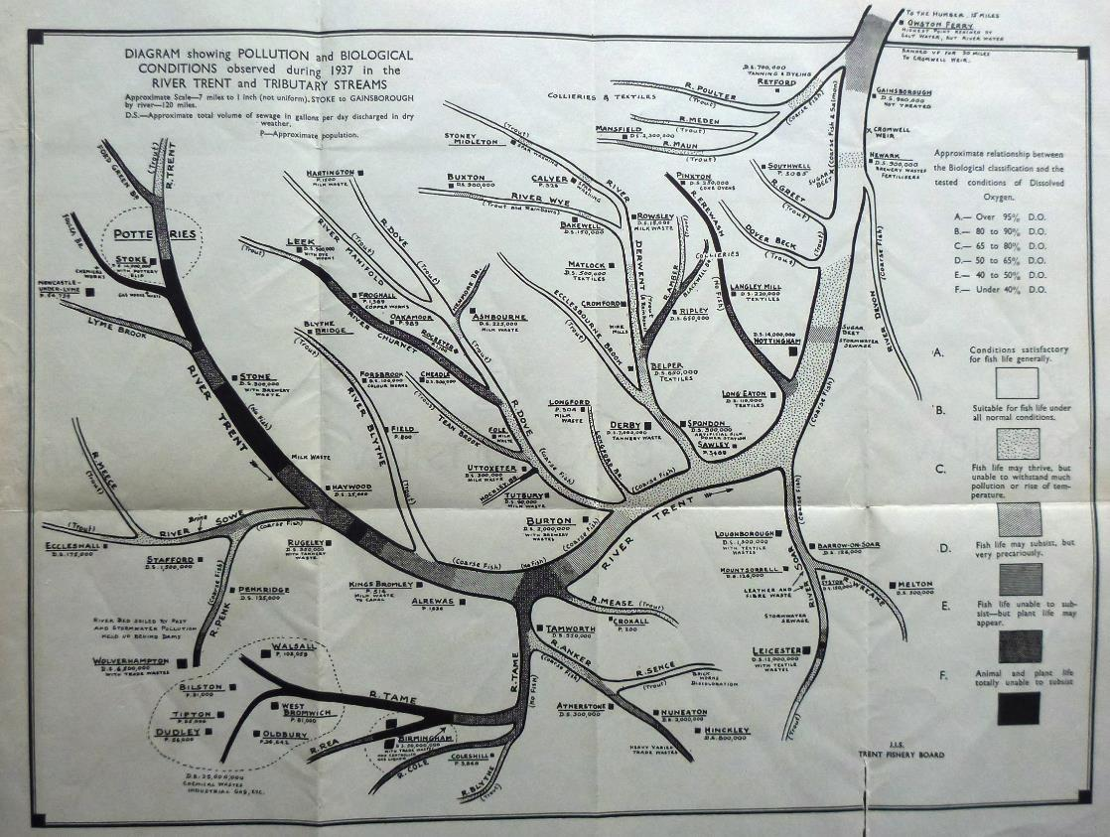
Urban/industrial areas on lowland headwaters – Birmingham, Stoke.
Chronic pollution C20th
1937 – black = no animal or plant life!
Upland rivers relatively clean (water supply) but salmon extinct by 1930s
WQ improves 1970 onwards
Salmon restoration from 1998

Slide 5
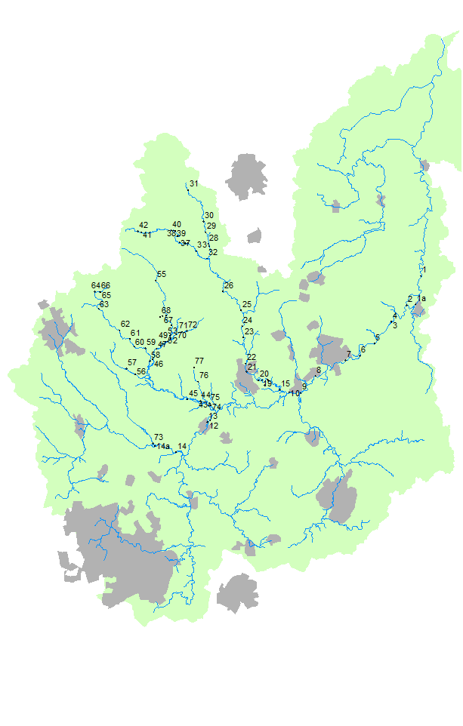
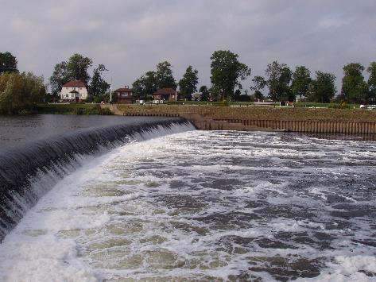
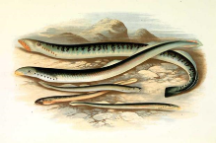
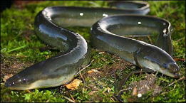
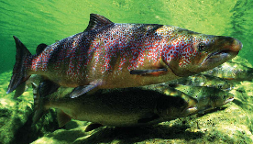
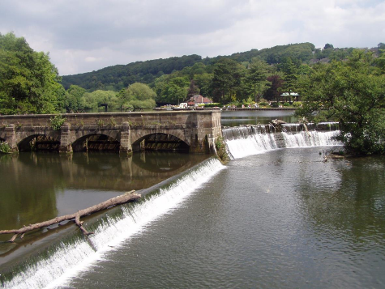
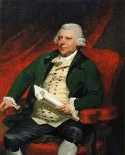
Barriers, barriers, barriers….
(P)
Lower catchment barriers permeable to salmon, but not eels, lamprey, etc.
Upper catchment barriers permeable to no species!
et al.
Notes:
Ecclesbourne – small sub-catchment (60 sq km, 28km of river/tribs.) – but important because:
Current upstream limit of salmon migration on the Derbyshire Derwent –Mills, cradle of C18th Industrial Revolution, Now UNESCO WHS
Salmon in Trent – restoration since 1998 – Dove and Derwent are upland spawning tribs. Lower catchment barriers permeable to salmon, but not eels, lamprey, most other species.

Slide 6
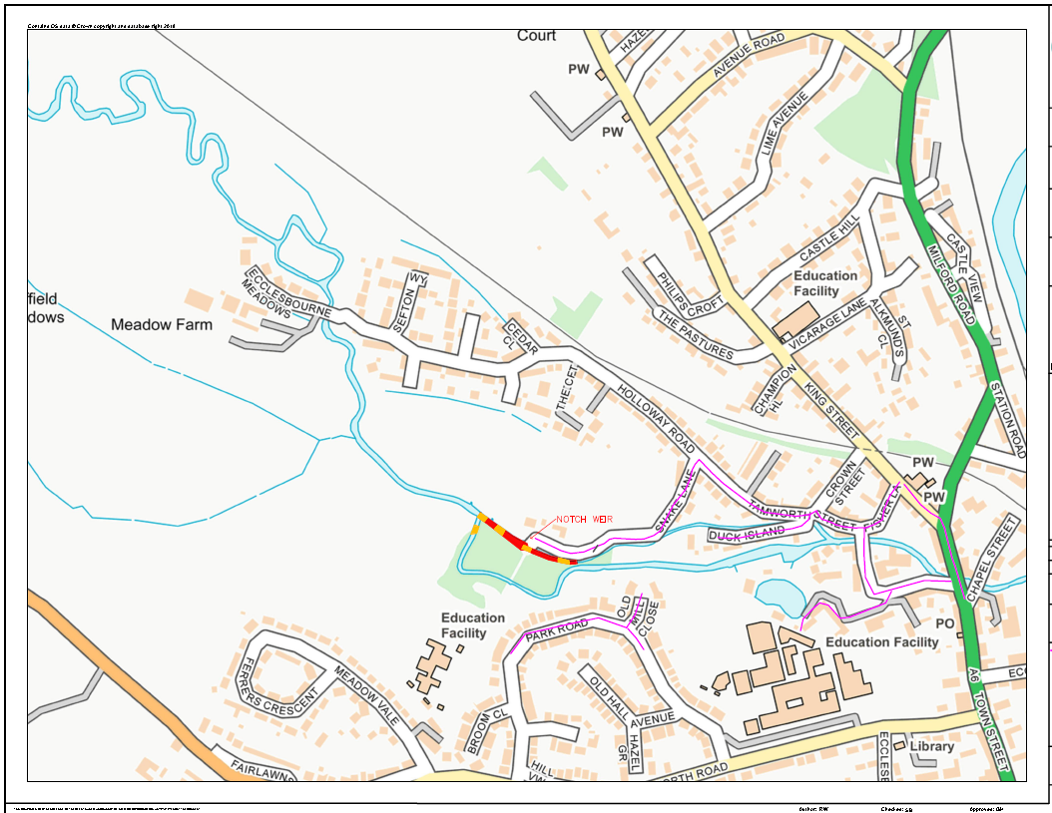
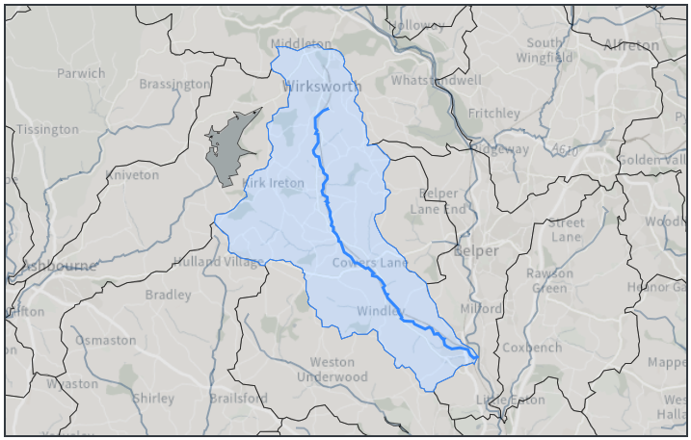
Notes:
Two remaining barriers on Ecclesbourne catchment, Snake Lane c.1km from Derwent confluence. Lots of salmon redds observed at the confluence and up to Snake Lane weir.
Layout of site, flow left to right. Flow split at upstream end into two channels. Northerly channel has flow priority (despite appearances). Weirs at Snake Lane and d/s end of secondary channel.

Slide 7
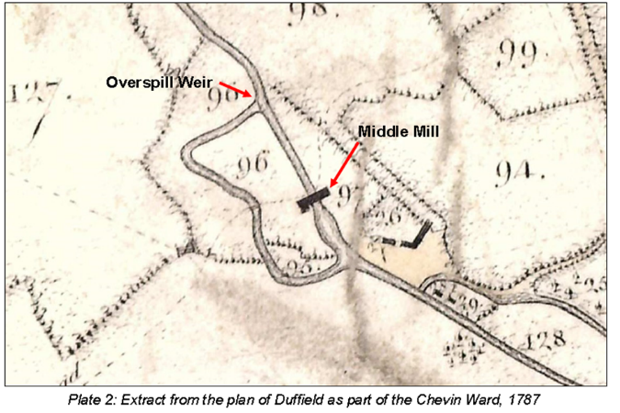
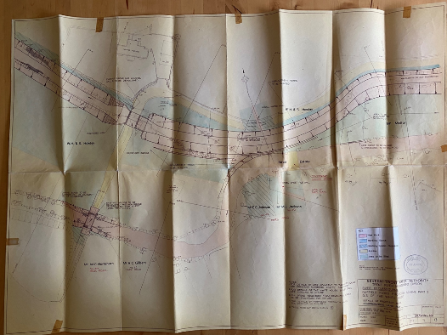
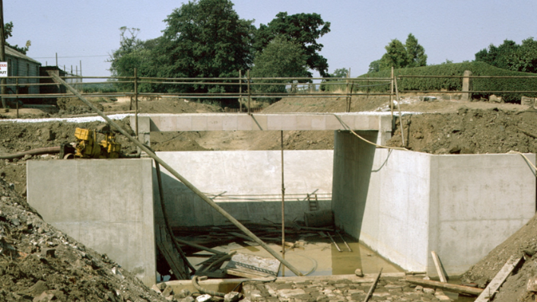
1960
1787
1975
Notes:
Why is it there?
Mills from at least 1787, probably centuries before.
Demolished circa 1960 leaving sluices
STWA Flood alleviation scheme 1970s – channel realignment and replacement of sluices with concrete weirs.

Slide 8
Notes:
Impassable barrier to upstream fish migration. Cuts off the Ecclesbourne from the Derwent c.1km upstream of confluence.
Been on the fish passage radar for years. Previous options appraisals had foundered – contaminated land, access, heritage, cost-benefit, political will, etc

Slide 9
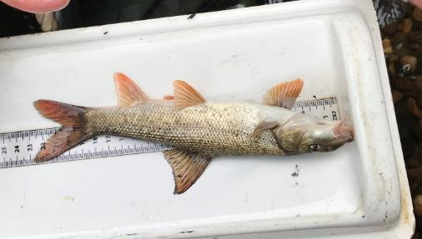
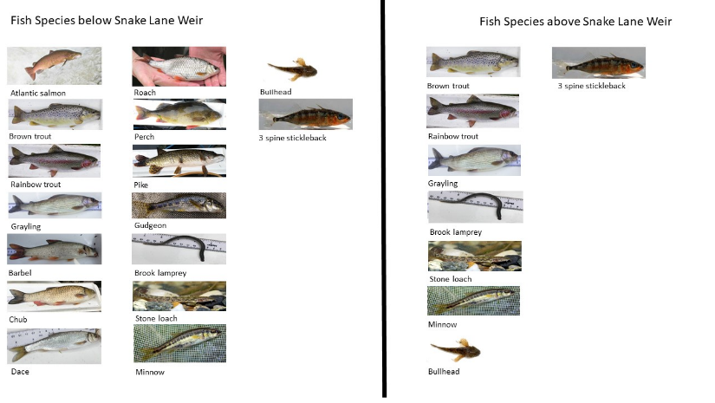
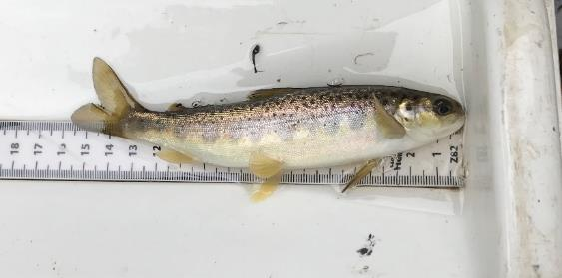
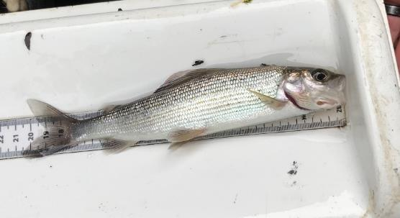
Impoverished fish community upstream of weir compared to downstream
Notes:
NB No eels

Slide 10
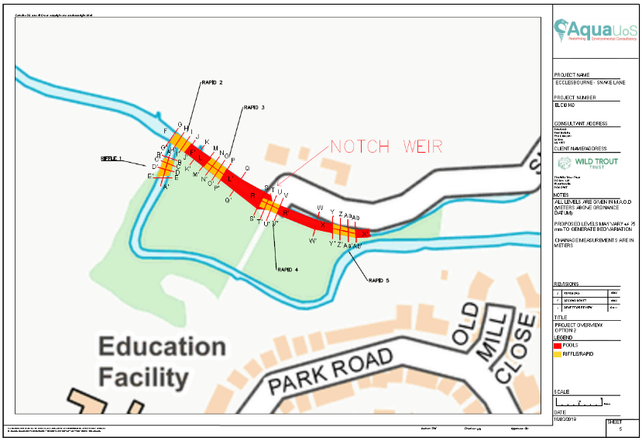
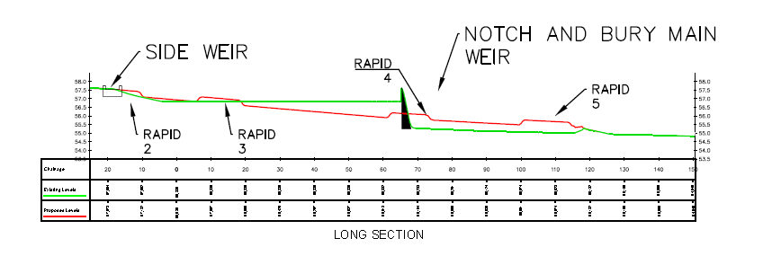
2.5-m high weir – remove
Maintain previous flow split (preferentially in N channel)
Remodel river bed to control increased hydraulic gradient
Modelled max. shear stress 500 N/m2 (=2.5 m/s). 600mm min. boulders
Four rock rapids over 120m
Fifth rapid on side channel to manage flow split
Notes:
The master plan
Notch weir to bed level
Build a series of 4 rapids over 120m reach to ensure same flow split at upstream end. Bury remains of weir within rapid.
5th rapid on secondary channel to manage flow split

Slide 11
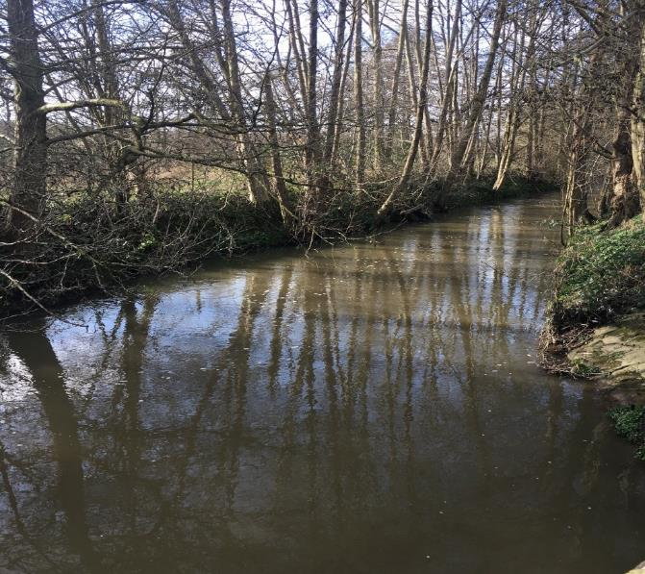
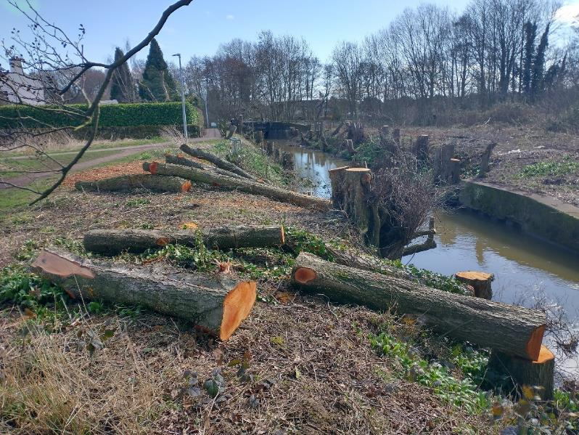
Tree Felling upstream of weir, February 2022
Notes:
Under Forestry Commission Felling Licence

Slide 12
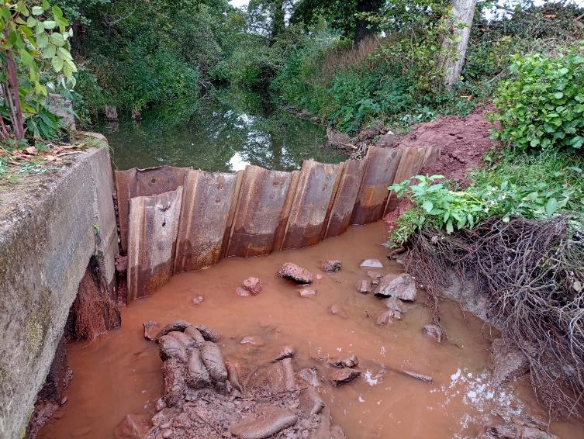
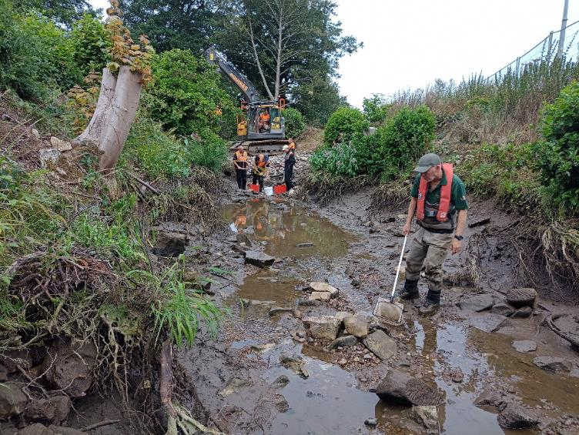
River diversion and fish rescue, July 2022
Notes:
Sheet pile and clay coffer dam diverts water into secondary channel
Flood risk emergency procedures – didn’t have a drop of rain!

Slide 13
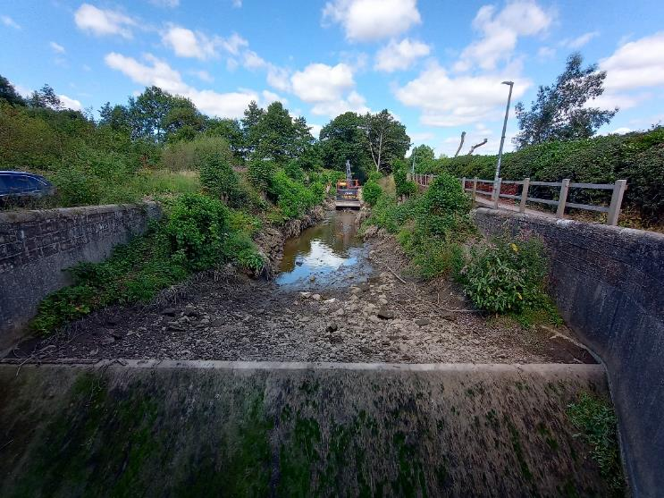
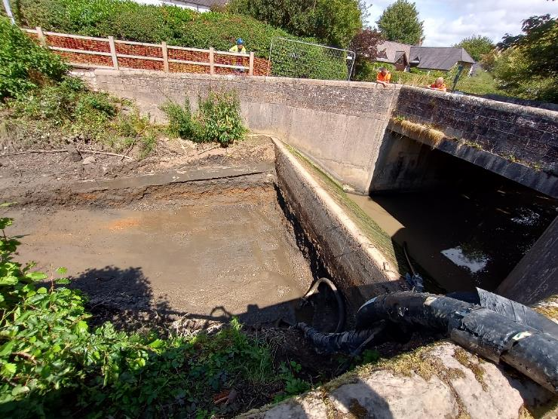
Notes:
Removed accumulated sediments to expose back of weir – stockpiled on site.
Installed rock access ramp and roadway for excavator access from upstream
Groundwater infiltration pumped over the weir and filtered through straw bale dam

Slide 14
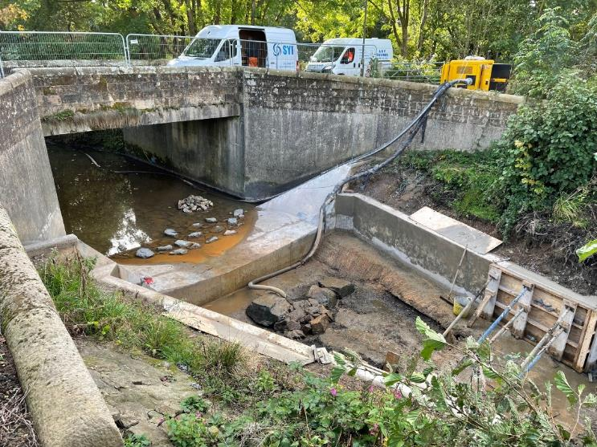
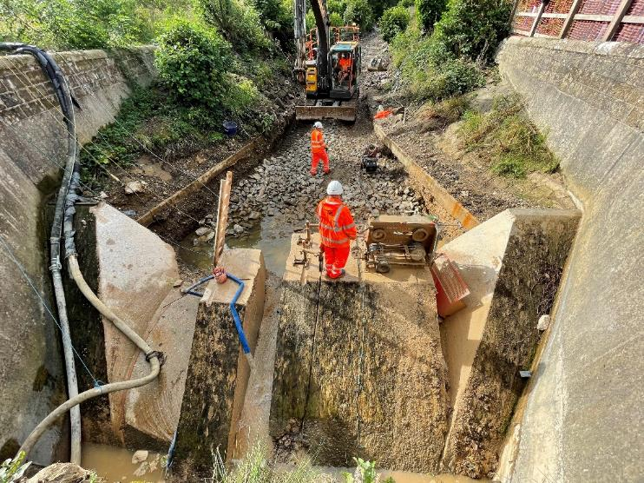
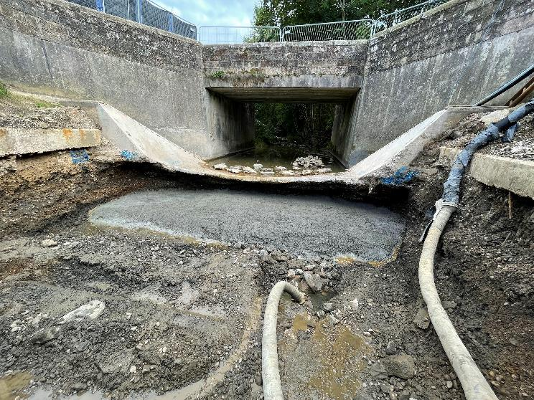
Notes:
diamond cutting; removal of ‘cake slices’
22 days work! Unexpected delay/cost. Some work done in parallel (downstream rapid and on secondary channel).
Structural engineer oversight.
Underpinning of weir base and wingwalls.

Slide 15
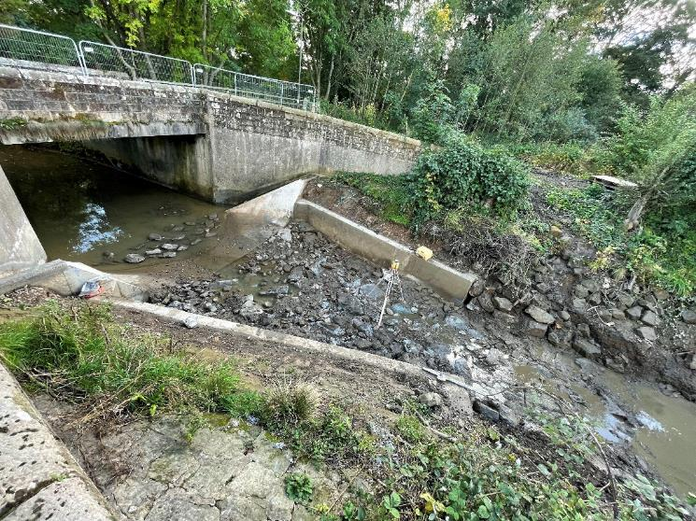
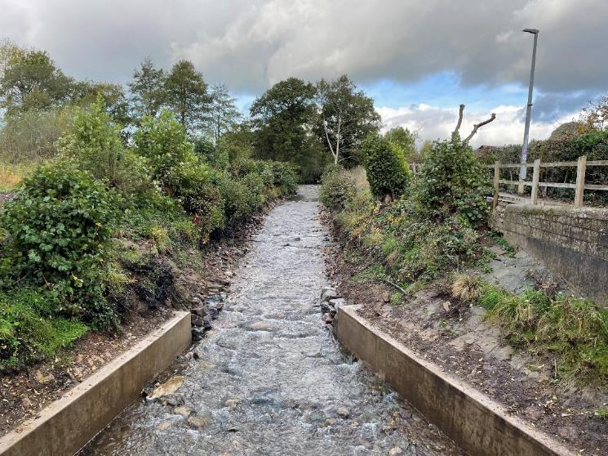
Notes:
Rock rapid construction

Slide 16
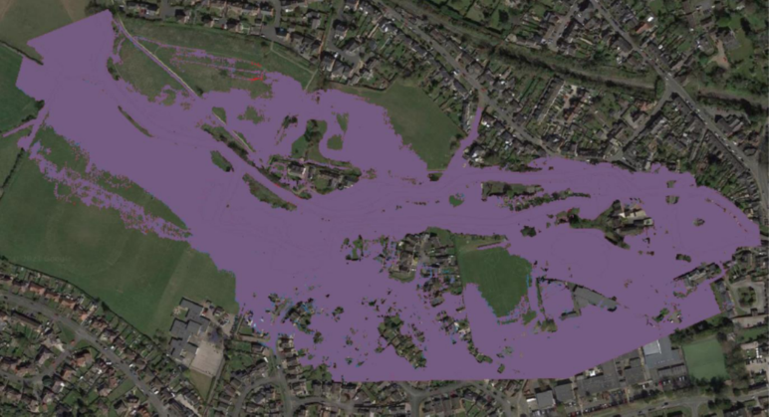
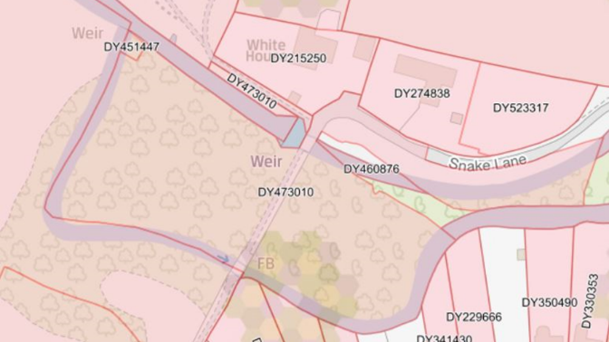
Project development – the challenges
Risk – (bridge, etc.) Contingency approach
Weir ownership - ???
Flood modelling & FRAP
Funding – failed HLF bid
EA-funded £430K
Three-year process 2019 – 2022
Delivery July – Oct 2022
Notes:
Risk – bridge, wingwalls, bank stability. Structural engineering input. ‘Suck it and see’ with adequate contingency.
Weir ownership – orphaned structure; no record of STWA or EA ownership; not on land registry. Due diligence and insurance.
Flood modelling & FRAP – successfully got FRAP then EA model error discovered, back to drawing board!
Funding – unsuccessful HLF Green Recovery bid; eventually funded via WEIF EA Partnership Grant to WTT. Ryan Taylor, Derwent Catchment Coordinator – would not have happened without him. Small contributions from Parish Council and Grayling Society.
Community engagement – Parish Council (covid zoom presentations), leaflet drops, door knocking, meetings with residents most affected, interp board on site 12 months in advance. During project – DWT officer schools etc. engagement 670 children.

Slide 17
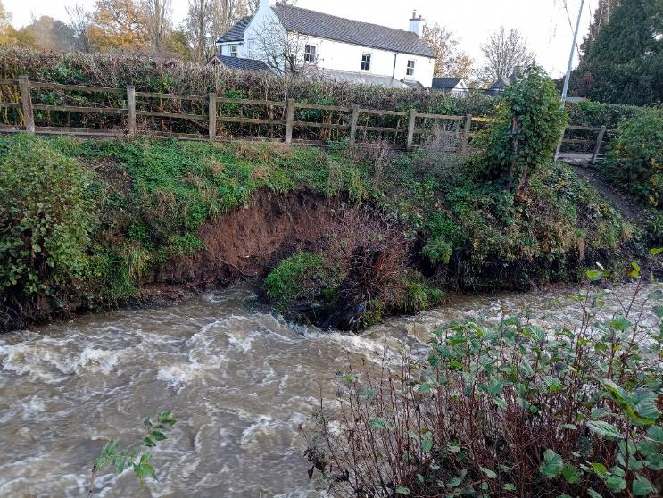
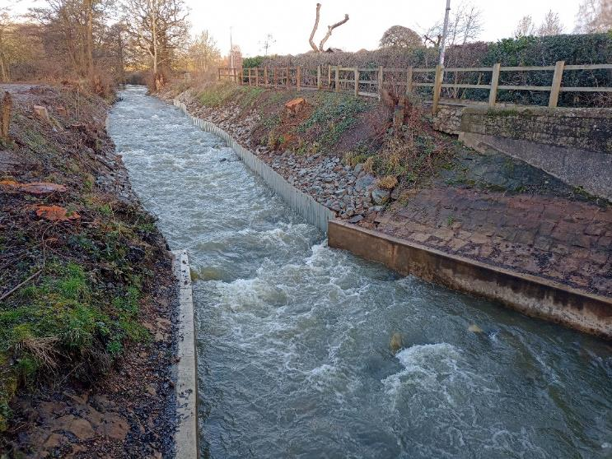
Biggest challenge - Bank collapse November 2022 😱😩
Notes:
After demobilisation.
Yes – we should have seen it coming!
Importance of contingency. Construction cost was £300K before bank collapse which added £80K.
Contractors were fantastic.
Not pretty, but not much choice.

Slide 18
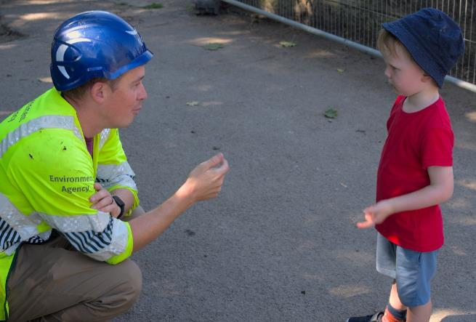
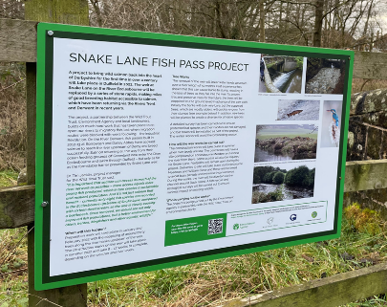
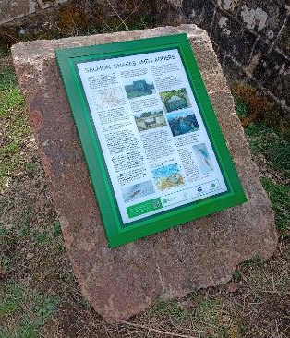
Community Engagement
Parish Council – talks, newsletter, social media
Door knocking – two-way process
Early information board on site
DWT Ecclesbourne Project Officer – 670 local school children engaged
Keeping public access open during construction and talking to people
Press and TV coverage
Permanent information board
Overwhelmingly positive reaction – “So nice to have a ‘good news’ environment story”
Notes:
Ongoing community engagement led by DWT – balsam bash, bug sampling (Ryan trying to recruit an new EA Biodiversity Officer

Slide 19
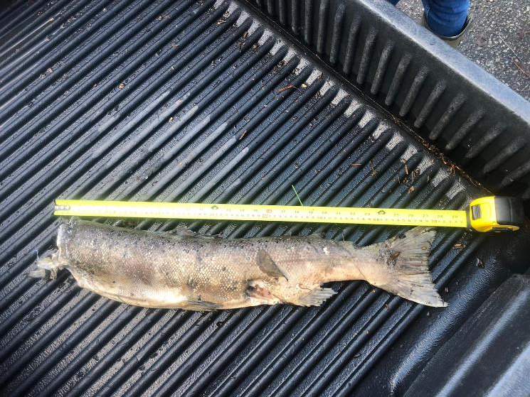
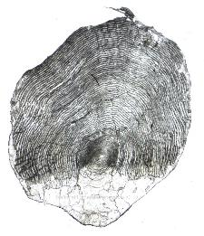
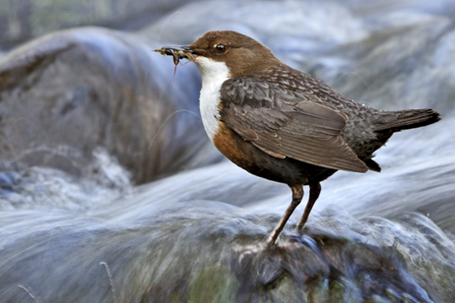
Early days, but…
Adult hen salmon found upstream Jan 2023
Dipper using the rapids/boulders
Further monitoring – fixed point photos/drone video; eDNA; EA e/f survey programme; redd survey
Last remaining barrier on Ecclesbourne is in our sights!
Not a BBQ!

Slide 20
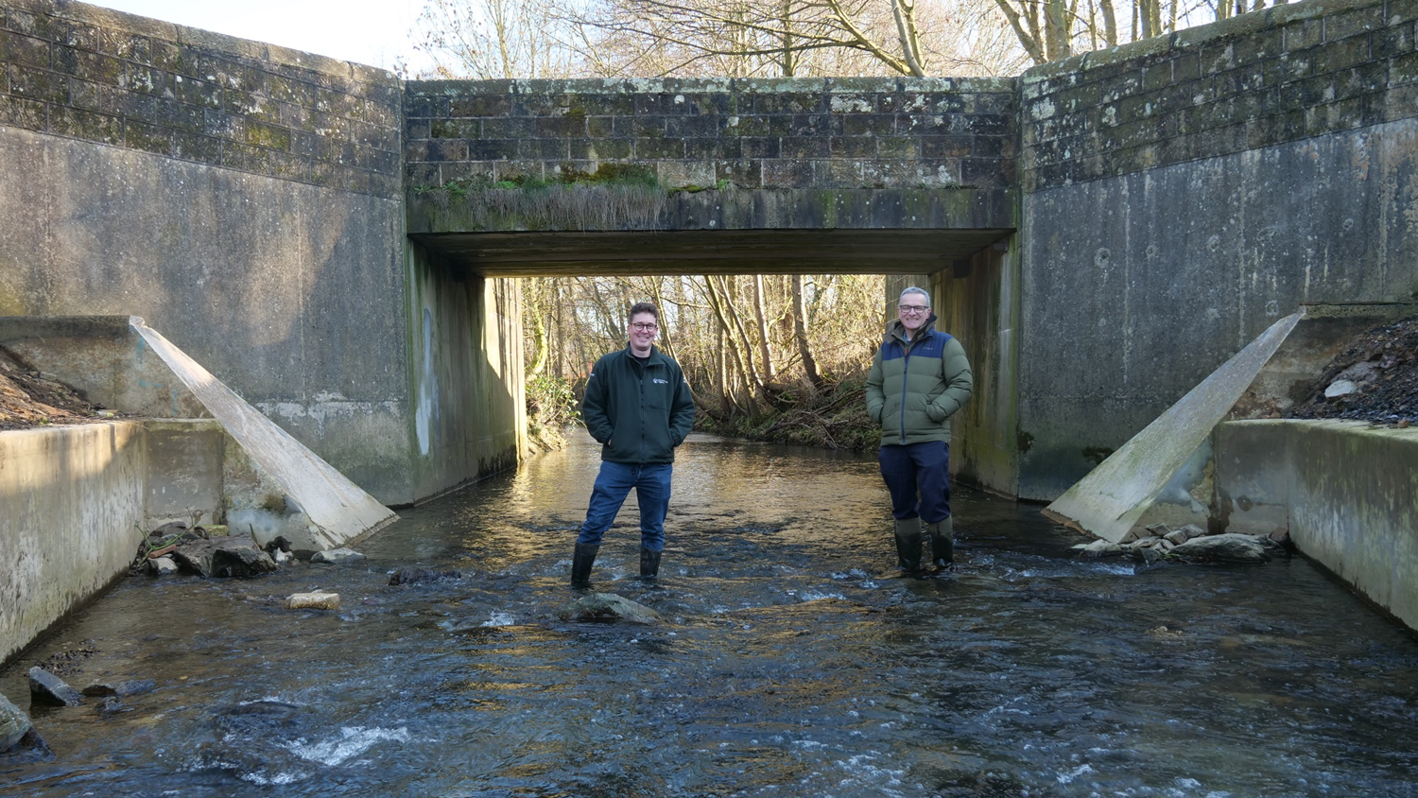

Slide 21
Thank you!
WILDTROUT.ORG

