Slide 1

UK Dam Removal Conference
18th May 2023
Weir’s it Gone? The ups and downs of removing a much-loved
and much-maligned weir
Luke Bryant
Assistant Director

Slide 2

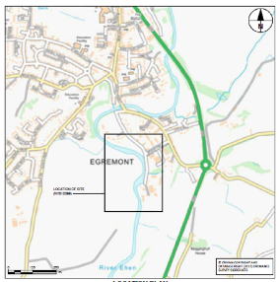
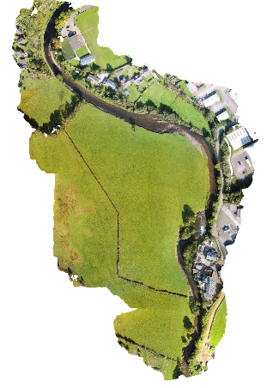
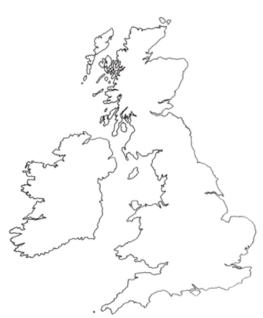
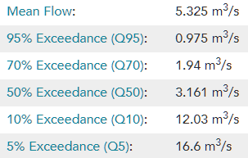

Ennerdale Mill Weir - Location
Notes:
Basic location and mention the photo shows the roughly 350m stretch we worked on

Slide 3
Ennerdale Mill Weir
Notes:
Vicinity of the small trading estate and access road

Slide 4
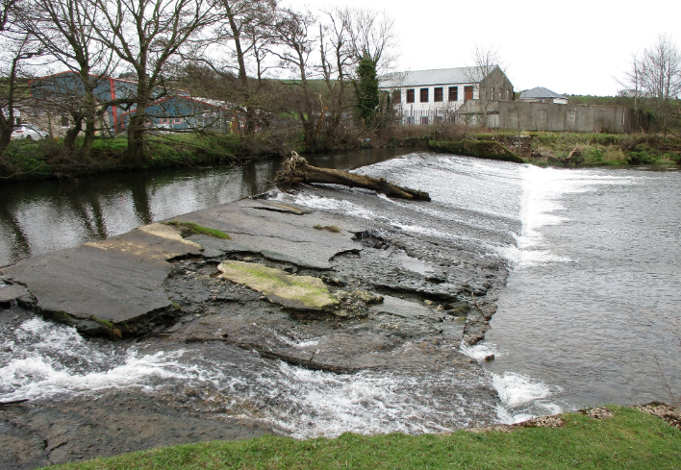
Ennerdale Mill Weir
Background:
  Large, failing weir on River Ehen
  Collapse would have been catastrophic for local businesses, surrounding land and FWPM
  Multi-year monitoring and options appraisal provided evidence of imminent failure
  Barrier to salmon migration – upstream and downstream
  People in Egremont liked the weir – seen as part of the town and their heritage

Slide 5


Ennerdale Mill Weir
Background:
  Large, failing weir on River Ehen
  Collapse would have been catastrophic for local businesses, surrounding land and FWPM
  Multi-year monitoring and options appraisal provided evidence of imminent failure
  Barrier to salmon migration – upstream and downstream
  People in Egremont liked the weir – seen as part of the town and their heritage
Partnership project under the Cumbria River Restoration Strategy (CRRS)

Slide 6
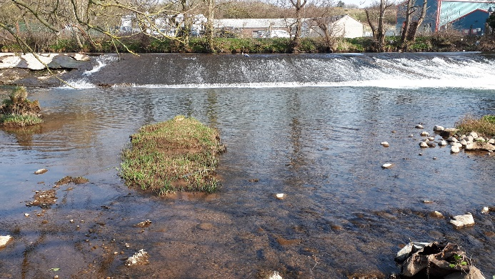
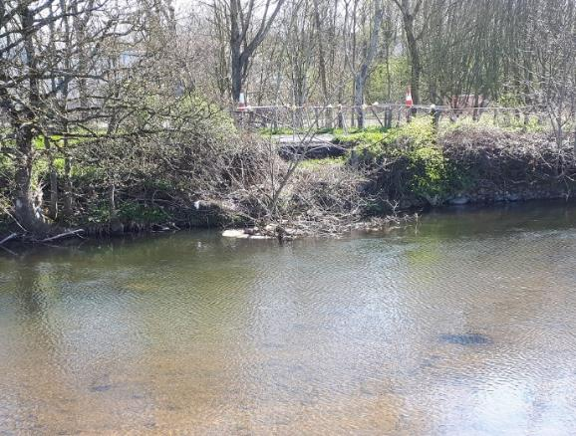
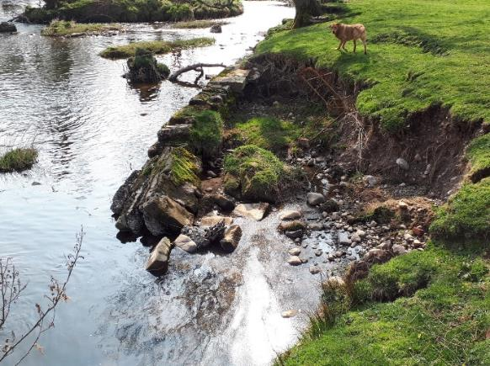
Issues with the weir, pre-removal
Notes:
Face of the weir, upstream riverbank slumping (collapsed drainage system, not erosion, but timing couldn't have been worse – 5 weeks before mobilisation), and downstream erosion just below weir

Slide 7
Opposition & Complexities
Weir Removal
Anglers
EA
NE
Internal
Historic England
Local Business
Notes:
There were 6 distinct forms of either outright objections to weir removal, or added complexities that made the project more challenging

Slide 8
Opposition & Complexities
Anglers
Most vocal of the ‘anti’ groups
Felt that removal wasn’t necessary
They would lose fishing rights
They would lose access to riverbank
We would cause erosion and flooding
Involved Fish Legal to try and stop removal
Local Business
EA
Weir Removal
Historic England
NE
Internal
Notes:
Multiple objections from anglers – most vocal of the ‘against’ groups – they felt not necessary / loss of fishing / loss of access (despite a byelaw banning fishing next to the weir!). They also involved Fish Legal to try to stop process, but wouldn’t engage with EA-led discussions
We worked hard to avoid these sorts of situations:

Slide 9
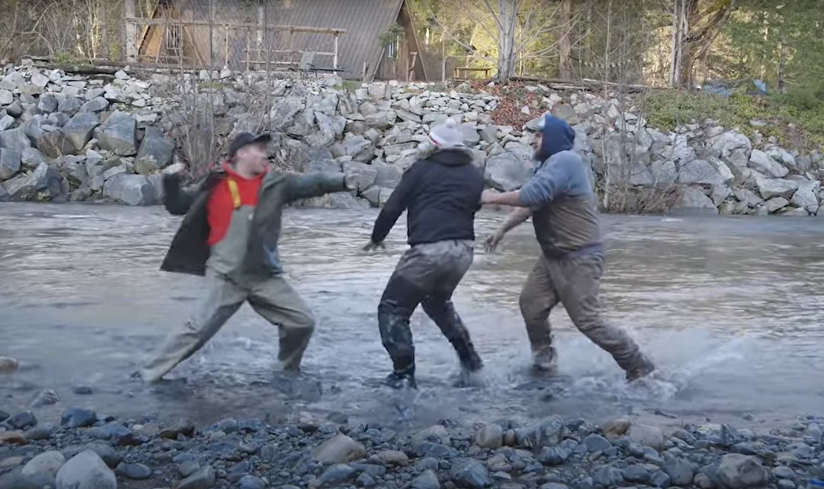
Opposition & Complexities
Anglers
Most vocal of the ‘anti’ groups
Felt that removal wasn’t necessary
They would lose fishing rights
They would lose access to riverbank
We would cause erosion and flooding
Involved Fish Legal to try and stop removal
Local Business
EA
Weir Removal
Historic England
NE
Internal
Notes:
Sorry I meant this slide:

Slide 10
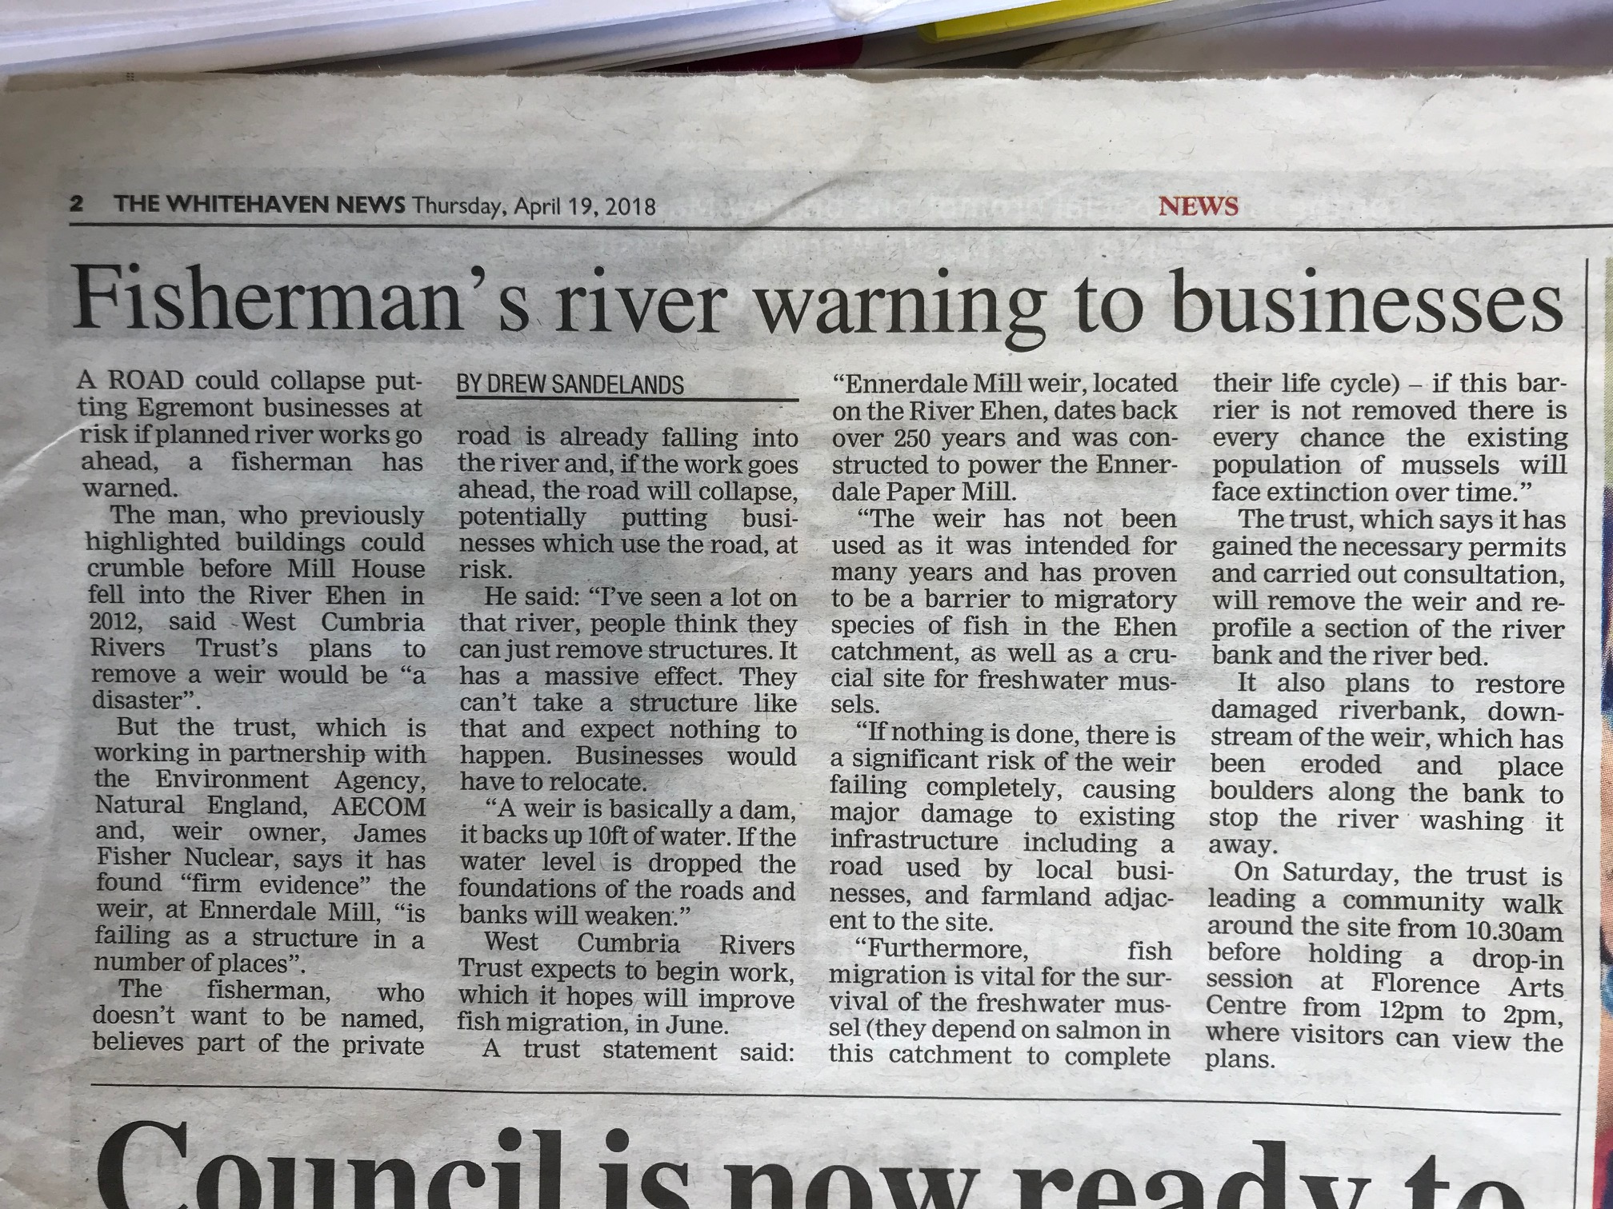
Opposition & Complexities
Anglers
Most vocal of the ‘anti’ groups
Felt that removal wasn’t necessary
They would lose fishing rights
They would lose access to riverbank
We would cause erosion and flooding
Involved Fish Legal to try and stop removal
Local Business
EA
Weir Removal
Historic England
NE
Internal
Notes:
Typically annoying article – headline is about the fisherman but actually most of the article does allow WCRT to refute the claims

Slide 11
Opposition & Complexities
Anglers
Most vocal of the ‘anti’ groups
Felt that removal wasn’t necessary
They would lose fishing rights
They would lose access to riverbank
We would cause erosion and flooding
Involved Fish Legal to try and stop removal
Local Business
EA
Weir Removal
Historic England
NE
Internal
Notes:
(move on quickly)

Slide 12
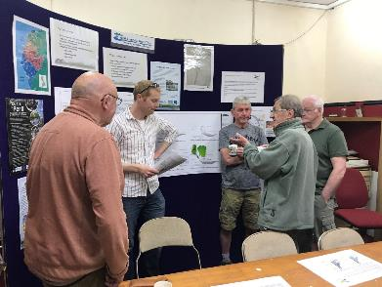
Opposition & Complexities
Anglers
Most vocal of the ‘anti’ groups
Felt that removal wasn’t necessary
They would lose fishing rights
They would lose access to riverbank
We would cause erosion and flooding
Involved Fish Legal to try and stop removal
WCRT and EA held multiple public meetings
Engagement attempted 2016-2018
ultimately, they disagreed…..
Local Business
EA
Weir Removal
Historic England
NE
Internal
Notes:
We tried repeatedly to engage (look at me trying to find the will to live!) but in the end, there was a difference of opinion between some of the anglers and WCRT

Slide 13
Opposition & Complexities
Anglers
Local Business
Main concern around roadside access
Worried about future flooding
Unhappy that the town’s heritage would be lost
Locals fond of weir – part of local history
Several claims of ‘grandad built it’ (despite construction over 250 years ago!)
EA
Weir Removal
Historic England
NE
Internal
Notes:
Local businesses and locals – removal will cause flooding / bank collapse / damage nearby road. Also complaints that their heritage will be lost / weir is a work of art / grandad helped build it (in 1750!!) / repair it

Slide 14
Opposition & Complexities
Anglers
Local Business
Main concern around roadside access
Worried about future flooding
Unhappy that the town’s heritage would be lost
Locals fond of weir – part of local history
Several claims of ‘grandad built it’ (despite construction over 250 years ago!)
Assumption the structure was unique or specially constructed
EA
Historic England
Weir Removal
NE
Internal
Notes:
Historic England – generally opposed as structure dates back to 18th Century.

Slide 15
Opposition & Complexities
Anglers
Local Business
Main concern around roadside access
Worried about future flooding
Unhappy that the town’s heritage would be lost
Locals fond of weir – part of local history
Several claims of ‘grandad built it’ (despite construction over 250 years ago!)
Assumption the structure was unique or specially constructed
We engaged with businesses and locals
We commissioned full Archaeological Survey & watching brief – very expensive
EA
Historic England
Weir Removal
NE
Internal
Notes:
Also assumed structure was historically unique or at least interesting

Slide 16
Opposition & Complexities
Local Business
Main concern around roadside access
Worried about future flooding
Unhappy that the town’s heritage would be lost
Locals fond of weir – part of local history
Several claims of ‘grandad built it’ (despite construction over 250 years ago!)
Assumption the structure was unique or specially constructed
We engaged with businesses and locals
We commissioned full Archaeological Survey & watching brief – very expensive
Historic England
Notes:
Historic England – proven to be typical cobbles on wooden frame, with a concrete face dating back to (roughly) the 1960’s

Slide 17
Opposition & Complexities
Anglers
Local Business
Main concern around roadside access
Worried about future flooding
Unhappy that the town’s heritage would be lost
Locals fond of weir – part of local history
Several claims of ‘grandad built it’ (despite construction over 250 years ago!)
Assumption the structure was unique or specially constructed
We engaged with businesses and locals
We commissioned full Archaeological Survey & watching brief – very expensive
We retained a small section on l.h bank to appease
EA
Historic England
Weir Removal
NE
Internal
Notes:
To try and appease locals and Historic England, we agreed to retain part of the left-hand weir stucture

Slide 18
Opposition & Complexities
Anglers
EA
COULDN’T HAVE BEEN BETTER
Local Business
NE
Weir Removal
Historic England
Internal
Notes:
Moving on to or other partners… they couldn’t have helped out more

Slide 19

EA / NE
me

Slide 20
Opposition & Complexities
Anglers
EA
Concerns were fair and reasonable:
Flood risk
Sediment release during construction
FWPM & damage from sediment release
Turbidity levels during construction
Local Business
NE
Weir Removal
Historic England
Internal
Notes:
But seriously… I was asked for the warts-and-all stories rather than the usual, glossy version. I definitely work in close partnership with the EA and NE and the staff on the ground have been great – rather, it’s often the process that goes on behind the scenes that slows down or reduces the amount of delivery we can achieve.

Slide 21
Opposition & Complexities
Anglers
EA
Concerns were fair and reasonable:
Flood risk
Sediment release during construction
FWPM & damage from sediment release
Turbidity levels during construction
BUT – process and delays became very costly and time-consuming:
Local Business
NE
Weir Removal
Historic England
Internal
Notes:
Questions raised during Impoundment Licence / planning / permitting stages meant extra work from consultant = time delays = project postponed from summer 2017 to summer 2018 = funding which had been secure was no longer (necessarily) available

Slide 22
Opposition & Complexities
Anglers
EA
Concerns were fair and reasonable:
Flood risk
Sediment release during construction
FWPM & damage from sediment release
Turbidity levels during construction
BUT – process and delays became very costly and time-consuming, e.g.
Impoundment licence – 18month process
Uncertainty around flood risk
Delays pushed delivery back
Funding then uncertain (and more needed)
Local Business
NE
Weir Removal
Historic England
Internal
Notes:
Questions raised during Impoundment Licence / planning / permitting stages meant extra work from consultant = time delays = project postponed from summer 2017 to summer 2018 = funding which had been secure was no longer (necessarily) available

Slide 23
Opposition & Complexities
Anglers
Internal
Staffing issues – illness and qualifications
Funding – costs increased so new funding identified from the MMO
MMO process – WCRT faced massive financial risk & exposure due to delayed reimbursement
At one point we were 2 weeks away from being £35K overdrawn (as a charity we have no overdraft facility) which would have meant no staff wages paid
Local Business
EA
Weir Removal
Historic England
NE
Notes:
Internal issues mainly surrounding financing – especially much of coming in arrears
On last point – ask “imagine the stress I and my director were under, worrying about being able to pay staff salaries”

Slide 24
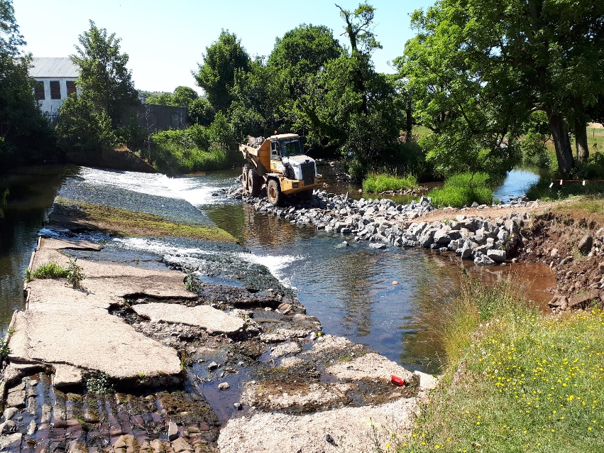
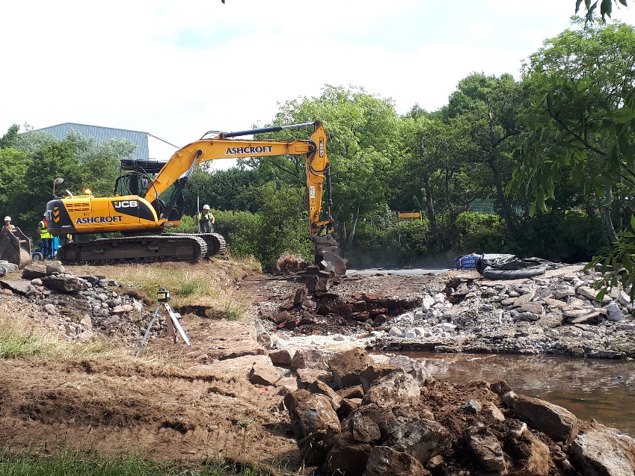
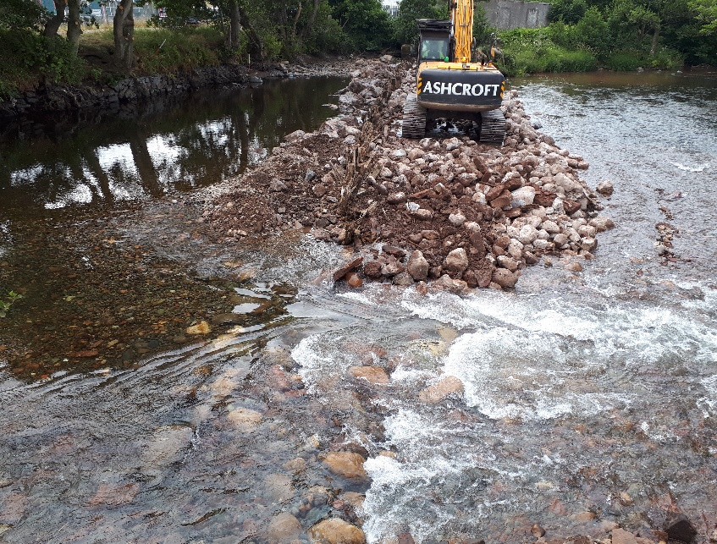
So… what?
All of these problems I’ve described could be described as ‘process’
Whereas ‘practical’ issues (landowner negotiations, finalising designs, contractor searching / tendering, river levels, weather…..) form a different set of challenges
Notes:
Despite this… we had excavators working in June 2018

Slide 25
Happy Ending? Communication is vital…
Community engagement
  Signs around town and notices in local newspapers
  Letters to town council and newspaper
  Leaflet drop to all local residents
  Events to promote project (e.g. community walk)
  Meetings with affected businesses
  Contractor took ‘ownership’ of project including Comms
Partnership working
  Stakeholder meetings
  Work with EA to speed up payments
  Regular meetings with NE and EA about FWPM
Notes:
I can’t overstate the importance of sharing information and making sure all stakeholders were kept abreast of developments

Slide 26
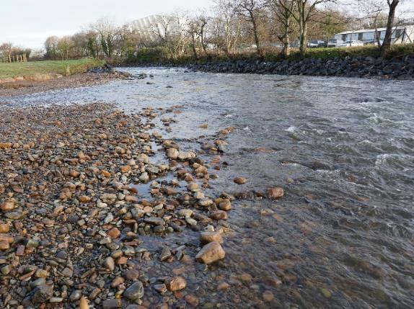
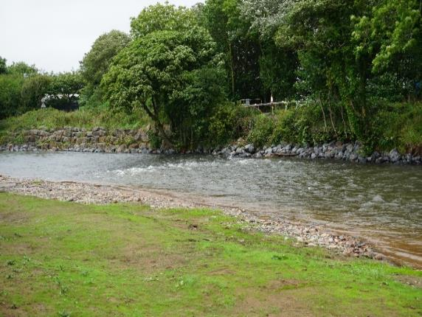
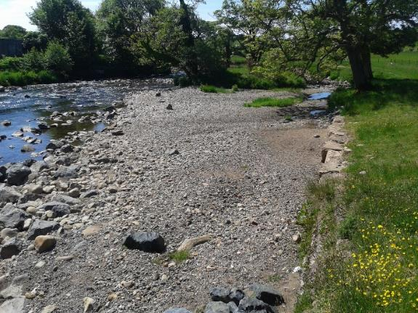
The result
Notes:
Weir fully removed
Upstream rapids created to manage erosion risk
Downstream riverbanks protected and more resilient to future flood events

Slide 27
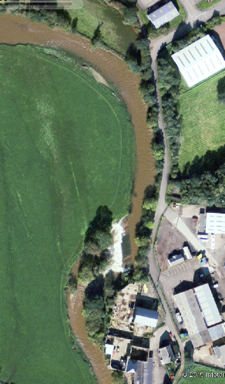
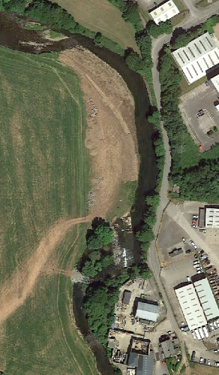
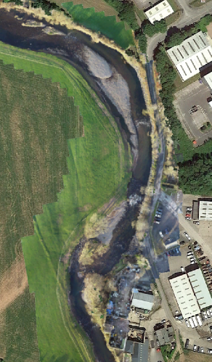
Performance
2008
2018
2019

Slide 28
Project outcomes
Completed on time and within budget (c. £350,000)
Zero pollution incidents during construction phase
FWPM protected – 2019 & 2022 surveys showed improved conditions
Natural sediment regime observed
Increased salmon numbers upstream (anecdotal)
Ongoing negativity from anglers
Notes:
And a final word from our anglers:

Slide 29
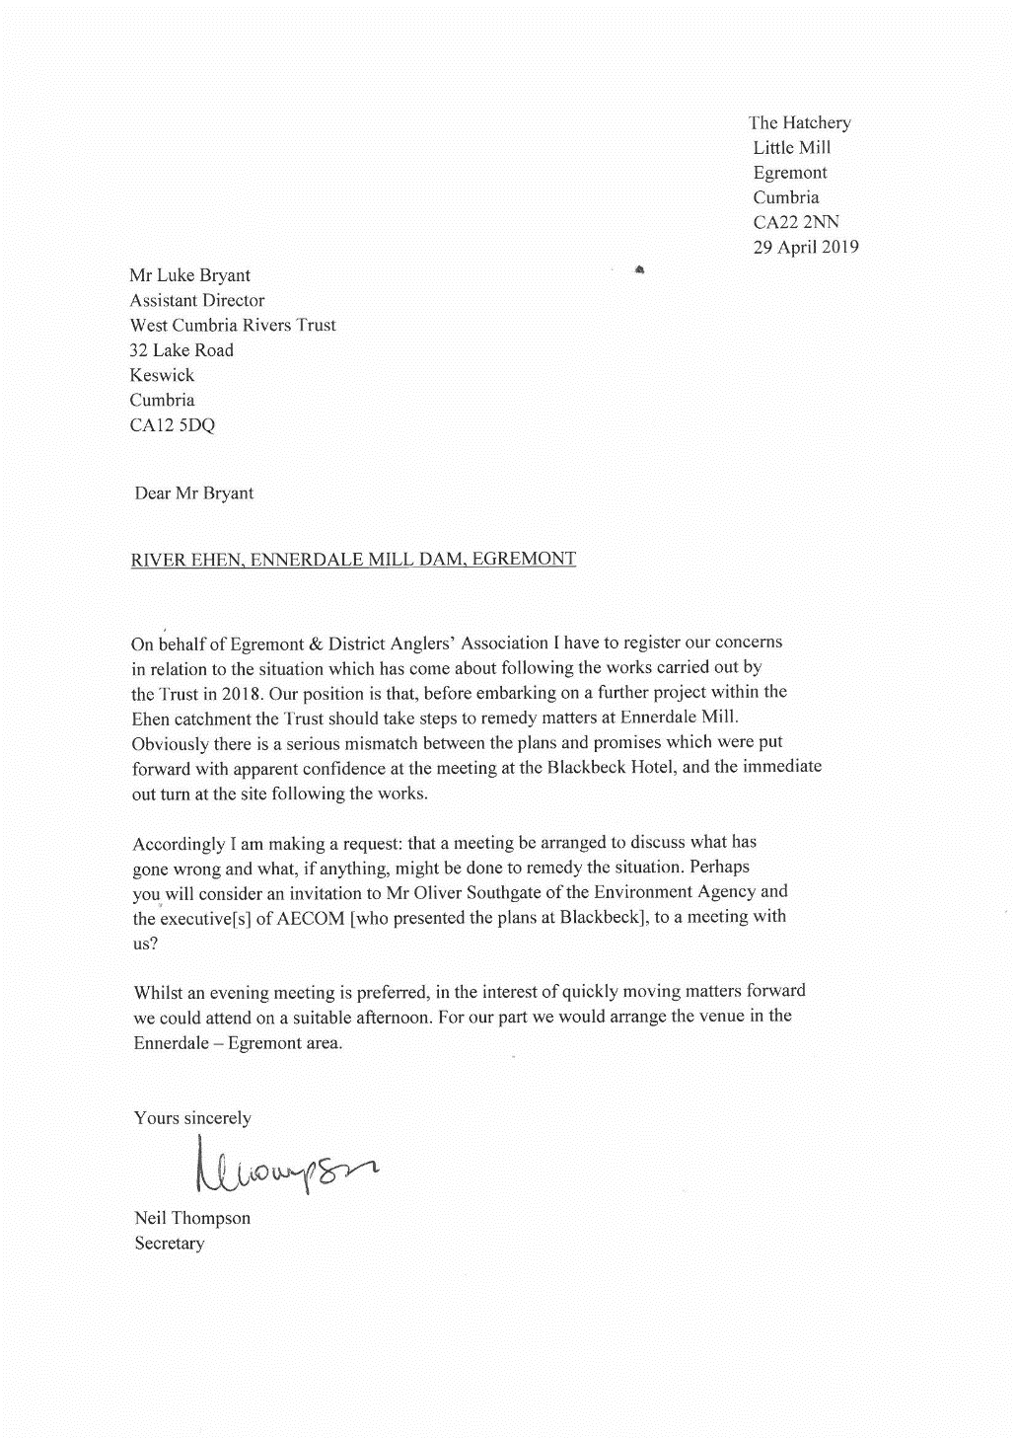
Project outcomes
Completed on time and within budget (c. £350,000)
Zero pollution incidents during construction phase
FWPM protected – 2019 & 2022 surveys showed improved conditions
Natural sediment regime observed
Increased salmon numbers upstream (anecdotal)
Ongoing negativity from anglers
Notes:
And a final word from our anglers:

Slide 30
Project outcomes
Completed on time and within budget (c. £350,000)
Zero pollution incidents during construction phase
FWPM protected – 2019 & 2022 surveys showed improved conditions
Natural sediment regime observed
Increased salmon numbers upstream (anecdotal)
Ongoing negativity from anglers
Adjustments to morphology of river alarming to some locals – but crucial to contextualise
River naturally restricting its own width
Notes:
But just look how happy the removal made some people;

Slide 31



Thank you to our key partners

Slide 32
Thank you
www.westcumbriariverstrust.org

