Slide 1
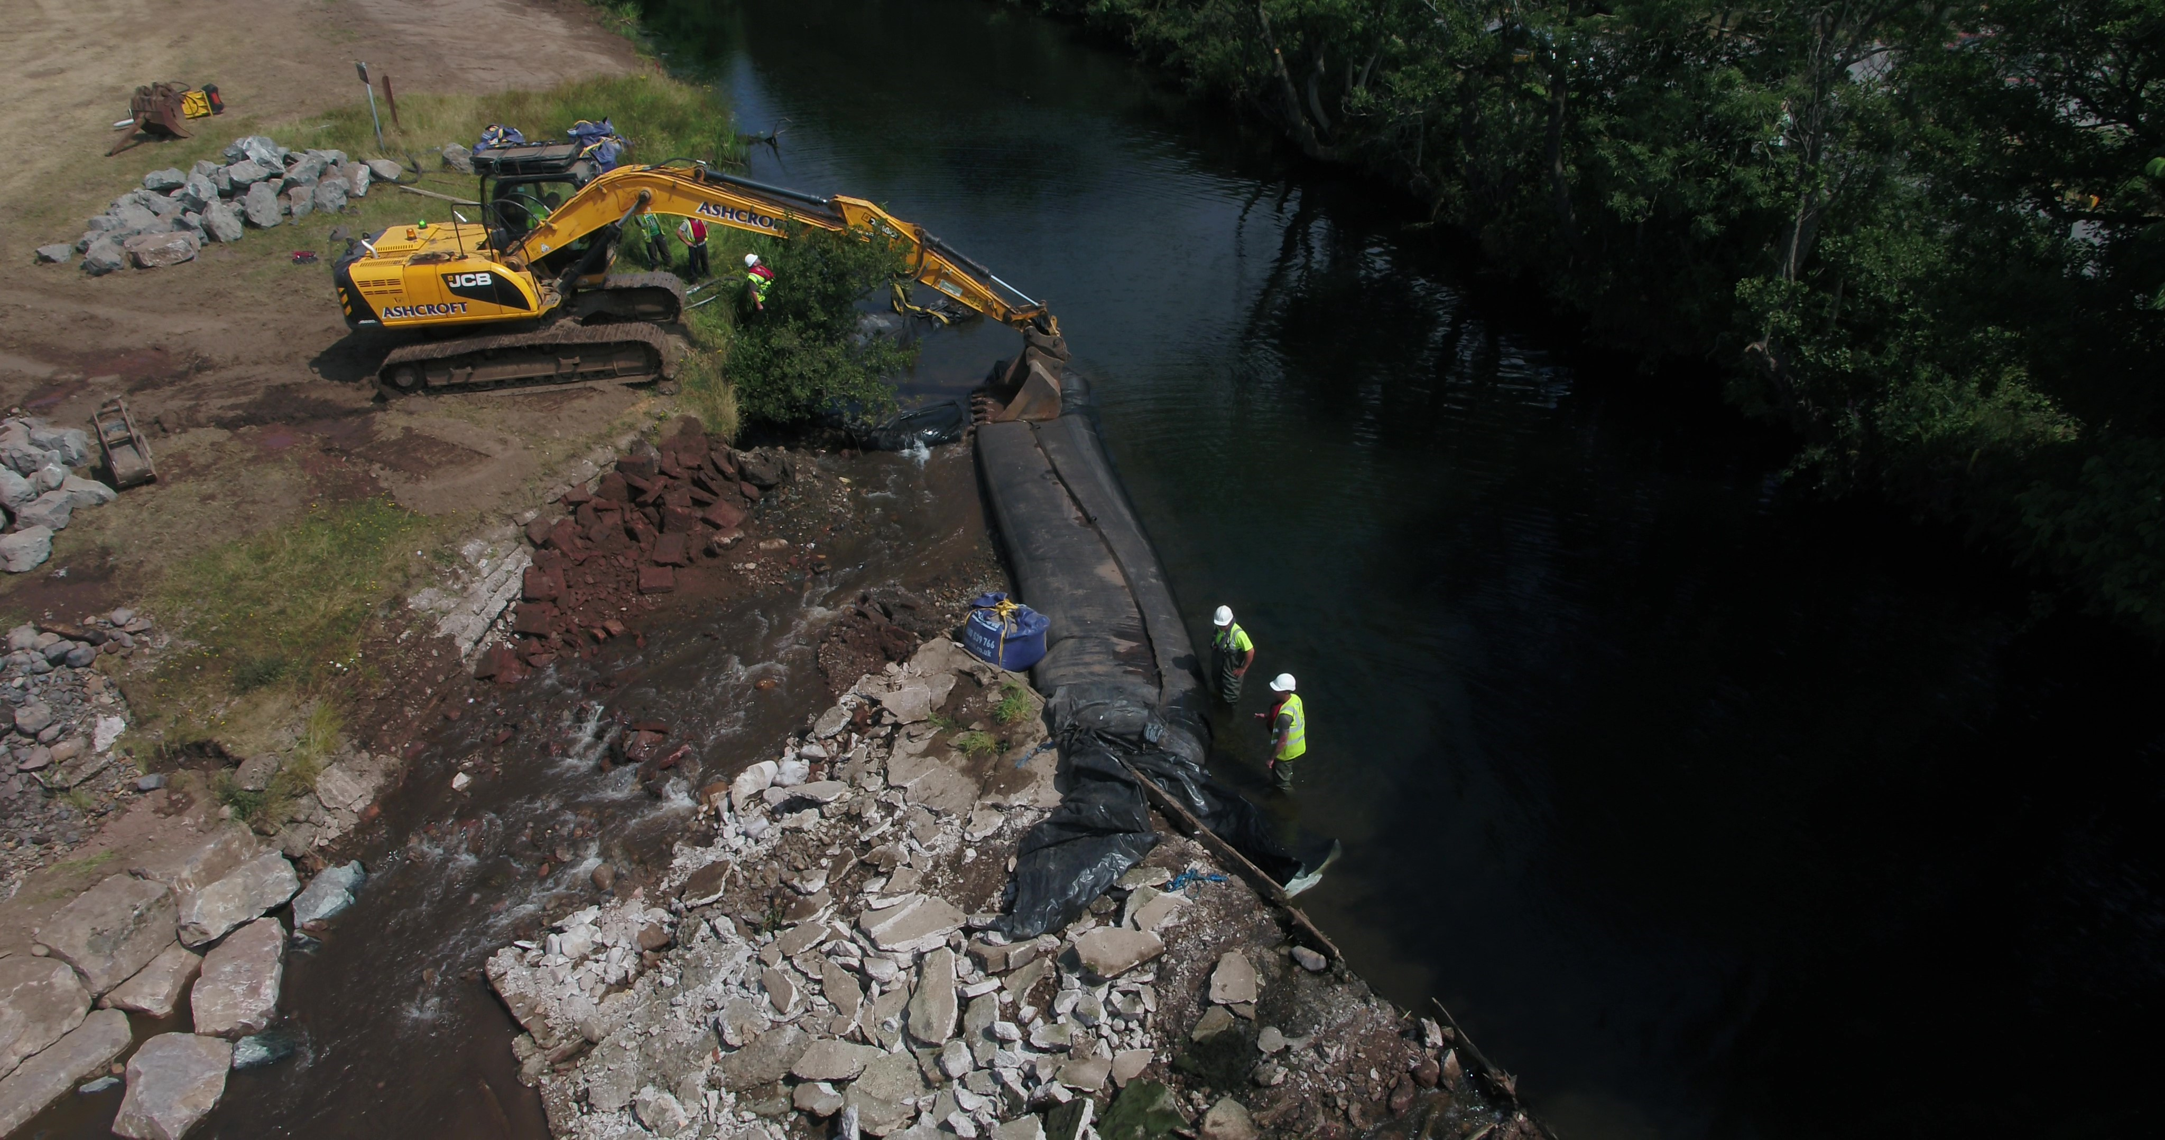
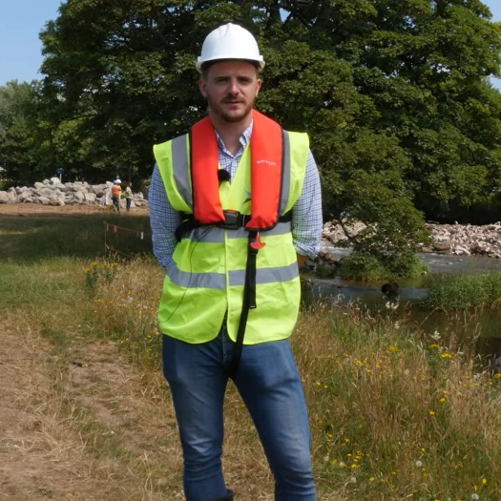



A CONTRACTOR'S PERSPECTIVE
HOW MUCH IMPACT IS
TOO MUCH IMPACT?
Ben Fisher
Head of Projects
Notes:
Hello everyone I'm ben fisher the head of projects at Ebsford environmental and today I'm going to give you a contractors perspective on weir removals and a particular challenge of understanding how much impact is too much impact when working in a river
Believe it or not the photo of me in the programme was only taken last year…it can be stressful business taking out weirs. Its certainly not for everyone

Slide 2
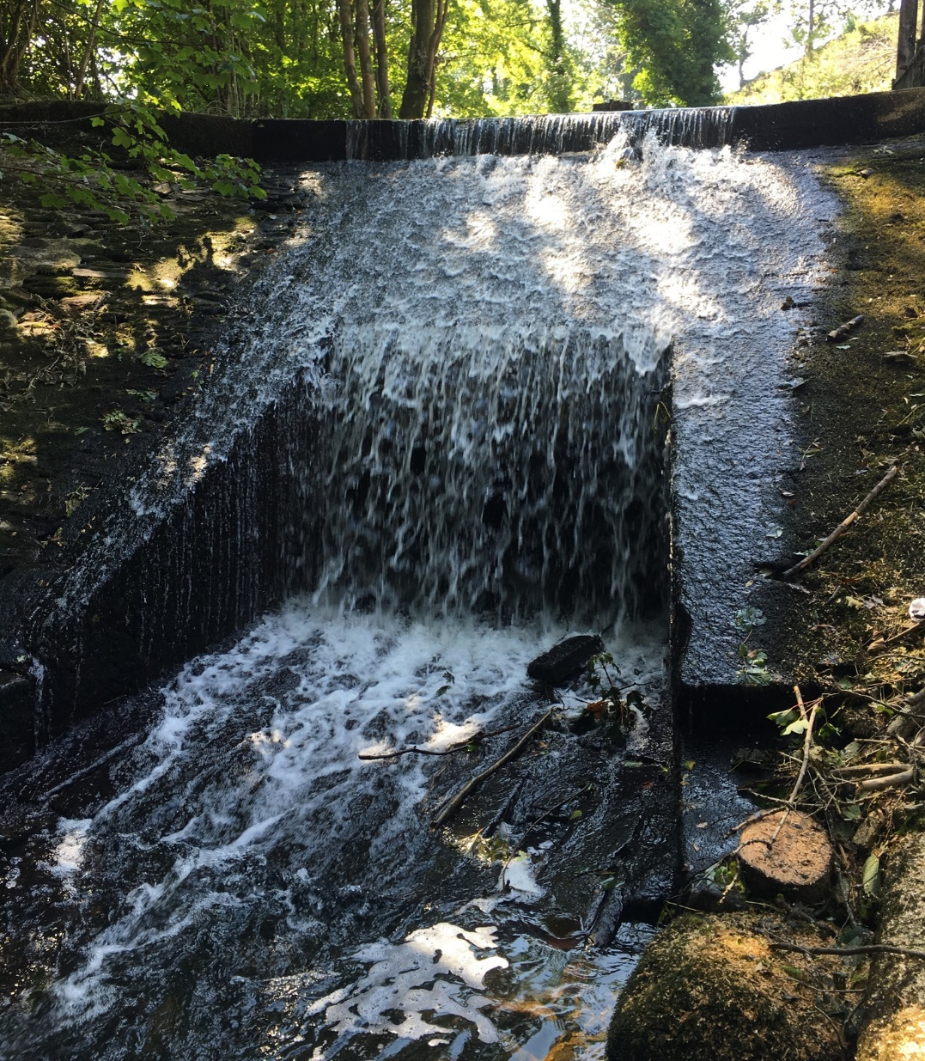
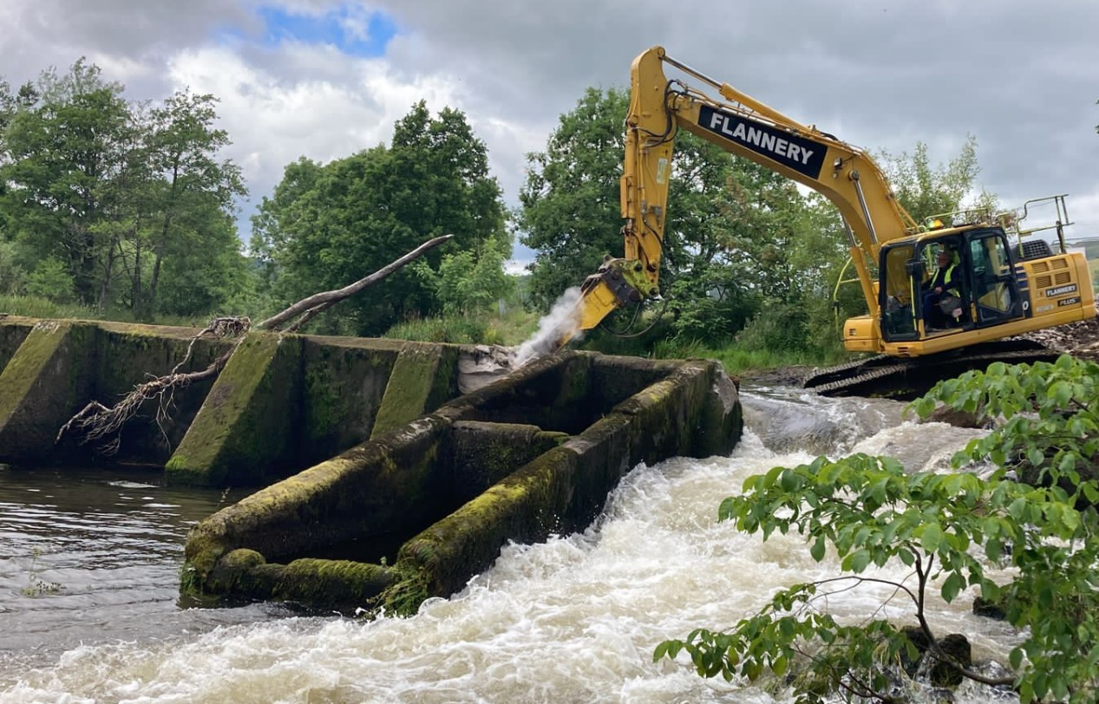
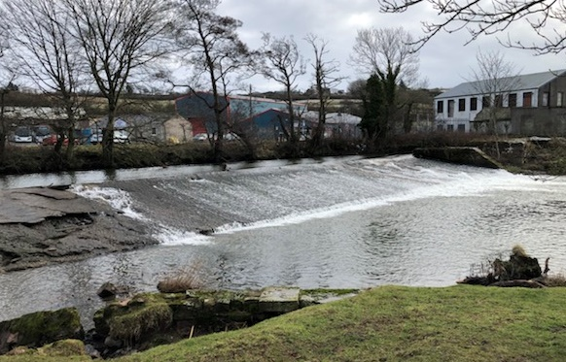
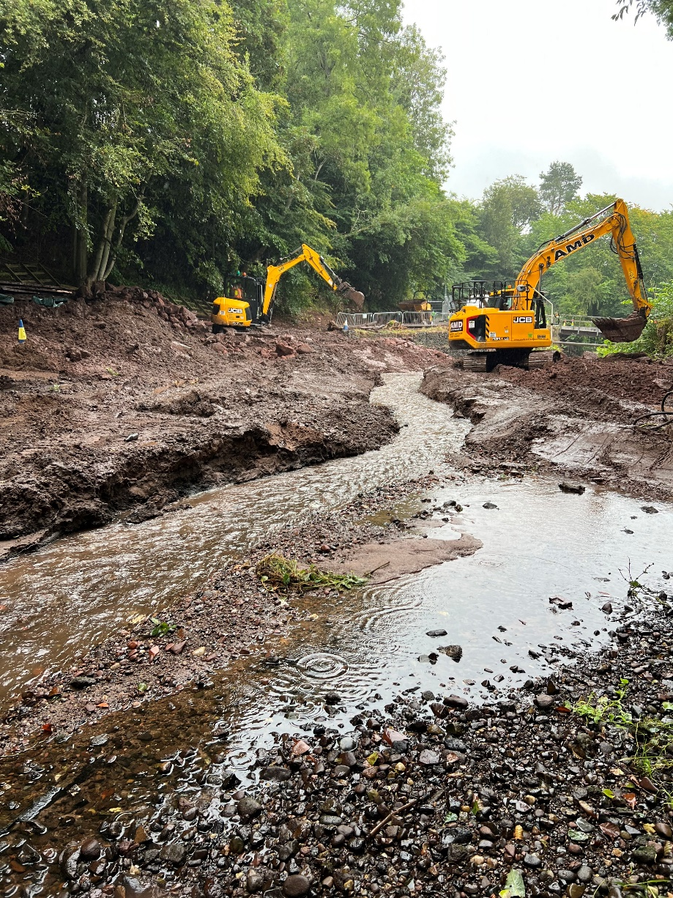
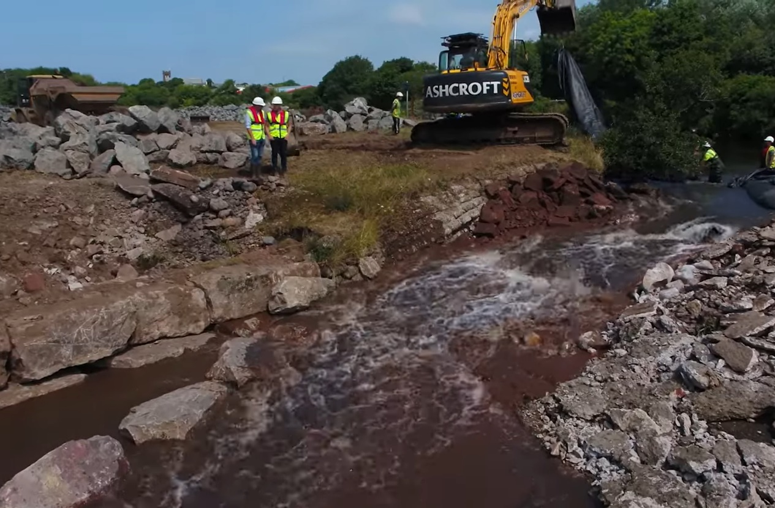
SME with approximately 60 full time members of staff throughout the UK with our head office In Yorkshire
Formed in 2011 focusing primarily on invasive species eradication – such as Japanese knotweed
To date have removed 8 weirs throughout the UK with number 9 scheduled for this summer
WHO ARE EBSFORD?
Notes:
Should probably say that quietly
“What has Japanese knotweed got to do with Weir Removals I bet your thinking?” … well in truth absolutely nothing…. But it did give us a pathway into the river industry
Within a couple of years Japanese knotweed work evolved into invasive species control around watercourses and then quite quickly moved into the restoration of rivers.
Thanks Lev!

Slide 3
AGENDA
KEY CHALLENGES & OUR APPROACH
CASE STUDIES – LESSONS LEARNT
HOW CAN WE MAKE THINGS BETTER?
Notes:
A real quick agenda
Key challenges and our approach when planning, pricing and then delivering works.
We will go through a couple of case studies
And then finally look at how we can make things better.

Slide 4
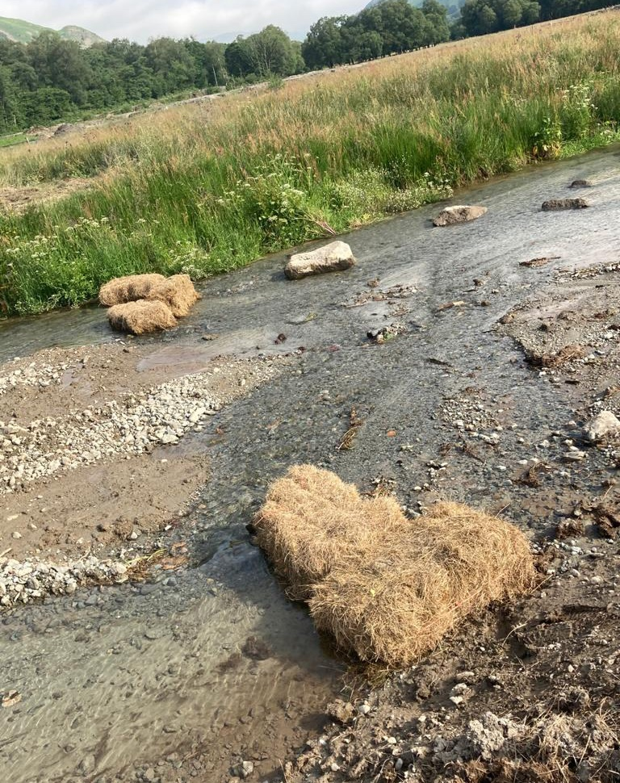
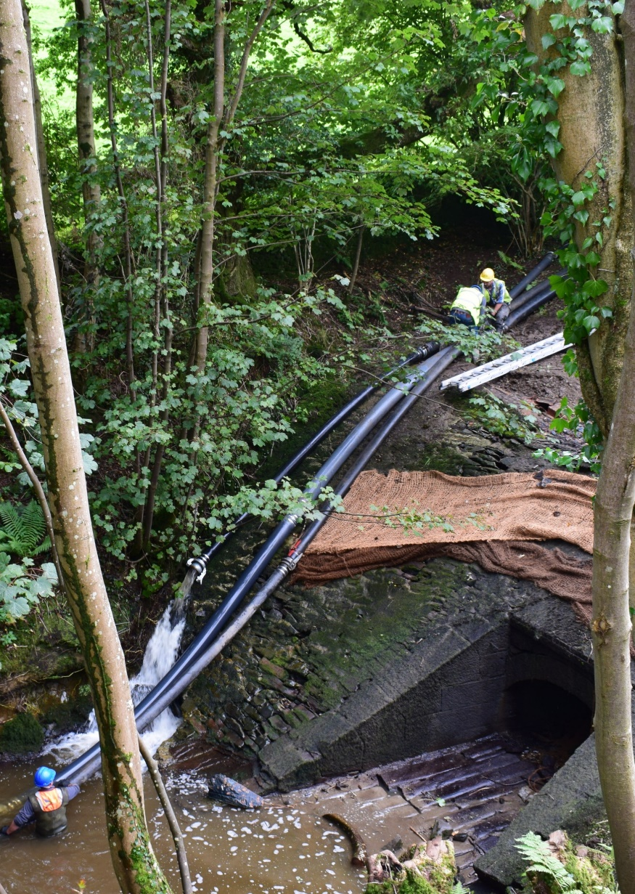
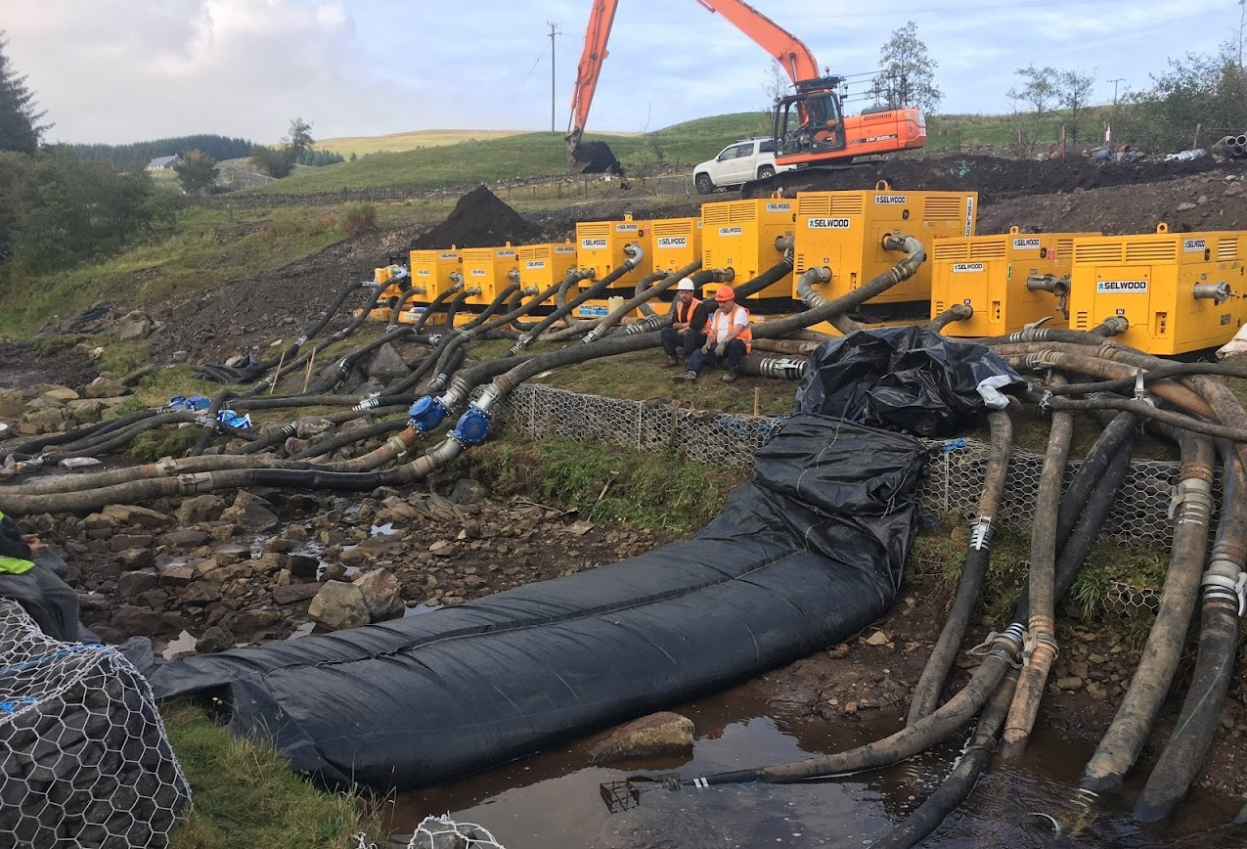
MANAGING OUR IMPACT ON THE RIVER
IMPACT:
Turbidity
Dissolved Oxygen
APPROACH:
Diversion Channel (outside of the river)
Over Pumping
Diversion Channel (within the river)
Works Phasing / Semi Dry Areas
Start Stop Processes based on DO/Turbidity readings
Notes:
Managing our impact on the river is without a doubt the biggest challenge we face as a contractor when removing a weir. The key things we are trying to manage are both the turbidity of the water.. We want to keep this as low as possible, and dissolved oxygen.. We want to keep this as high as possible.
Managing our impact on the river becomes much easier when we can manage the water. There are various ways we can do this, some more expensive than others.
The more expensive approaches include a diversion channel around the weir or over pumping.
More cost effective approaches includes diversion channels and works phasing
Finally if we accept that some tasks require us to work in a live river channel, we will implement start stop processes based on Dissolved Oxygen and Turbidity readings. This is great for managing impact but given that the hourly cost for people and equipment when taking out large structures can be in excess of £700 per hour can get expensive quite quickly. 1 works hour followed by 1 hours downtime - can double our cost.

Slide 5
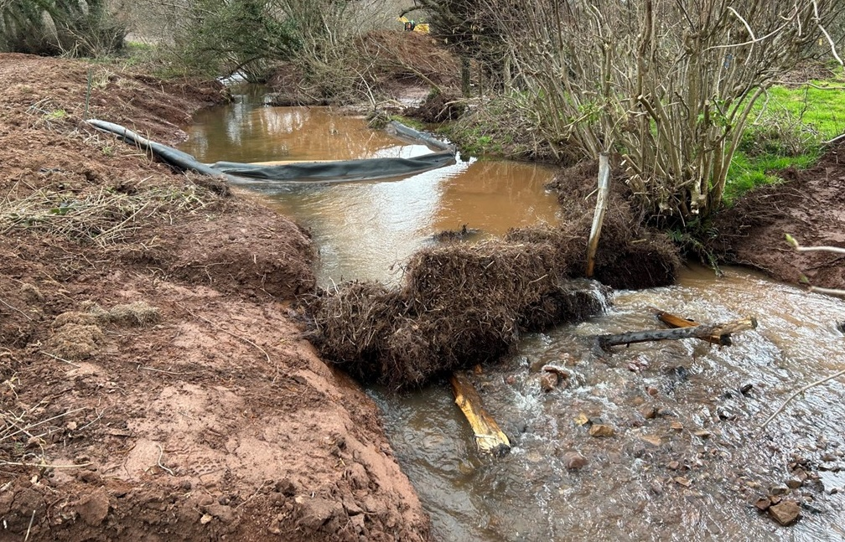
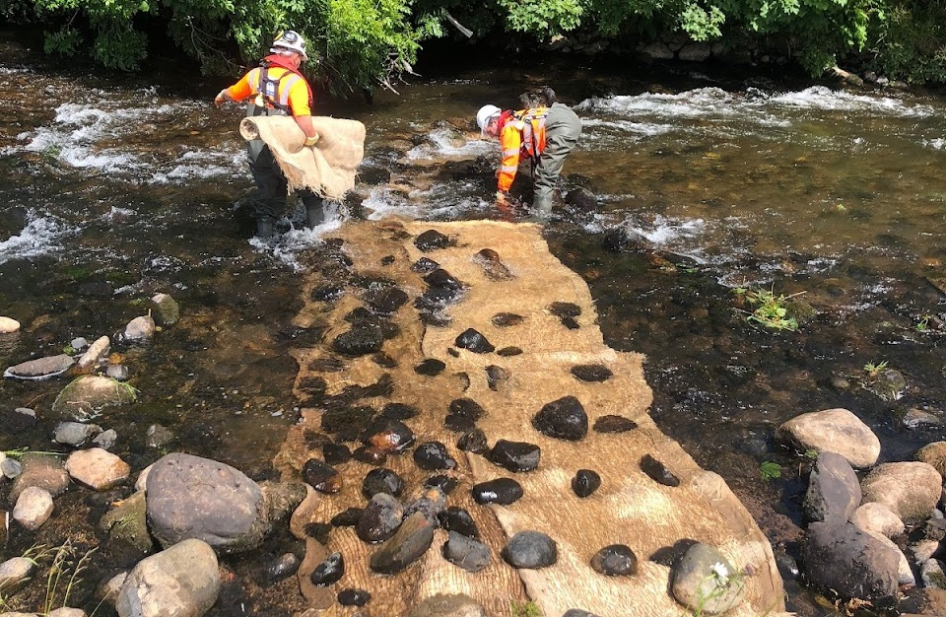
IN-CHANNEL MEASURES
Straw / Heather Bales
Silt Curtains
Silt Entrapment Mats
Coir Rolls
Bubble Curtains
Temporary in-channel features
Silt Fencing
Notes:
In addition to the methods of managing water on the previous slide, every project should have a combination of the following in place downstream of the works area.
The key aim of the in channel measures are to try slow the flow of the water and encourage sediment to drop out before moving downstream
And just when you think you’ve got the perfect methodology for managing water and all of the downstream measures you could wish for..in order to remove the weir with the lowest possible impact – along comes the great British weather.

Slide 6
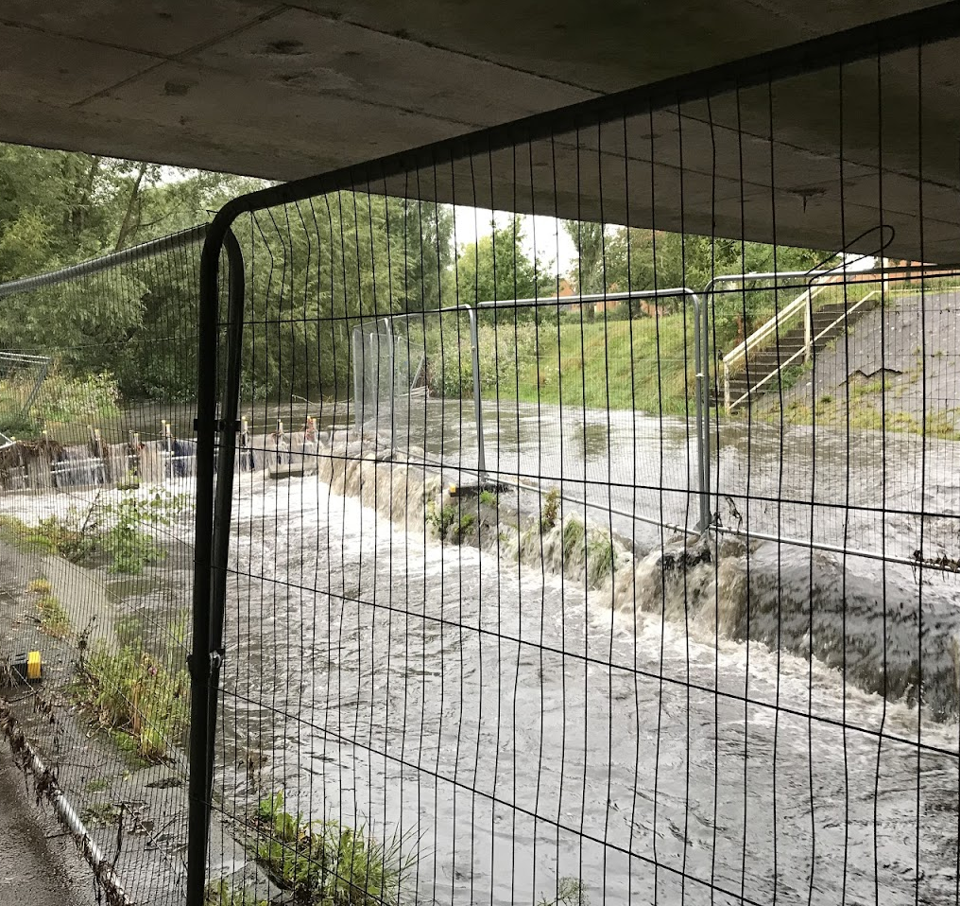
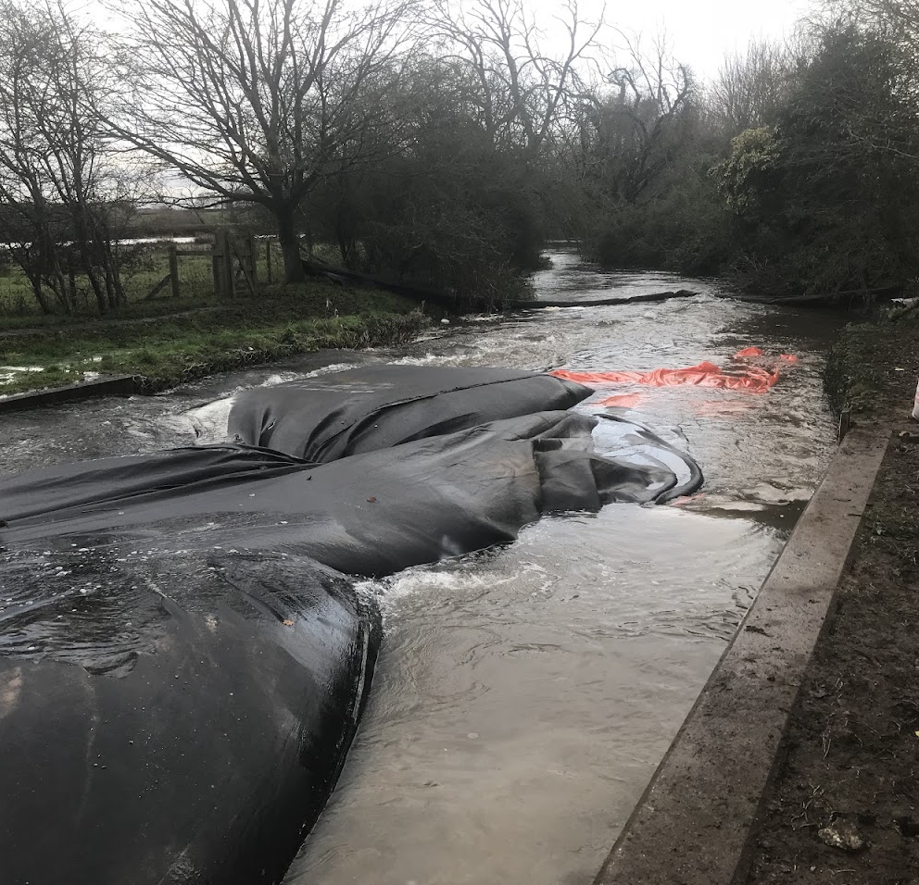
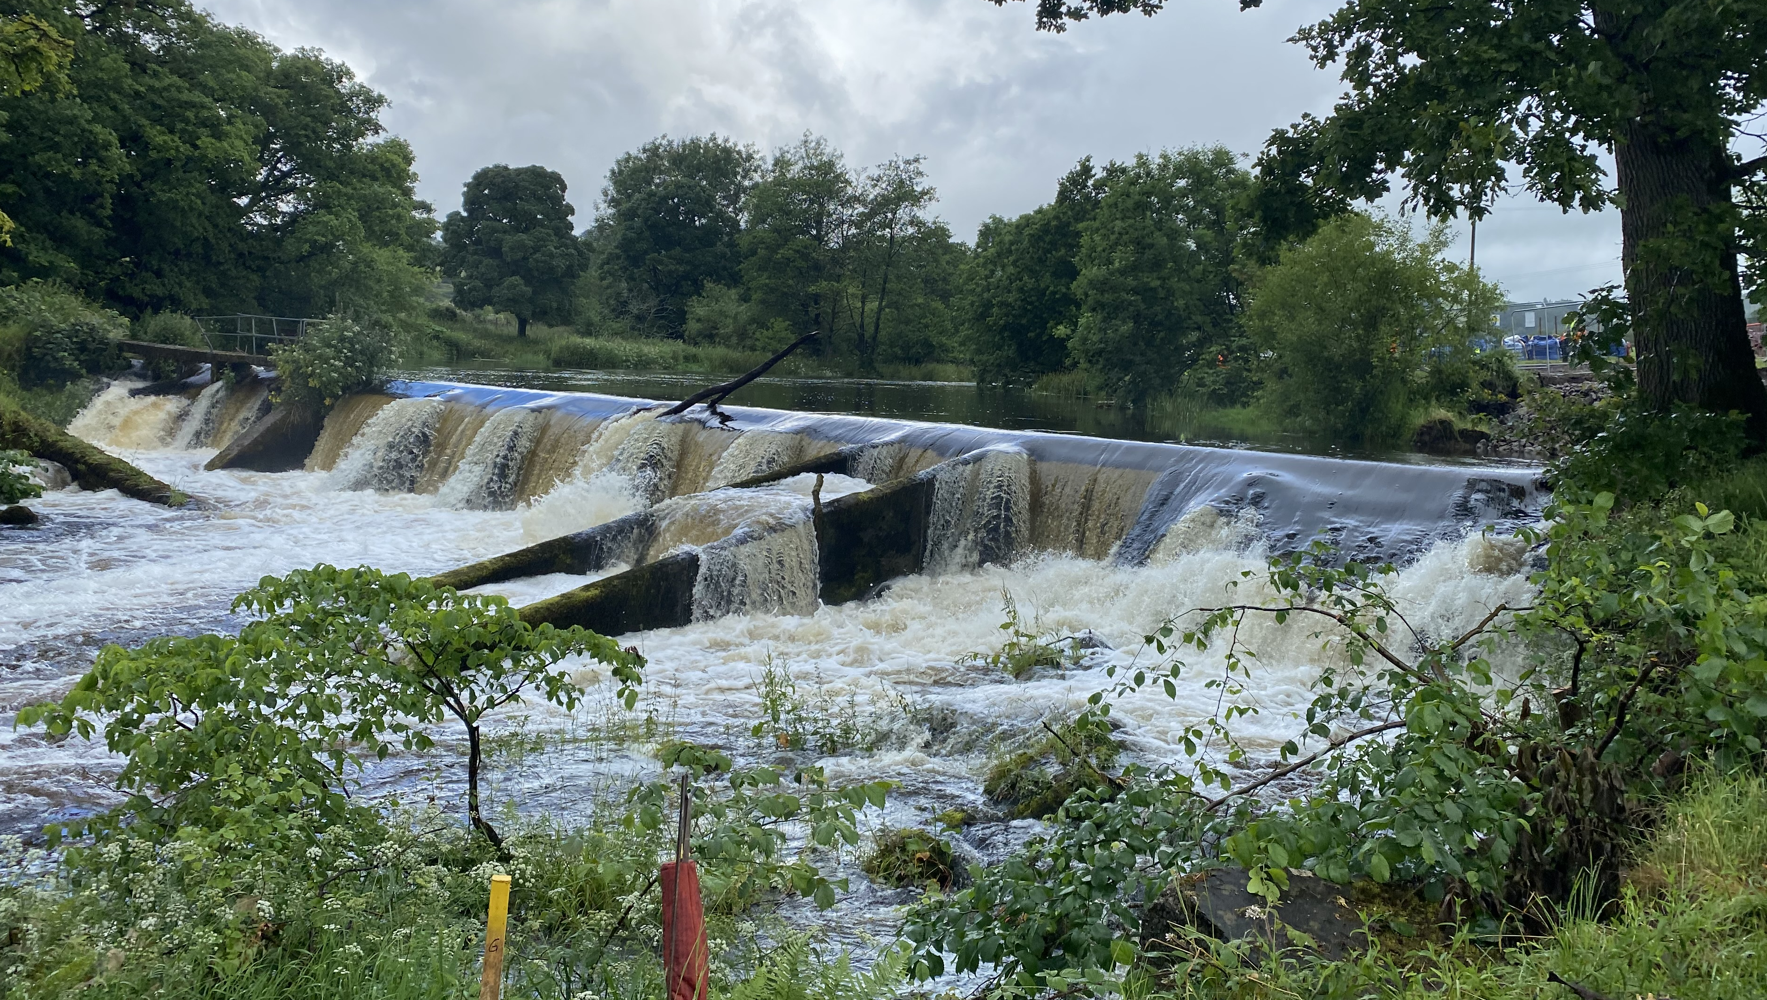
THE WEATHER
Notes:
Weve got aqua dams flying down stream in Derbyshire
Weve got an over flowing bypass culvert in solihull
and on the day of taking the first notch of bowston weir, the heavens opened upstream sending our sediment controls downstream and leaving the site unsafe to work. Much to the disappointment of some people in the room who had flown from Europe especially to see it.

Slide 7
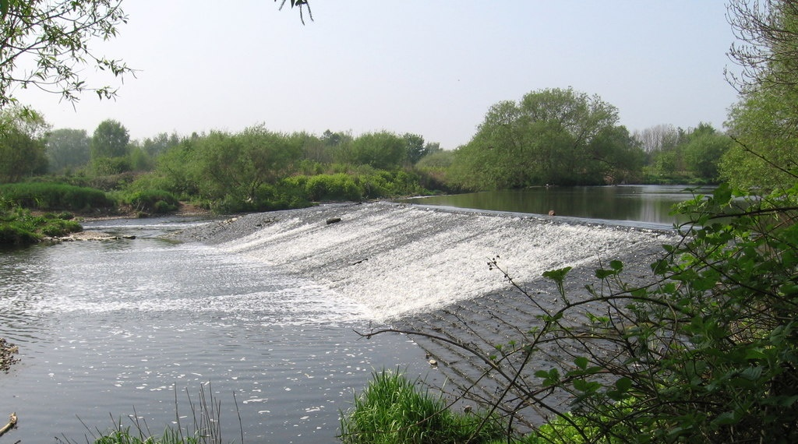
EXERCISE
HORBURY JUNCTION WEIR
110M WIDE
3M HIGH
COST TO REMOVE?
£250,000
£500,000
£1,000,000
Notes:
Were going to carry out a little exercise which I hope will illustrate the challenge we have when it comes to managing our impact when pricing and planning a project.
Here we have a photo of Horbury Junction Weir near Wakefield on the River Calder.
What I would like you to do is decide how much this should cost to remove
To help – no over pumping and no bypass channel
So based on two very big assumptions. 1 – We are working in a live channel And 2 we don’t need to import any stone to stabilise the bed. All we need to do is remove the weir – how much do you think this should cost?
250,000, 500,000 or 1 MILLION Pounds…
The good news? Your all right – it could cost any of the above so well done. The main difference between the three costs is time.
The bad or challenging news for us – and every other contractor is how do we go about pricing this?

Slide 8
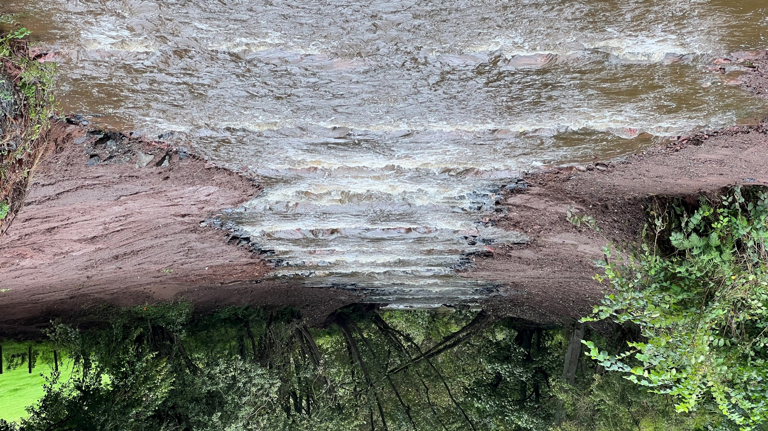
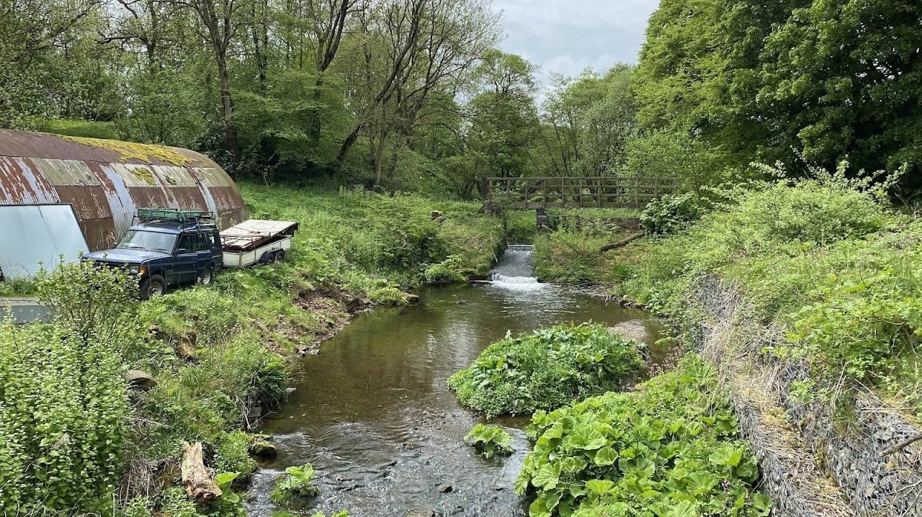
COST VS IMPACT
Of the 8 weirs we have removed over the past 5 years, 6 of these were won at competitive tender.
Not always but the scoring criteria for the tendering process can often be weighted towards cost.
No known standards for what level of impact is acceptable.
This can put contractors in a difficult position.
Notes:
Unfortunately in our experience there is a direct inverse correlation between cost + impact on the river when removing a barrier
This isn’t just confined to weir removal but river restoration in general.
The cheaper the cost - the greater the short term impact.
Especially at tender stage when we are pricing it - If we use Horbury as an example

Slide 9
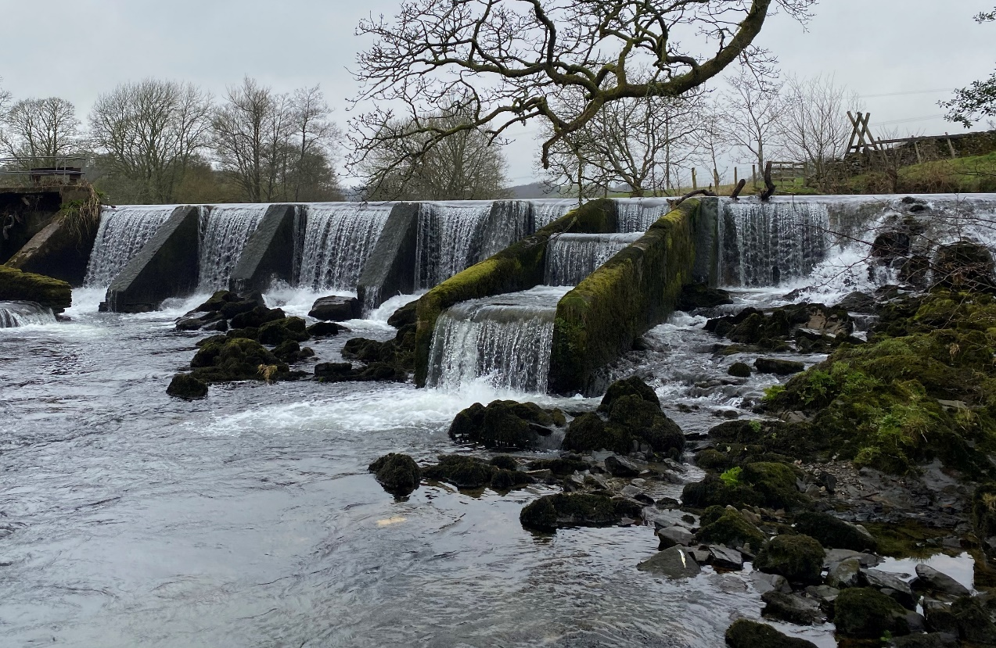
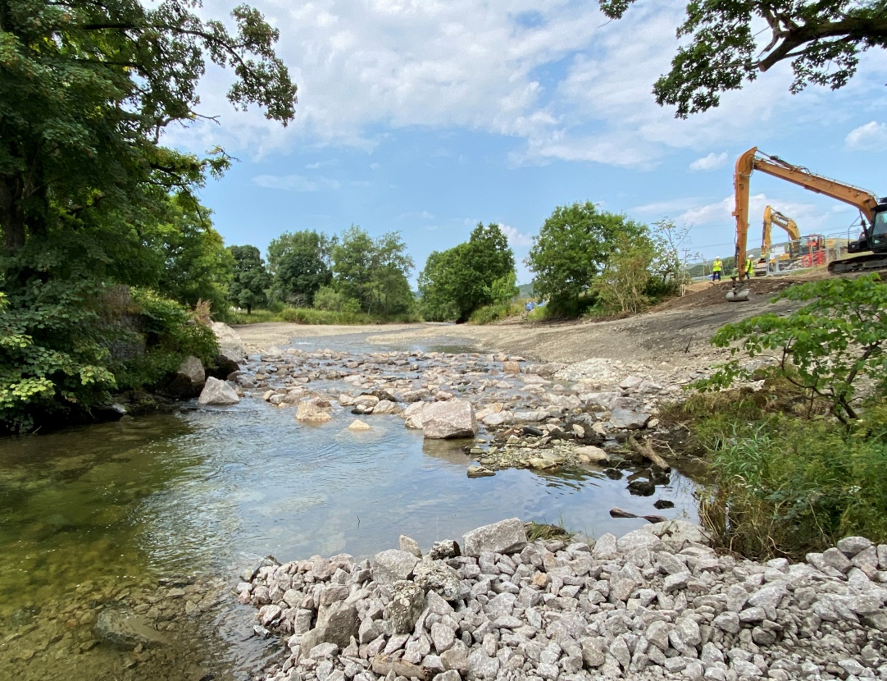
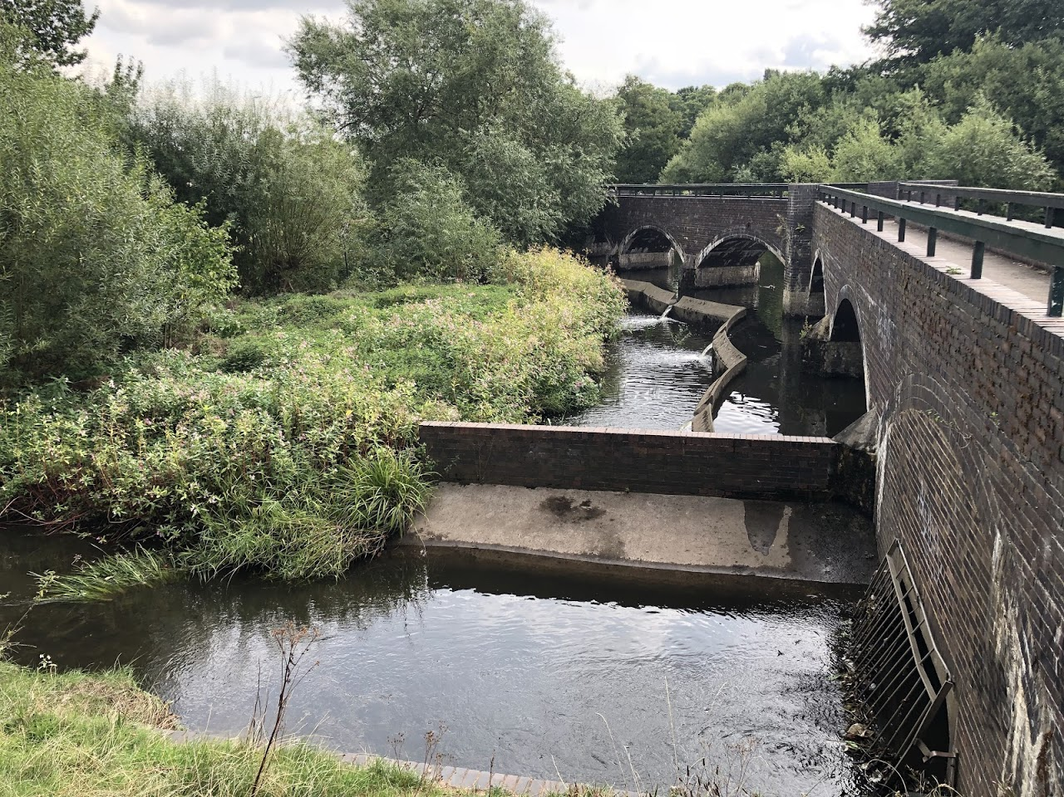
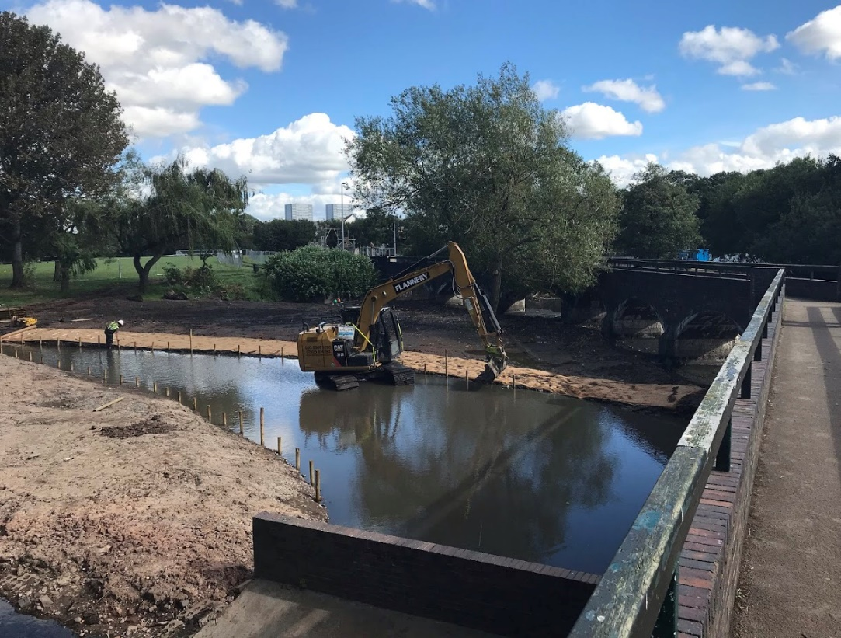
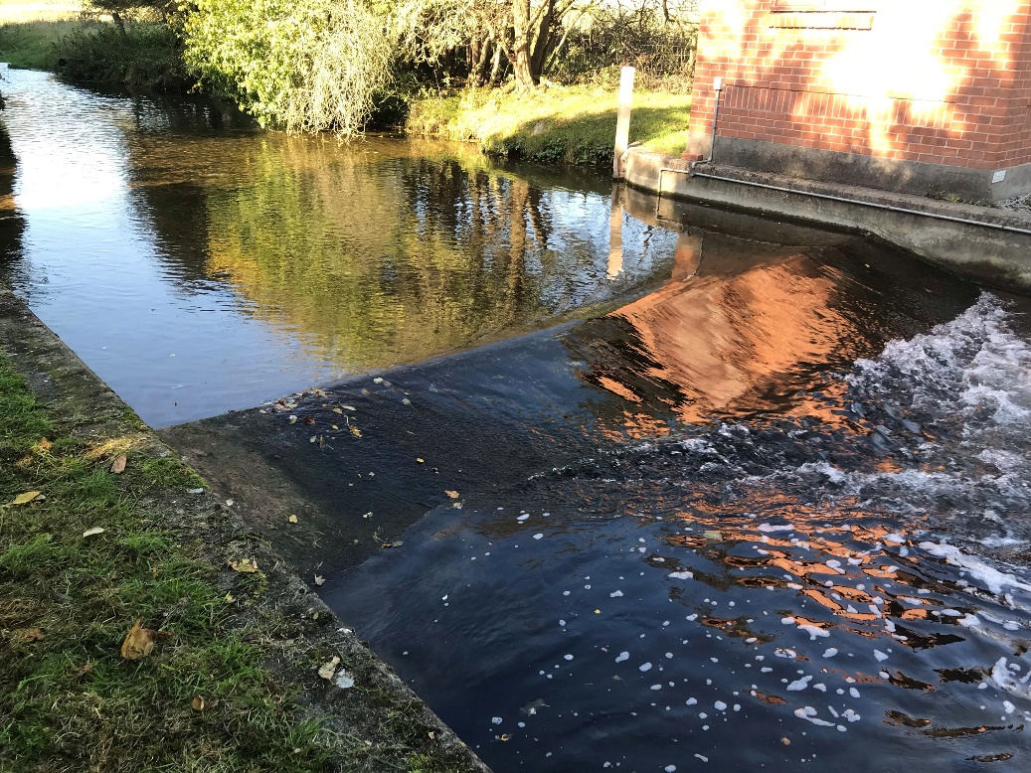
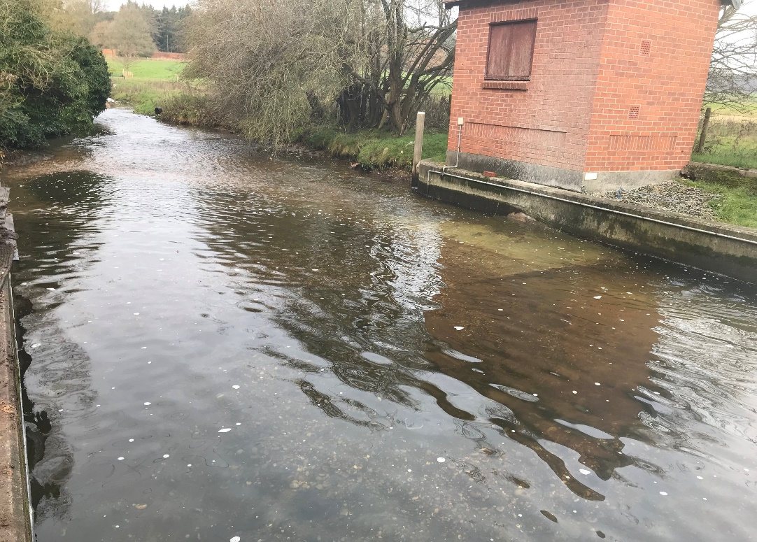
BOWSTON WEIR
MANAGING CHANGE
MERIDAN PARK
PERLETHORPE WEIR
Notes:
Working in the natural environment has plenty of challenges and usually some of these are unforeseen,
What we have learnt is that as a client its incredibly important to keep the designers and the environment agency involved throughout so that any required changes to suit site conditions can be implemented quickly and seamlessly.

Slide 10
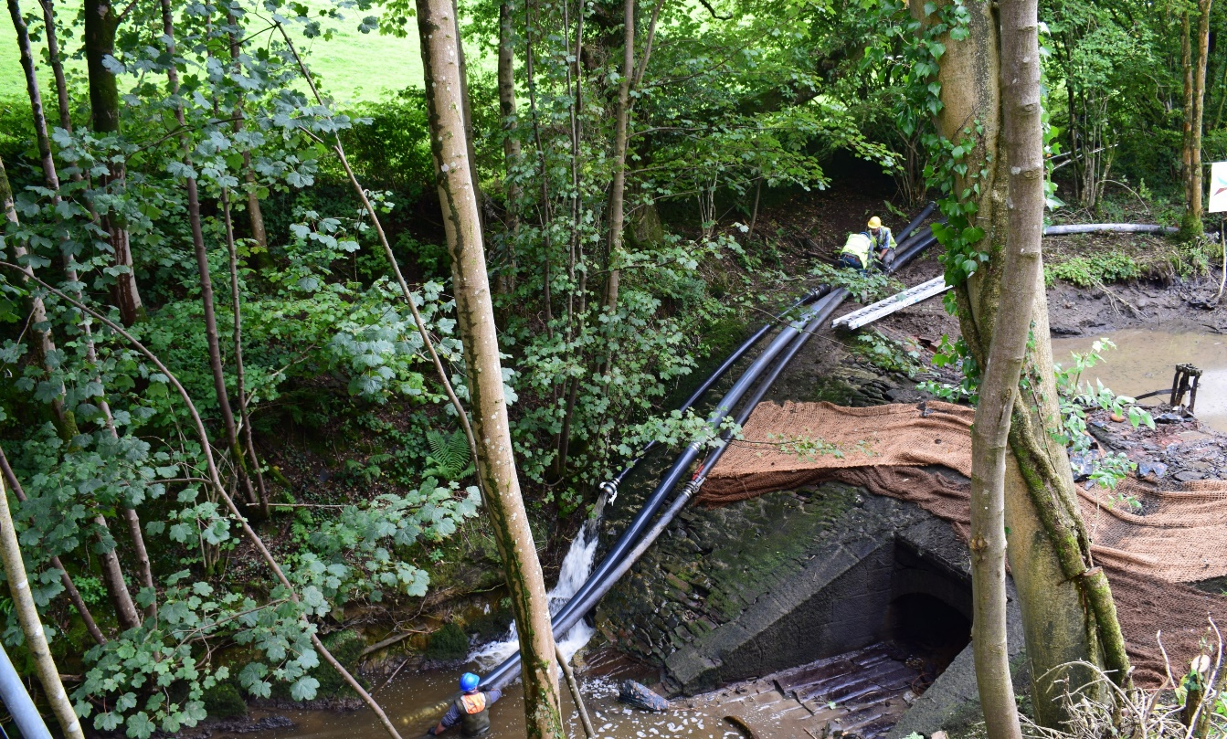
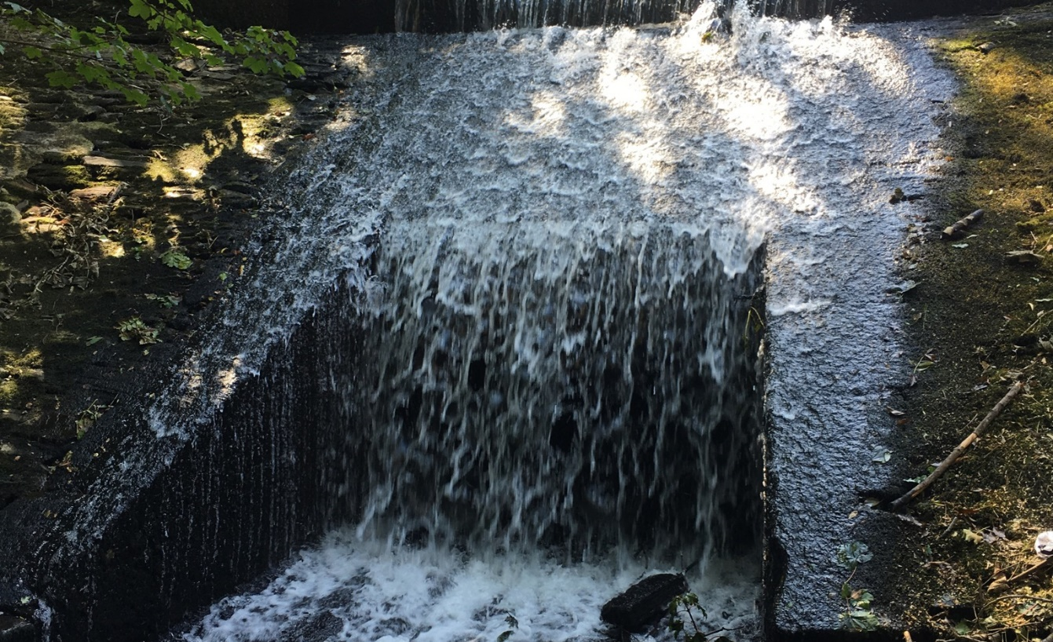
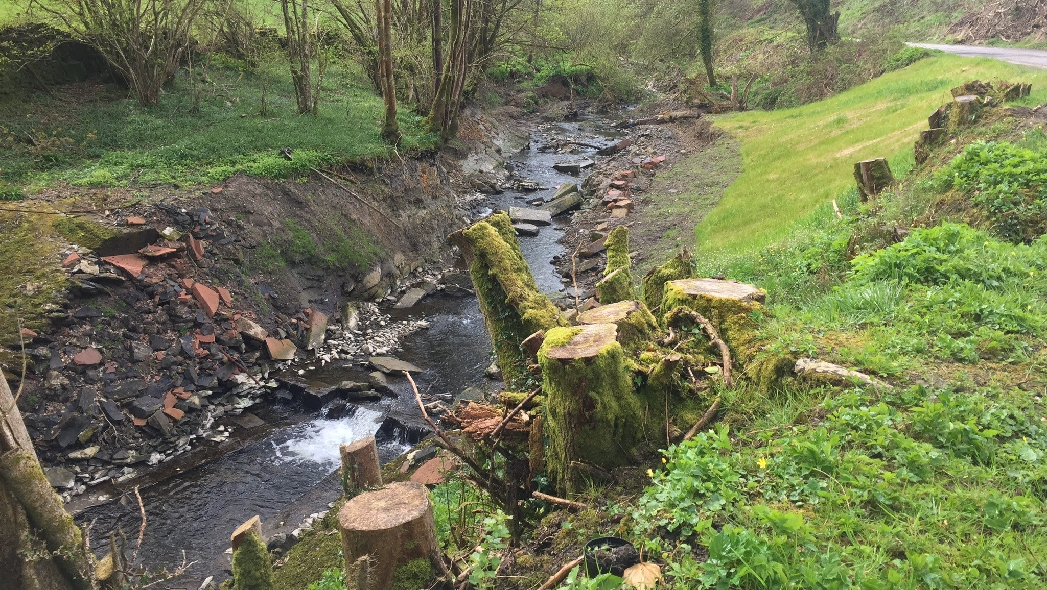
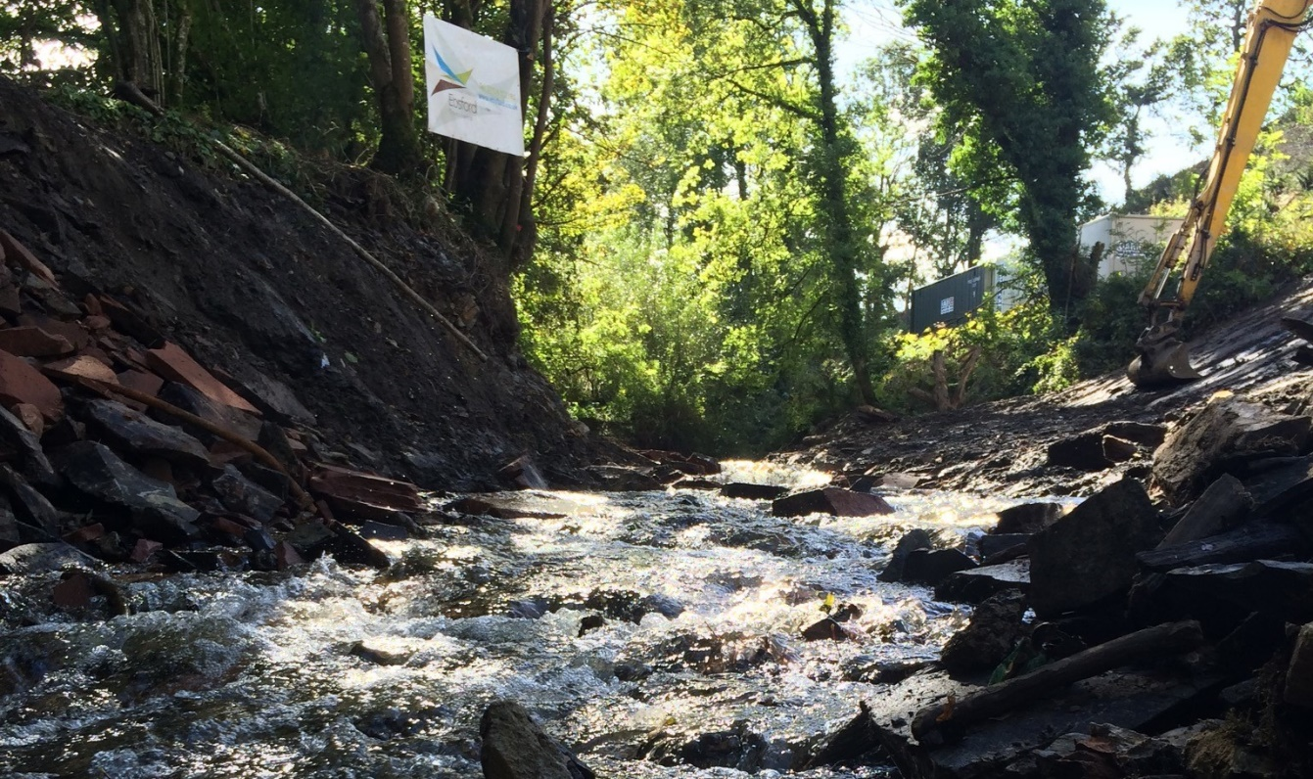
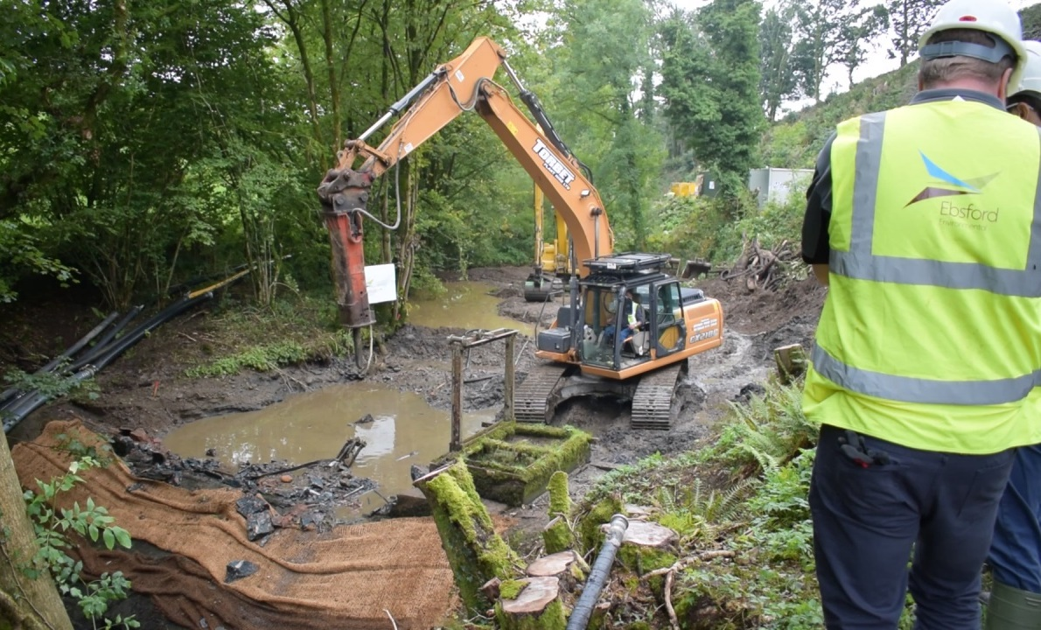
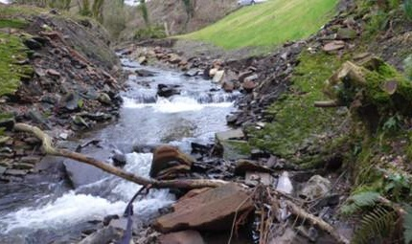
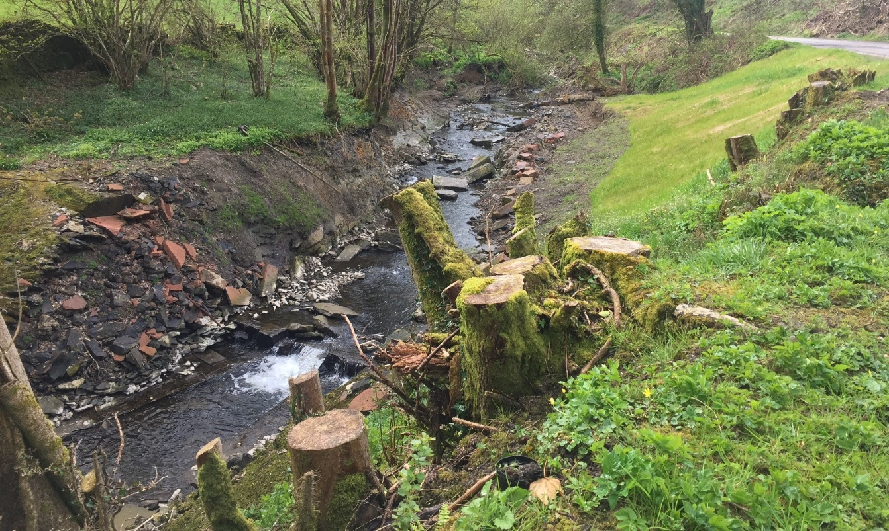
PROJECT SUMMARY
CREAMERY WEIR
Notes:
Now we have spoken about some of our challenges I thought it would be worthwhile touching on some of the weirs we have removed. The methods we used, and the lessons we learnt – there's been quite a few of them,
Creamery Weir, located in Dumfries and Galloway was the first weir we removed back in 2016 for the river and fisheries trust on behalf of Sepa. Creamery Weir was a 3.5m high barrier that spanned 13.5m wide across the Old Mill Burn.
The design involved a series of step pools to manage the fall in gradient along the length.
Our first thought was how to manage the water, … by pass channel not suitable so we selected over pumping with three 6 inch pumps – suitable for summer flow… unfortunately we didn't get too many normal summer flows during our time on site. On average we achieved about a day at a time of working in the dry before the water levels rose and breached the dams, saturating the works area – not the end of the world but did mean stopping works often and waiting for the site to adjust.
Fortunately - as we have learnt to often the case with these 100 year old structures deconstruction happens quicker than expected so we were able to complete on programme.

Slide 11
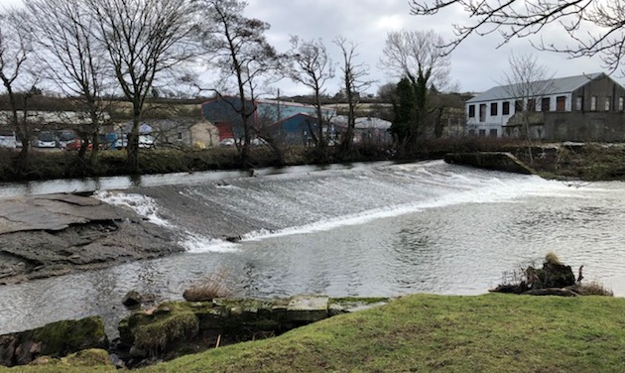
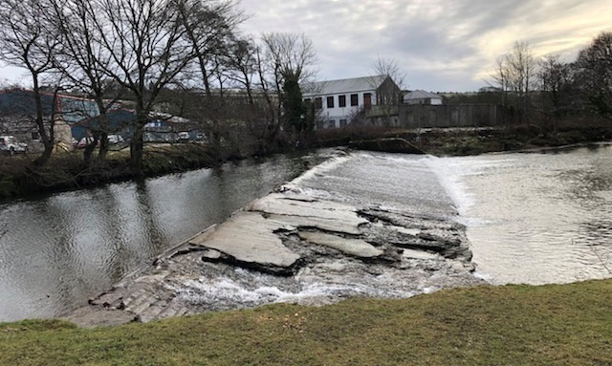
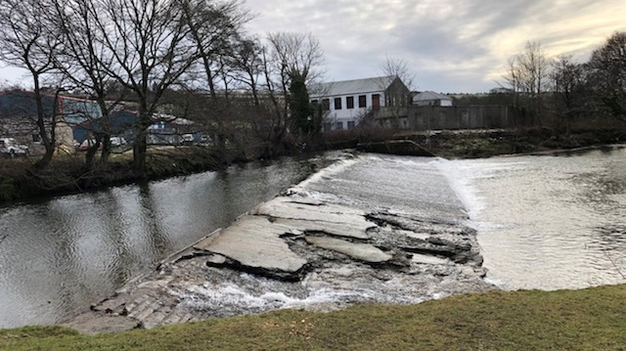
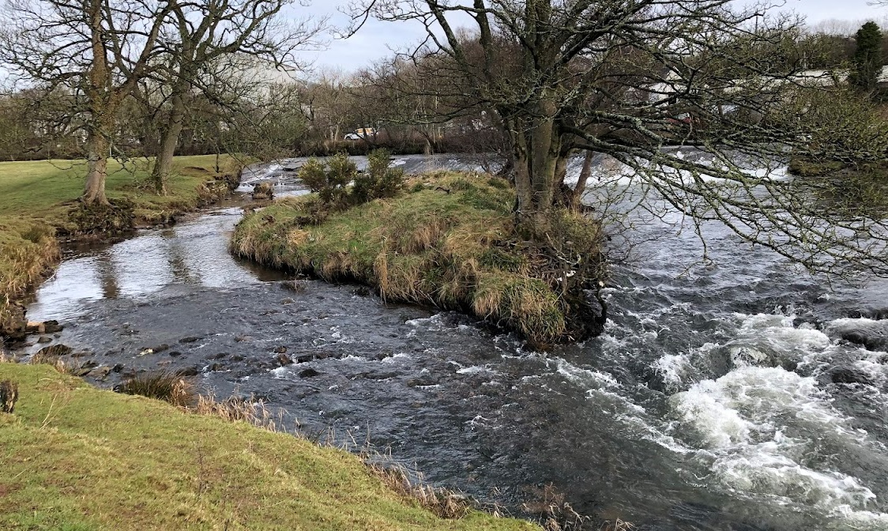
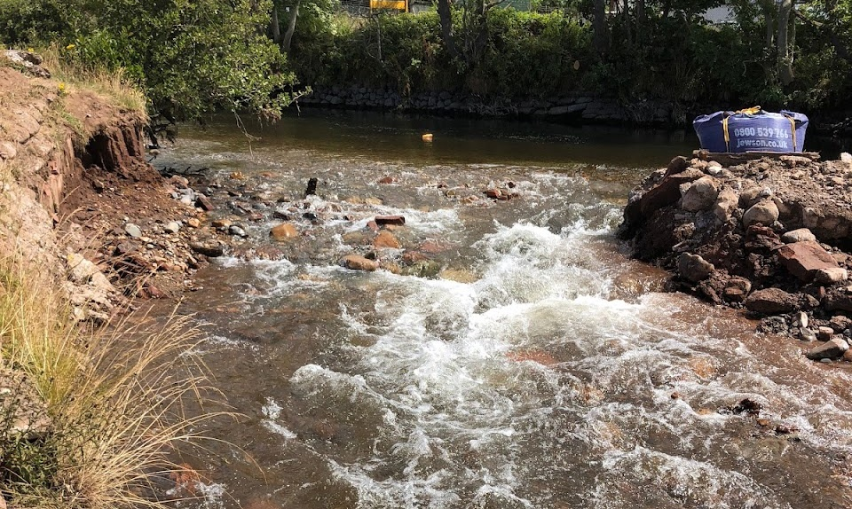
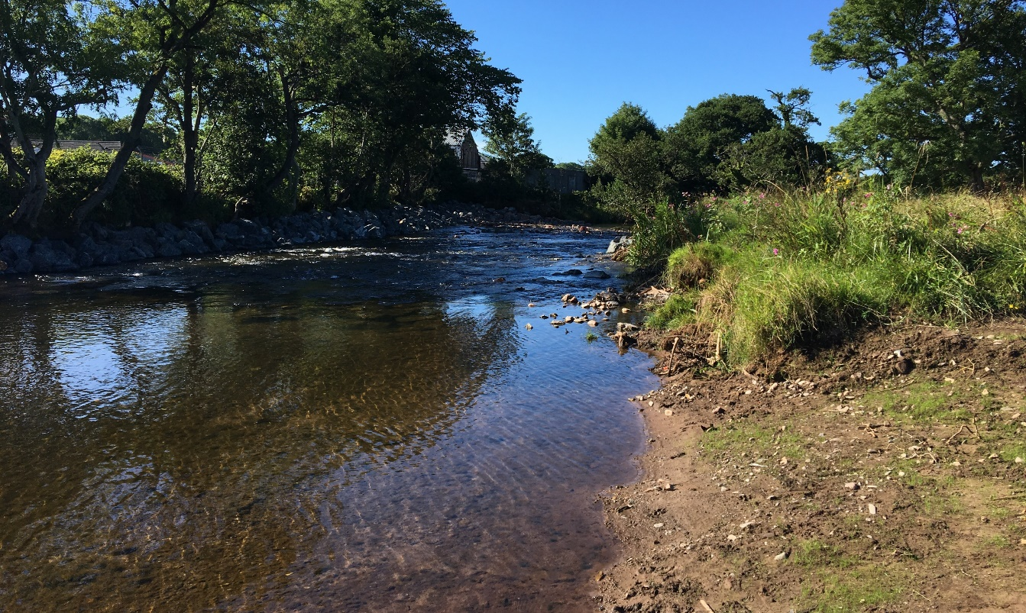
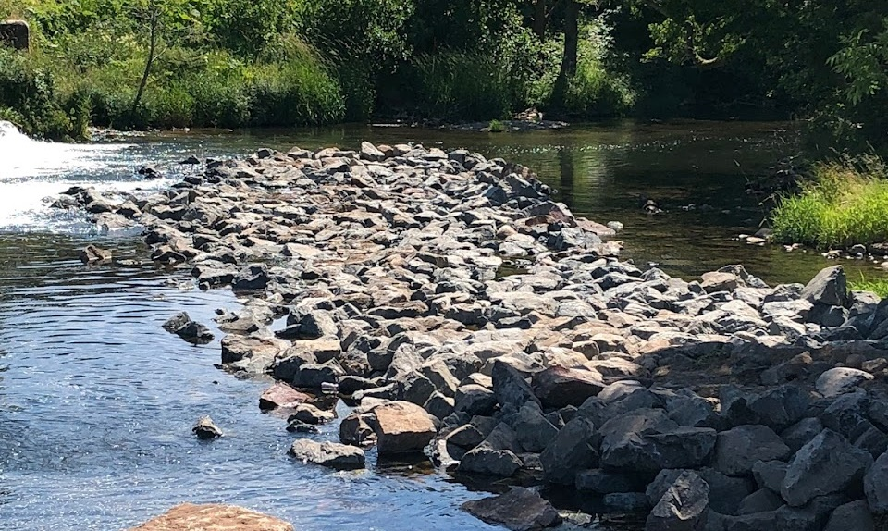
PROJECT SUMMARY
ENNERDALE MILL DAM
Notes:
As others have touched on today Ennerdale was around 50m wide with a height of around 2m
Given what we learnt at Creamery weir over pumping was out of the question and with only access from the right hand bank, diverting the river, would have meant flooding out the only area we had to work from.
This meant we had to work with the water in the live channel.
Implemented a range of measures to try reduce our impact including works phasing, flow manipulation, working platforms & finally downstream in channel measures.

Slide 12
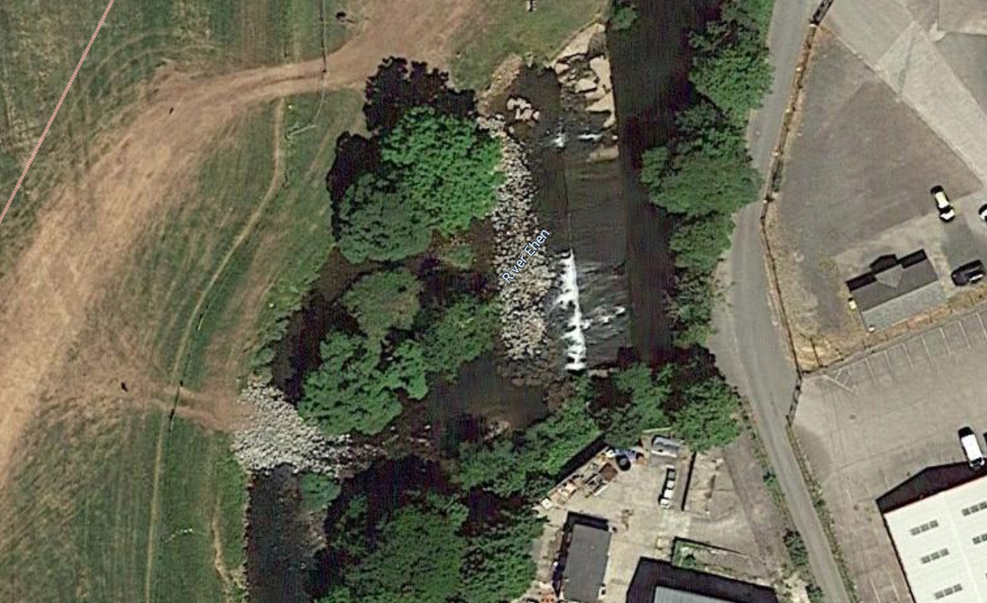
Notes:
Co-incidentally Google earth updated its imagery midway through the scheme which helps to show this process.
Working with the river dynamics we Notched the weir on the right hand bank. This encouraged water to run down the right hand bank around the island and into the stone access track. This had multiple benefits, firstly it gave us access into this section of the river round to the left hand bank of the weir and secondly it slowed the flow pooling the water encouraging sediment to drop out.

Slide 13
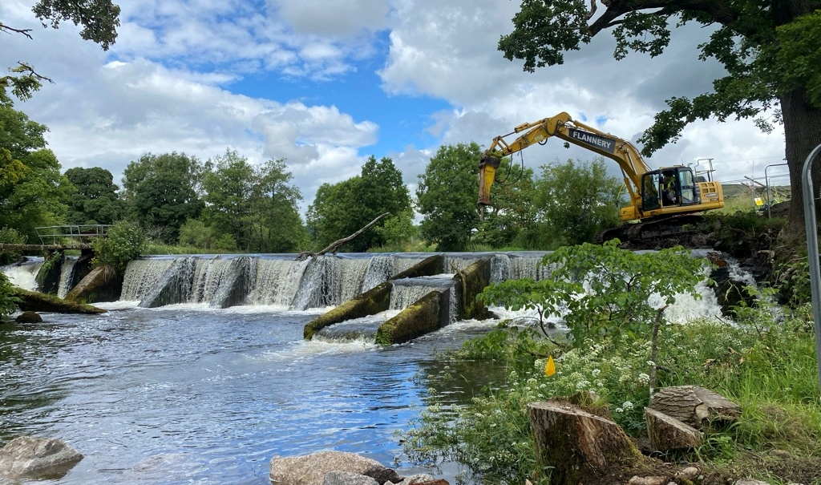
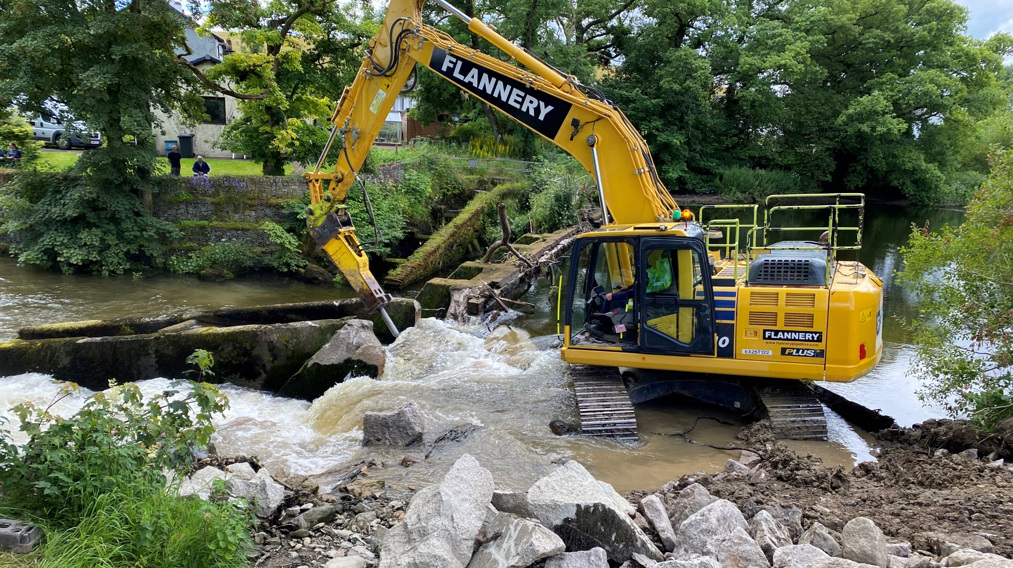
SUMMARY
IMPROVING WEIR REMOVALS
Encourage designers to engage with contractors as early as possible
Keep designers and stakeholders involved to collaborate, manage change and ensure successful project delivery.
How much impact is too much impact?
Work with stakeholders to agree acceptable short-term impact to the river during the works
Notes:
The method for managing the water can have a huge impact on project costs
If we are starting and stopping works – what levels of turbidity and Dissolved Oxygen should we work to before we stop? This information at tender stage would be incredible.
Ive posed the question again How much impact is to much impact?
Well we obviously still don’t know the answer to this. But If we could work with stakeholders to .. What we will see is..
Probably more cost effective weir removals, better performing contractors and certainly a much more seamless and stress free removal process

Slide 14
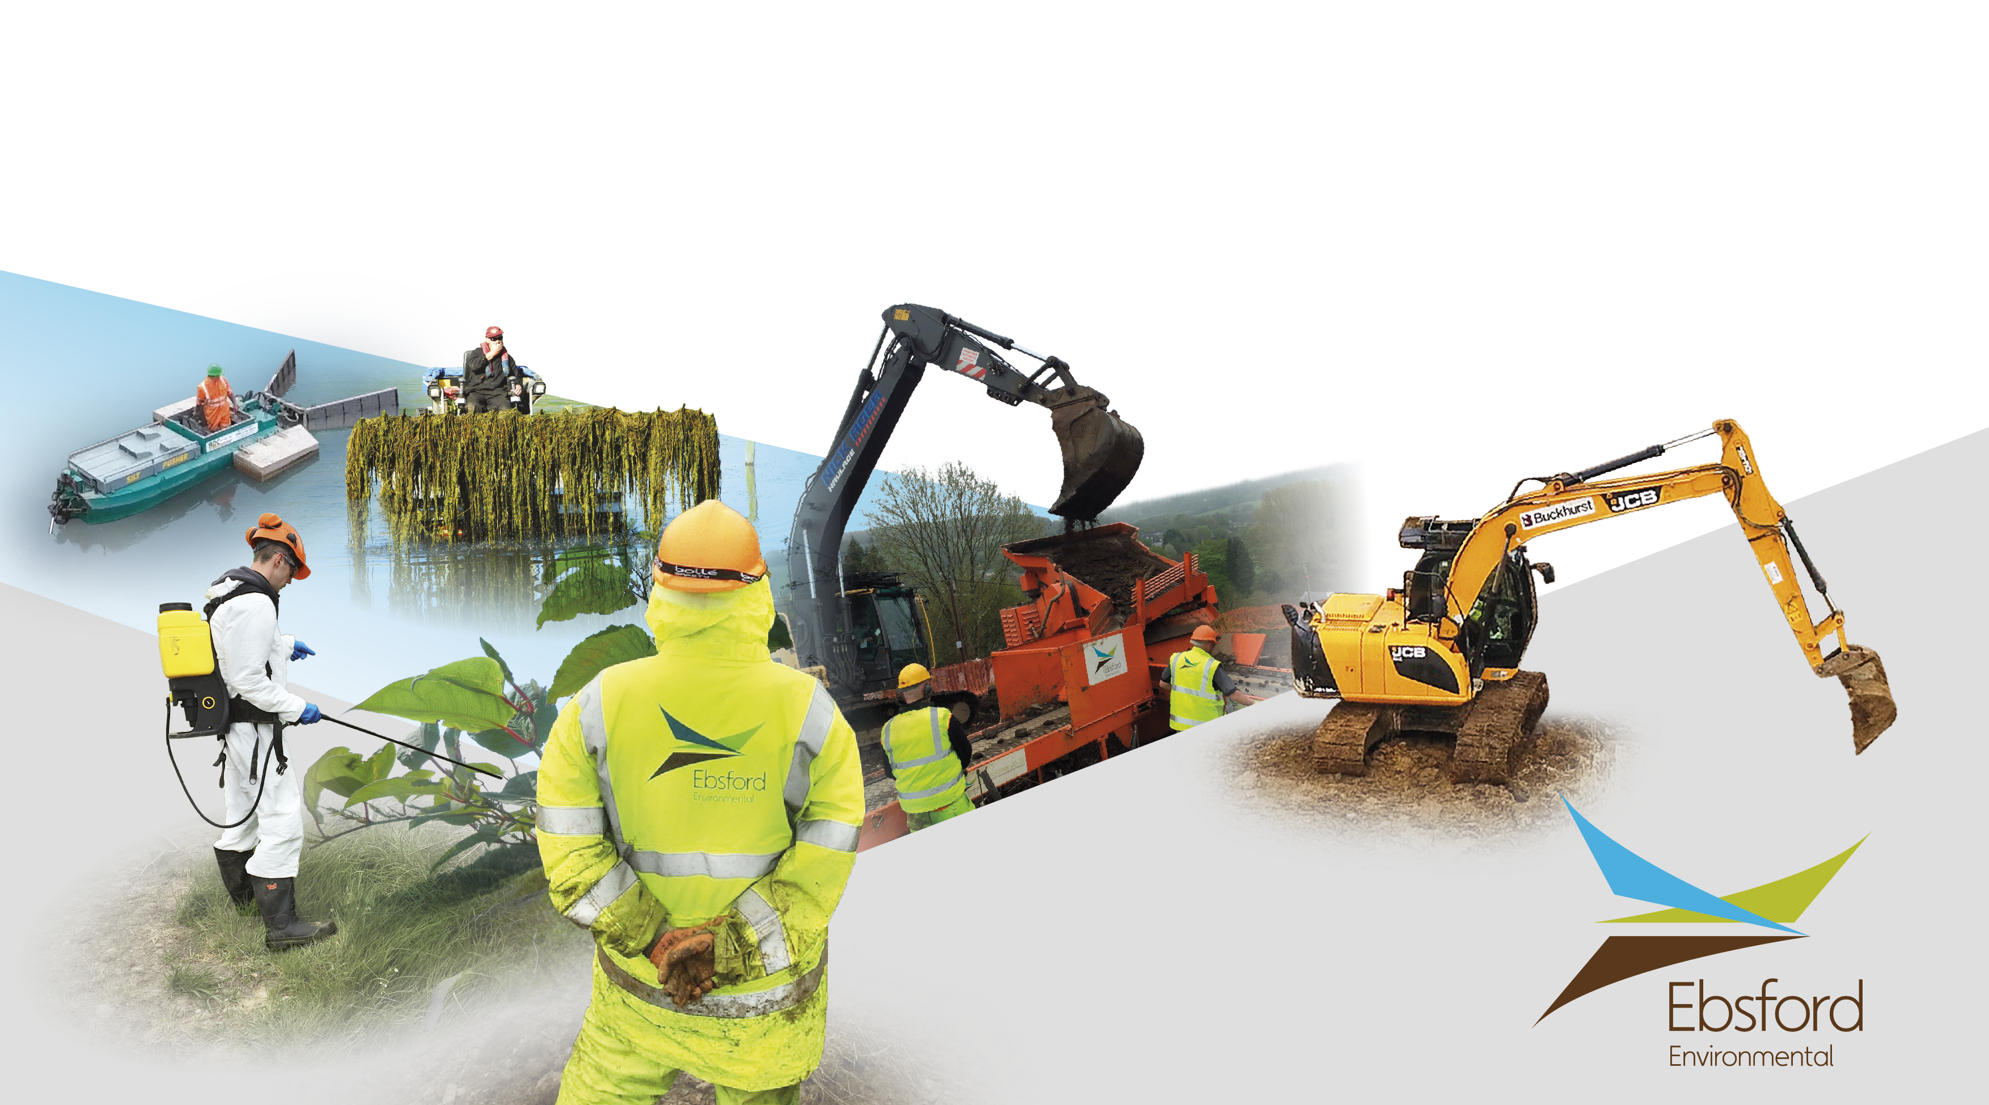
THANK YOU FOR LISTENING!
benfisher@ebsford.co.uk

