Slide 1
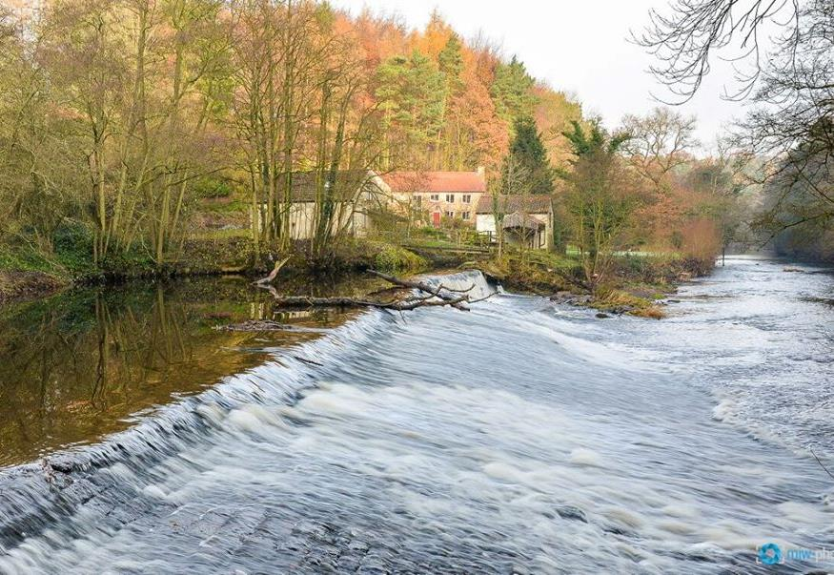
Getting shot of Scotton
Dam Removal Conference
May 2023
Prof Jon Grey
Research & Conservation Officer
jgrey@wildtrout.org @ProfJGrey

Slide 2
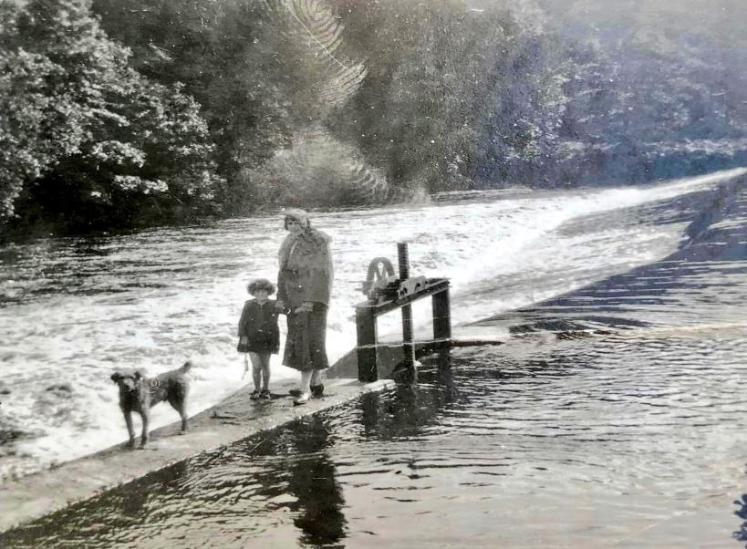
Scotton Weir, R Nidd, N Yorks
Former mill weir for hydropower
Naturally narrower part of valley (Nidd Gorge)
in situ for >200y
Notes:
Part of the Humber catchment, the Nidd should hold good populations of migratory fish species like salmon, lamprey & eel but was highly fragmented for hydropower during the industrial revolution

Slide 3
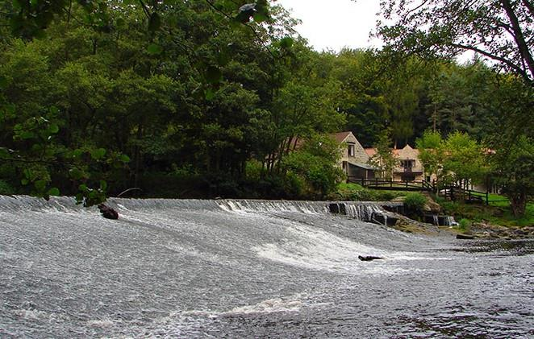
Scotton Weir, R Nidd, N Yorks
75m wide & 4m high
Nidd is a fragmented system but Scotton ranked 2nd on EA ‘hit-list’ behind Hunsingore
Notes:
Unlike some of the other Yorkshire rivers (Don, Aire, Wharfe to a certain extent) addressing fish passage on the Nidd has lagged behind. Hunsingore ranked #1 priority for fish passage – Hunsingore is d/s of Scotton. EA deem it impossible to remove so technical fish passage solutions being considered. Scotton ranked #2 despite being halfway along the catchment

Slide 4
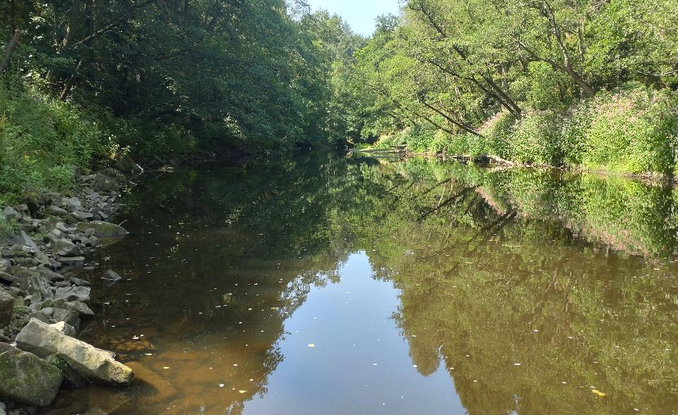
Scotton Weir, R Nidd, N Yorks
Impoundment >800m u/s
Channel d/s starved of gravel
Notes:
Much of the Nidd channel appears dominated by boulder and large cobble because smaller sediments trapped between weirs. Bank revetment and flood defences along much of its length limits resupply so obvious benefits to geomorph too

Slide 5
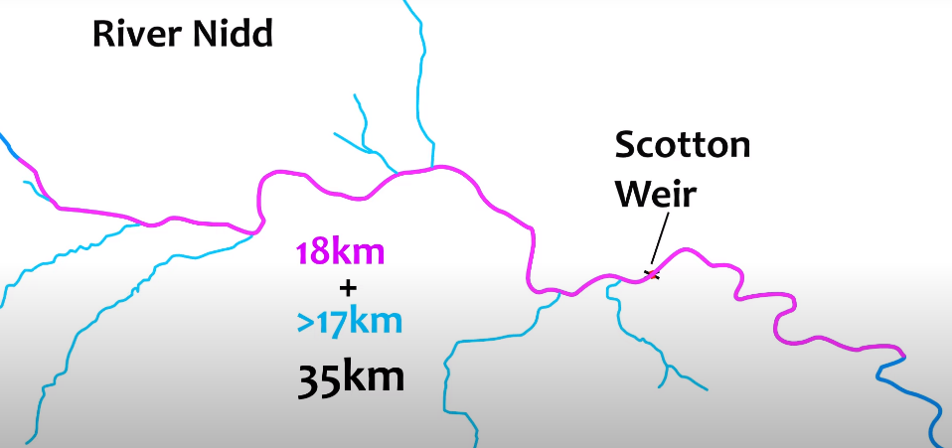
Free passage estimates
Notes:
Several key tributaries made much more accessible as well as the 18km of mainstem with uninterrupted passage.
WTT good working relationship with most of the angling clubs and some landowners in vicinity, improving habitat for ~8y

Slide 6
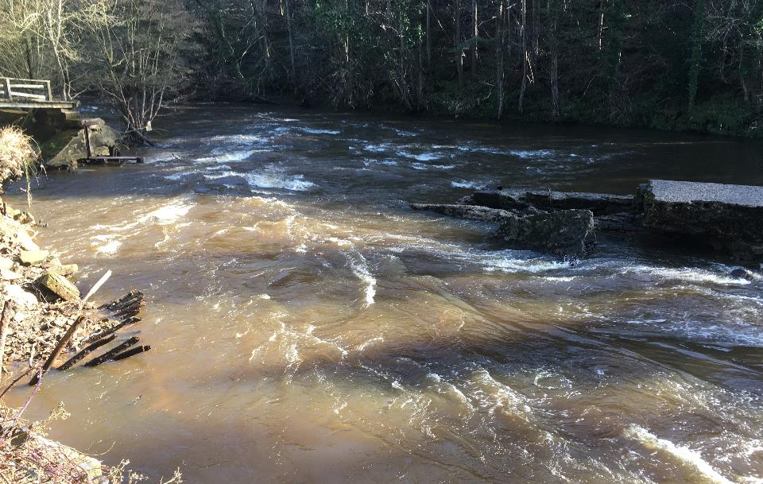
Spate flow Dec 2018
Notes:
Seems the lifespan of many such weirs is nearing an end. Recent collapse of Newlay, Gargrave etc, structural integrity of many others now questionable. Scotton was damaged at the weakest point during spate flow Dec 2018 and causing severe erosion to the LB (ie toward the mill, now a private residence)
So, the landowner had already begun protracted discussions with EA re permitting for removal

Slide 7
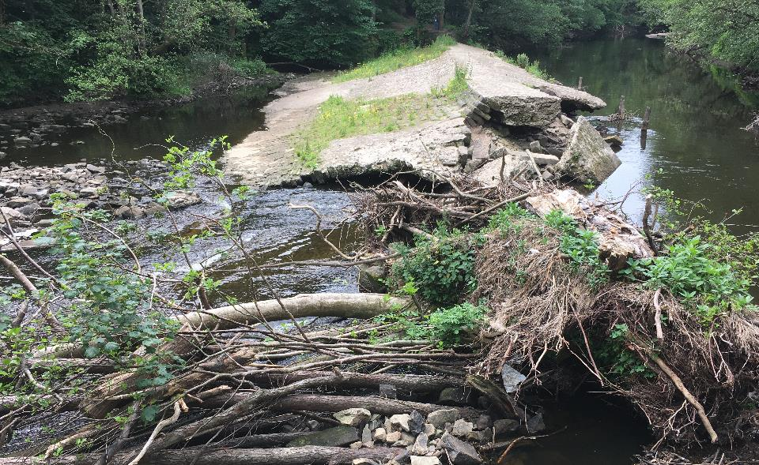
Partial, inconsistent lowering
Notes:
Damaged but still causing issues: the headloss was reduced to <2m when clear but the narrow aperture regularly plugged with trees & other debris.
Still passage issues for fish and sediment transport issues
Beyond environmental concerns, clearly a safety issue in terms of sudden release of impounded water etc
Allowed for a ‘cross-section of the weir to be viewed showing that increases in height had been mostly achieved by pouring concrete over the original stonework, so of limited heritage interest
Also, owner concerned re safety because people started walking on it / slipping off it

Slide 8
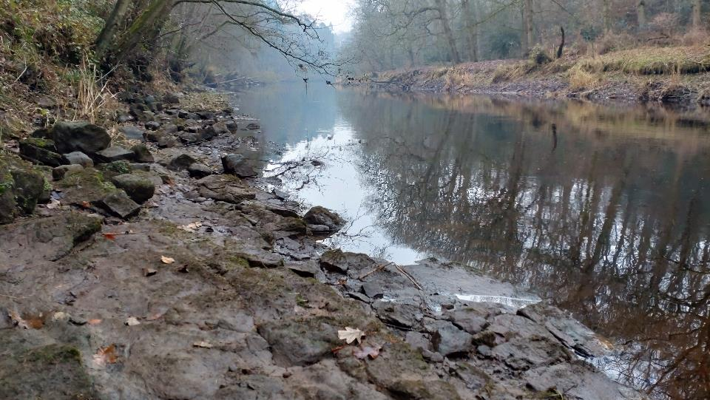
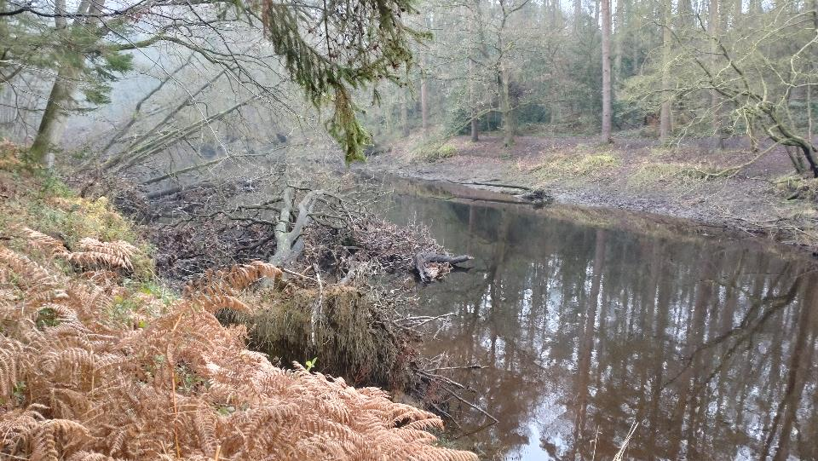
Breach allowed for u/s assessment
Every structure / location will bring its own challenges and require a ‘bespoke’ solution
Barrier removal
Nature-like bypass
Notching / partial removal
2. Fixed riffle / rock ramp easement
2. Technical / low-cost passage solutions
Notes:
Under low flow and when no ‘plugs’ in the breach, allowed extent of likely bank ‘adjustment’ to be gauged. There was some evidence of bank slump and trees toppling toward the river from original breach event. Assessed to be v little further adjustment. Larger trees with intact root balls were already being retained in margins – fab habitat
Situated within Nidd Gorge, bedrock seams quickly apparent which would limit any knick-point migration u/s

Slide 9
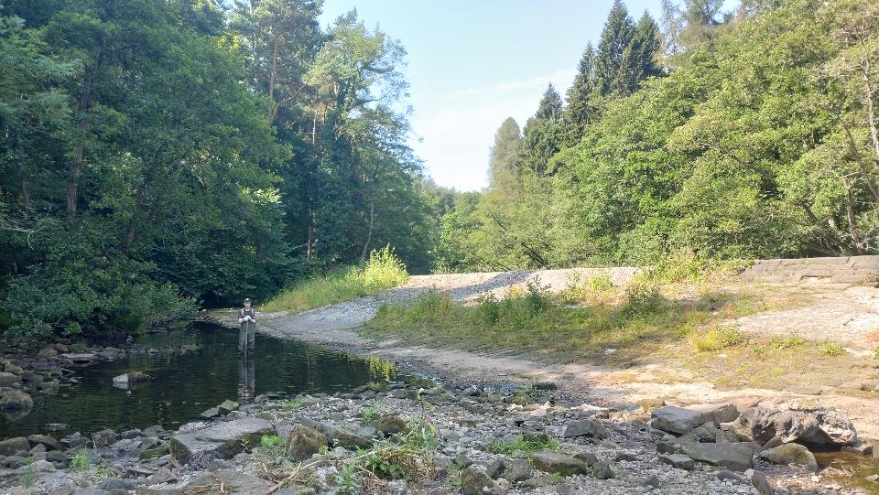
Stars aligned…
Full channel restoration might trump barrier removal
Only 2 riparian owners
Method statement
& permissions underway; contractor relatively flexible
ORP funding call
Notes:
Despite the scale of the weir, a relatively simple project:
Weir & mill under single ownership with riparian holding within affected zone on the LB u&d/s
RB under single ownership (Woodland Trust) – supportive as long as of no financial burden
Supportive EA FBG team and Yorks Dales RT
Supportive stakeholders (two angling clubs)
Experienced contractor - good working relationship with local EA
Breach and 3y elapsed time had already demonstrated likely extent of change u/s, hence argued strongly against requirement for modelling etc.
Also, given the Nidd should naturally be ~20-25m wide rather than 75m wide, plenty of scope to retain much of the stone infill within channel to facilitate geomorphological recovery, so no waste issues.
Dressed stone to be recycled as bank revetment to prevent further damage to mill buildings.

Slide 10
Timeline
Dec 2018 – Dec2021 owner (frustrated) negotiations
Dec 2021 – WTT site visit
Jan 2022 – ORP 1st round application for full removal
Mar 2022 – ORP 2nd round
April 2022 – Bespoke permit signed off
Jun 2022 – ORP award of €75,935
…..
18/08/22 – Contractor off site
Notes:
Extremely condensed….
Aside from WTT officer time to write the two rounds of application, the award from ORP covered project management time, pre & post monitoring (ongoing), and contractor costs for full removal
It included a 10% contingency which was partially used up because of rising fuel costs during that period

Slide 11
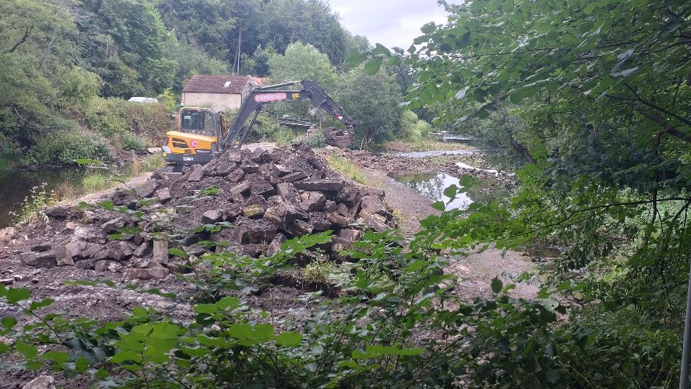
10/07/22 – Contractor on site
V low summer flow conditions
Priority to ‘separate’ weir from RB
Diverted flow from original breach to LB to ‘new’ channel to RB
https://www.youtube.com/watch?v=o3kAglzf7Nk
Notes:
Perfect conditions for improving fish passage, not fish passage per se!
Cleared plugs / debris from breach site and used rubble from around breach to create access ramp & causeway onto weir
H&S priority to prevent public from trespassing onto weir
Hefty sediment curtains in place
Link to timelapse coverage – not suggesting you play it!

Slide 12
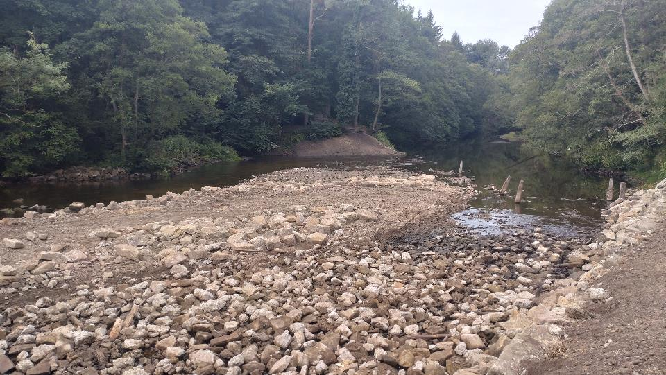
18/08/22 – Contractor off site
Immediately following plant extraction
Central deposition bar of unconsolidated material left deliberately under permit
https://www.youtube.com/watch?v=o3kAglzf7Nk
Notes:
Just short of 6 weeks to complete
No hitches bar:
fuel prices going through roof,
losing one track off an excavator,
and having someone remove the SD card from the time lapse camera but not steal the camera! Thus missed the first 2 days of prep work and had to relocate camera to more inaccessible position
Same link to timelapse coverage

Slide 13
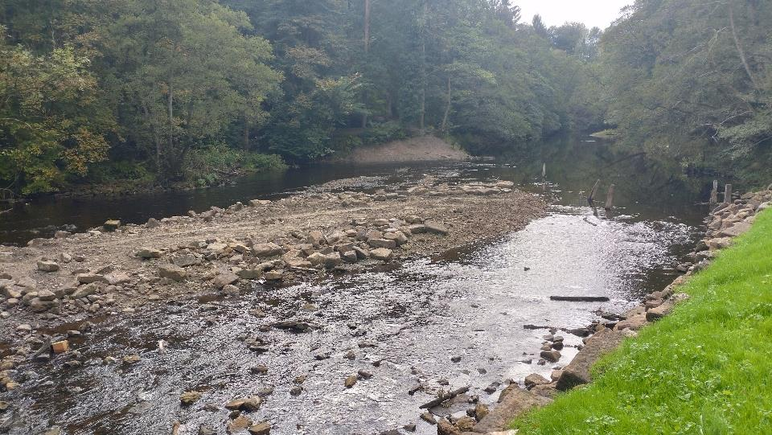
12/10/22…
Virtually no change, 2mo later
Notes:
Just short of 6 weeks to complete
No hitches bar:
fuel prices going through roof,
losing one track off an excavator,
and having someone remove the SD card from the time lapse camera but not steal the camera! Thus missed the first 2 days of prep work and had to relocate camera to more inaccessible position
Same link to timelapse coverage

Slide 14
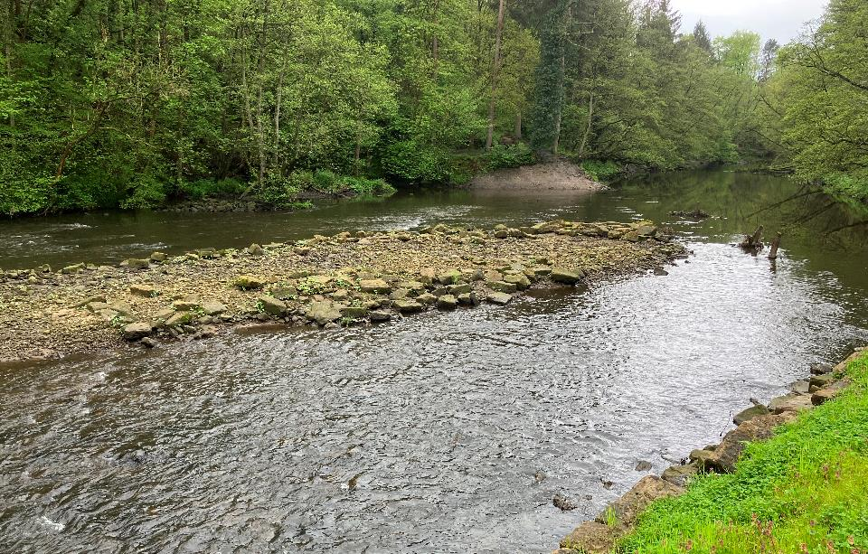
06/05/23…
Notes:
Hot off the press…. Some deposition on the central bar but still relatively little change after one winter, almost 10mo down the line
Regulated flows, reservoirs, some repair work. Flood 3m, not had much over 1.5m at Pateley gauge.

Slide 15
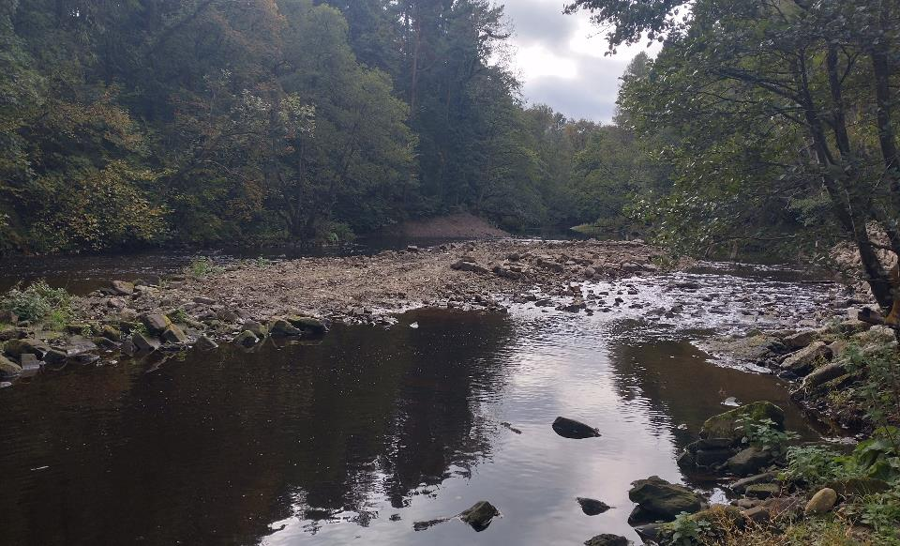
Monitoring
Pre (1mo) & post (12 & 24mo)
Channel x-sections
Fish community (via angling catch returns)
Fixed Point Photography
Prof Jon Grey
jgrey@wildtrout.org
jgrey@wildtrout.org
@ProfJGrey
Notes:
Limited opportunities for drone etc due to extensive, high canopy
Only have pre-data currently as <12mo. However, given lack of water in Yorkshire, not expecting much drastic change as of yet!
Despite ORP funding stated as project must be completed within 12mo, argued for award of post project monitoring to 24mo.

Slide 16
Quick plug for ORP
Notes:
Can’t recommend them enough. Does what it says on the tin.

