Slide 1
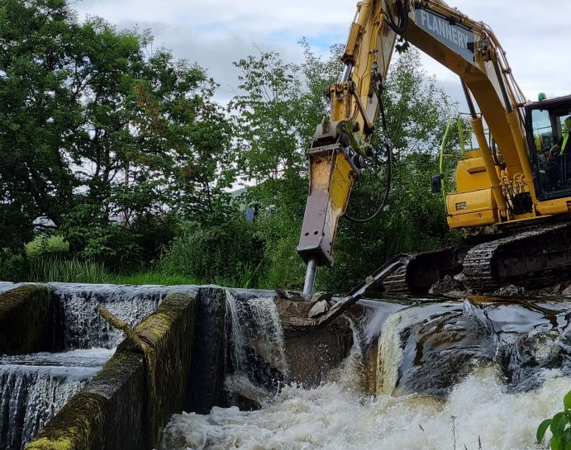
Overcoming the pain barrier: Stories of successful weir removal
Neil Entwistle & George Heritage
@SalfordHydro & @Dynamic_Rivers

Slide 3
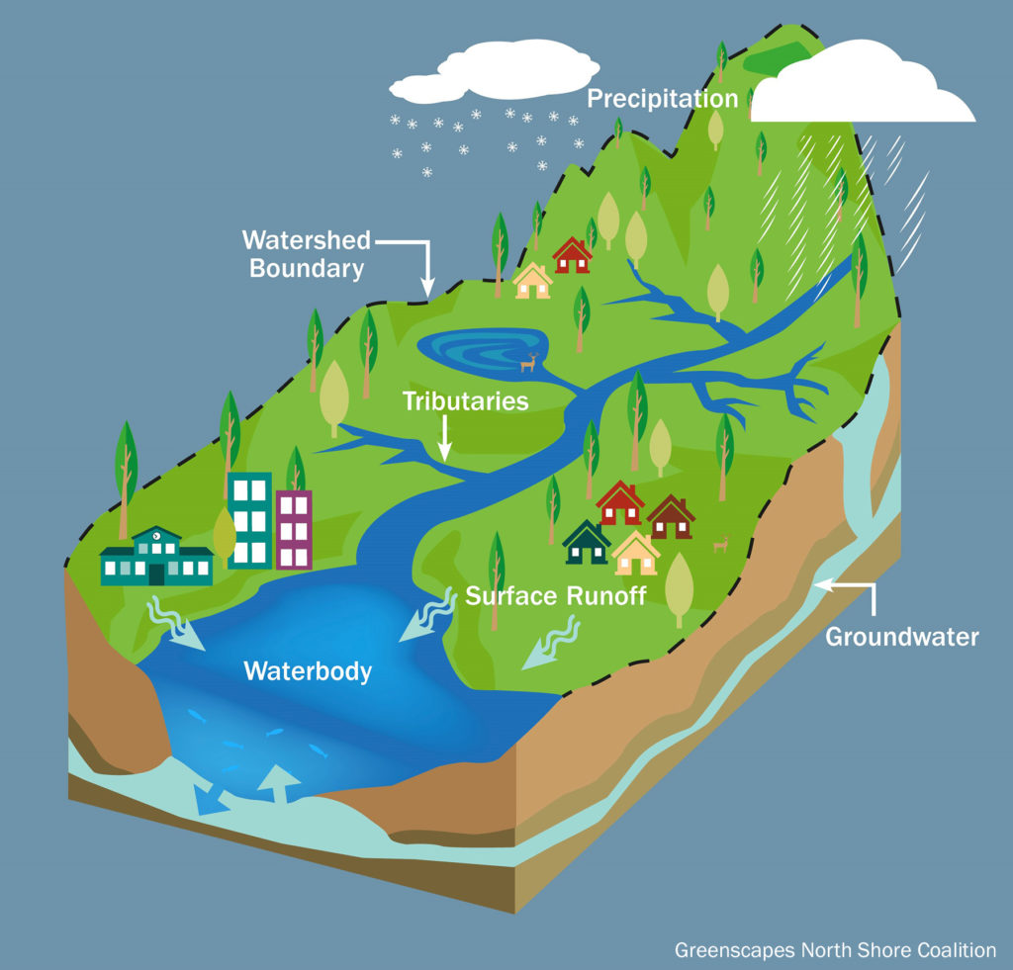
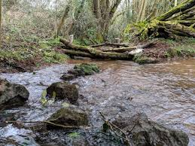
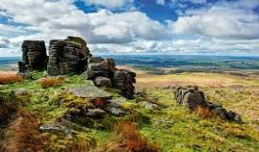
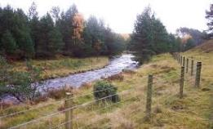
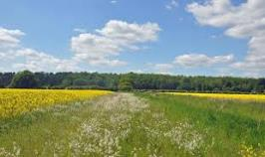
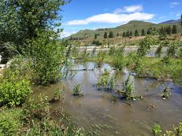
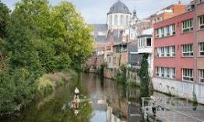
Restoration
NFM
Catchment Habitats
Debris Dams, Ditch Blocking, Ponds, Scrapes
River Restoration
Moorland Restoration, Planting
Land Management
Floodplain Rejuvenation
Urban River Rehabilitation
Meandering, Wandering, Anastomosing, fan rejuvenation, Step-pool, Pool-rapid, Bedrock channels
Farmer Engagement, Pollution control, Sediment control, Stocking regimes, Land management, integrated farming
Making space for water, ‘Stage Zero’ Wetlands, Open water, tributary restoration
Weir removal, feature reinstatement, Coarse sediment management

Slide 4
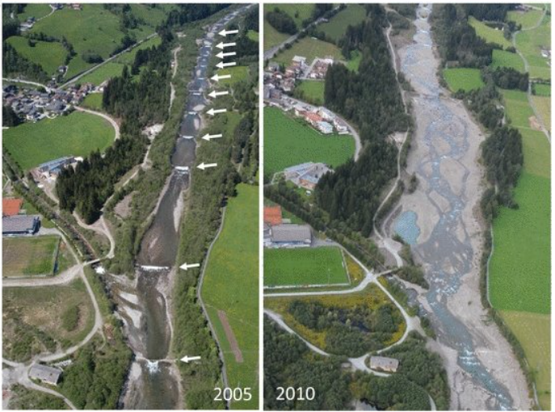
Mareit River, Italy
Photograph by Francesco Comiti

Slide 5
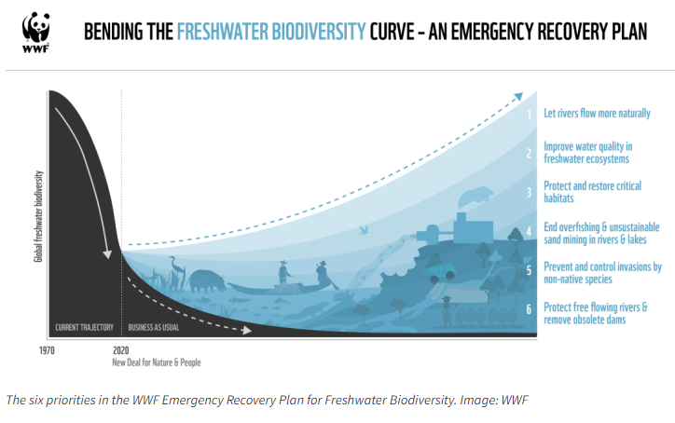
84% of global freshwater
species populations
Notes:
The WWF’s current approach to fostering widespread dialogue and action on tackling the freshwater biodiversity crisis centres on their Emergency Recovery Plan for Freshwater Biodiversity. The plan, discussed in a blog back in February, is based on six key themes.
They are: letting rivers flow more naturally; reducing pollution; protecting critical wetland habitats; ending overfishing and unsustainable sand mining in rivers and lakes; controlling invasive species; and safeguarding and restoring river connectivity through better planning of dams and hydropower.
The authors of the Emergency Recovery Plan suggest that unless significant collective action is taken to ‘bend the curve’ of freshwater biodiversity loss globally then the downward trends of species loss and ecosystem degradation will continue apace. The time to tackle this crucial issue is now: the key question, as Muruven puts it, is, “are we capable as a freshwater community of coalescing around the Emergency Recovery Plan for the next five years and collectively have a go at bending the curve?”

Slide 6
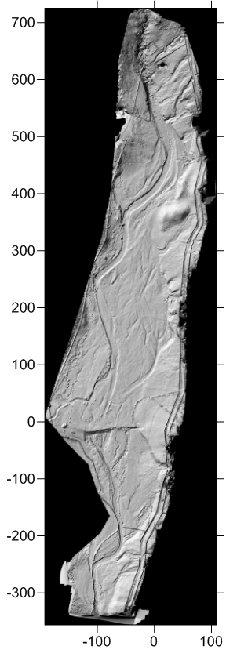
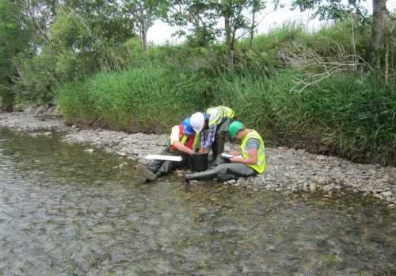
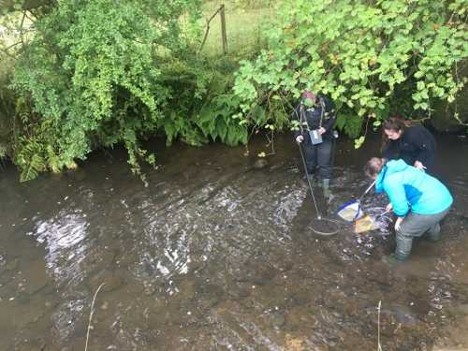
Monitoring
Geomorph
Inverts
Fish

Slide 7
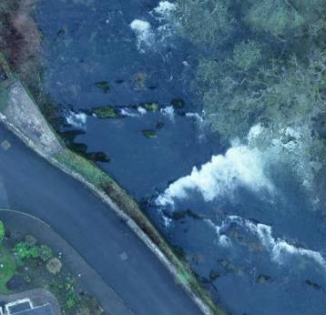
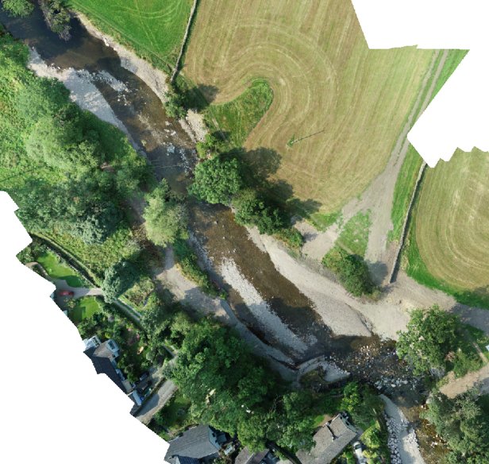
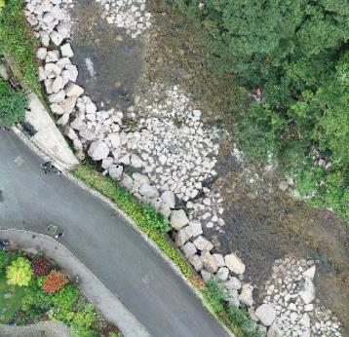
Pre restoration
Post 1st bankfull flow
Post restoration

Slide 8
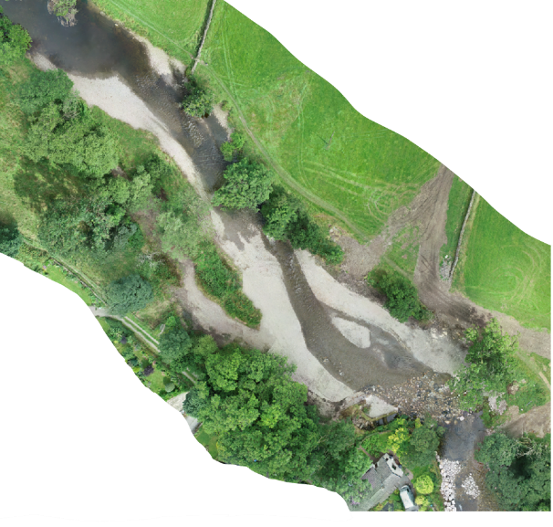
Pre restoration
Post 2nd bankfull flow
Post restoration

Slide 9
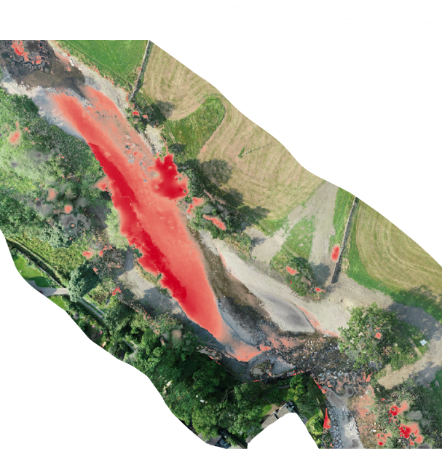
Pre restoration
Post 1st bankfull flow
Naturalisation
Erosion
Post 2nd bankfull flow
Post restoration
Deposition

Slide 10
Pre restoration
Post 1st bankfull flow
Naturalisation
Erosion
Post 2nd bankfull flow
Post restoration
Deposition

Slide 11
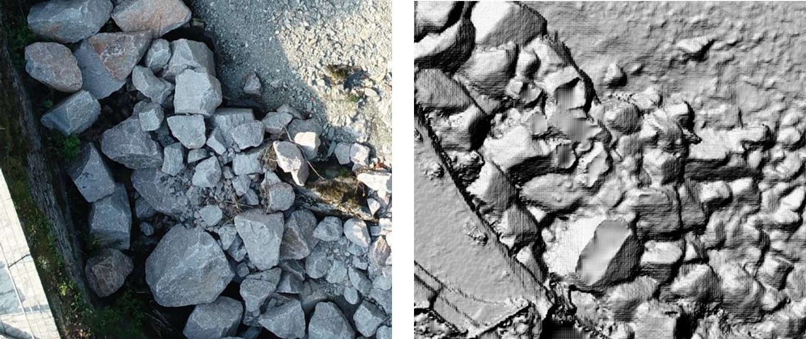
Quantifiable Evidence

Slide 12
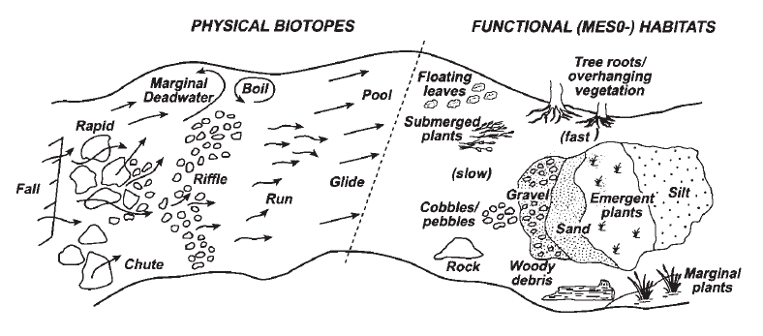
New Habitat
Newson, M. D., & Newson, C. L. (2000). Geomorphology, ecology and river channel habitat: mesoscale approaches to basin-scale challenges. Progress in Physical Geography, 24(2), 195-217.

Slide 13
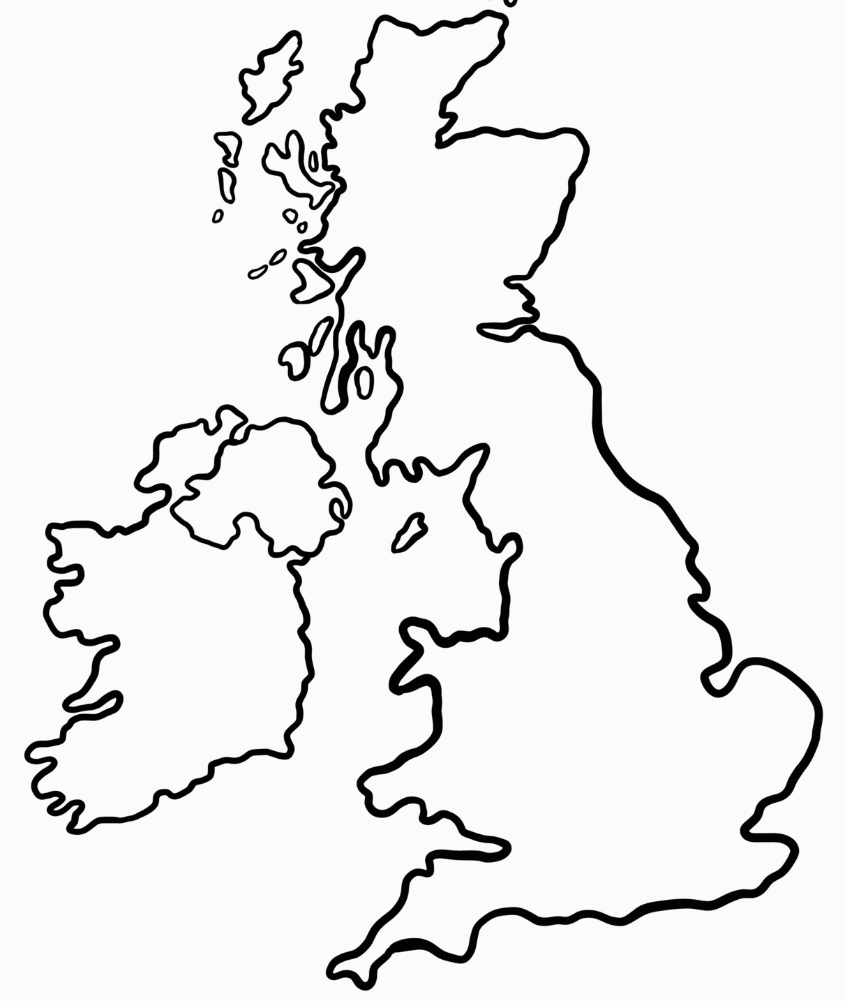
River Glen

Slide 14
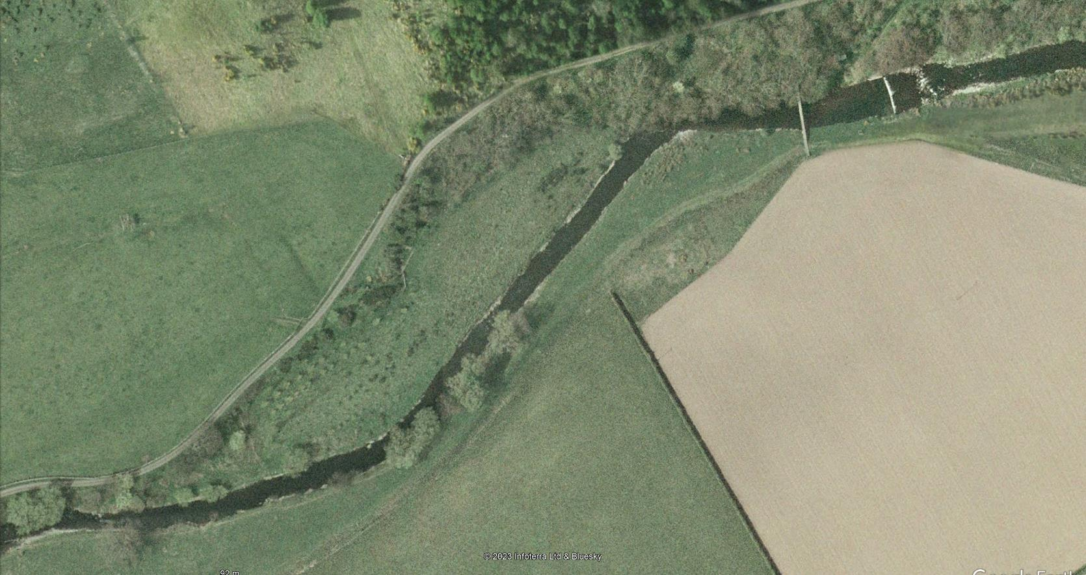
River Glen
2007
Riffle
Run
Bar
Pool
Glide

Slide 15
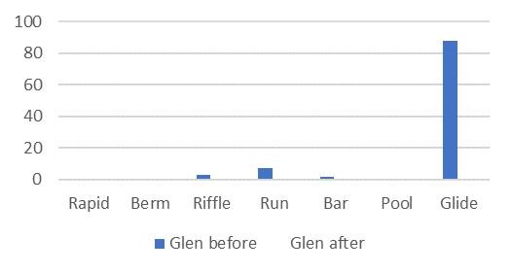
River Glen
2007
Riffle
Run
Bar
Pool
Glide

Slide 16
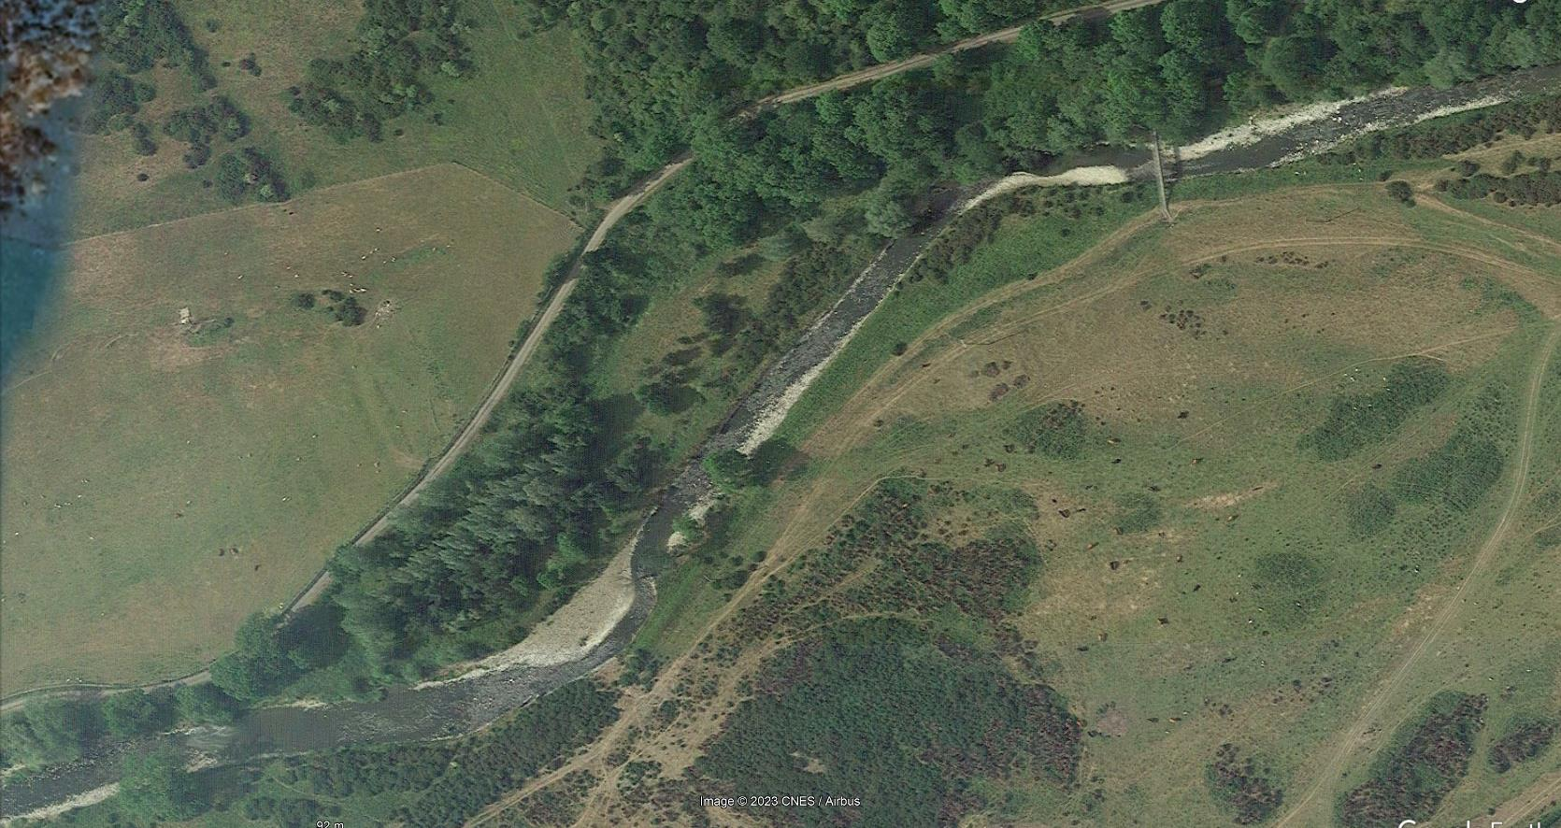
River Glen
2023
Riffle
Run
Bar
Pool
Glide

Slide 17
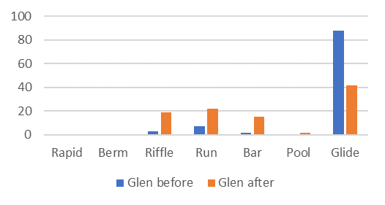
River Glen
2023
Riffle
Run
Bar
Pool
Glide

Slide 18
River Irwell

Slide 19
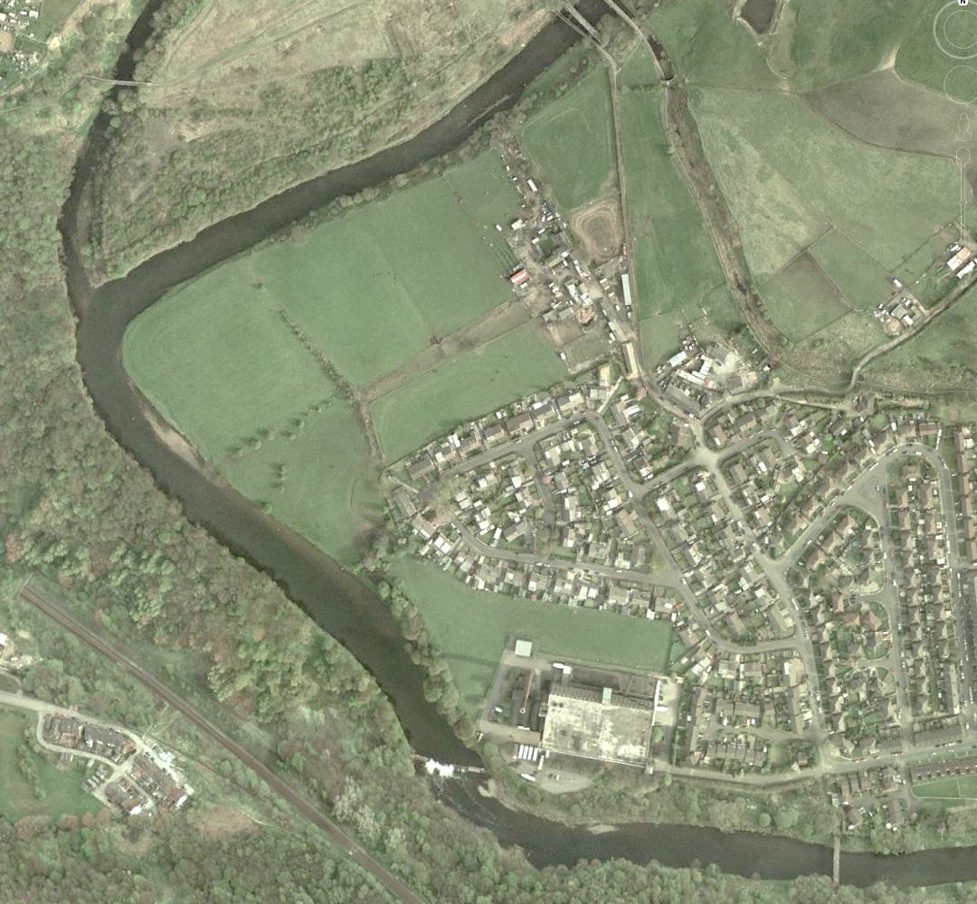
River Irwell
2014
Berm
Riffle
Run
Bar
Pool
Glide
Prestolee Mill Dam

Slide 20
River Irwell
2014
Berm
Riffle
Run
Bar
Pool
Glide
Prestolee Mill Dam

Slide 21
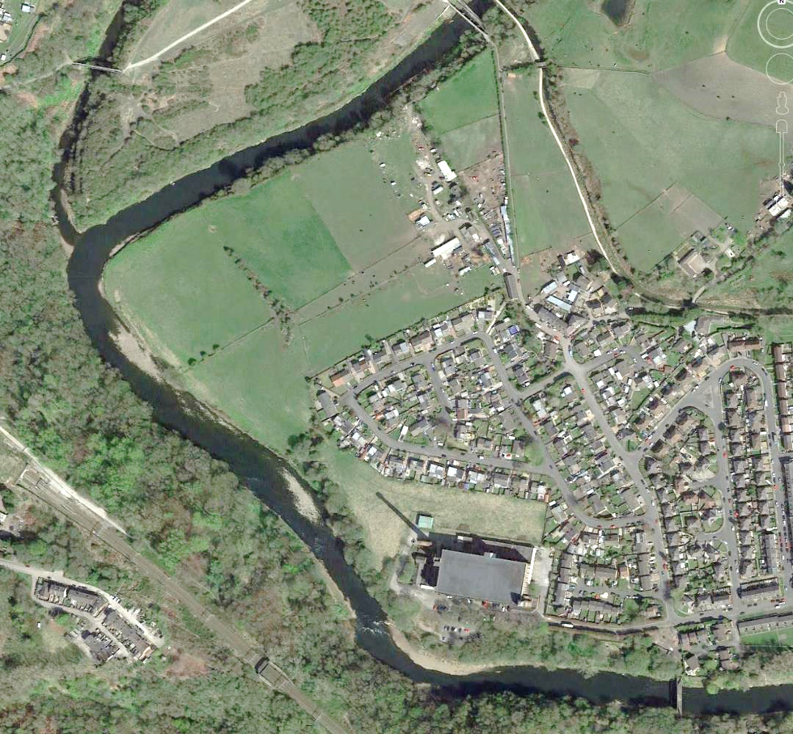
River Irwell
2023
Berm
Riffle
Run
Bar
Pool
Glide
Prestolee Mill Dam

Slide 22
River Irwell
2023
Berm
Riffle
Run
Bar
Pool
Glide
Prestolee Mill Dam

Slide 23
River Irwell
Field trip
route
2023
Berm
Riffle
Run
Bar
Pool
Glide
Prestolee Mill Dam

Slide 24
River Croal

Slide 25
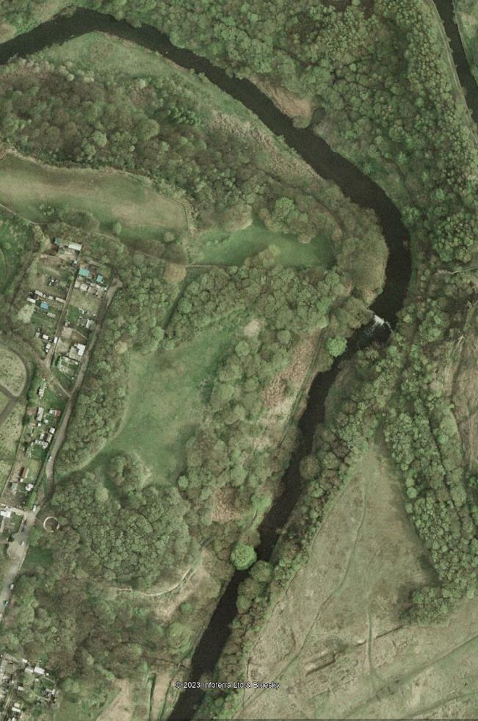
River Croal
Berm
Riffle
Run
Bar
Pool
Glide

Slide 26
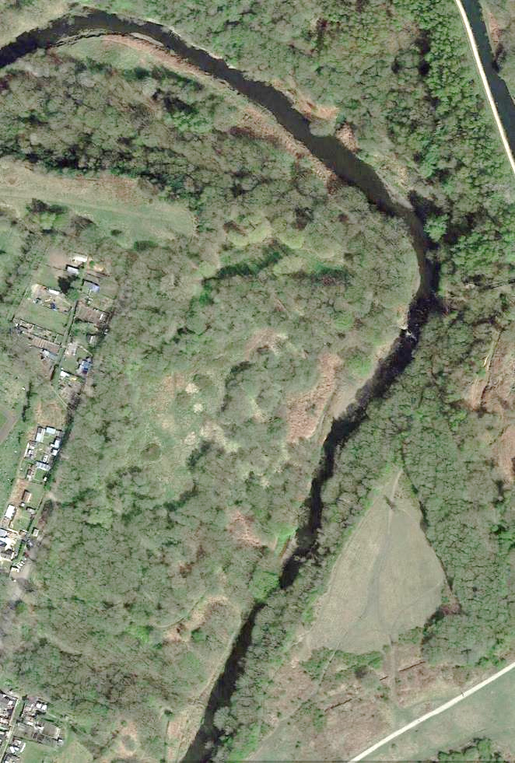
River Croal
Berm
Riffle
Run
Bar
Pool
Glide

Slide 27
River Croal
Berm
Riffle
Run
Bar
Pool
Glide

Slide 28
River Croal
Berm
Riffle
Run
Bar
Pool
Glide
Field trip
route

Slide 29
River Ehen

Slide 30
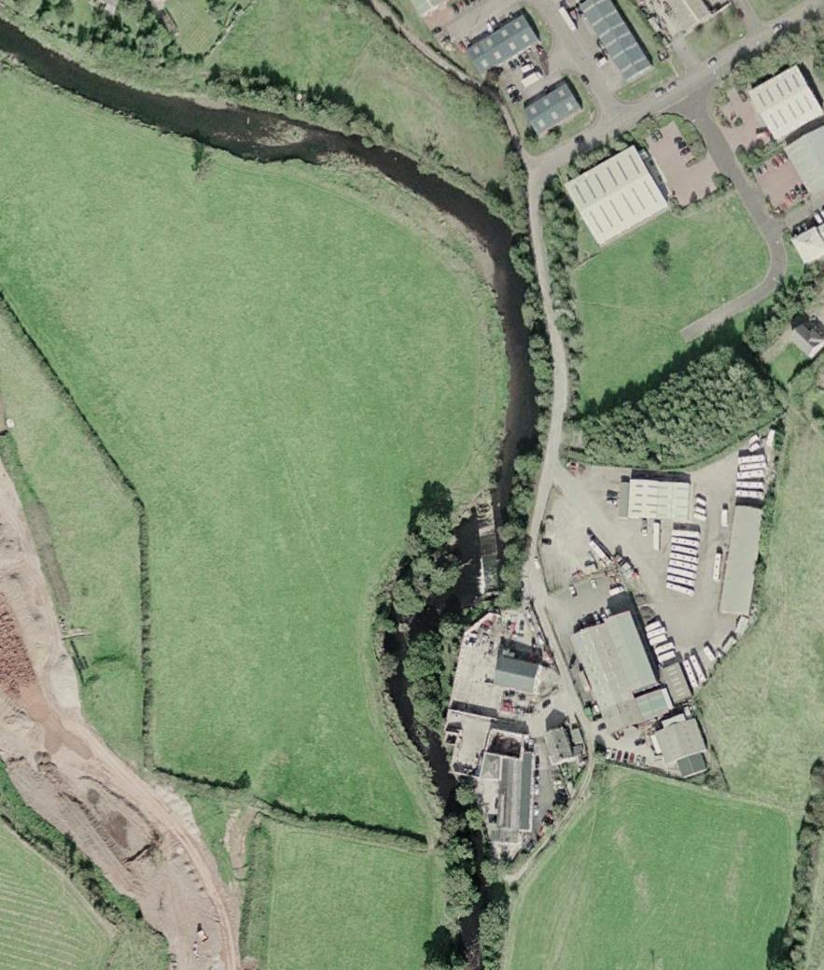
River Ehen
Rapid
Berm
Riffle
Run
Bar
Pool
Glide
Ennerdale Mill Dam

Slide 31
River Ehen
Rapid
Berm
Riffle
Run
Bar
Pool
Glide
Ennerdale Mill Dam

Slide 32
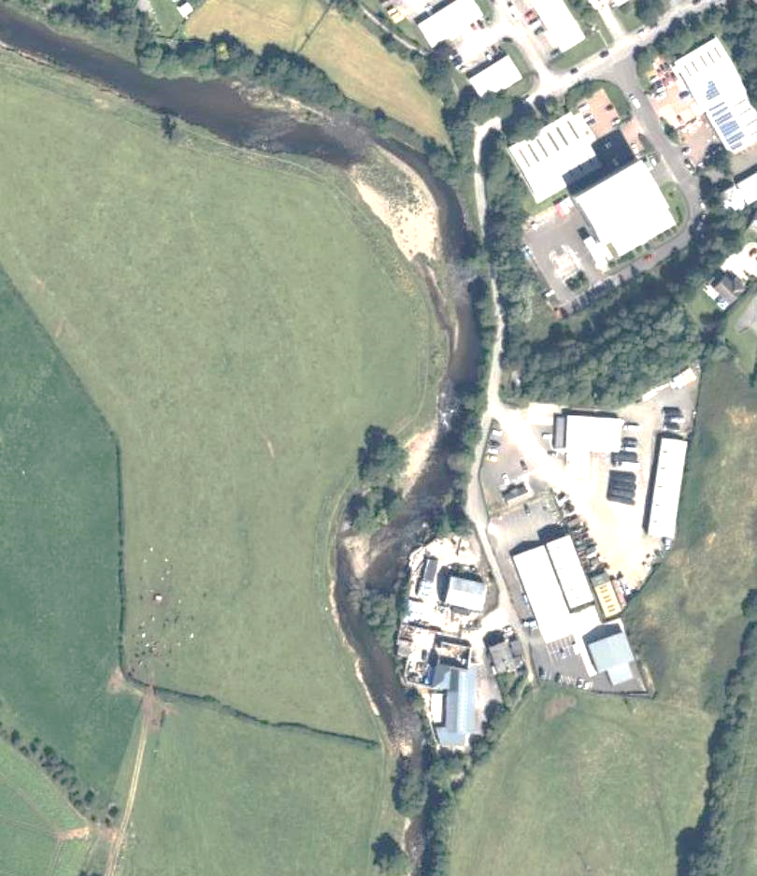
River Ehen
Rapid
Berm
Riffle
Run
Bar
Pool
Glide
Ennerdale Mill Dam

Slide 33
River Ehen
Rapid
Berm
Riffle
Run
Bar
Pool
Glide
Ennerdale Mill Dam

Slide 34
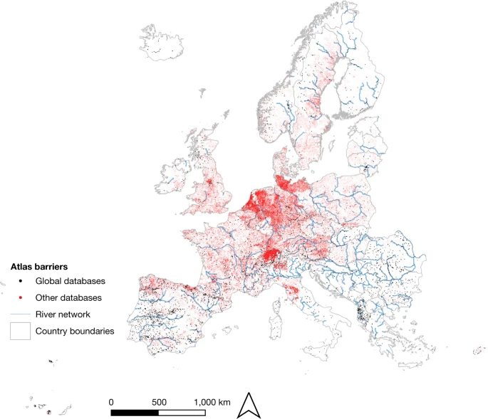
Artificial instream barriers in Europe
Distribution of 629,955 unique barrier records compiled from 120 local, regional and national databases
Belletti, B., Garcia de Leaniz, C., Jones, J., Bizzi, S., Börger, L., Segura, G., ... & Zalewski, M. (2020). More than one million barriers fragment Europe’s rivers. Nature, 588(7838), 436-441
DATA: https://figshare.com/articles/dataset/AMBER_Atlas_of_Instream_Barriers_in_Europe/12629051

Slide 35
Artificial instream barriers in Europe
Distribution of 629,955 unique barrier records compiled from 120 local, regional and national databases
Belletti, B., Garcia de Leaniz, C., Jones, J., Bizzi, S., Börger, L., Segura, G., ... & Zalewski, M. (2020). More than one million barriers fragment Europe’s rivers. Nature, 588(7838), 436-441
DATA: https://figshare.com/articles/dataset/AMBER_Atlas_of_Instream_Barriers_in_Europe/12629051

Slide 36
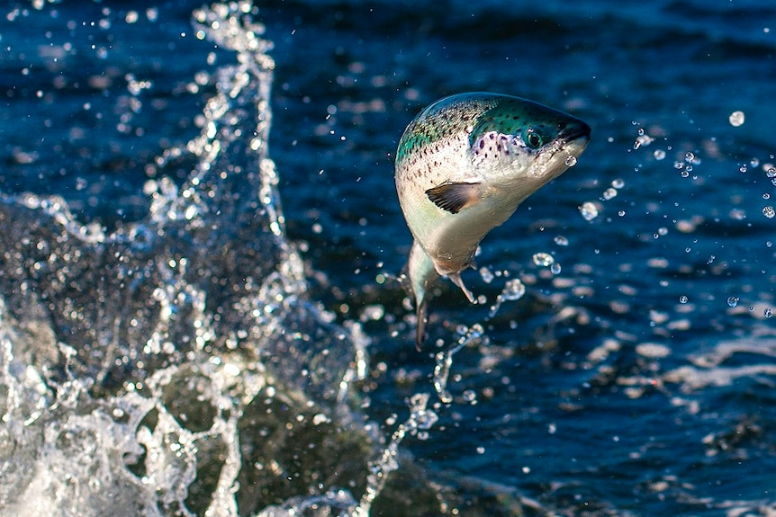
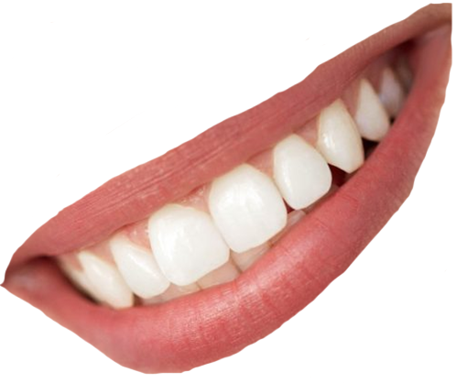
Thank you!
Neil Entwistle & George Heritage
@SalfordHydro & @Dynamic_Rivers

