Slide 1
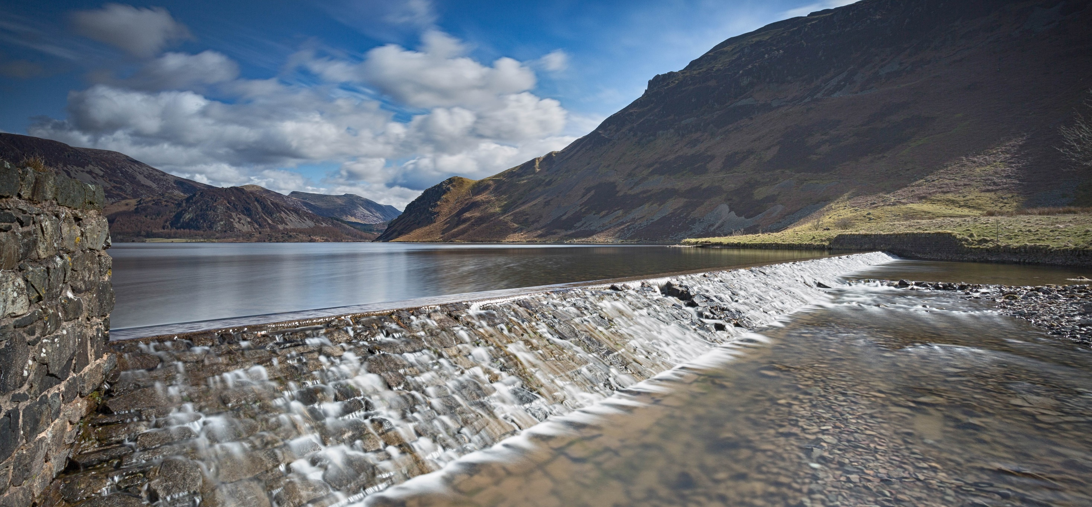


5 Dams, 5 Lakes
Lake naturalisation through impoundment removal
Alice Senior and Simon Webb
Ennerdale Water

Slide 2
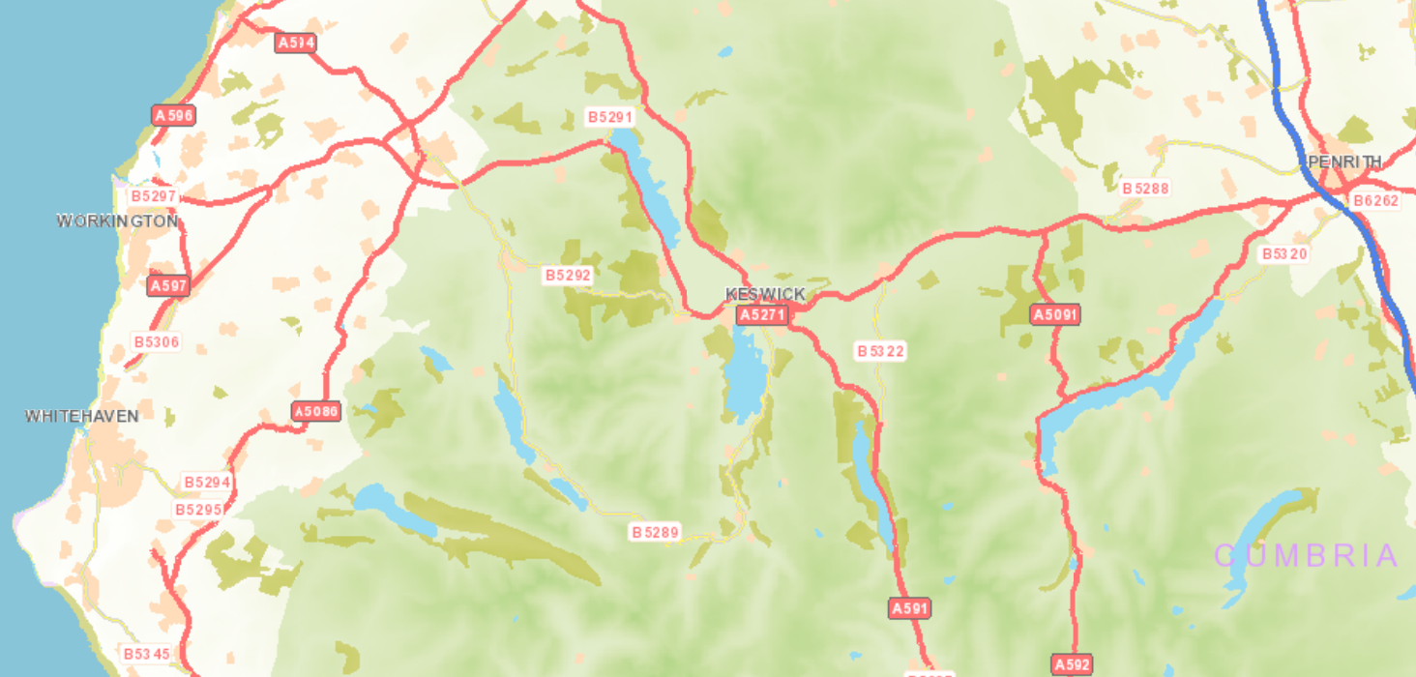
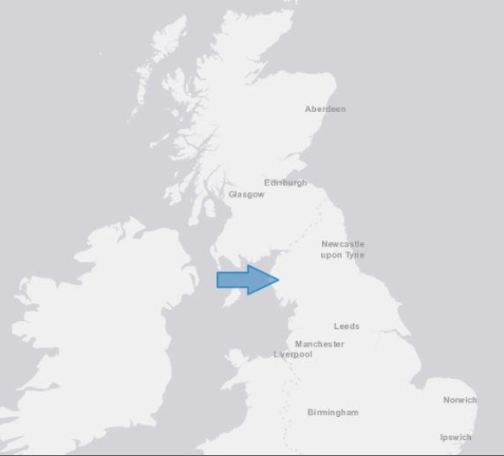

Slide 3
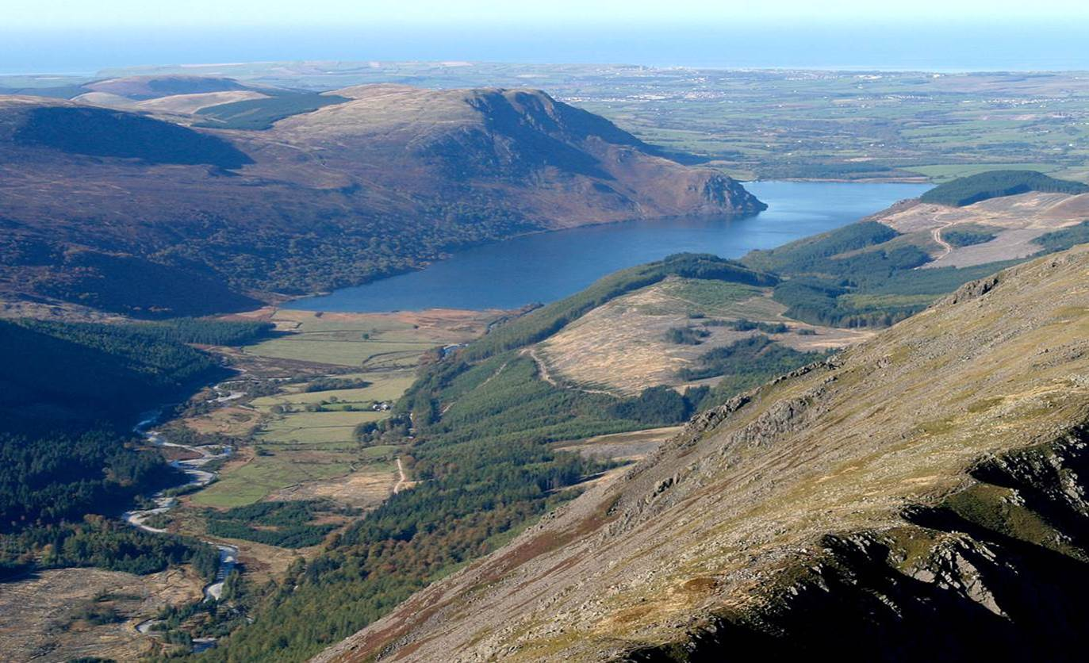

Slide 4
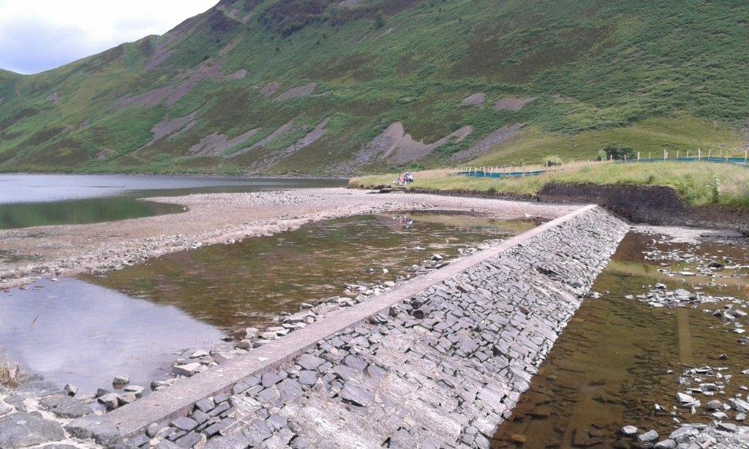

Slide 6
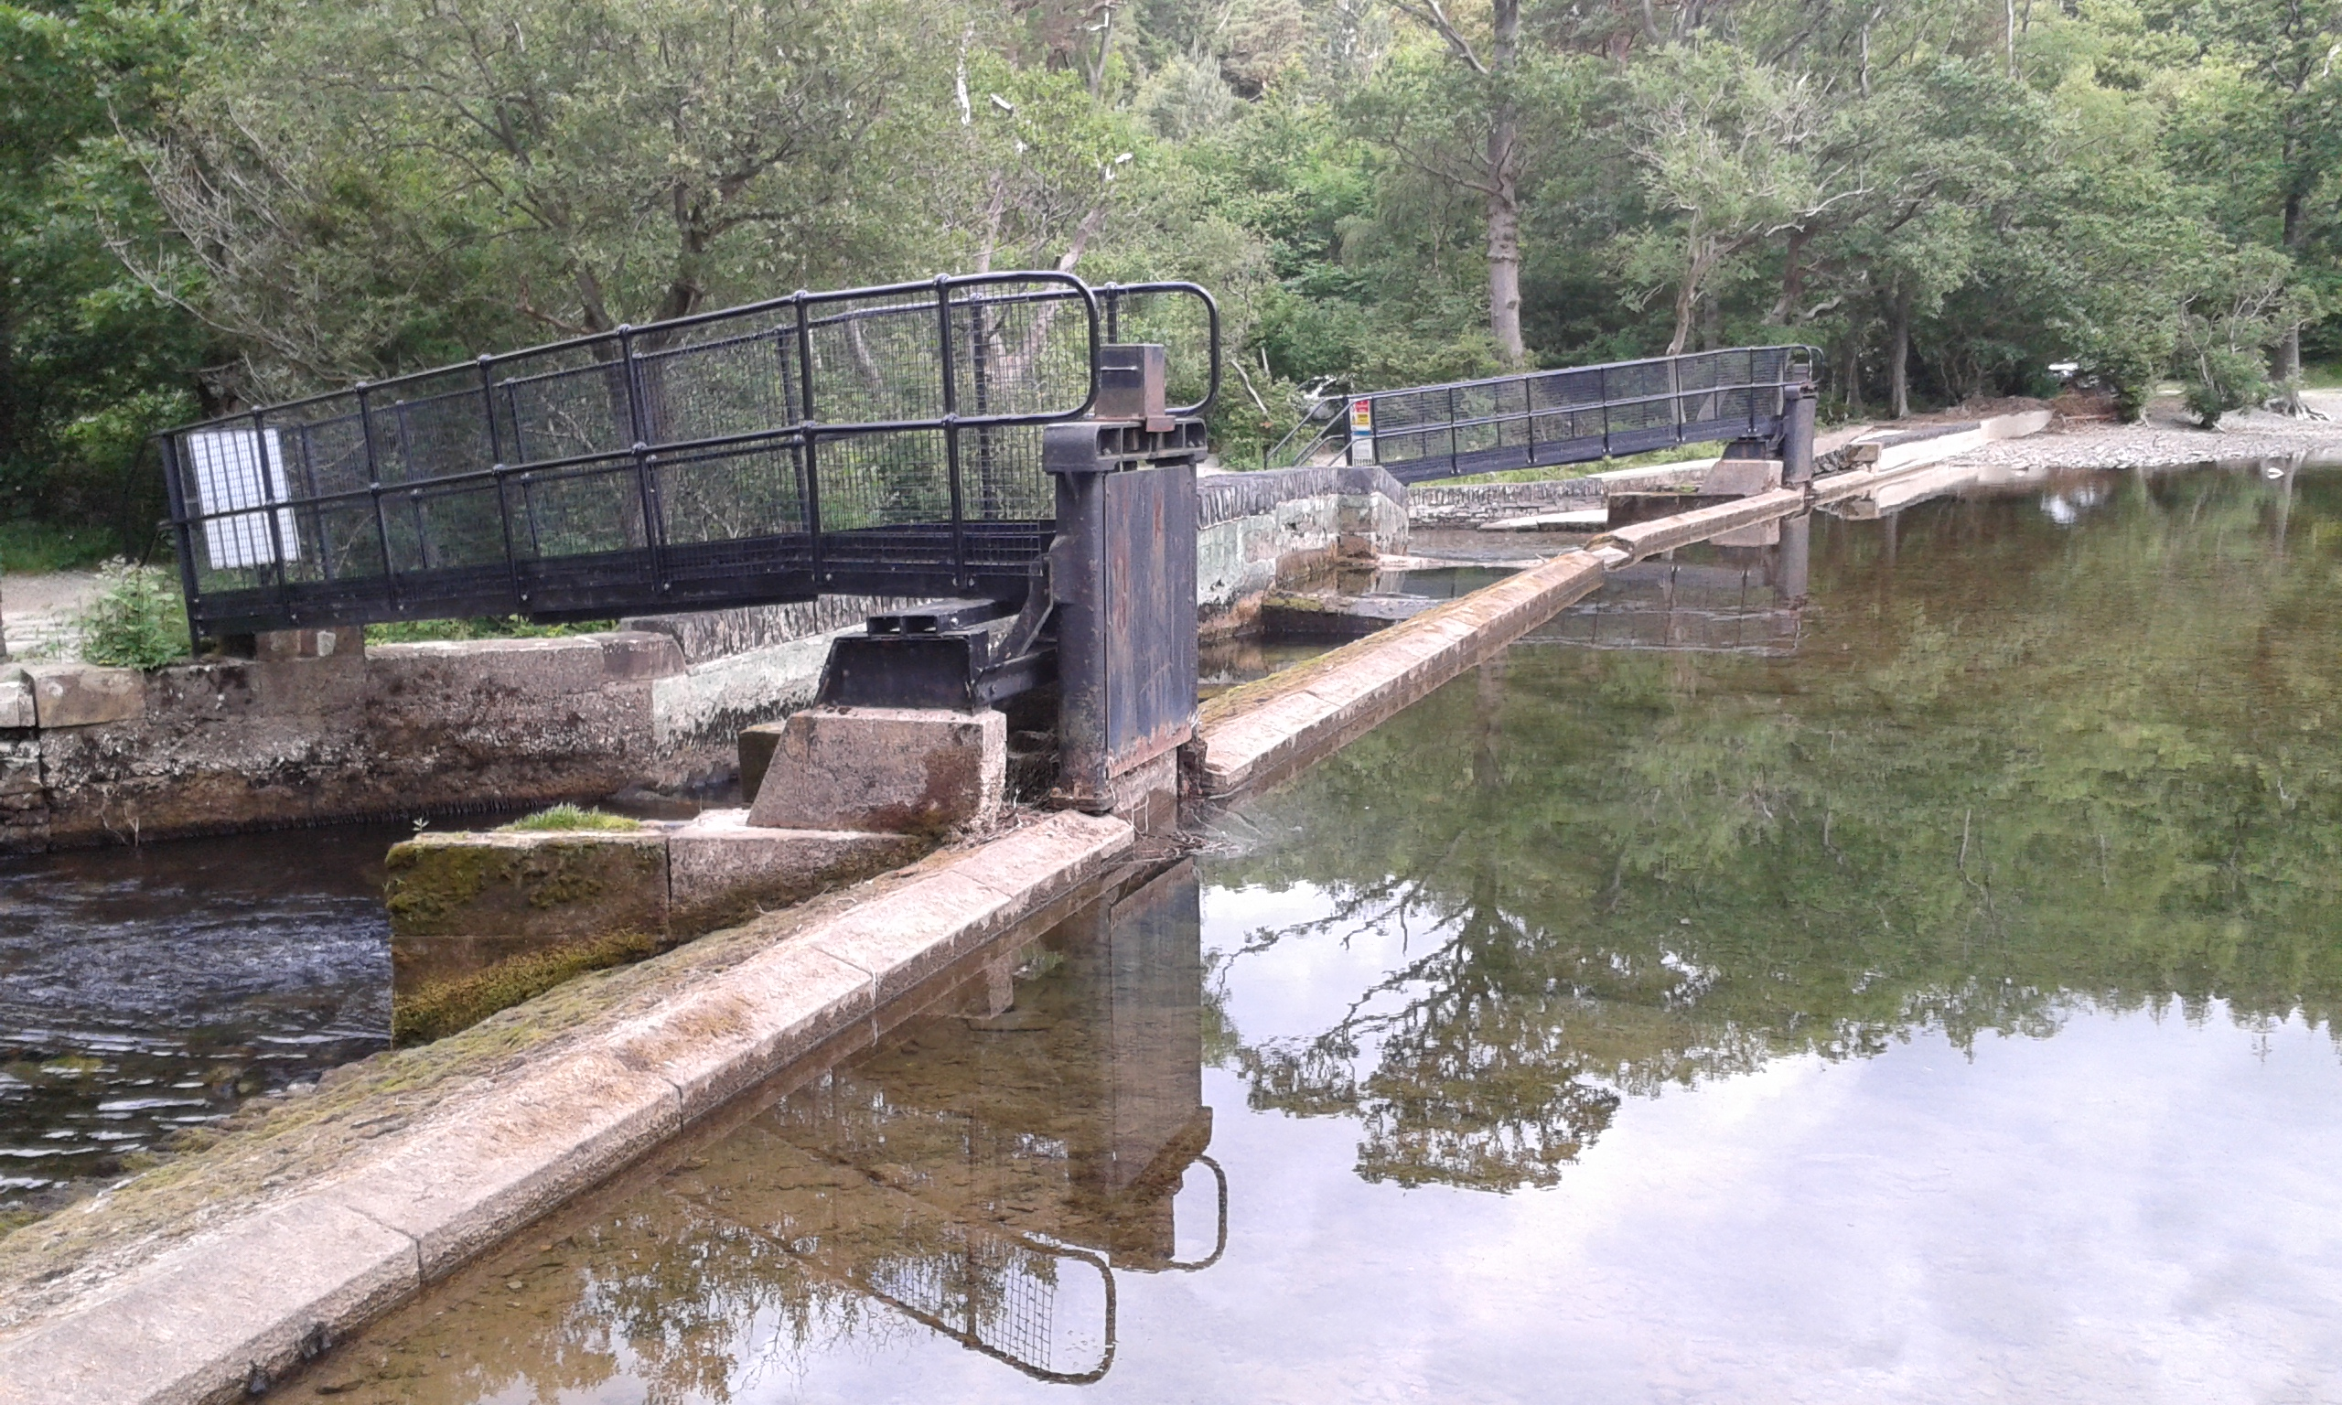

Slide 7
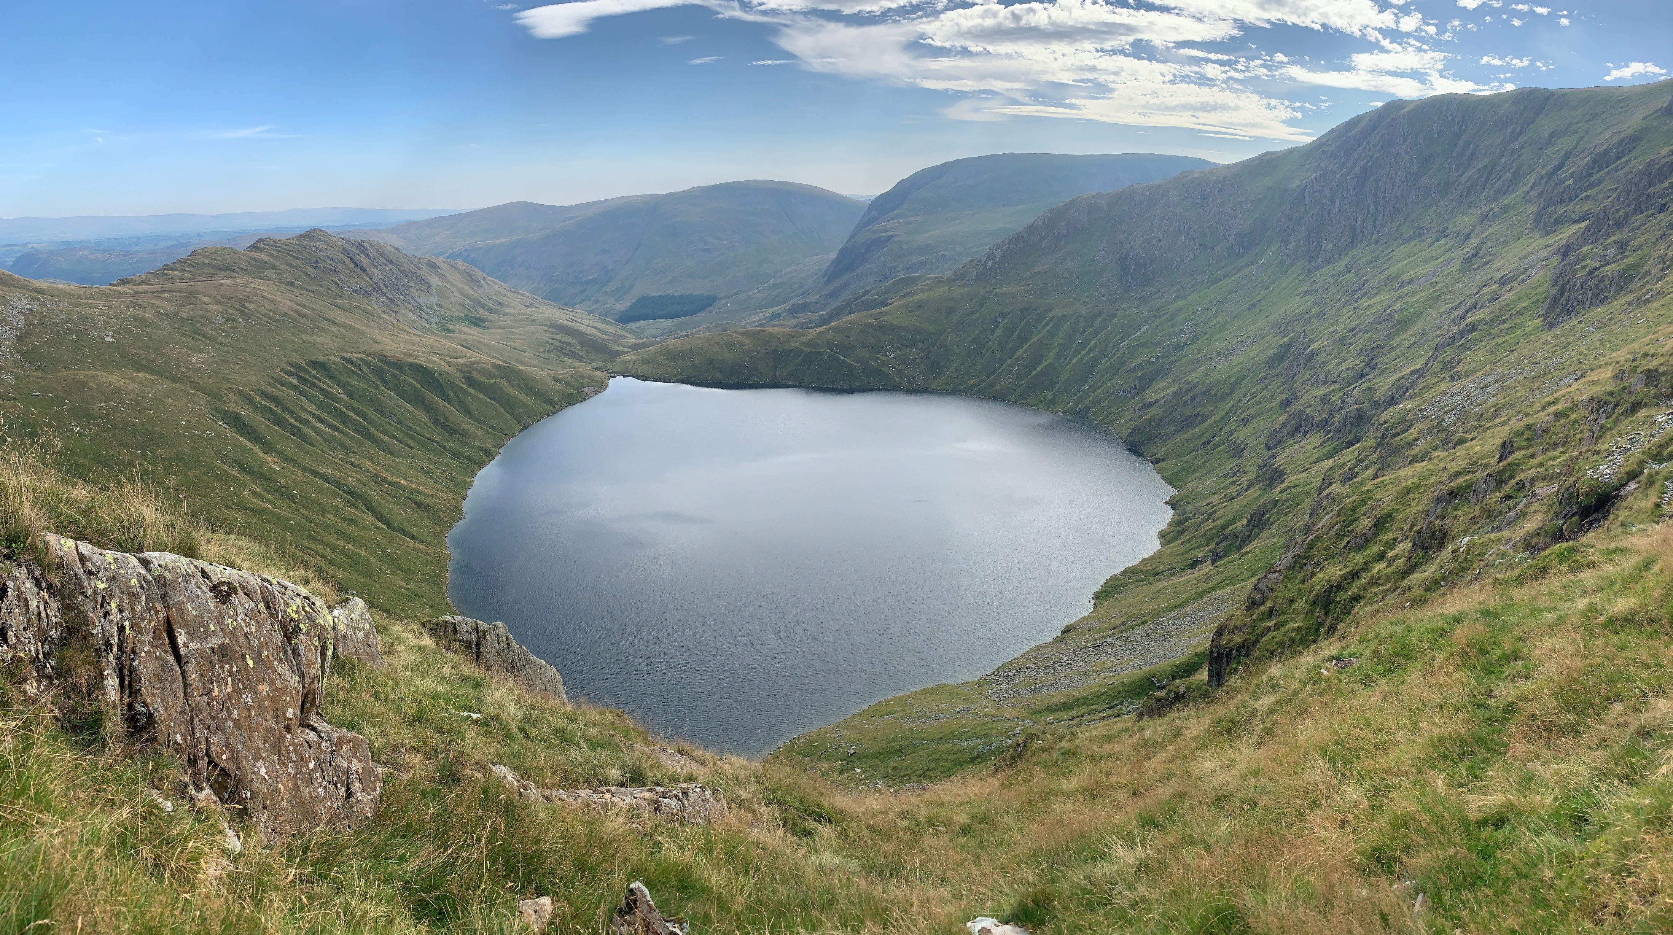

Slide 8
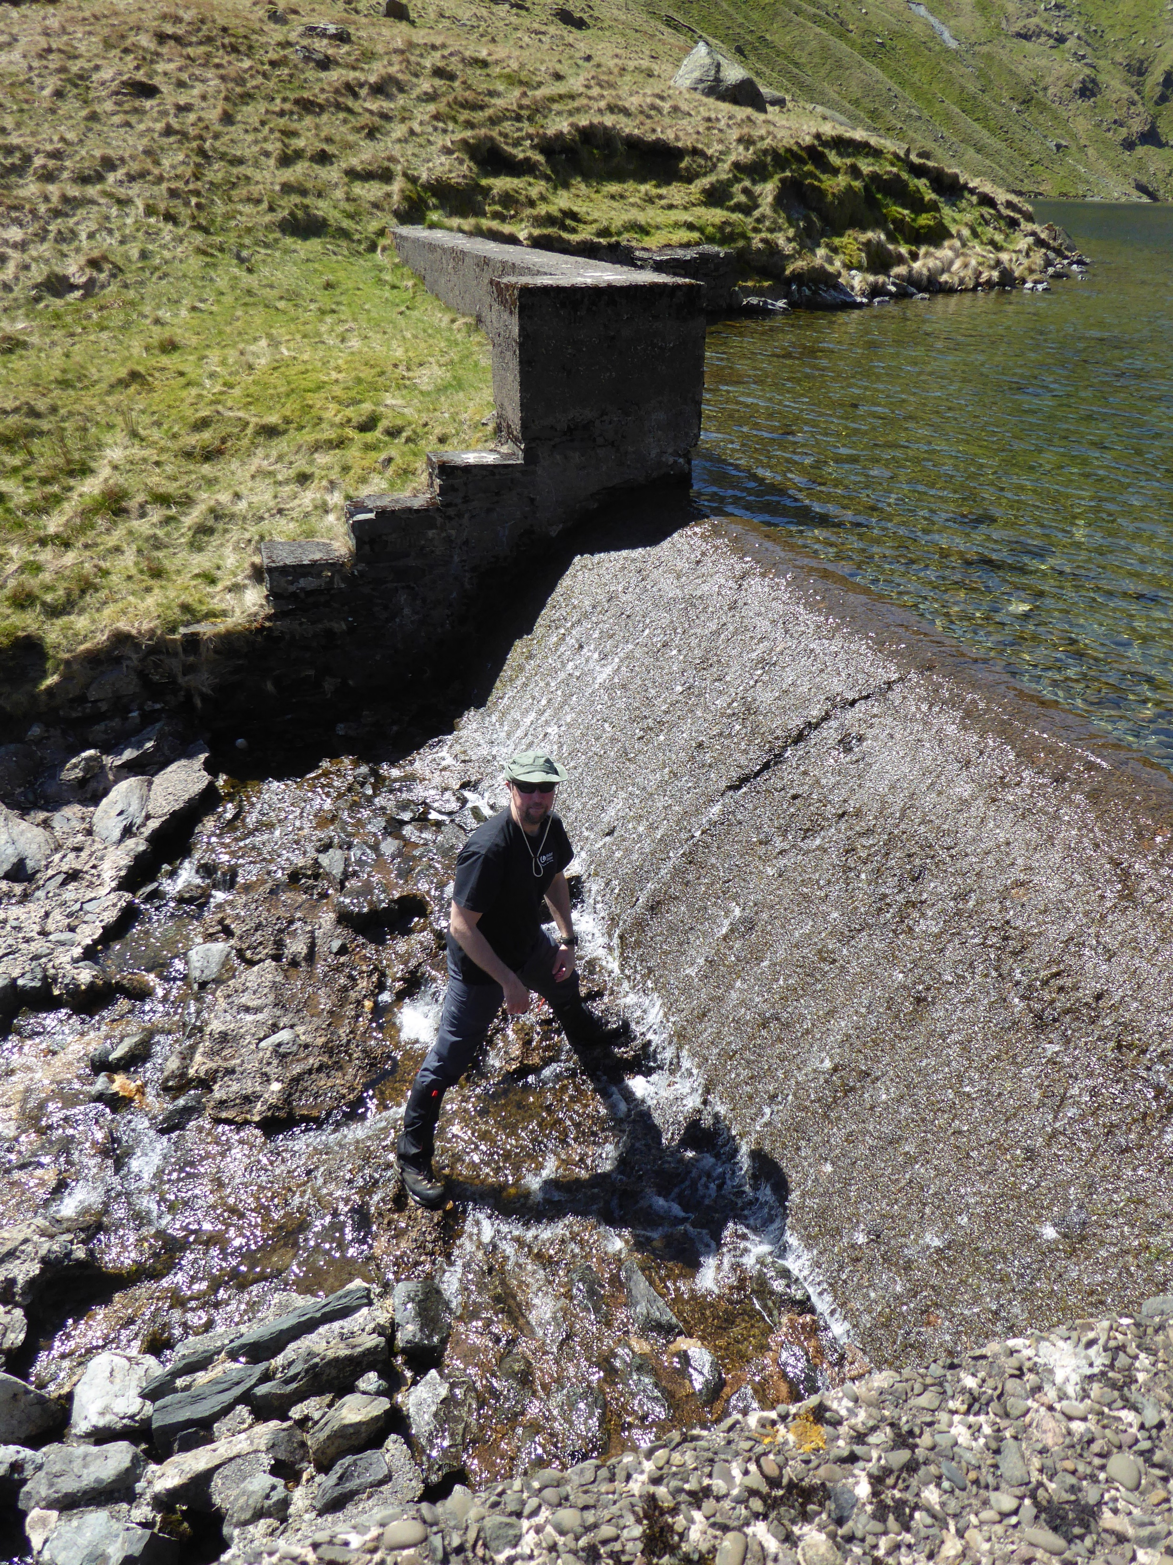

Slide 9
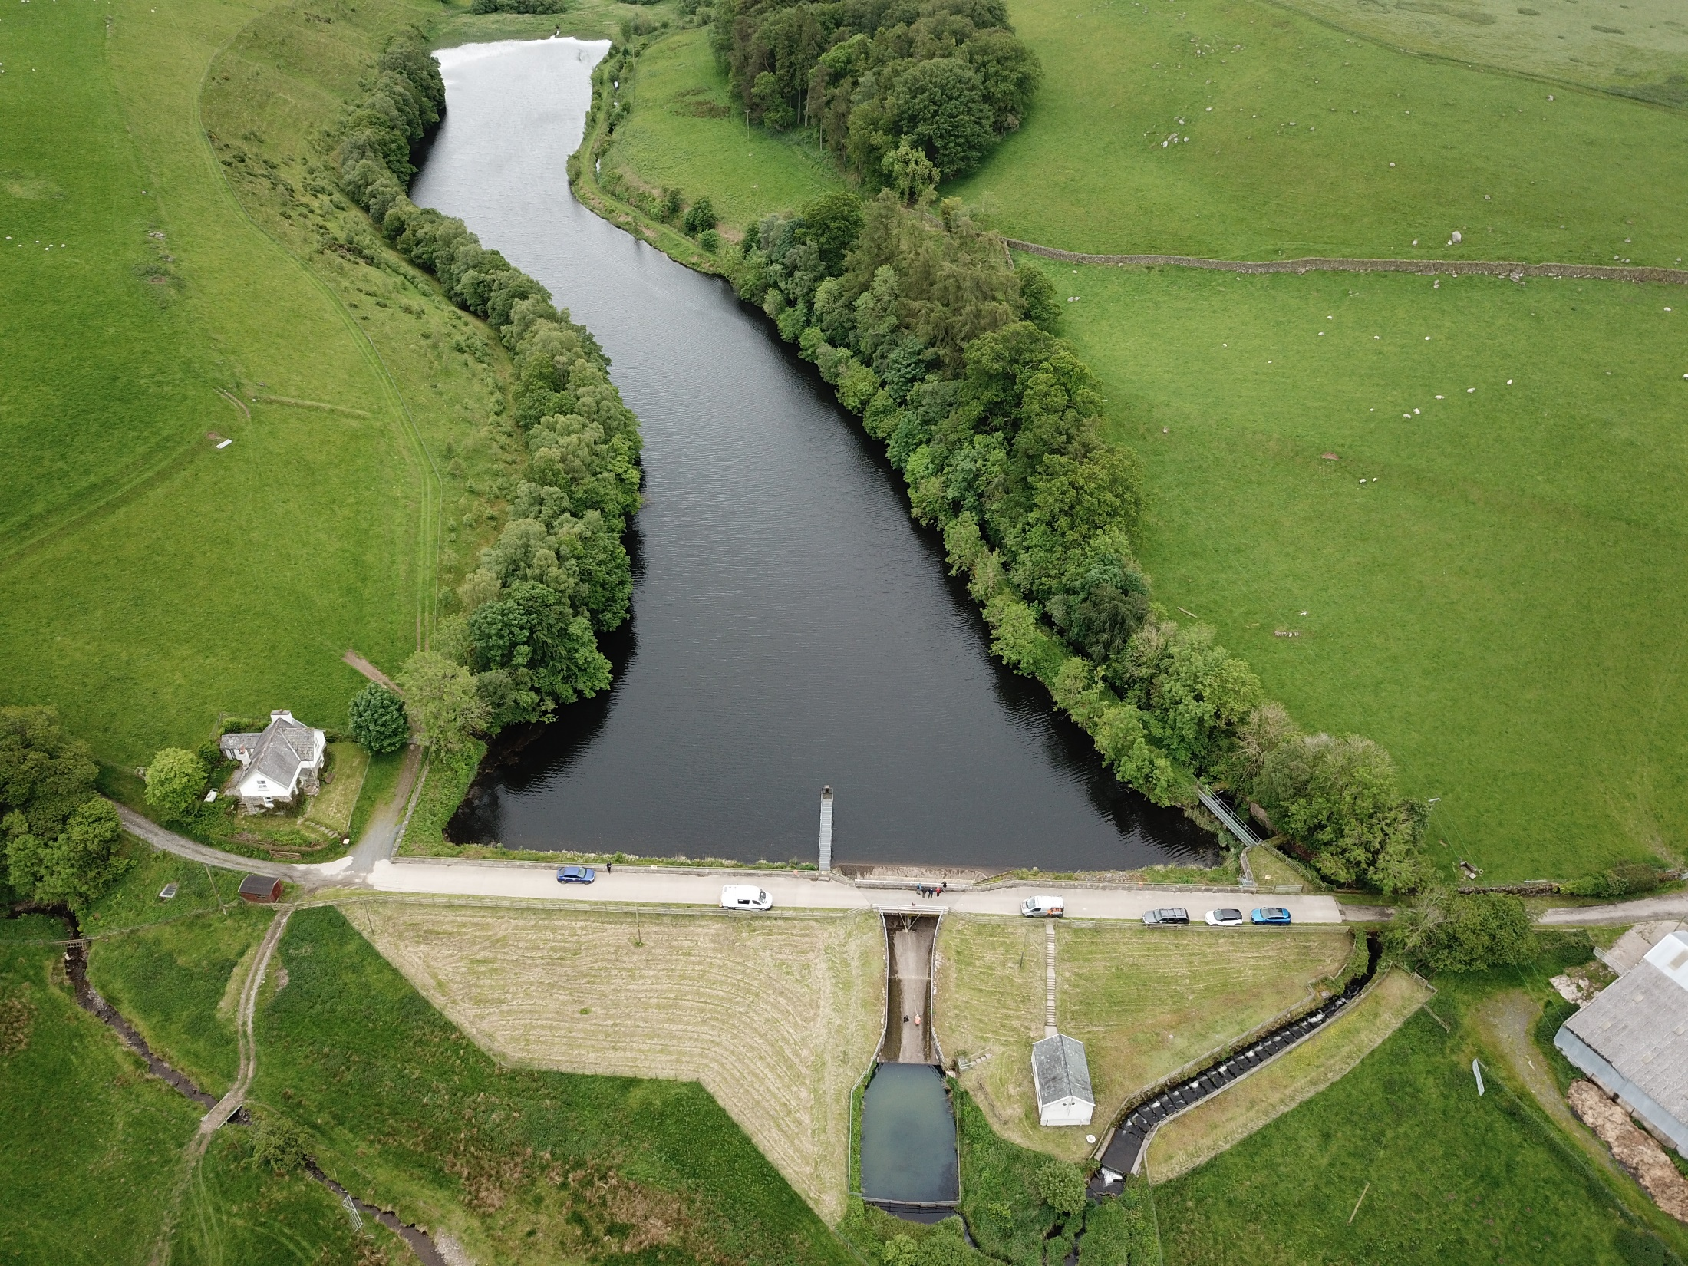

Slide 11
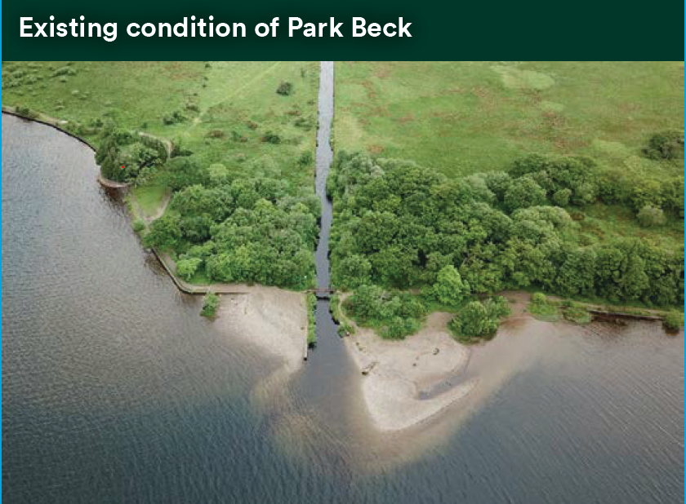
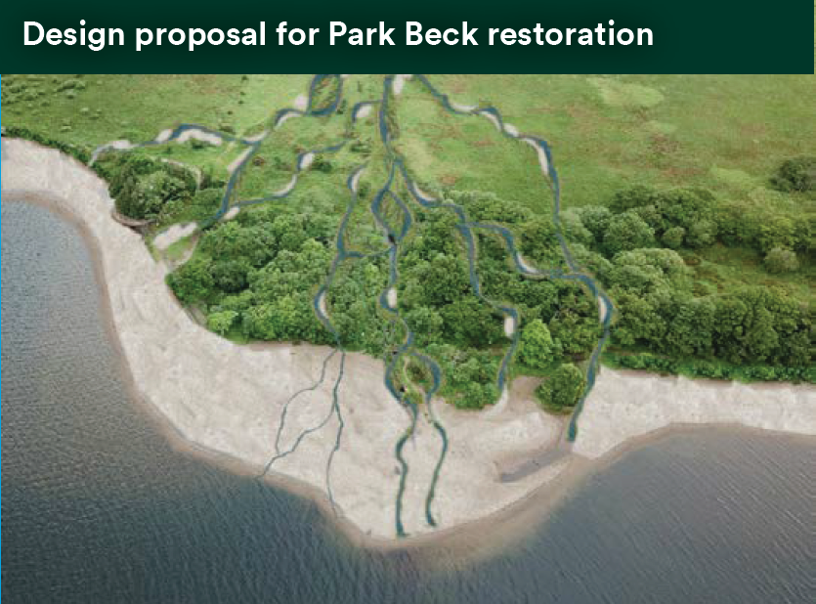

Slide 12
2015 - 2020
2020 - 2025
2025 - 2030
2030 - 2035
Thirlmere Transfer
Crummock
Feasibility
Design, EIA, planning application
Construction
Overwater
Feasibility
Design, planning application
Construction
Chapelhouse
Feasibility
Design, planning application
Construction
Ennerdale
Feasibility
Design, EIA, planning application
Construction
Blea Water
Design, planning application
Construction

Slide 13
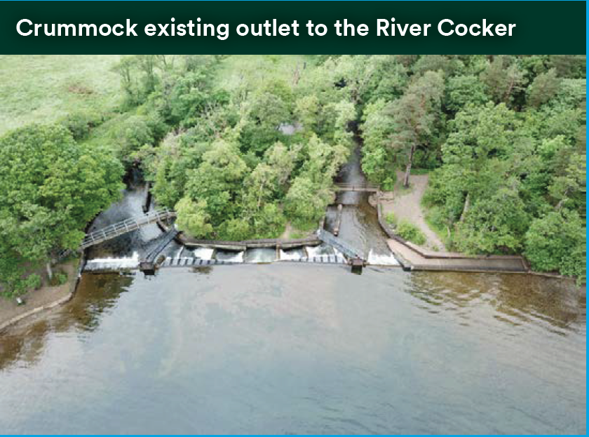
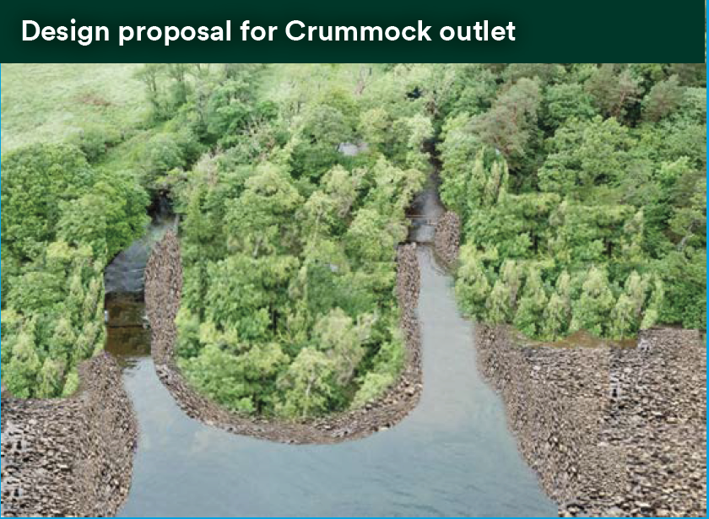

Slide 14
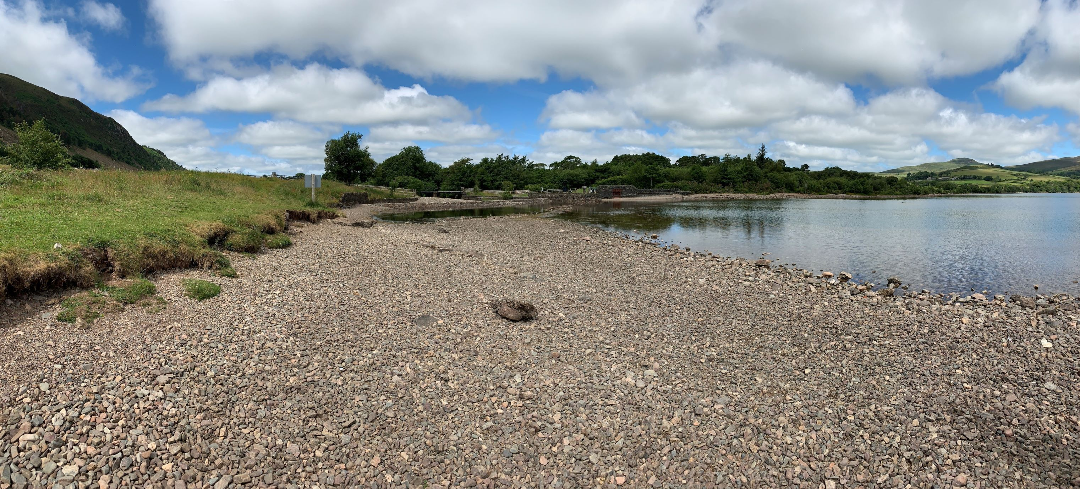

Slide 15
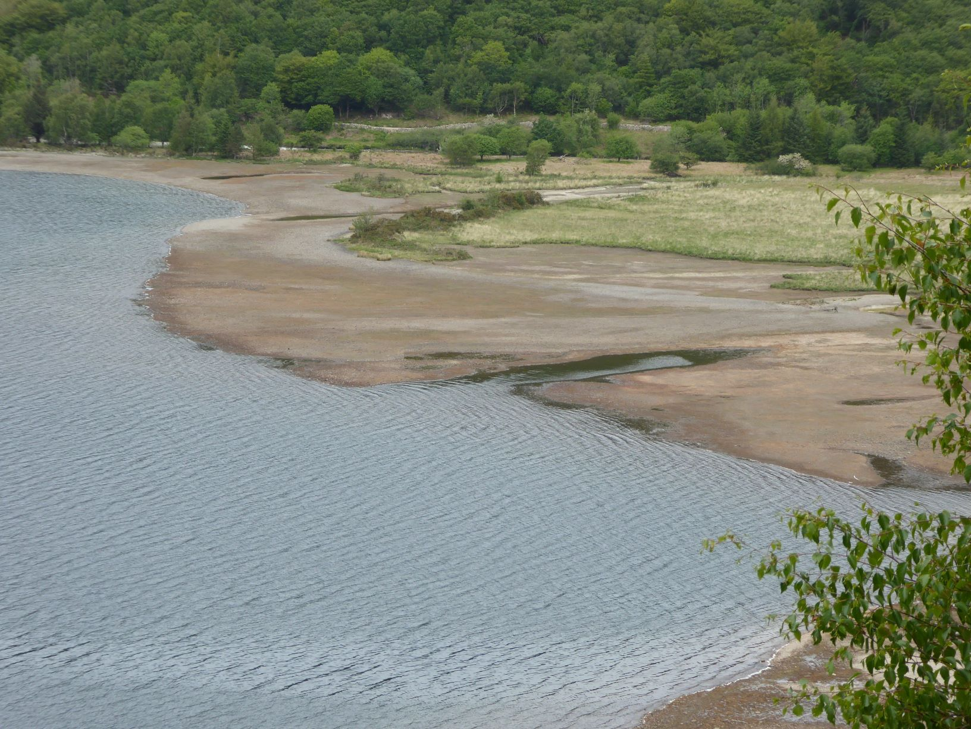

Slide 16
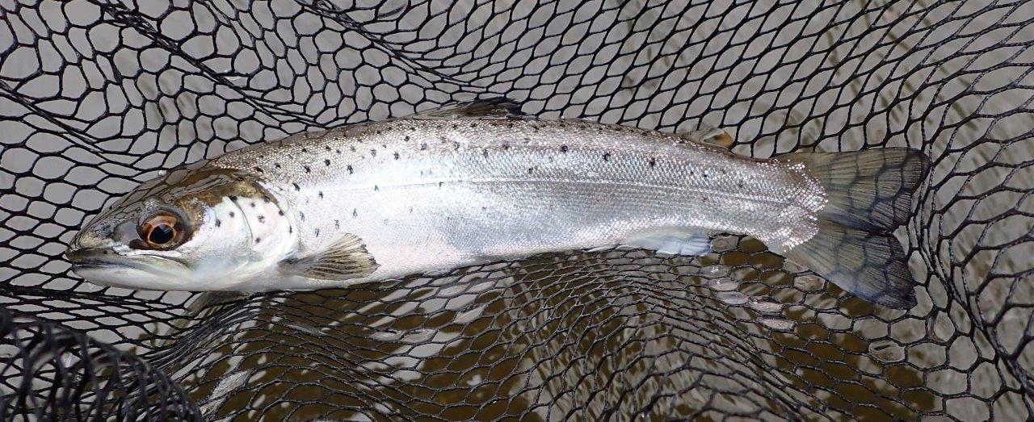

Slide 18
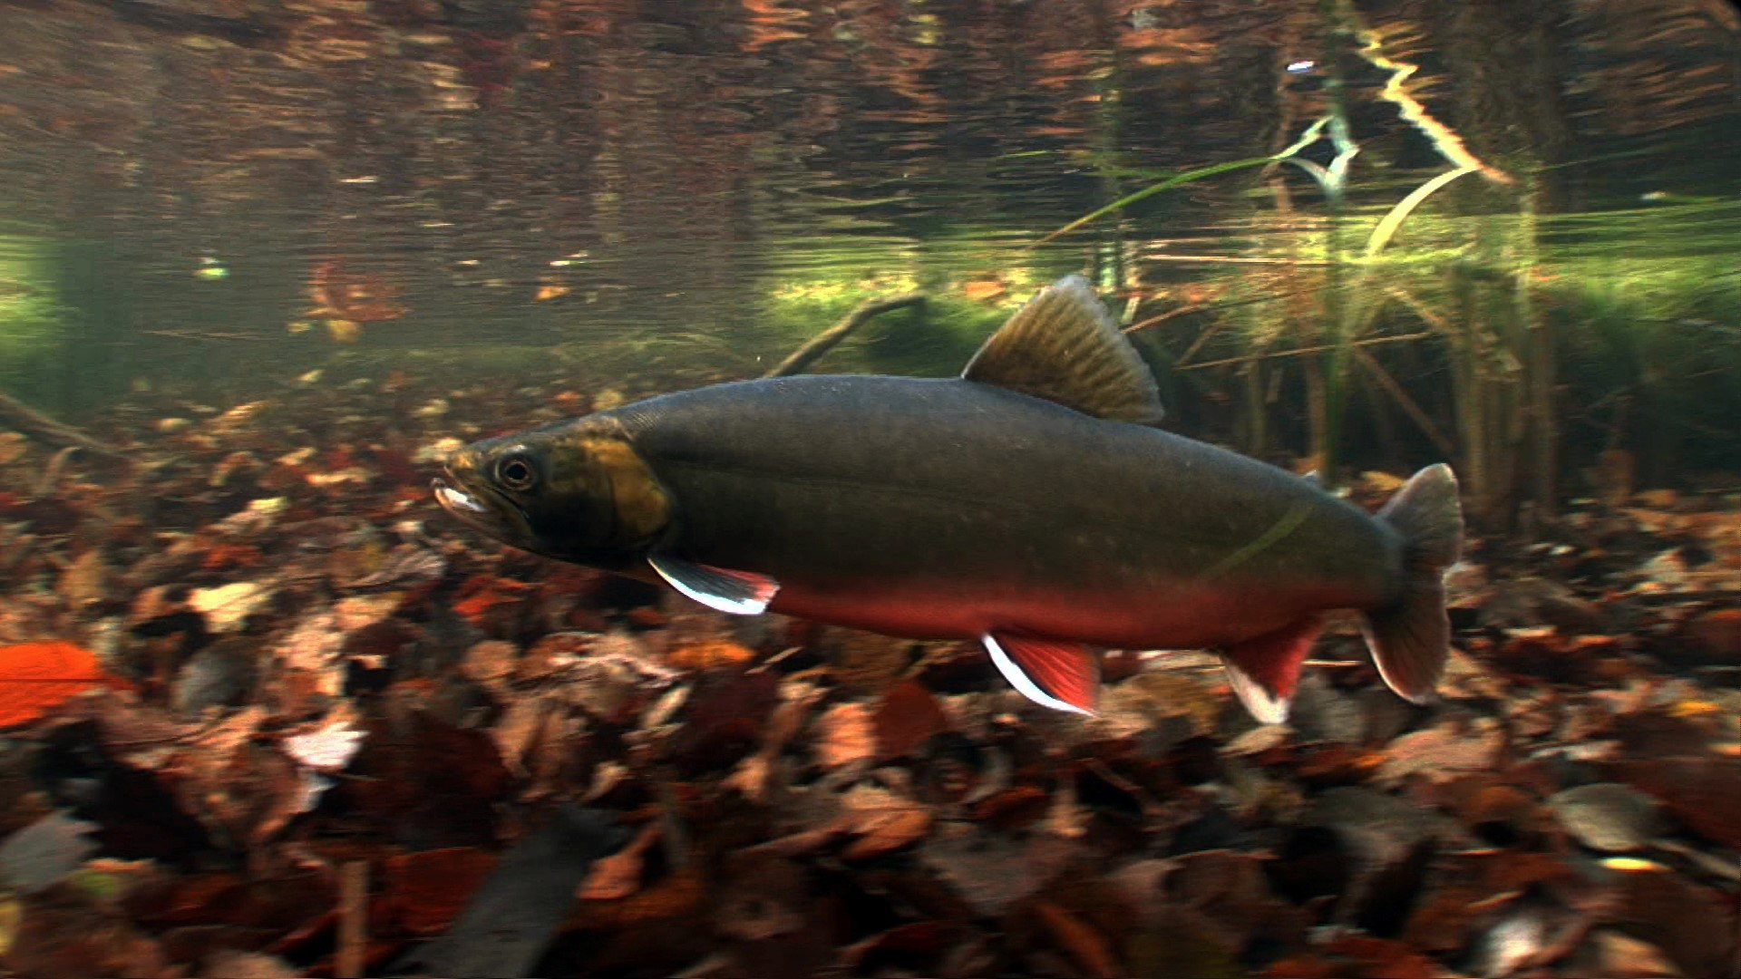

Slide 19
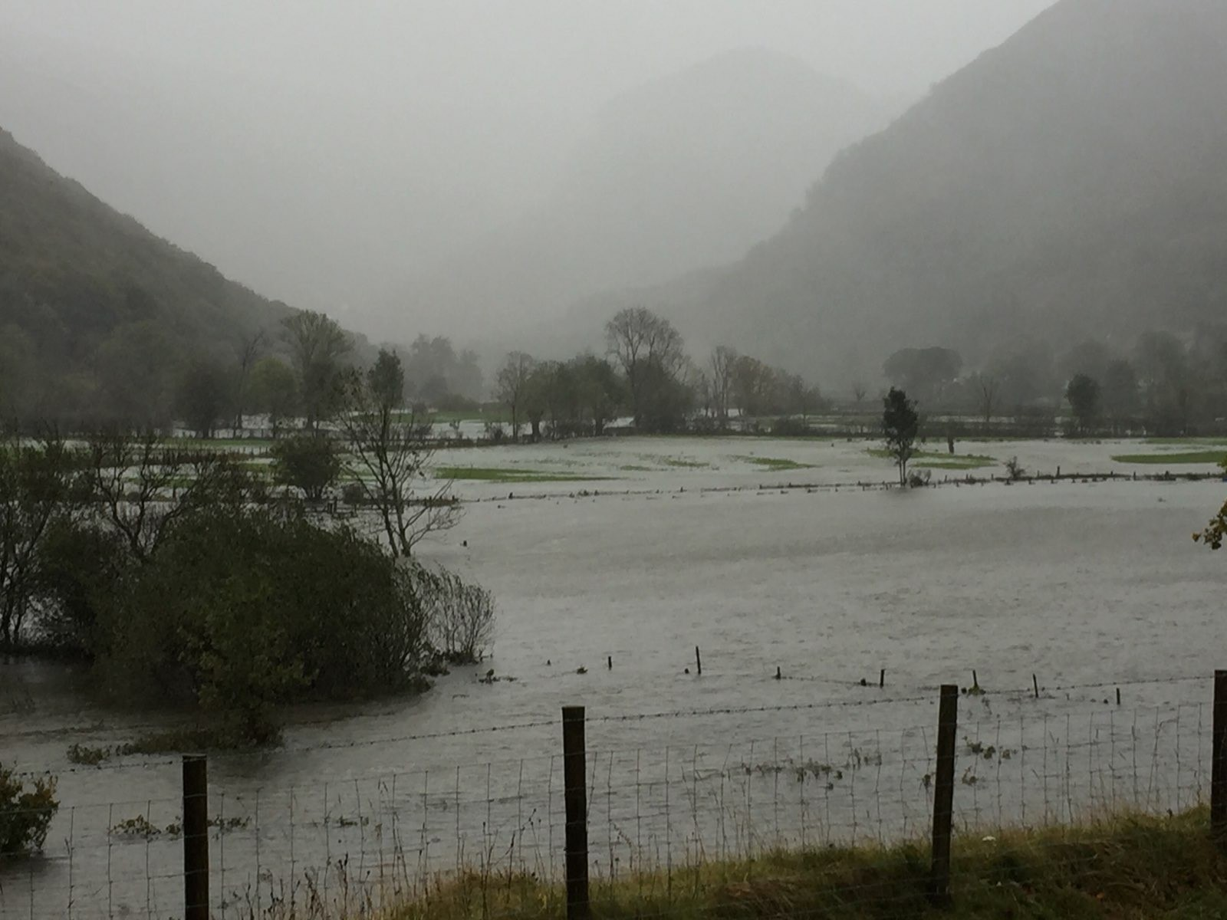

Slide 20
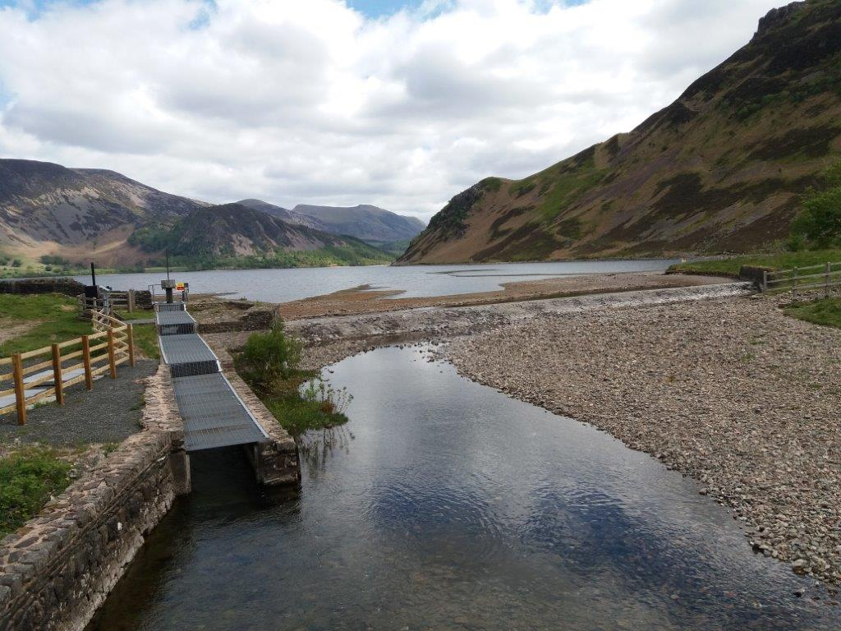

Slide 21
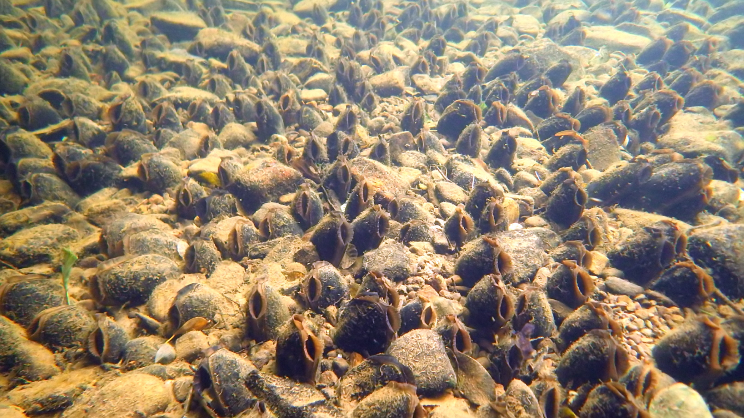

Slide 22
