Slide 1
The First Avenue Weir Removal Works
Dr. Sangeetha Viswan, CGeog (Geomorph)
Geomorphology Technical Specialist
West Midlands
Environment Agency
UK DAM Removal Conference
MAY 18 – 19, 2023

Slide 2
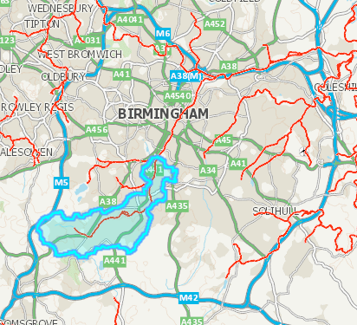
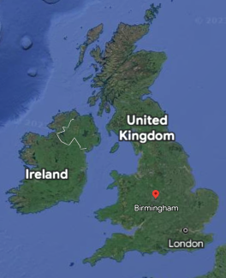
River Rea
Notes:
The River Rea, flows in a northerly direction through Birmingham, West Midlands. It rises at Waseley Hills and flows north east through Birmingham and joins the River Tame just south of Spaghetti Junction. Much of the river, as it runs through the City, is culverted and not easily visible. A number of small streams and brooks feed the river as it makes its way across Birmingham. First Avenue is located along the corridor defined by the River Rea in the Selly Park area of Birmingham.
The waterbody is designated as a Heavily Modified Waterbody for Urbanisation and Flood Protection and is failing to meet good ecological conditions as required by the Water Framework Directive. The ‘Rea source to Bourn Brook’ WFD waterbody (GB104028042510) comprises of 14.036km of length and have a catchment area of 30.229 km2. The ecological elements which are preventing this water body achieving good ecological potential are Fish, Invertebrates and macrophytes as this water body does not have the range of aquatic ecology that is expected within this type of river.

Slide 3
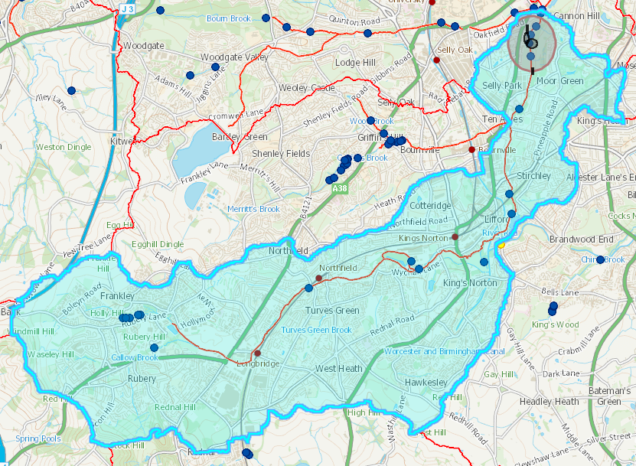
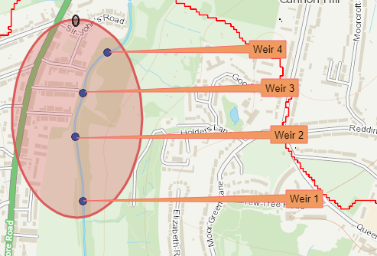
First Avenue Weirs
Notes:
Many reaches of River Rea had been modified (re-aligned and straightened and weirs had been put in place) in the past. There are a number of weirs present in this waterbody and they act as barriers to species migration and also prevents sediment continuity.
Regardless of the heavily modified nature of this water body, this reach has got a variety of substrate types (cobbles, pebbles & fine gravels) present in the channel, and it provides riffles and pools in many places.
There are four weirs in the First Avenue Area.

Slide 4
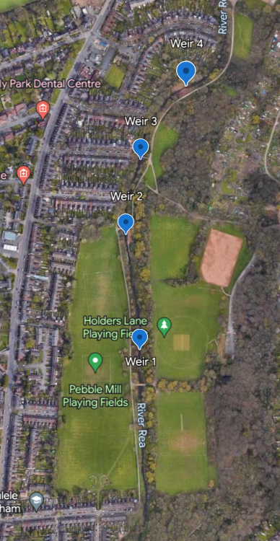
Project Background
First Avenue Flood Alleviation Scheme
Embankment
Weir 3 and Weir 4
Weir 1 and Weir 2 (environmental
benefits)
Weir removals identified as part
of HMWB mitigations
Notes:
Weir removal works were separated from the FAS work and delivered in partnership with BCC

Slide 5
Pre-Weir removal data analysis
Topographical Surveys
Geomorphological Walk Over Survey
Conveyance Estimation Software – Shear Stress and size of the maximum mobile sediment in various velocity scenarios
Sediment Sampling
Heritage Assessment
BNG Survey

Slide 6
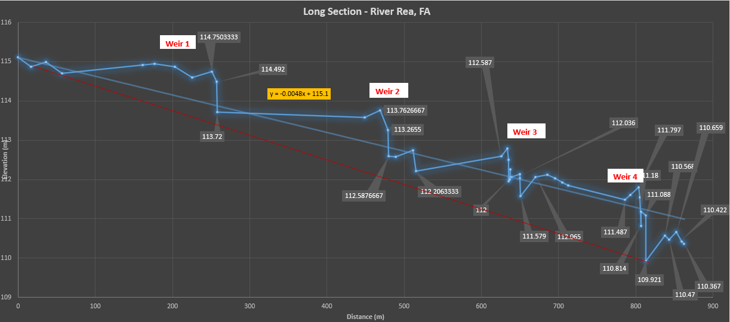
River Rea Long Section First Avenue Weirs
Notes:
Distance from first weir to fourth weir is 550m

Slide 7
Geomorphological Walkover Survey

Slide 8
CES Analysis
Several Cross Sections
Stable reach
Upstream/ downstream of weirs
Assume weirs removed with evenly graded bed (slope 0.0048)
Section | Scenario | max velocity (m/s-1) | max shear stress (N/m2) | mobile sediment (mm)
Reference | QMED - 16 cumecs | 2.2 | 35 | 27.1
Near houses u/s park | QMED - 16 cumecs | 2.7 | 42 | 32.5
Upstream of weir 1 | QMED – 16 cumecs | 2.4 | 38 | 29.5
Upstream of weir 1 | Flow contained by embankment – 100 cumecs | 4.0 | 80 | 62.1
Upstream of weir 1 | With embankment removed @ 16 cumecs | 2.1 | 30 | 23.3
Upstream of weir 1 | With embankment removed @ 100 cumecs | 2.8 (in channel); 1.5 (on fp) | 48 (in channel); 30 (on fp) | 37.2
Upstream of weir 3 | QMED – 16 cumecs | 2.2 | 36 | 27.9
Upstream of weir 3 | Top of embankment – 100 cumecs | 3.2 | 58 (up to 80 n/m2 on banks) | 45.0
Upstream of weir 3 | With embankment removed @ QMED | 2.4 | 38 | 29.5
Upstream of weir 3 | With embankment removed @ 44 cumec flood | 2.8 | 42 | 32.6
U/s final weir with gabions | QMED – 16 cumecs | 2.6 | 43 | 33.3
U/s final weir with gabions | Flow to top of bank – 36 cumecs | 3.2 | 58 | 45.0

Slide 9
CES Analysis
The embankment confines flows & increases the risk of channel scour
Removing the embankment would inundate the floodplain
Replicate the channel morphology of the reference reach
The reach with the gabions experiences high velocities and boundary shear stresses.
Need something that can resist velocities of at least 3.2m/s
Notes:
The embankment through the park confines flows within channel during higher than bankfull floods. During high flows (well above a QMED discharge), the embankment therefore increases the risk of channel scour.
Removing the embankment would significantly reduce erosive forces during extreme flows because flows greater than QMED would spill into the park. But it would inundate the floodplain to a depth of c. 0.3-0.5m, with floodplain velocities up to max 1.5m/s, and this would occur every couple of years on average.
If the channel morphology of the reach near the houses, the channel is likely to remain fairly stable. This reach is a little wider than the reaches next to the embankment. The narrowing may be the result of the weirs causing a backwater effect that reduces slope and therefore erosive energy, but this needs further investigation.
The reach with the gabions unsurprisingly experiences high velocities and boundary shear stresses.
Need something that can resist velocities of at least 3.2m/s, and given the turbulence at the edges of channels there would be significant change

Slide 10
Heritage
Brick construction of weirs appear to be relatively recent
Current river alignment dates to the mid 20th century
Notes:
All four weirs are of brick construction and appear to be relatively recent in date. Analysis of historic mapping shows that the current river alignment dates to the mid-20th century, replacing the historic course a short distance west. While the southern part of the channel runs through an area which was, historically, fields, the northern part follows the mill race of Mill Green Rolling Mill, which dates to the 16th century. The modern nature of the river channel means that all but the northernmost weir must, by necessity, be of modern construction, as they are located at points which do not correspond with the pre-1970s alignment of the river. The northernmost weir is located on the final stretch of the historic mill race, just upstream of its reconnection to the River Rea. As such, although the weir appears to be of modern brick construction and it is consistent in style and material to the other weirs, it is not possible to fully exclude the possibility that earlier material is concealed by the later brickwork.

Slide 11
Phased Weir Removal
Phase 1 (January 2022)
Complete removal of weir 1 and 2
Partial removal of weir 3 and 4
Phase 2 (November 2022)
Removal of rest of weir 3 and 4
Removal of failed gabions
Notes:
Storm Dudley, Eunice and Franklin – February 2022

Slide 12
Weir 1
Pre-weir removal
April 2022
Notes:
Weir 1
Location - SP0609782726
Legth - 6.32m
Height - 1.03m
Width – 7.3m
Type – Rectangular
Materials – concrete
Other Comments – A footbridge is location around 60m upstream of the weir

Slide 13
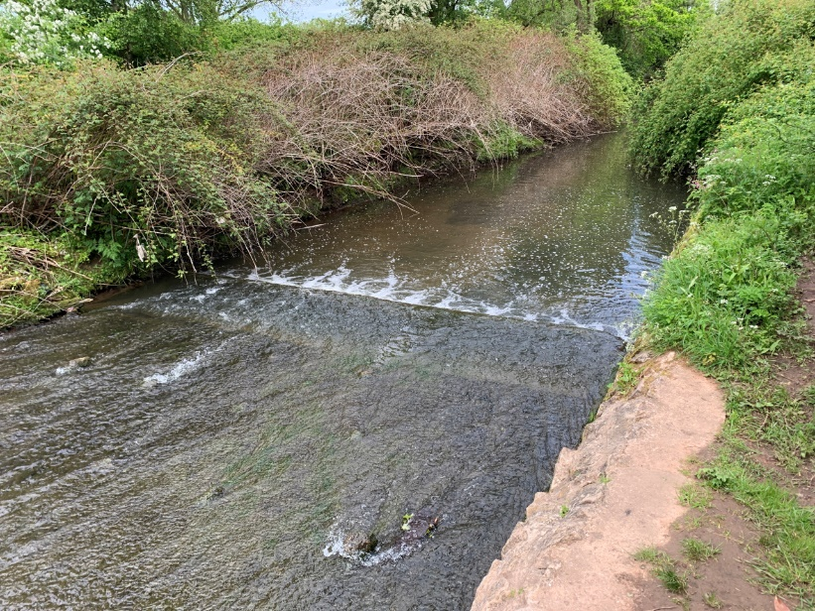
Weir 1
After
Before

Slide 14
Weir 1
May 2023

Slide 15
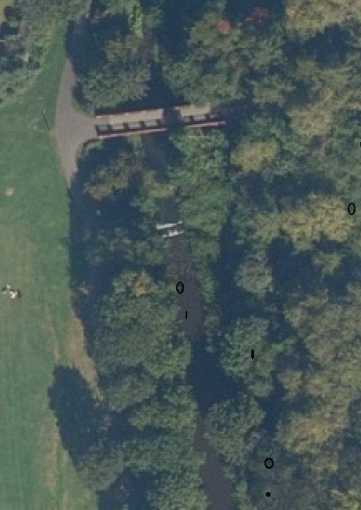
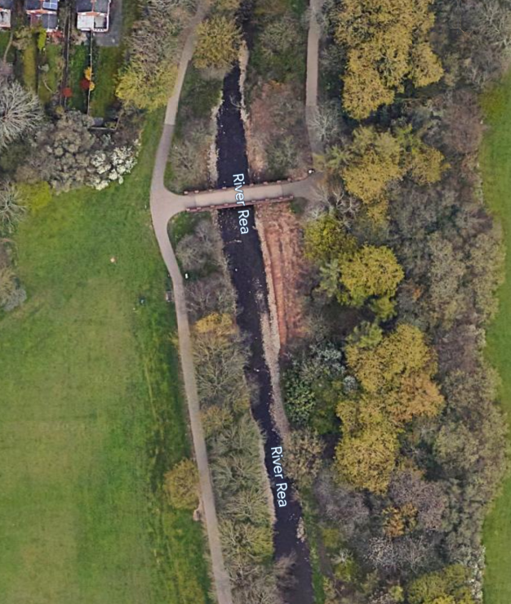
Weir 2
Pre-weir removal
April 2022
Notes:
Weir 2
Location - SP0607082949
Length - 9.73m
Height - 1.17m
Width – 4.30m
Type – Rectangular
Materials – concrete and gabions
Others Comments–
1. Gabion bank protection present on both sides of the weir. But they are failing
2. A Footbridge is located around 18m downstream of the weir
Stone pitching is present in the upstream and downstream reaches of the foot bridge
4. Stone pitching is eroding closer to the footbridge upstream
5. Banks are protected with Gabions approximately to the next weir
6. Gabions are failing in the downstream sections

Slide 16
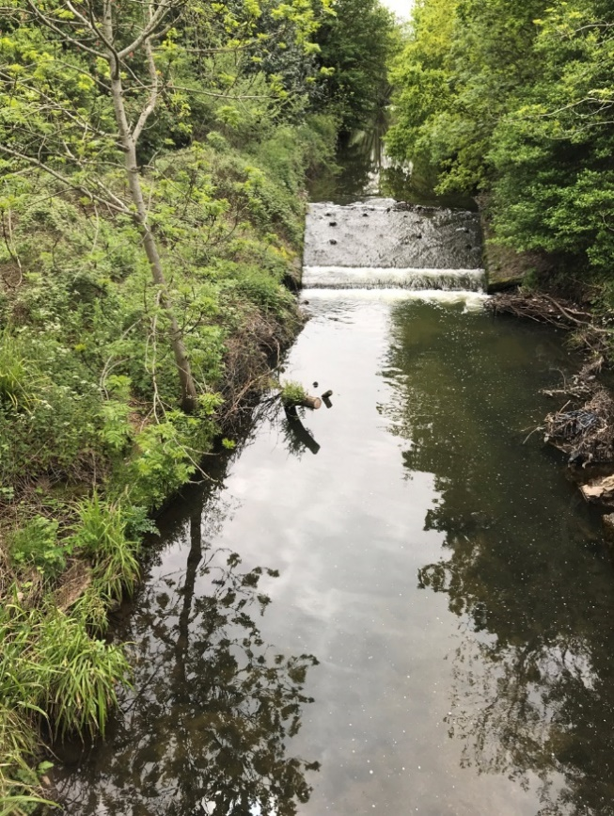
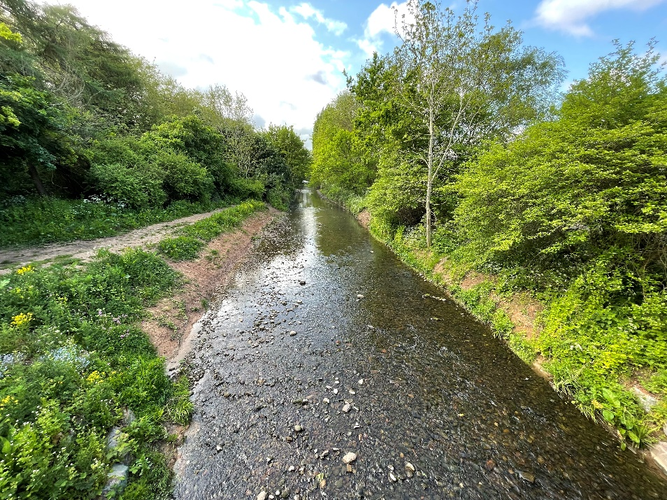
Weir 2
After
May 2023
Before

Slide 17
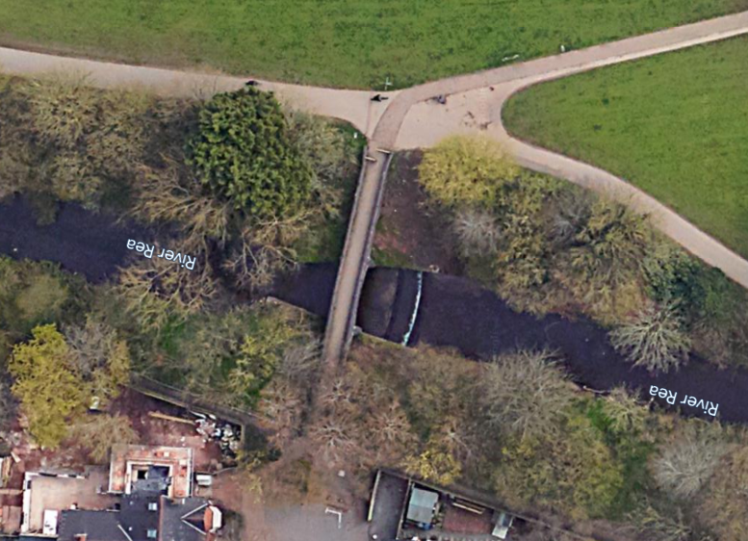
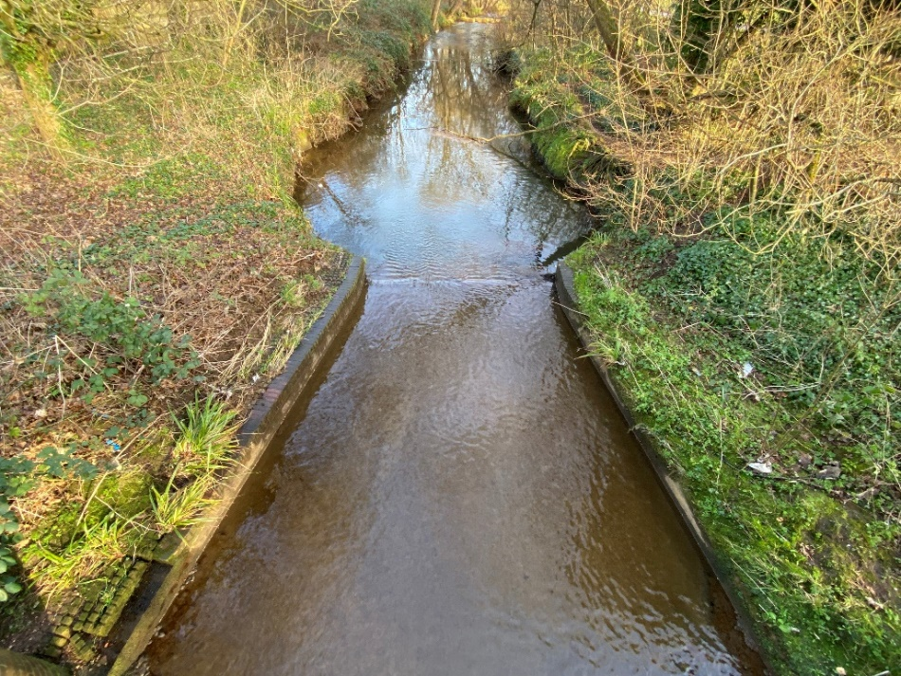
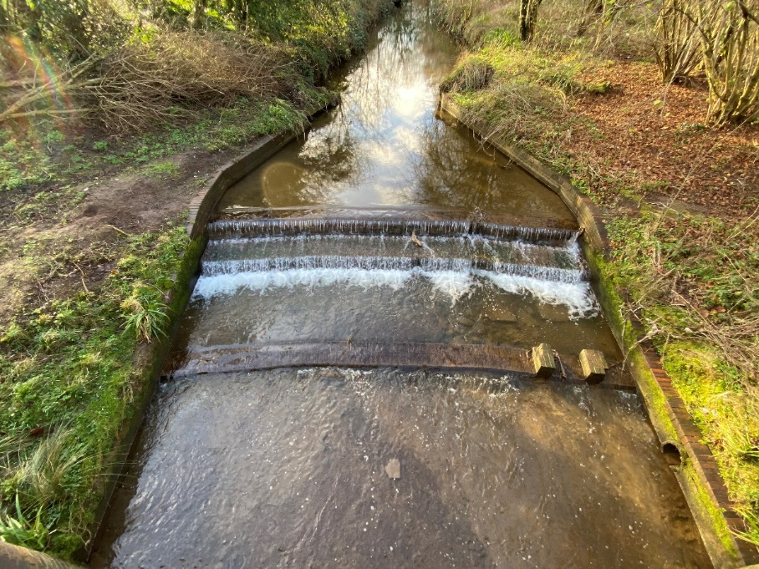
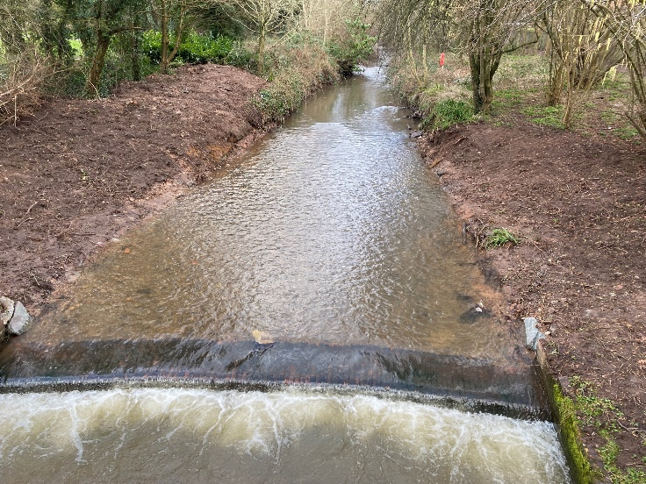
Weir 3
Before
Before
Before
After Phase 1
Notes:
Weir 3
Location - SP0609883100
Height – 1.5 m (approx.)
Length – 13.5m (approx.)
Width – 8.0m (approx.)
Type – 3 steps
Materials – Bricks
Others Comments–
This structure is connected to the footbridge downstream and base of the structure extends further downstream of the bridge

Slide 18
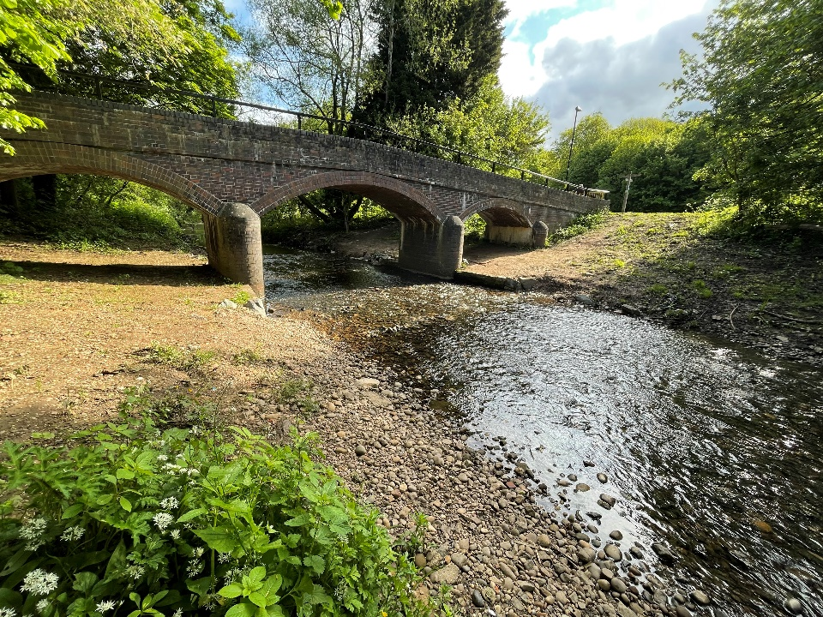
Weir 3
Before
May 2023

Slide 19
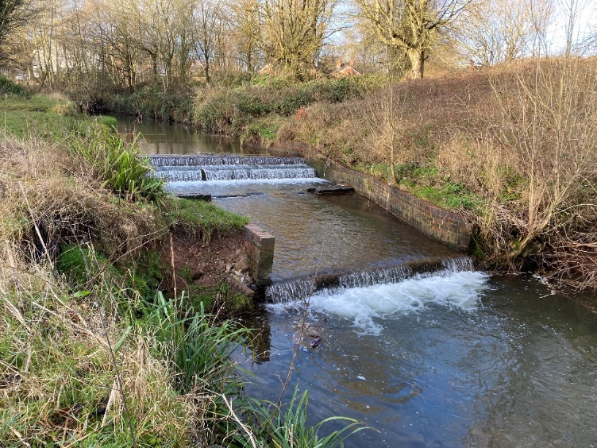
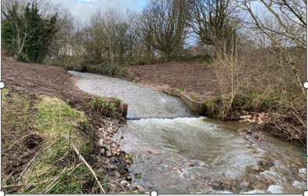
Weir 4
Before
After Phase 1
Before
After Phase 1
Notes:
Weir 4
Location - SP0618283240
Height - 1.88m
Length – 19.66m
Width – 6.60m (approx.)
Type – 4 steps
Materials – Bricks
Others Comments–
1. There is a ford crossing upstream of the weir
2. The banks are protected with bricks. But they are eroding away

Slide 20
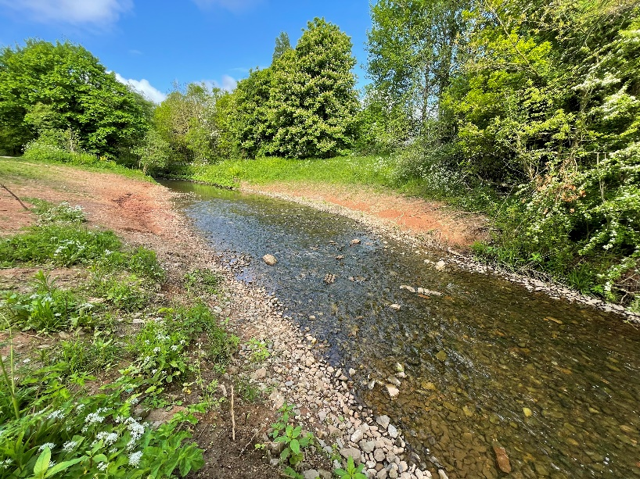
Weir 4
Phase 2
Phase 2
May 2023
Notes:
Legth -

Slide 21
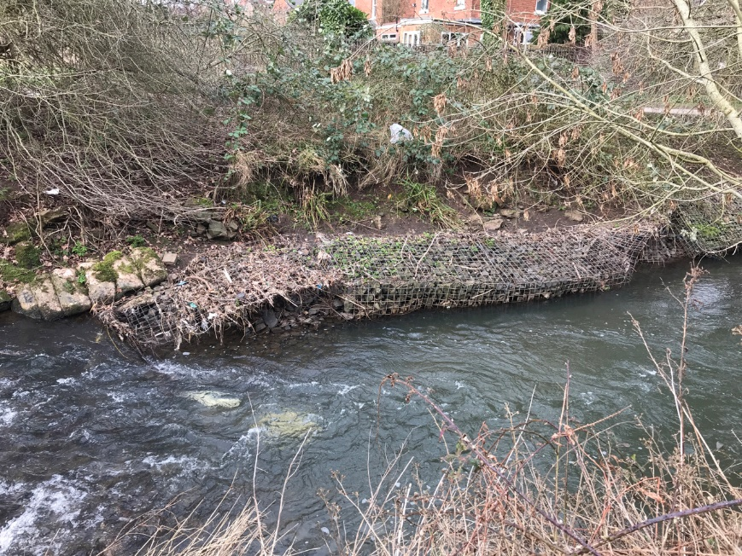
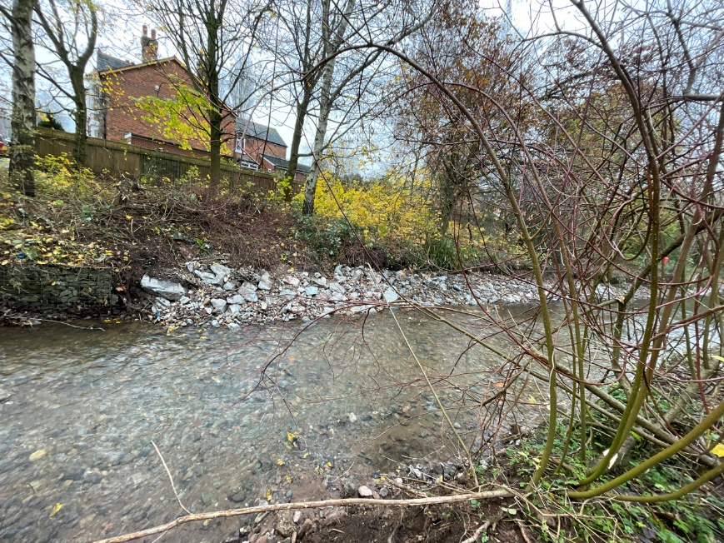
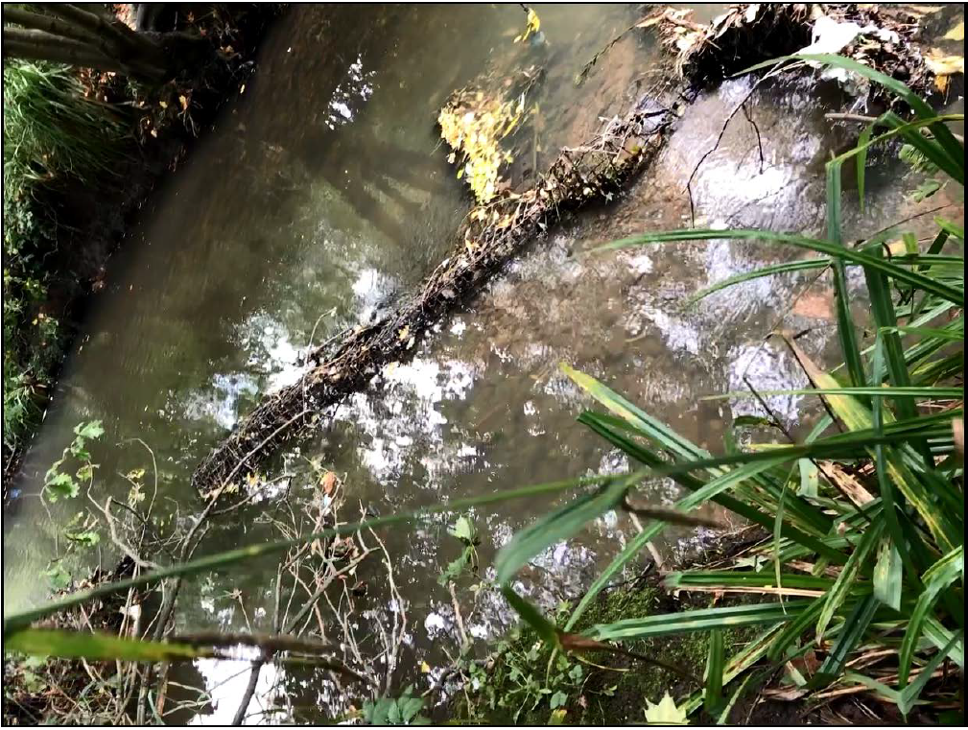
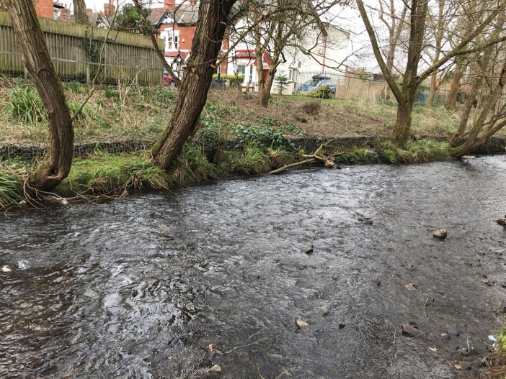
Gabion Replacement

Slide 22
Summary
Public Access
Geomorphological Change – Riffles
University of Birmingham – postgraduate dissertation
BNG Survey – 47% for River units
Bullhead Fish in the River Rea
Low cost with partnership with BCC
Notes:
Phase 1
Compete removal Weir 1 and 2
Partial removal of weir 3 and 4
Gravel – 216.9 tonnes
£131,518.25
Phase 2
Remove rest of weir 3 and 4
Gabion removal and replacement with blockstones
£62,074.88

