Slide 1
Barriers to barrier removal
UK Dam Removal Conference 2023

Slide 2
The Ribble
753 Square Miles
3000+ Miles of streams and Rivers
National Park, AONB.
2 x (small) Riverine SSSI (Both for Hydrogeomorph Features
One required a weir removal
One is the result of a weir!
Human population of 2 million
Barrier population 1500+
Mostly small (>1.5m)
Some 8m
Small Hydro power population of 4
Big population of reservoirs and abstraction (Victorian Engineers!)

Slide 3
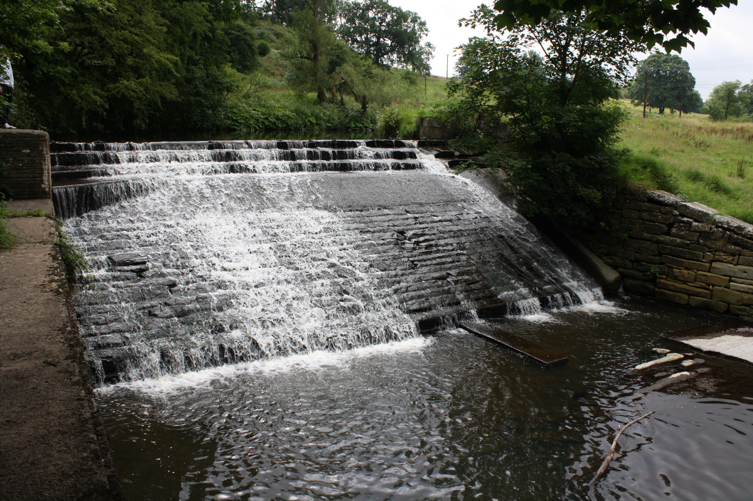
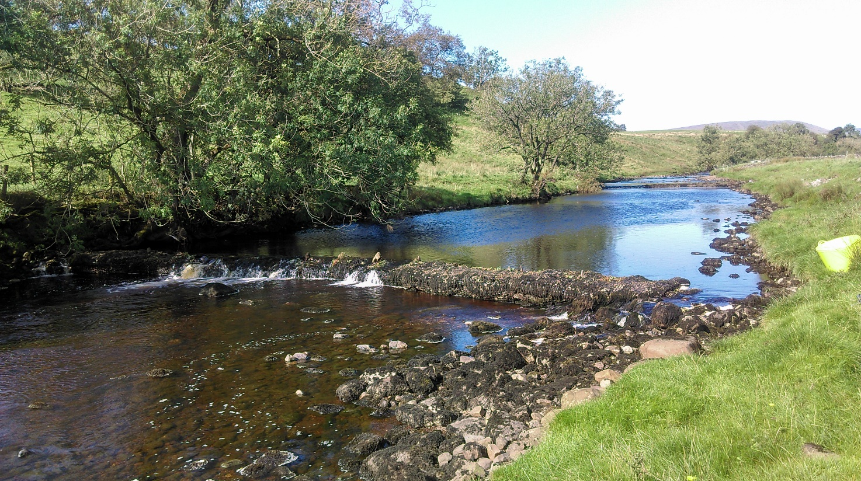
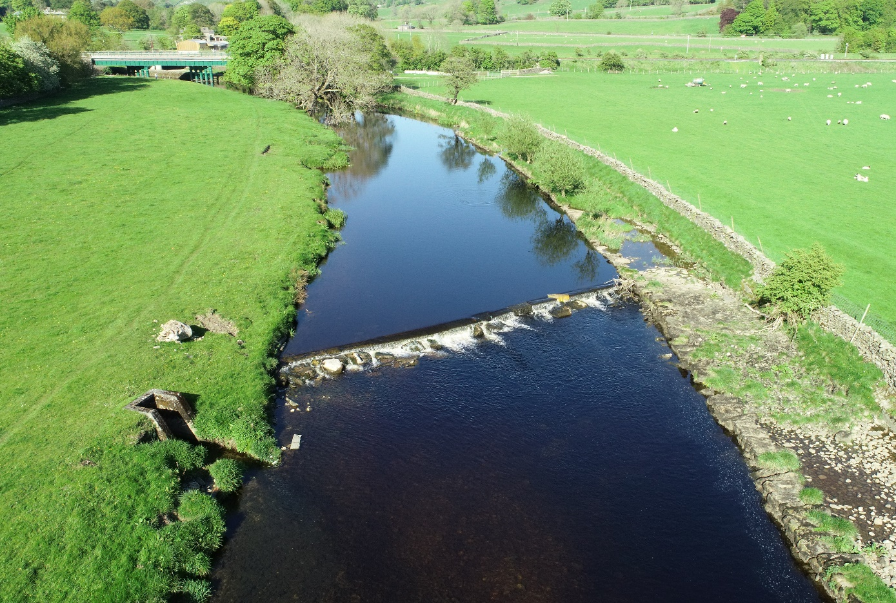
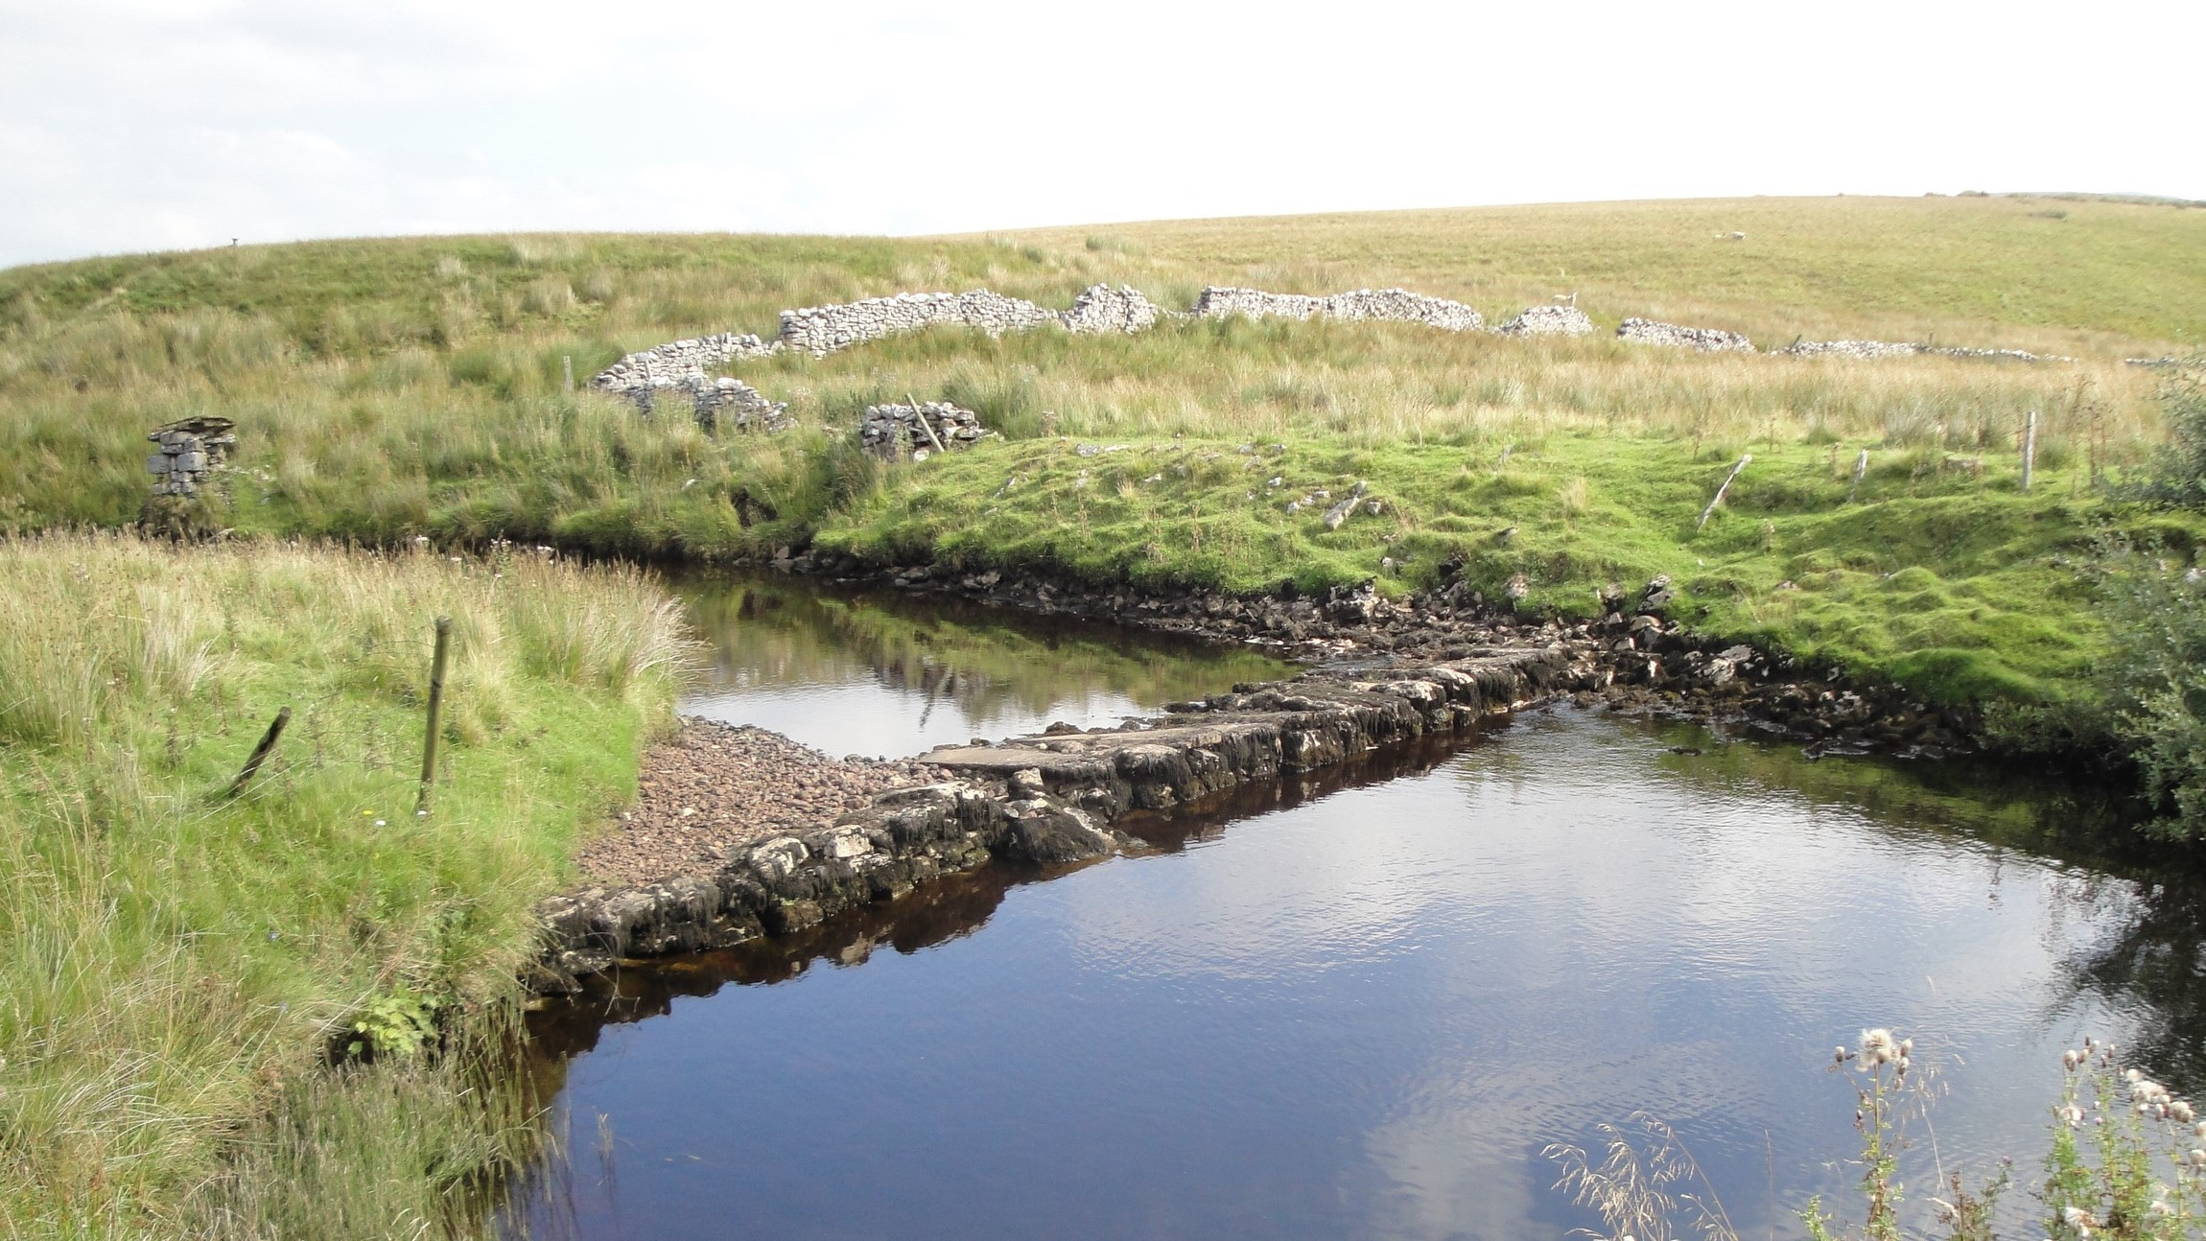
Some of the barriers to barrier removal
Utilities
Water
Electricity
Gas (Major Accident Hazard Pipelines)
Sewage
Roads
Railway
Houses
Anglers
Ecologists
Archaeologists
Farmers/landowners
Potential Hydro
The public (our “waterfall”)
Notes:
All removed but the one with the sewer in it!

Slide 4
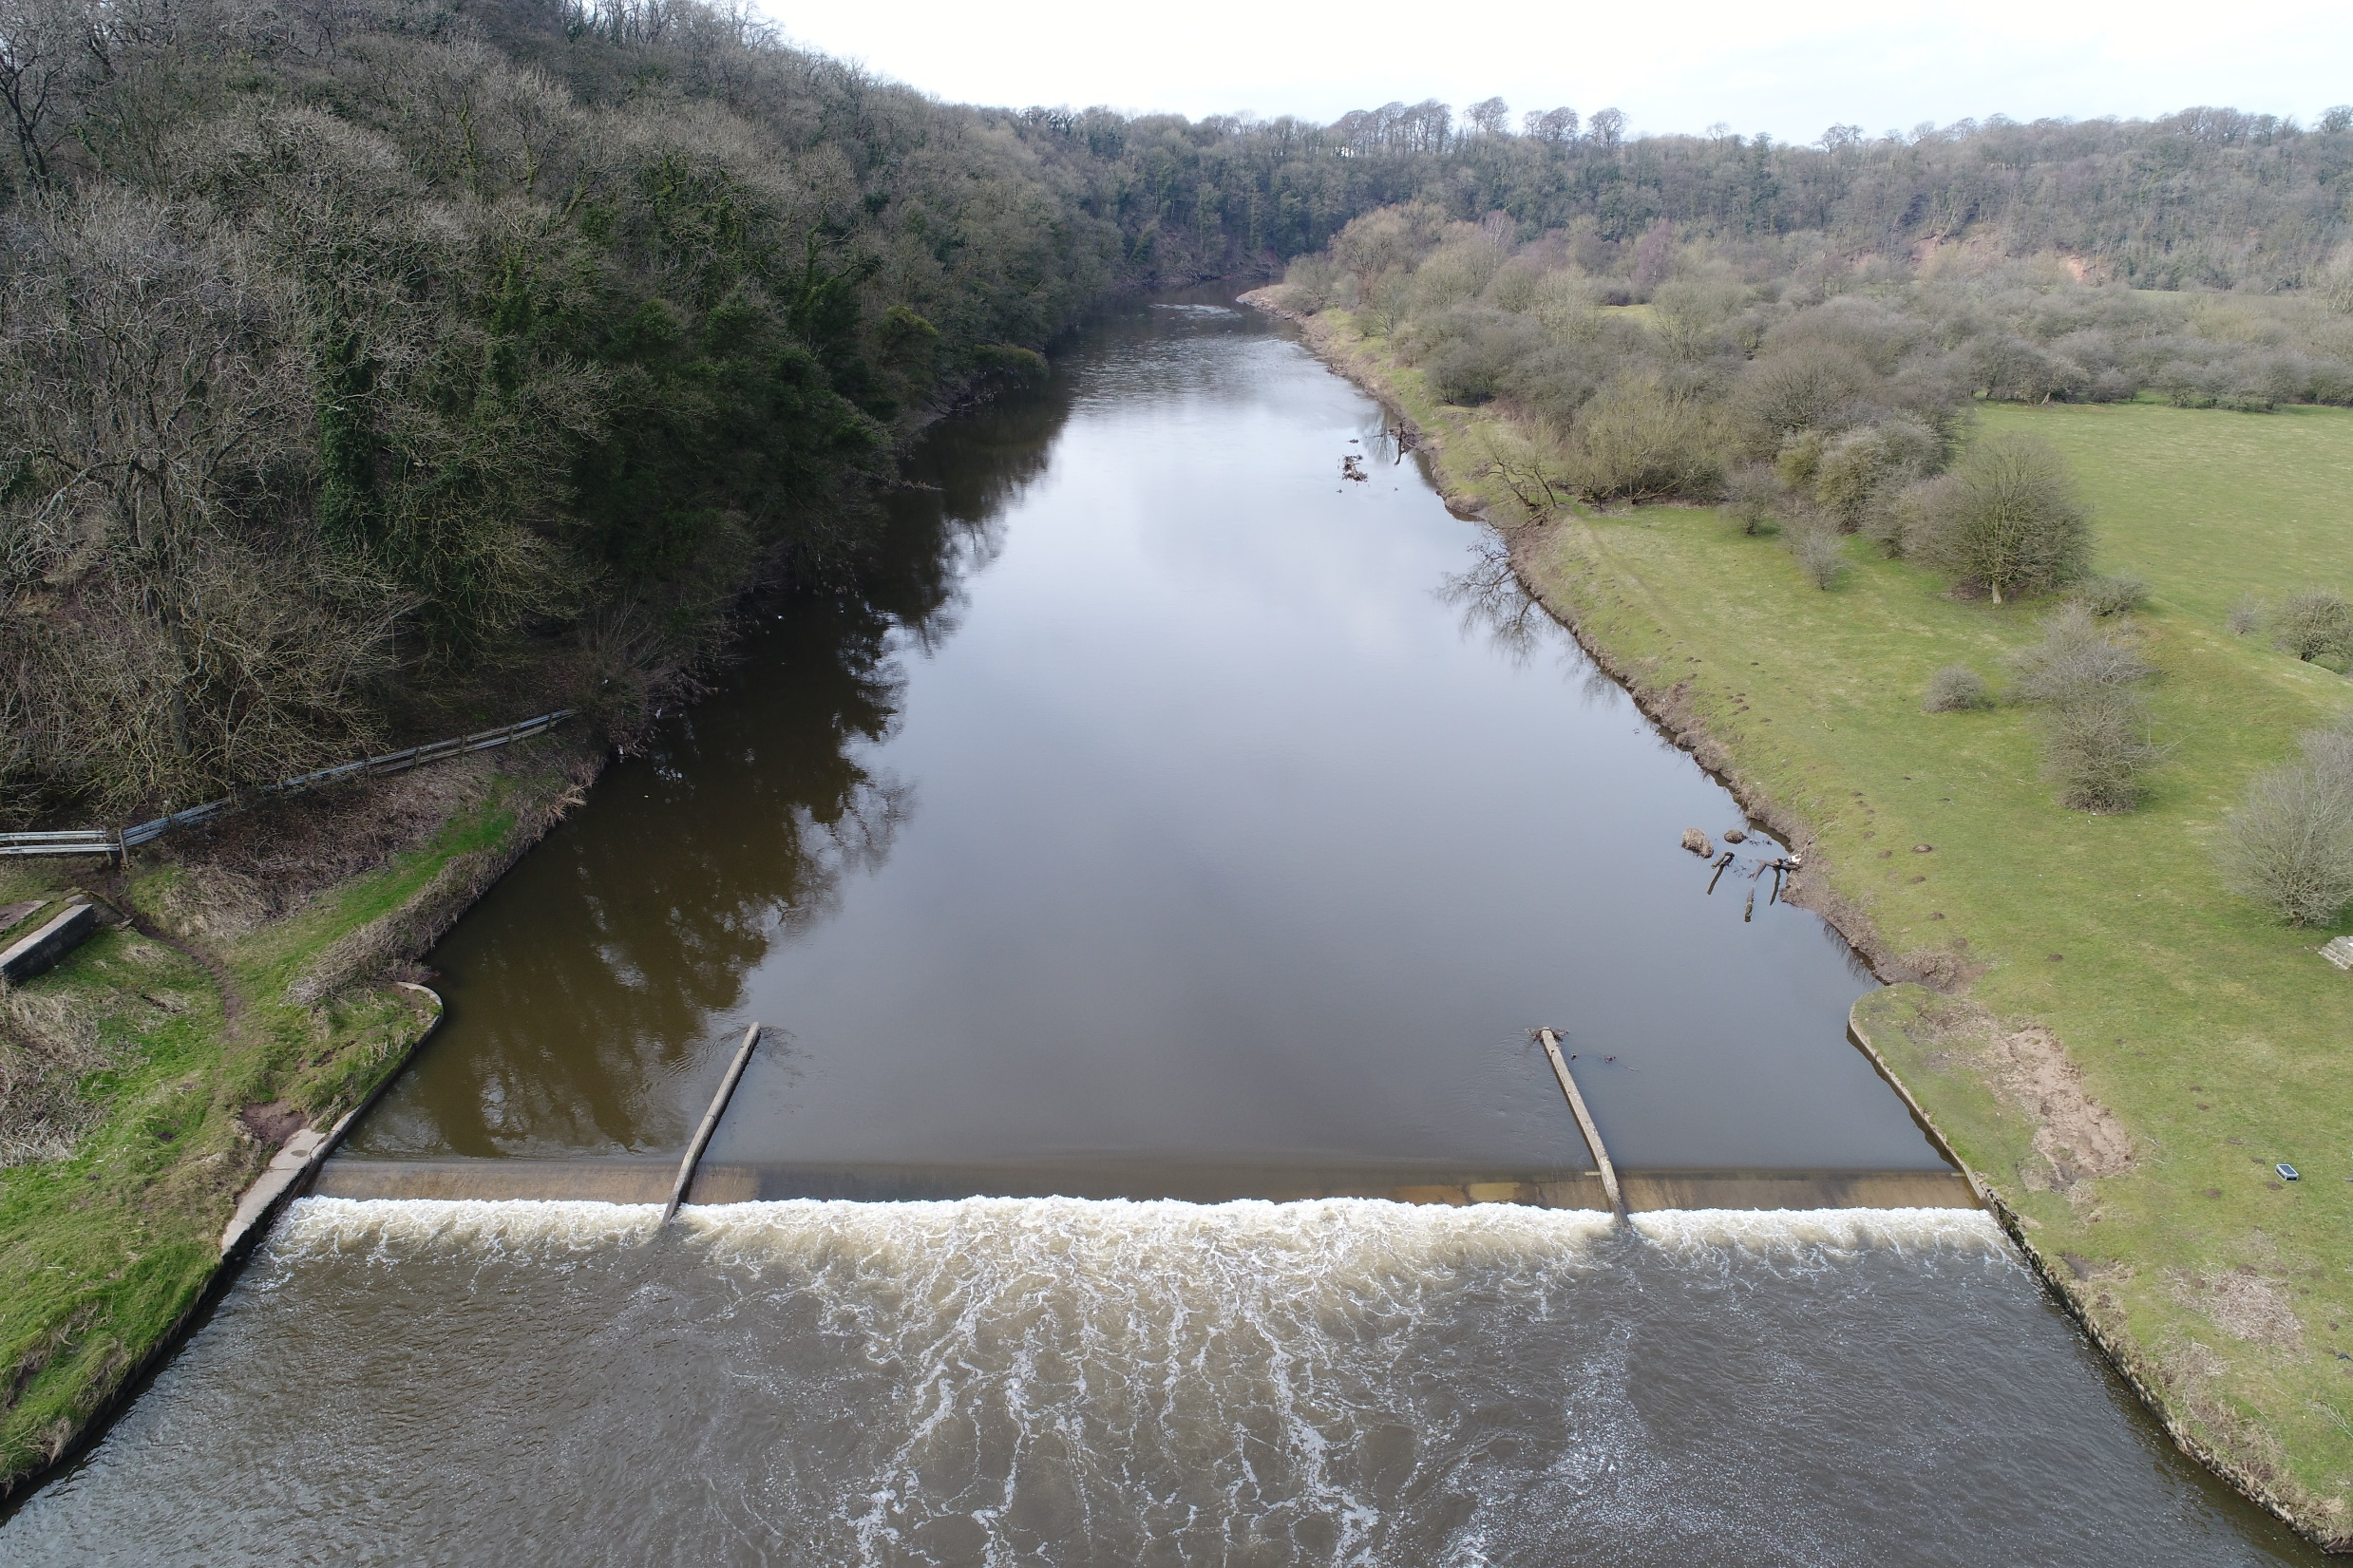
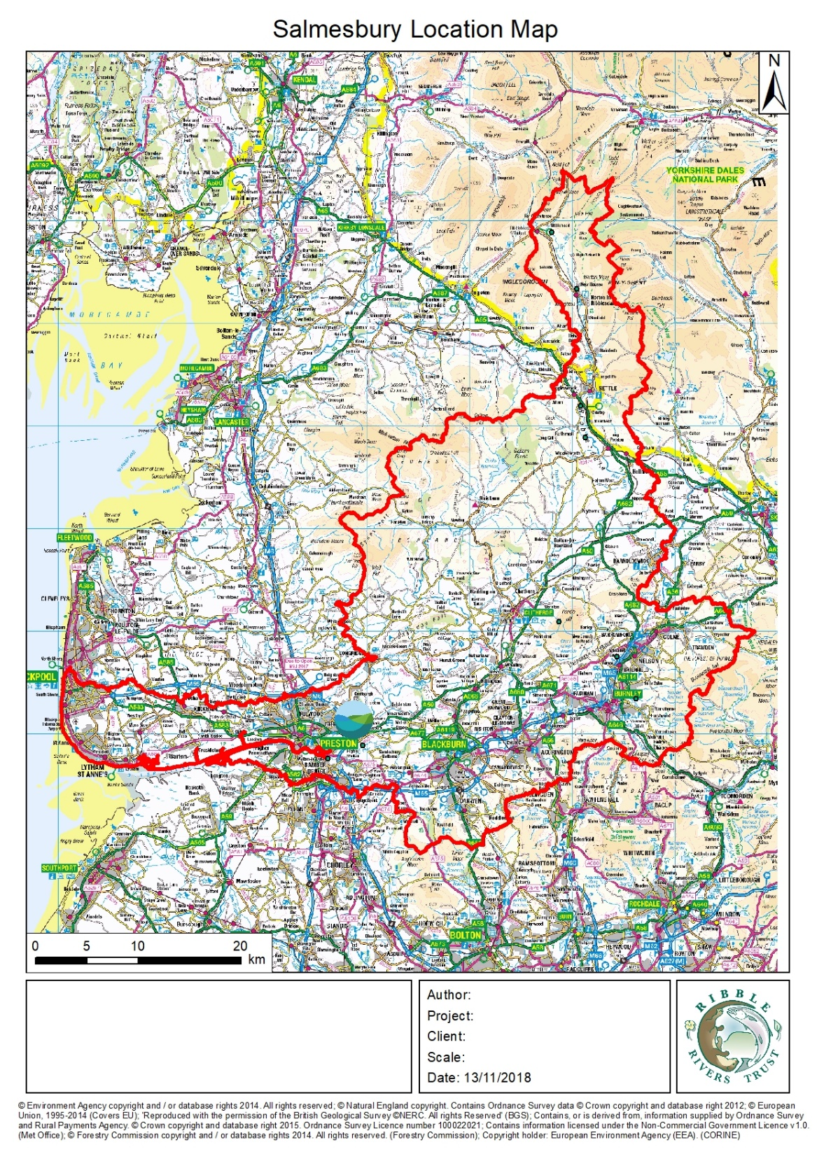
Practical Barriers
The EA owned Samlesbury gauging weir
Near the Tidal Limit on the Ribble
First Barrier to fish migration
A bottle neck exploited by anglers and predators alike
No longer in use for gauging
Used by fire and rescue service for training due to H&S incidents
Cited specifically as the key reason water body is failing
Identified as a limiting factor for our MCZ species (Smelt)
A financial liability for the EA
EA have had compensation claims associated to incidents
Indemnity clause to landowner
Obviously a quick and easy win?
Notes:
Starting with Practical barriers – yes that is meant to be a Pun. So quick and easy wins, everyone agrees a project, secure the money bing bang bosh and barriers removed right?

Slide 5
Hmmmm…..
The following scene is based on real events…….
The characters have been anonymised to protect their identities…..
There is only marginal dramatisation of the events….
Lancashire Wildlife Trust Flagship Nature Reserve on oneside
Private Landowner demanding blanket indemnity on the other
Planning permission required
Boundary of two authorities – neither wants to deal with it
Environmental Permit Required
Impoundment Licence…

Slide 6
The biggest barrier
Having overcome all the usual barriers individually, now have to prove we have at least 3 times,
Or up to 6
Environmental Permit
FRAP
Impoundment Licence
Revoking impoundment Licence
Planning permission (possibly twice)
With the same information….
Often assessed by people with little technical knowledge

Slide 7
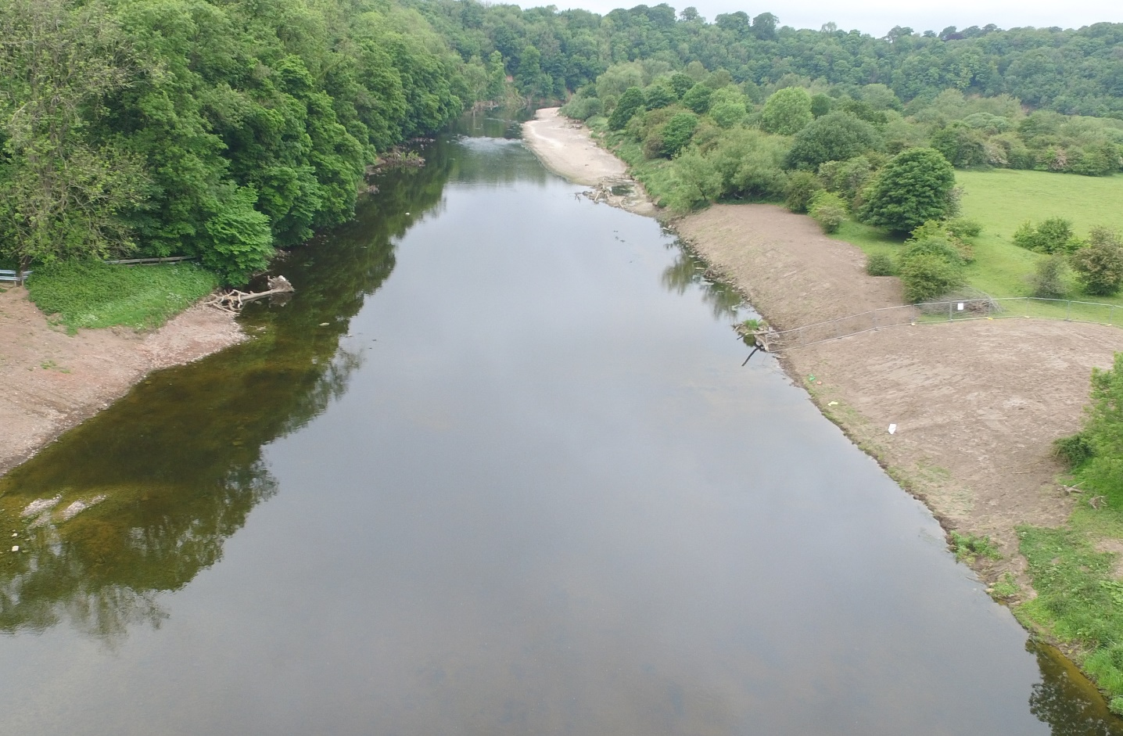
Notes:
2 years later (for a quick win)

Slide 8
Regulation is the biggest barrier?
But the low risk impoundment check list…
“Risk” is subjective
Likelihood x consequence
Regulation or Risk Aversion?
The system is not “Yes if”
Its “No, but”
We need to remove the culture of risk aversion
We need to remove repetitive regulation
Notes:
At one time planners were relaxed, and we were told “get on with it, we will grant retrospective if anyone makes a fuss”
We used to only need an FDC
Demonstrating levels of likelihood and consequence is inconsistent, and disproportionate. £25k of modelling for a £5k weir removal that was completed in side 3 days. Or £1500 for an archaeologist report for a £500 removal gone in a day
Changes to legislation/acts may seem like a herculean or impossible task, but weir removal at scale we need is becoming as difficult if not more so. So lets just get on with it!

